Slide 1
CONDUCT-DISSOCIAL DISORDER; CHALLENGES AND MANAGEMENT.
BY
DR. OGBODO, DANIEL O.
A CLINICAL MEETING PRESENTATION.
FEDERAL NEURO-PSYCHIATRIC HOSPITAL, BENIN.
23-09-2026.

Slide 2
OUTLINE.
Objectives.
Introduction/definitions.
Epidemiology.
Clinical features.
Etiology and risk factors
Assessment and Diagnostic criteria.
Differential diagnosis.
Challenges associated with the disorder.
Management
Prevention and prognosis
Conclusion
Case vignette
References

Slide 3
OBJECTIVES.
By the end of this presentation, the audience should be able to:
Define conduct dissocial disorder.
Identify the core clinical features and risk factors.
Apply ICD 11 principles in assessment and diagnosis.
Identify common psychiatric and developmental comorbidities.
Discuss evidence-based psychosocial and pharmacological management and strategies.
Identify strategies for prevention and early intervention.
Describe important prognostic factors and challenges in clinical practice.

Slide 4
INTRODUCTION/DEFINITION.
Conduct-dissocial disorder (CDD) is a childhood/adolescent mental and behavioral disorder characterized by a persistent pattern of behavior that violates the rights of others or major age-appropriate societal laws, rules and norms. This pattern of behavior is atypical for individuals of comparable age, developmental level, gender and sociocultural context.

Slide 5
EPIDEMIOLOGY.
Estimated prevalence of conduct disorder among the general population ranges from 5-10%.
More common in boys than girls (4:1).
Studies have shown it is more common in low socioeconomic class than in higher groups.
Some studies have also been done in some schools in Nigeria to estimate the prevalence of CDD in some parts of Nigeria and they include:

Slide 6
A study done by Angela I. Frank-Brings and Edward A.D. Alikor and published in The Nigerian Health Journal, in a secondary school in port Harcourt, Nigeria showed that among 885 students used for the study, 140 of them were diagnosed with conduct dissocial disorder, giving a prevalence of 15.82%.
Another study done in the south-south part of Nigeria among primary school children by Mkpouto et. al showed that of the 1174 children studied, 115 of them had conduct disorder with a prevalence rate of 9.8%.

Slide 7
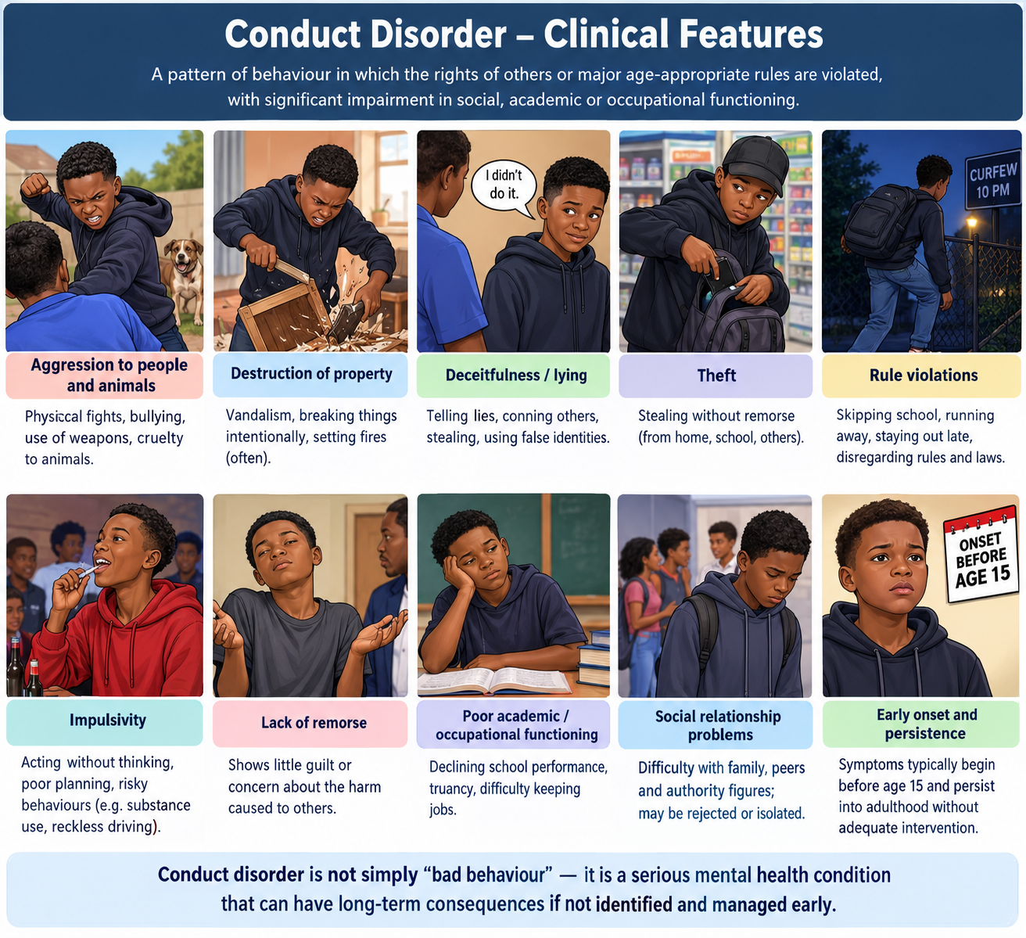

Slide 8
CLINICAL FEATURES (CNTD).
Females can present with other symptoms in addition to the ones shown above, like:
Spitefulness
Frequent unprotected sex leading to sexually transmitted diseass and unwanted pregnancy.
Drug abuse.
Running away from home

Slide 9
ETIOLOGY/RISK FACTORS.
The etiological factors of CDD are multi-factorial and are grouped into 4 groups, viz:
GENETIC FACTORS: it has been discovered that there is a strong genetic contribution to the vulnerability to conduct disorder. It clusters in the family.
These factors are amplified when combined with the child’s environment.
II. NEURO-BIOLOGICAL FACTORS: some studies suggest that defects or injuries to certain areas of the brain can lead to behavioural problems.

Slide 10
MRI studies have shown that children with conduct dissocial disorder have decreased grey matter in the limbic system of their brain.
This abnormality can cause altered emotional processing, reduced sensitivity to punishment, difficulty in emotional regulation, impulsivity.
It has also been shown that Some juvenile offenders have high levels of serotonin levels in their blood.

Slide 11
ETIOLOGY/RISK FACTORS (CONTD).
iii. PSYCHOSOCIAL FACTORS.
Harsh, punitive parenting.
Chaotic home.
Parental psychiatric disorder.
Substance abuse in parents, maternal alcoholism during pregnancy.
Peer influences.
Poor living environment.

Slide 12
ETIOLOGY/RISK FACTORS(CONTD).
IV. ENVIRONMENTAL FACTORS
Adolescents living in a geographical area with great population density.
Lack of supportive social network.
Increased exposure to substance use in the urban areas.
High community rate of truancy.

Slide 13
DIAGNOSTIC CRITERIA.
Using the international classification of diseases, 11th version (p.544:6c91), diagnosis of conduct-dissocial disorder is made when there is a repetitive and persistent pattern of behavior in which the basic rights of others or major age-appropriate social or cultural norms, rules or laws are violated.
Multiple behaviors are involved and they include:
Deceitfulness or theft.
Serious violation of rules.
Destruction of properties.

Slide 14
DIAGNOSTIC CRITERIA(CNTD).
Aggressions towards people or animals.
The pattern of behavior must be persistent and recurrent, including multiple incidents of the type of behaviors described above over an extended period of time( at least 1 year). The mere commission of one or more delinquent act is not sufficient for the diagnosis.
The behavior results in significant impairment in personal, family, social, educational, occupational or other important areas of functioning.

Slide 15
SPECIFIERS BASED ON AGE.
These include:
CONDUCT DISSOCIAL DISORDER, CHILDHOOD ONSET:
The criteria for CDD are met and the features occur before adolescence period. That is, before 10years of age.
CONDUCT DISSOCIAL DISORDER, ADOLESCENT ONSET:
All the diagnostic criteria of CDD are met but none of the features were present prior to the adolescent age.
CONDUCT DISSOCIAL DISORDER, UNSPECIFIED.
The criteria for CDD are met but the information is not enough to determine if the first symptom was before or after the age of 10.

Slide 16
DIFFERENTIAL DIAGNOSIS.
Oppositional defiant disorder (ODD).
Attention deficit hyperactivity disorder (ADHD).
Disruptive mood dysregulation disorder (DMDD).
Intermittent explosive disorder (IED).
Adjustment disorder with conduct disturbances.
Substance-related disorder.
Autism spectrum disorder.

Slide 17
COMORBIDITIES
Attention deficit hyperactivity disorder (ADHD).
Learning disorder.
Substance use.
Depression.
Anxiety disorder.
Autism spectrum disorder (ASD).

Slide 18
CHALLENGES POSED BY CDD.
CLINICAL CHALLENGES.
Difficulty/delay in recognizing the disorder and hence, causing delayed or no intervention at all.
Shortage of trained personnel in the area of management of the disorder.
Poor adherence to treatment.
SOCIAL AND COMMUNITY IMPACT.
Delinquency and crime.
Aggression and violence.
Substance abuse.

Slide 19
Cost of care.
FAMILY-RELATED CHALLENGES.
Parental negligence.
Family conflicts.
Care-giver exhaustion.
Family stigmatization.
Reliance on harsh discipline.
SCHOOL-RELATED CHALLENGES.
Lack of school screening.
Suspension from school.

Slide 20
MANAGEMENT OF CDD.
GENERAL PRINCIPLES.
Management should be:
Early.
Multidisciplinary; involving the psychiatric doctors and nurses, psychologist, occupational therapist and the school teachers of the individual.
Individualized and should be appropriate for the child’s developmental age.
Family focused.
Long term when necessary.

Slide 21
Management begins with taking a detailed history with collateral from school, a social welfare officer, parents.
Physical examination and birth history of the child.
Psychological assessment for people with conduct-dissocial disorder before treatment is commenced include:
Intelligent quotient assessment.
Personality assessment(MMPA).
Treatment involves the family members and even the school teachers in addition to the bio-psycho-social model.

Slide 22
ROLE OF MEDICATIONS.
Medication is usually not the primary treatment for conduct disorder itself.
It may be considered when:
There is significant comorbidity like ADHD.
Severe aggression requires additional intervention.
There is another psychiatric condition that requires pharmacological treatment.
Medication should be prescribed and monitored by an appropriately qualified clinician/psychiatrist.

Slide 23
PSYCHOLOGICAL AND PHYSIOLOGICAL INTERVENTIONS.
Evidence-based approaches may include:
Parent management training.
Cognitive behavioral training.
Problem-solving skill training.
Anger-management interventions.
Social skills training.
Family therapy
Multisystemic approaches for severe/high-risk cases.

Slide 24
PARENT/CAREGIVER MANAGEMENT.
Caregivers should be supported to:
Establish clear and consistent rules.
Use predictable consequences.
Reinforce positive behavior.
Avoid harsh or inconsistent punishment.
Monitor activities and peer relationships.
Improve communication.
Work closely with schools and health care professionals.

Slide 25
SCHOOL-BASED MANAGEMENT.
Schools can:
Provide structured routines.
Establish clear behavioral expectations.
Reinforce appropriate behavior.
Monitor attendance and academic progress.
Provide counseling and behavioral support.
Develop individualized support plans.
Maintain communication with parents/caregivers.

Slide 26
MANAGEMENT OF SEVERE CASES.
For severe cases:
Conduct a thorough risk assessment.
Address immediate safety concerns.
Involve child/adolescent mental health specialist.
Consider intensive family-based interventions.
Coordinate healthcare, school, social services and relevant community agencies.
Hospitalization may be required occasionally when there is significant immediate risk or another acute psychiatric condition.

Slide 27
PREVENTION
Categorized into: primary, secondary and tertiary prevention.
PRIMARY PREVENTION:
Positive parenting.
Prevent exposure of child to violence.
Organize school programs that will impact positively on the child.

Slide 28
SECONDARY PREVENTION.
Early recognition.
Address mal-treatment in school and at home.
Treat co-morbidities.
TERTIARY PREVENTION.
Legal/forensic support.
Avoid substance use.
Social rehabilitation.
Risk and safety management.

Slide 29
PROGNOSIS
POSITIVE PROGNOSTIC FACTORS.
Early intervention.
Supportive family relationships.
Good school engagement.
Fewer comorbid conditions.
Less severe behavioral problems.
Female gender.

Slide 30
POOR PROGNOSTIC FACTORS.
INDIVIDUAL RELATED:
Early onset (before the age of 10).
Severe, frequent and varied anti-social behaviors.
Hyperactivity and attention problems.
Low intelligent quotient.
Pervasiveness (at home, school and elsewhere).

Slide 31
POOR PROGNOSTIC FACTORS (CONTD).
FAMILY RELATED:
Parental criminality and alcoholism.
High hostility/discord focused on the child.
Harsh inconsistent parenting.
Low income.
ENVIRONMENT RELATED:
Economically deprived areas.
Ineffective/absence of schools

Slide 32
CONCLUSION.
Conduct dissocial disorders are characterized by a repetitive pattern of behavior in which the basic rights of others or laws are violated.
It occurs more in adolescence. However, it can occur in late childhood.
Early detection by differentiating it from mere mischief is paramount for early intervention.

Slide 33
CASE VIGNETTE.
A 15-year old boy is brought to the child and adolescent psychiatry clinic by his mother because of worsening behavioral problems over the past 2 years.
He has become increasingly aggressive and defiant at home and in school. He frequently gets into fights with other students, threatens younger children and has deliberately damaged school properties. On several occasions, he has stolen money and mobile phones from classmates and denied responsibility despite evidence.
His academic performance has deteriorated over time and he has been suspended from school several times. He shows little remorse after hurting others and often blames victims for what happened. No history of hallucination, delusion or mood disorder.
On mental state examination, he was irritable and poorly cooperative but oriented with no evidence of psychosis.
Physical examination findings essentially normal.
Q1: WHAT IS THE DIAGNOSIS HERE
Q2: LIST THE KEY FEATURES DEMONSTRATED.

Slide 34
ANSWERS
Q1: CONDUCT-DISSOCIAL DISORDER.
Q2:
AGGRESSION TOWARD PEOPLE/ANIMALS.
DESTRUCTION OF PROPERTY.
DECEITFULNESS AND THEFT.
SERIOUS RULE VIOLATIONS.
TRUANCY.
PERSISTENT ANTISOCIAL BEHAVIOR.
LIMITED REMORSE/EMPATHY

Slide 35
REFERENCES.
Benjamin J. Sadock; synopsis of psychiatry, Kaplan and Sadock’s. 11th Edition, chapter 31;pages 1247-1253.
Harrison et al. Shorter Oxford textbook of Psychiatry. 7th Edition. Chapter 16; pages 832-839.
Clinical Descriptions and Diagnostic Requirements for ICD-11; Disruptive Behaviors and Dissocial Disorders.

