Slide 1
INTRODUCTION TO NEUROTRANSMITTERS AND BRAIN RECEPTORS
PRESENTER
DR UMEH CHUKWUEMERIE JOSEPH
FEDERAL NEUROPSYCHIATRIC HOSPITAL, BENIN
19/08/2026

Slide 2
OUTLINE
LEARNING OBJECTIVES
INTRODUCTION
CLASSIFICATION
NEUROTRANSMITTERS AND THEIR RECEPTORS
CONCLUSION
REFERENCES

Slide 3
LEARNING OBJECTIVES
Describe synthesis, storage, release, reuptake and degradation of major neurotransmitters.
Define neurotransmitters and receptors and explain their role in chemical communication.
Review major monoamine, cholinergic and amino-acid neurotransmitter systems.
Relate neurotransmitters and receptors to important neuropsychiatric disorders and drug actions.

Slide 4
NEUROTRANSMITTER
A chemical messenger released by a neuron that alters the activity of another cell through specific receptors.
A typical neurotransmitter generally have mechanisms for synthesis, storage and release.
The physiological effect depends on the receptor subtype and the target cell

Slide 5
NEUROTRANSMITTERS CONTD
Neurotransmitters influence cognition, emotion, movement, arousal, sleep, motivation and autonomic functions.
A single behavioral process is usually influenced by several interacting neurotransmitters.
Receptor diversity allows the same nerotransmitter to produce different effects in different cells.

Slide 6
NEUROTRANSMITTERS MoA
Action potential reaches the presynaptic terminal.
Voltage-gated Ca²⁺ channels open and Ca²⁺ enters the terminal.
Synaptic vesicles fuse with the membrane and release neurotransmitter.
neurotansmitter crosses the synaptic cleft and binds receptors.
Signal is terminated by reuptake, enzymatic degradation, diffusion or uptake by glia cells.

Slide 7
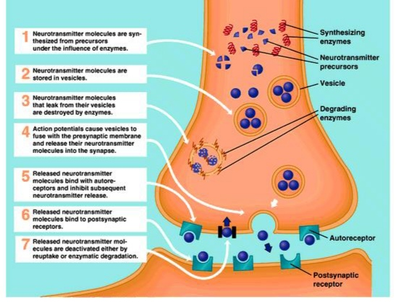

Slide 8
CLASSIFICATION
CHEMICAL CLASSIFICATION
FUNCTIONAL CLASSIFICATION

Slide 9
CHEMICAL CLASSIFICATION
1. Acetylcholine
2. Biogenic Amines
Catecholamines: Dopamine, Norepinephrine and Epinephrine
Indolamines : Serotonin and histamine

Slide 10
CLASSIFICATION
3. Amino Acids
GABA—Gamma -amino butyric acid
Glycine
Aspartate
Glutamate
4. Neuropeptides
Substance P ,Endorphins and Encephalin
Somatostatin, gastrin, cholecystokinin, oxytocin, vasopressin, Luteinizing hormone releasing hormone (LHRH)

Slide 11
CLASSIFICATION
5. Purines
Adenosine
ATP(Adenosine triphosphate)
6. Gases and Lipids
Nitric Oxide (NO)
Carbonmonooxide (CO)
Cannabinoids

Slide 12
FUNCTIONAL CLASSIFICATION
EXCITATORY NEUROTRANSMITTERS
Glutamate
Acetylcholine
Histamine
Dopamine
Norepinephrine
Epinephrin

Slide 13
INHIBITORY NEUROTRANSMITTERS
GABA (Gamma-aminobutyric acid)
Serotonin (5-HT)
Dopamine
Glycine

Slide 14
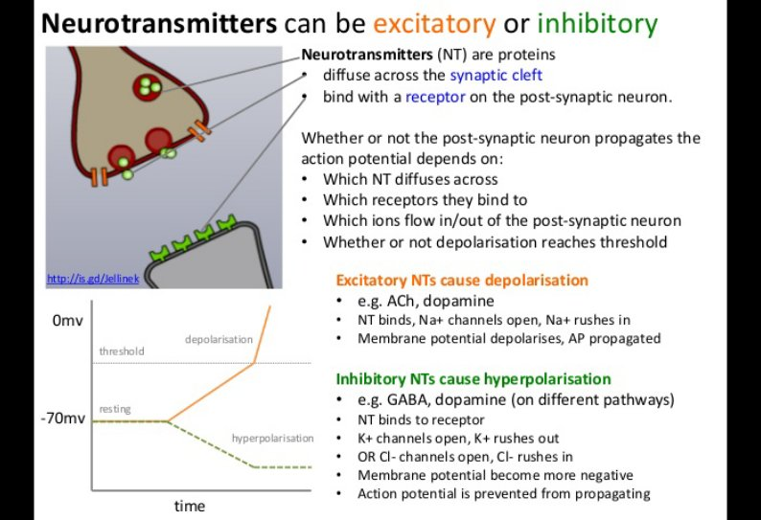
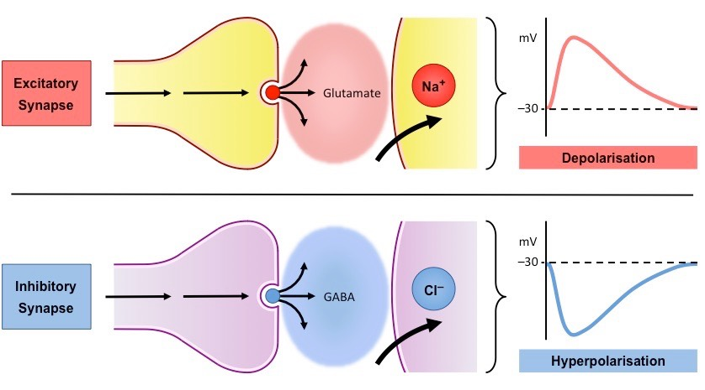

Slide 15
RECEPTORS
They are macromolecule or binding site located on the surface
or inside the effector cell that serves to recognize the signal
molecule or drug and initiate the response to it, but itself has no other
function.
Receptor distribution and coupling help determine the behavioral effect of a neurotransmitter.
The same neurotransmitter can excite one cell and inhibit another.

Slide 16
RECEPTORS CONTD
Autoreceptors
Heteroreceptors
Ionotropic receptors
Metabotropic receptors

Slide 17
MONOAMINES
Monoamines are synthesized from amino-acid precursors and packaged into vesicles by VMAT.
Stimulation causes vesicles to release their contents into the synaptic cleft.
Released neurotransmitter activates postsynaptic receptors and may activate presynaptic autoreceptors.
Transporters reclaim neurotransmitter; intracellular enzymes such as MAO and COMT contribute to degradation.

Slide 18
SEROTONIN
Serotonin (5-HT) is synthesized from dietary tryptophan.
Tryptophan hydroxylase converts tryptophan to 5-hydroxytryptophan; which is then decarboxylated by aromatic decarboxylase to form serotonin.
Most central serotonergic cell bodies lie in the midline raphe nuclei.
Rostral raphe nuclei project widely through the brain; caudal systems project to brainstem and spinal cord.

Slide 19
SEROTONIN CONTD
Serotonin is involved in mood, anxiety, sleep-wake regulation, and nociceptive modulation.
Serotonergic activity varies across the sleep-wake cycle and is absent during REM sleep.
Median raphe contributes prominently to limbic innervation; dorsal raphe contributes strongly to striatal and thalamic innervation.
The system acts through many receptor subtypes.

Slide 20
SEROTONIN RECEPTORS
5-HT1 receptors generally inhibit adenylate cyclase and include 5-HT1A.
5-HT1A receptors occur postsynaptically and as somatodendritic autoreceptors on serotonergic neurons.
5-HT2 receptors are prominent excitatory receptors and include 5-HT2A and 5-HT2C.
Other families include 5-HT4, 5-HT5, 5-HT6 and 5-HT7.

Slide 21
DOPAMINE
Catecholamines begin with tyrosine.
Tyrosine hydroxylase converts tyrosine → L-DOPA.
Aromatic L-amino-acid decarboxylase converts L-DOPA → dopamine.
Dopamine β-hydroxylase converts dopamine → norepinephrine inside storage vesicles; PNMT converts norepinephrine → epinephrine in adrenergic neurons/adrenal medulla.

Slide 22
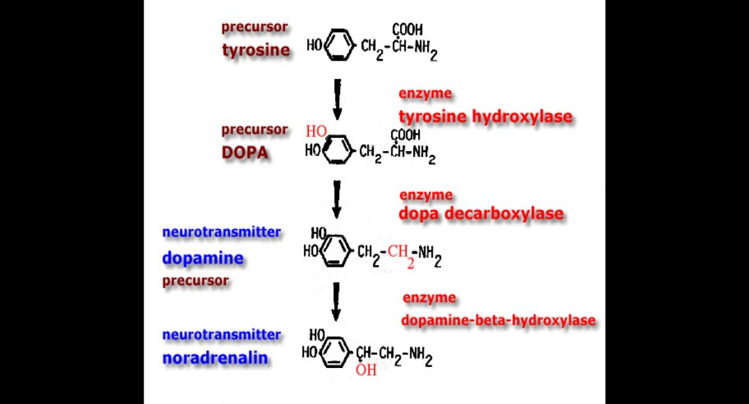

Slide 23
DOPAMINE PATHWAYS
Nigrostriatal pathway: involves the substantia nigra and dorsal striatum; important in motor control.
Mesolimbic: nucleus acumbence, amygdala.
Mesocortical:prefrontal cortex
Tuberoinfundibular: hypothalamic dopamine projections regulate prolactin secretion.

Slide 24
DOPAMIN RECEPTORS
D1-like family: D1 and D5; activation stimulates cAMP formation.
D2-like family: D2, D3 and D4; activation generally reduces cAMP signalling.
D2 receptors are a major pharmacological target of antipsychotic drugs.
Dopamine receptor distribution and subtype selectivity help explain both therapeutic and adverse effects.

Slide 25
NORADRENALINE
Noradrenergic neurons are concentrated in the locus coeruleus and brainstem.
α1 receptors are generally excitatory and act through Gq-phosphoinositide signalling.
α2 receptors often inhibit cAMP formation and can activate K⁺ channels.
α2 autoreceptors reduce noradrenergic firing and transmitter release; e.g clonidine.

Slide 26
HISTAMIN
Brain histamine is synthesized from histidine by histidine decarboxylase.
Histaminergic neurons arise mainly from the tuberomammillary region of the hypothalamus.
Histamine contributes to arousal, wakefulness, feeding behaviour and neuroendocrine regulation.
H1 receptor blockade is associated with sedation and weight gain seen with several anti psychotics

Slide 27
HISTAMIN RECEPTORS
Four receptor subtypes are described: H1, H2, H3 and H4.
H1 receptors are widely distributed in the CNS, especially thalamus, cortex and cerebellum.
H1 activation tends to increase excitatory neuronal responses.
H3 receptors are important CNS autoreceptors and heteroreceptors and are being investigated in sleep, cognition and metabolic disorders.

Slide 28
ACETYLCHOLINE
Choline + acetyl-CoA → acetylcholine via choline acetyltransferase (ChAT).
Choline uptake is a rate-limiting step in synthesis.
ACh is stored by the vesicular acetylcholine transporter and released by exocytosis.
Acetylcholinesterase rapidly hydrolyses ACh in the synaptic cleft; choline is recycled.

Slide 29
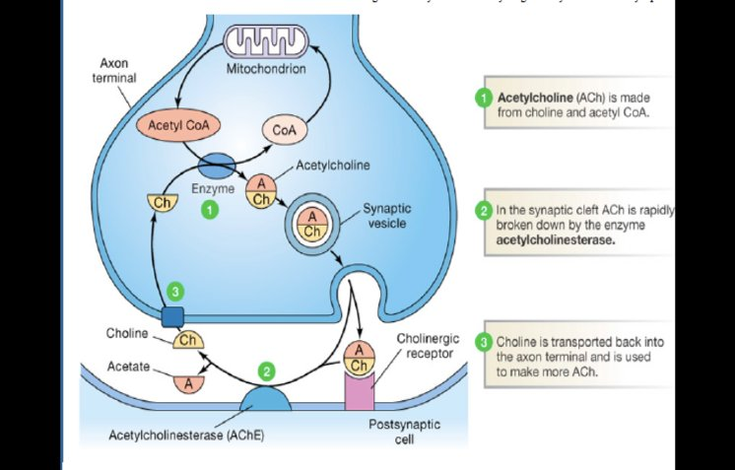

Slide 30
CENTRAL CHOLINERGIC SYSTEM
Basal forebrain cholinergic neurons project widely to cortex, hippocampus and limbic structures.
The nucleus basalis of Meynert is an important source of cortical cholinergic innervation.
Mesopontine cholinergic neurons project to thalamic and midbrain structures and contribute to arousal/REM sleep.
Loss of basal forebrain cholinergic neurons is associated with cognitive decline in Alzheimer disease.

Slide 31
CHOLINERGIC RECEPTORS
Muscarinic receptors are GPCRs; M1 is prominent in cortex, hippocampus and striatum and is linked to memory and synaptic plasticity.
Nicotinic receptors are ligand-gated cation channels and contribute to attention, working memory and processing speed.
α7 nicotinic receptor abnormalities is linked to impaired sensory gating in schizophrenia.
Nicotinic receptors in mesolimbic pathways contribute to the reinforcing effects of nicotine.

Slide 32
GLUTAMATE
Glutamate is a major excitatory neurotransmitter in the brain.
It is prominent at dendritic spines and in thalamocortical and corticolimbic pathways.
Glutamatergic signalling is central to learning, memory and synaptic plasticity.
Because excitatory transmission is metabolically demanding, excessive glutamate signalling can become harmful.

Slide 33
GLUTAMATE RECEPTORS
Ionotropic receptors: AMPA, kainate and NMDA receptors.
Ionotropic glutamate receptors are ligand-gated cation channels responsible for fast excitatory transmission.
mGluRs are GPCRs that modulate glutamatergic signalling.

Slide 34
THE ROLE OF ASTROCYTES
Astrocytes surround glutamatergic synapses and are major regulators of extracellular glutamate.
EAAT1 and EAAT2 are important astrocytic glutamate transporters.
EAAT3 is neuronal; EAAT4 is prominent in cerebellar Purkinje cells; EAAT5 is expressed in retina.
Impaired glutamate uptake can raise extracellular glutamate and increase excitotoxic vulnerability.

Slide 35
GABA
GABA is the major inhibitory neurotransmitter in the brain.
GABA is synthesized from glutamate by glutamic acid decarboxylase (GAD).
GAD65 is concentrated at nerve terminals; GAD67 is an important source of neuronal GABA.
GABA action is terminated through high-affinity transport into presynaptic terminals and astrocytes and through metabolism.

Slide 36
GABA CONTD
GABA transaminase breaksdown GABA ,hence inhibition of the enzyme can have anti convulsant effect
Tiagabine inhibits GABA transport; vigabatrin irreversibly inhibits GABA-T.
GABA signalling is relevant to anxiety disorders, schizophrenia, epilepsy and alcohol dependence.

Slide 37
GABA RECEPTORS
GABAA is a ligand-gated chloride channel distributed throughout the brain.
In the neurons, when activated, they open and typically permit Cl⁻ influx producing hyperpolarization.
Benzodiazepines act at an allosteric site and enhance GABAA receptor function rather than directly replacing GABA.

Slide 38
GABA RECEPTORS CONTD
GABAB receptors are G protein coupled receptor and is made up of a functional dimer of seven-transmembrane subunits.
Postsynaptically, they produce prolonged inhibition, including activation of K⁺ channels.
Presynaptically, GABAB receptors function as autoreceptors or heteroreceptors to inhibit transmitter release.
Baclofen is an example of GABAB receptor agonist.

Slide 39
GLYCINE
Glycine is especially important in brainstem and spinal cord, although glycine receptors occur more broadly.
It is synthesized from L-serine and packaged by VIAAT/VGAT.
GlyT2 supports presynaptic glycine reuptake; GlyT1 in astrocytes regulates extracellular glycine and NMDA receptor function.
The glycine receptor is a ligand-gated chloride channel; strychnine is the antagonist.

Slide 40
CONCLUSION
Neurotransmitters are fundamental to communication between neurons. They play a central role in regulating brain function and behaviour.
Their effects are determined not only by the neurotransmitter released, but also by the receptor subtype, location, and intracellular signalling pathway involved.
Disruption of these systems and their receptors contributes to the pathophysiology of many neuropsychiatric disorders.

Slide 41
REFRENCES
Sadock BJ, Sadock VA, Ruiz P. Kaplan & Sadock’s Comprehensive Textbook of Psychiatry. 9th ed. Lippincott Williams & Wilkins; 2009. Chapter 1: Neural Sciences, section 1.4 Neurophysiology and Neurochemistry.
Kandel ER, Koester JD, Mack SH, Siegelbaum SA. Principles of Neural Science. 6th ed. McGraw Hill; 2021.
Purves D, Augustine GJ, Fitzpatrick D, et al. Neuroscience. 7th ed. Oxford University Press; 2023.
Brunton LL, Hilal-Dandan R, Knollmann BC, eds. Goodman & Gilman’s The Pharmacological Basis of Therapeutics. 14th ed. McGraw Hill; 2023.
Ritter JM, Flower R, Henderson G, Loke YK, MacEwan DJ, Rang HP. Rang & Dale’s Pharmacology. 10th ed. Elsevier; 2024.

Slide 42
THANK YOU

