Slide 1
PHYSIOTHERAPY MANAGEMENT OF OSTEOARTHRITIS
NNAMANI CHUKWUEMEKA
PHYSIOTHERAPY UNIT
FEDERAL NEURO PSYCHIATRIC HOSPITAL, BENIN
BENIN CITY
JULY, 2026

Slide 2
OUTLINE
Introduction
Epidemiology
Risk factors
Relevant anatomy
Pathophysiology
Signs and symptoms
Stages of Osteoarthritis
Diagnosis
Management
Progression and monitoring
Prevention
Conclusion
References

Slide 3
OBJECTIVES
Define Osteoarthritis (OA)
Describe the risk factors of OA
Understand the pathophysiology of OA
Identify the clinical features of OA
Understand the role of physiotherapy in OA management

Slide 4
INTRODUCTION
Osteoarthritis (OA) is the most common form of arthritis and one of the leading causes of pain and disability worldwide.
OA is a chronic degenerative joint disease in which the protective cartilage that covers the ends of bones gradually breaks down, changes in the underlying bone and inflammation of surrounding tissues occur, causing pain, stiffness, swelling and difficulty moving the affected joint (WHO, 2023).
It is a whole-joint disease that affects every structure within the joint (NICE, 2022).

Slide 5
INTRODUCTION
OA develops gradually and usually worsens over time. It most commonly affects weight-bearing joints such as the knees, and hips but can also involve the hands, spine, and shoulder (Kolasinski et al., 2020).
Although it cannot be cured, appropriate management can significantly reduce pain, improve function and enhance quality of life.
Physiotherapy is a core first-line non-surgical treatment for osteoarthritis with low risk and cost. It plays a central role in helping individuals maintain function and independence (Muhammad et al., 2026).

Slide 6
EPIDEMIOLOGY
OA affects over 600 million people globally, representing about 7.7% of the global population (Qiao et al., 2025).
Knee joint affectation constitutes the vast majority of the global burden at 60.6% of all cases, followed by hand OA (23.9%), and hip OA (9.3%).
The prevalence rate is consistently higher for females than for males particularly after menopause. The condition increases steadily with age; it may begin in individuals over 40 years of age; it is much more common among adults aged 60 years and above (Hunter and Bierma-Zeinstra, 2019).
High Body Mass Index (BMI) accounts for a significant fraction of OA-related disabilities.

Slide 7
EPIDEMIOLOGY
Africa accounts for approximately 37% of the global prevalence of OA, with a prevalence of up to 16% of the African population and 34.3% among adults aged 40 and older presenting to clinics (Chen et al., 2026).
Regional studies show that knee OA is the most prevalent, accounting for 34% of OA cases.
In Africa, rural and peri-urban demographics often exhibit high OA rates connected to occupational stressors accounting for roughly 25% of cases, previous joint injuries, and high BMI among aging women (Chen et al., 2026).

Slide 8
EPIDEMIOLOGY
Studies report an OA prevalence of up to 21.6% among Nigerians over the age of 40.
Nigerian women are more affected (68.7%) compared to men. The condition is heavily concentrated in older adults, with the highest rates found in populations over the age of 60 (Yahaya et al., 2021).
Symptomatic knee OA is the most frequent presentation. Lumbar OA is also highly reported in hospital assessments.
Traders/self-employed individuals (39.8%) and rural farmers/manual labourers (24.5%) represent a significant part of the population affected by OA in Nigeria (Yahaya et al., 2021).

Slide 9
EPIDEMIOLOGY
There is an inverse relationship of OA with income. Low-income earners show an Odds Ratio (OR) of 2.23 for developing severe, symptomatic knee OA compared to higher income brackets (Yahaya et al., 2021).
Physical limitations and obesity also play a compounding role in both the onset and severity of knee OA within the Nigerian population (Ogunbona et al., 2020).

Slide 10
RISK FACTORS
Age
Obesity
Previous injury
Occupation
Genetics
Gender
Sedentary lifestyle
Muscle weakness
Joint deformities

Slide 11
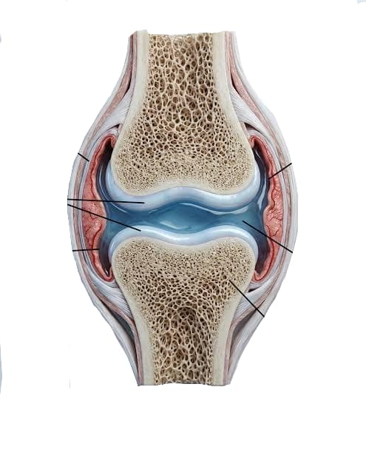
RELEVANT ANATOMY
Articulating bone
Fibrous
capsule
Synovial
membrane
Articular
cartilage
Synovial
membrane
Joint Cavity &
Synovial Fluid
Ligament
Articulating bone
Ligament
Source: www.medicoplasma.com

Slide 12
PATHOPHYSIOLOGY
Risk
Factors
Mechanical
Stress
Ligaments become lax
Muscles weaken
Signs &
Symptoms
Chondrocytes
attempt repair
Synovial membrane
inflammation
Inflammatory
Mediators
Subchondral bone
remodeling & Osteophytes
Proteoglycans and collagen
are progressively lost
Cartilage softens,
cracks, and thins

Slide 13
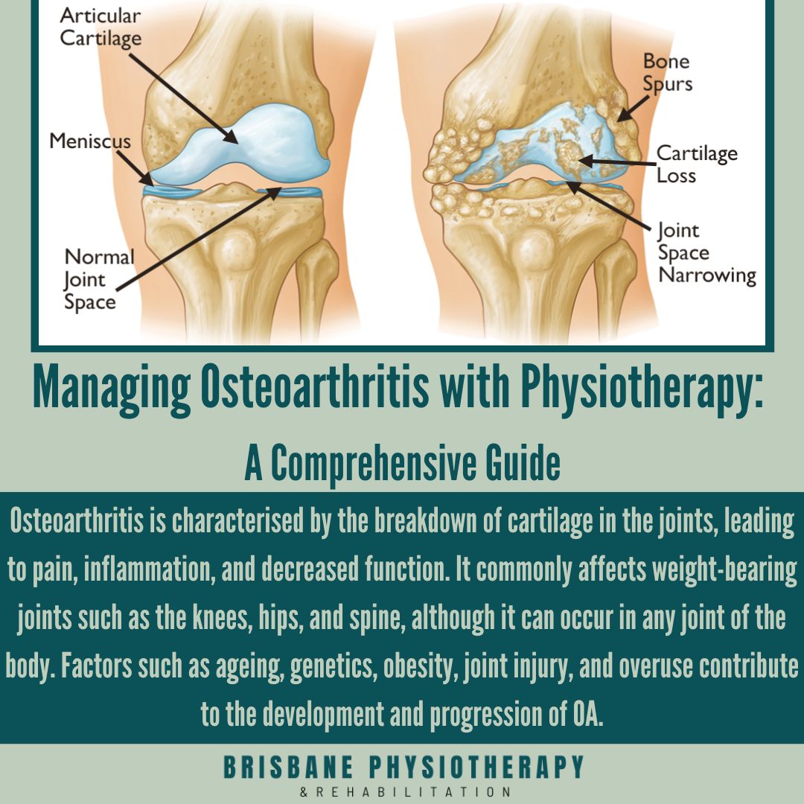
Source: www.brisbanephysiotherapy.com

Slide 14
Signs and Symptoms
Joint pain
Stiffness
Swelling
Reduced Range of motion
Crepitus
Muscle weakness
Altered gait

Slide 15
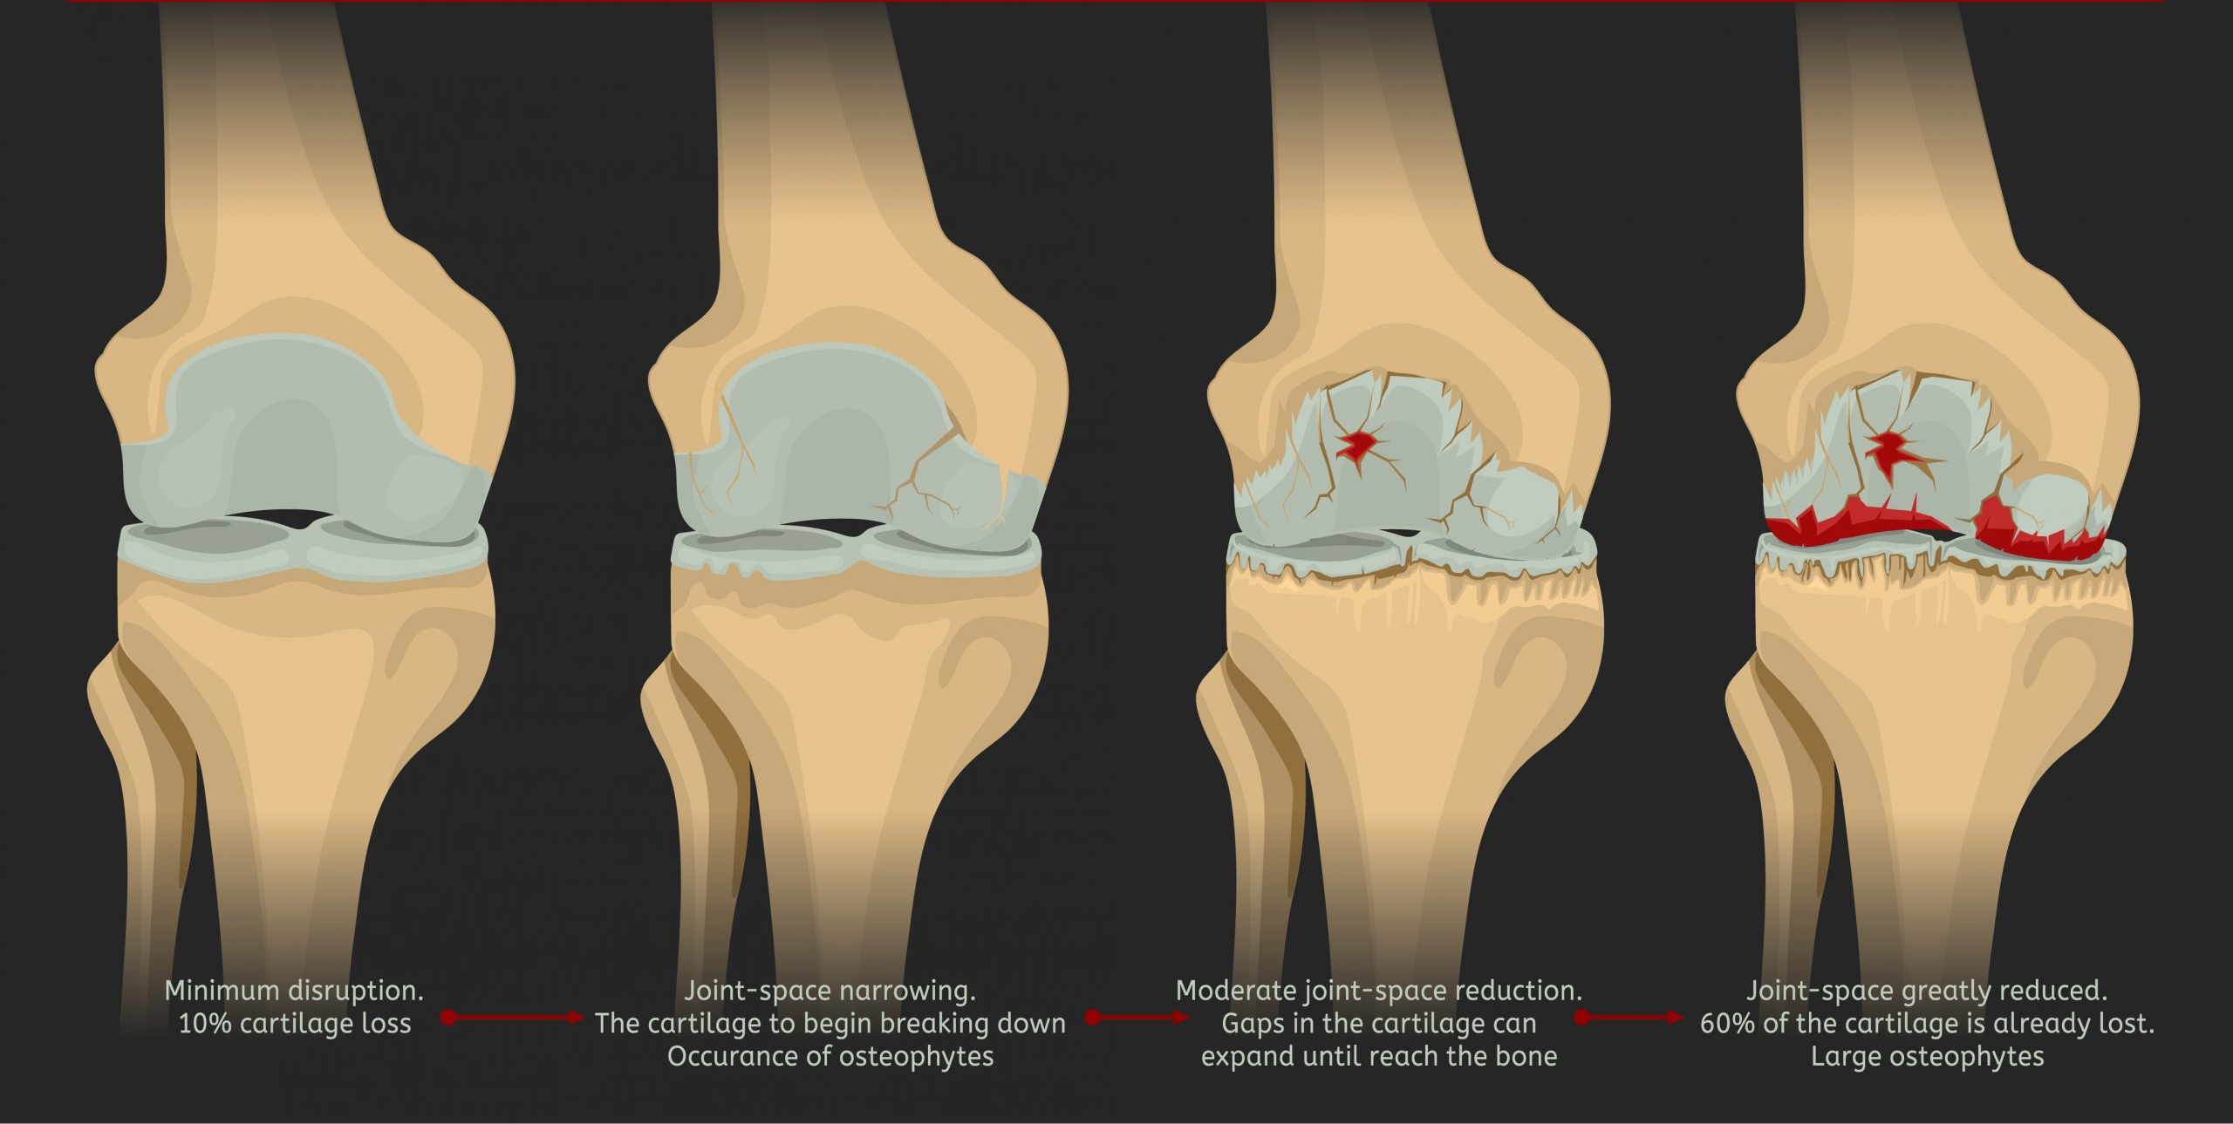
STAGES OF OSTEOARTHRITIS
Stage 1: Minor
Stage 2: Mild
Stage 3: Moderate
Stage 4: Severe
Source: www.complete-physio.co.uk

Slide 16
DIAGNOSIS
Medical History
Physical Examination
Radiological Investigation

Slide 17
MANAGEMENT
MULTIDISCIPLINARY MANAGEMENT
Physiotherapist
Physician
Occupational Therapist
Dietician
Orthopedic Surgeon

Slide 18
MANAGEMENT
Goals of Physiotherapy Management
Reduce pain
Improve joint movement
Strengthen muscles
Improve balance
Improve walking ability
Promote independence
Delay or avoid invasive procedures where possible (e.g. Intra-articular injection or surgery)
Improve quality of life
Prevent disability

Slide 19
MANAGEMENT
PHYSIOTHERAPY MANAGEMENT
Assessment
  Subjective
  Objective
Exercise Therapy: Exercise is the cornerstone of physiotherapy treatment. The physiotherapist will design a progressive, multimodal exercise program.
  Strengthening Exercises
  Stretching Exercises
  Range of Motion Exercises
  Balance Training
  Functional Training
Manual Therapy: This involves hands-on techniques performed by physiotherapists such as soft tissue mobilization and passive joint mobilization.

Slide 20
MANAGEMENT
Thermo Therapy: This involves heat application to the affected area to reduce pain, relax muscles, reduce stiffness and improve circulation.
  Infrared
  Paraffin wax bath
  Hydro-collator packs
Electro Therapy
  Transcutaneous Electrical Nerve Stimulation (TENS)
  Therapeutic Ultrasound
Hydrotherapy: This is when exercises are performed in deep warm water.
Assistive Devices: Knees braces & Walking aids
Patient Education: Education empowers patients, improve adherence to treatment and help achieve better outcome in the long-run.
Home Exercise Programs: A home program should be individualized, simple, safe, progressive and performed consistently.

Slide 21
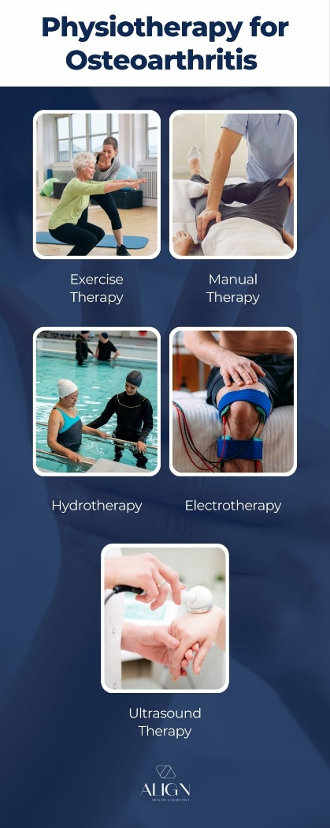

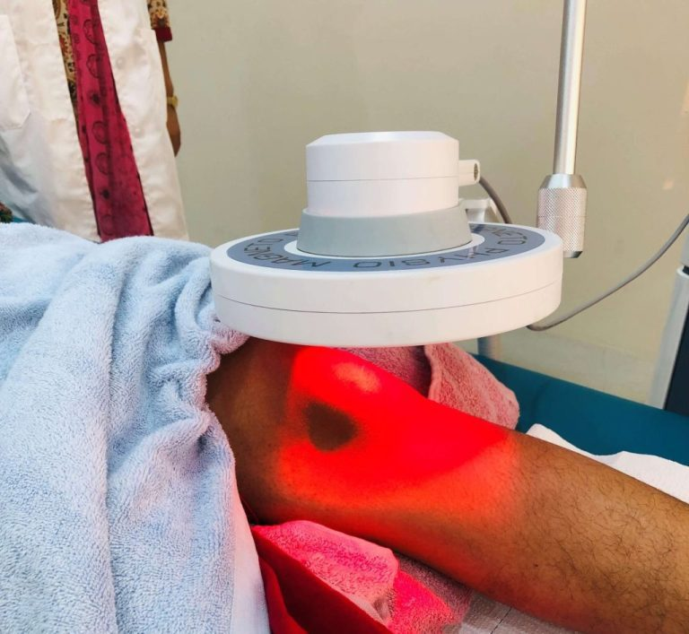
TENS
Ultrasound Therapy
Infrared Therapy
Hydrotherapy
Source: www.alignhc.com.au

Slide 22
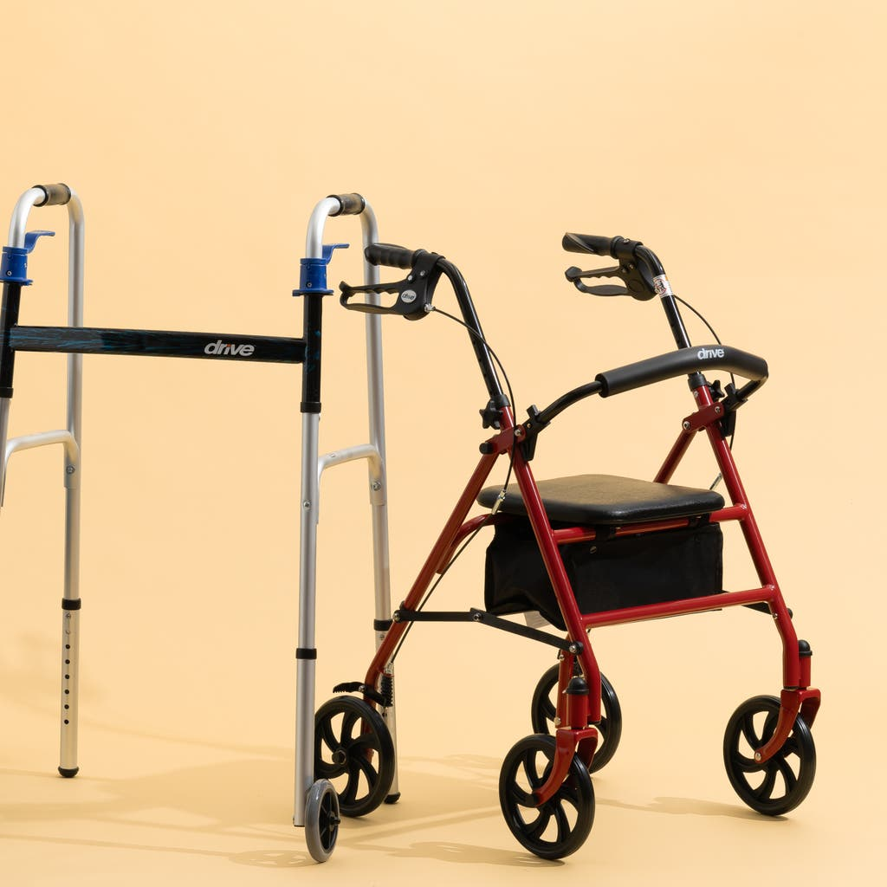
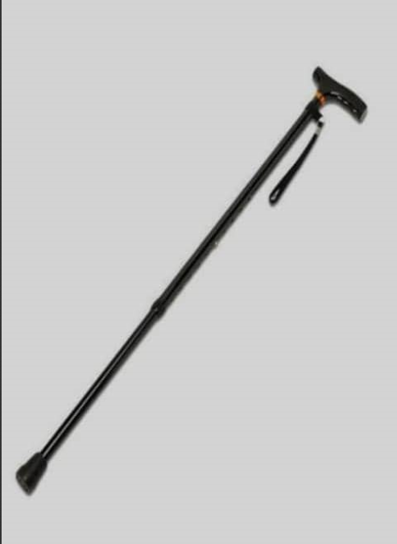
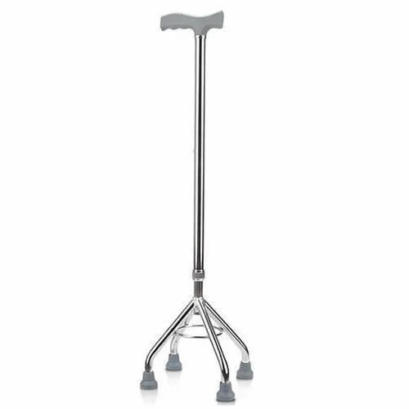
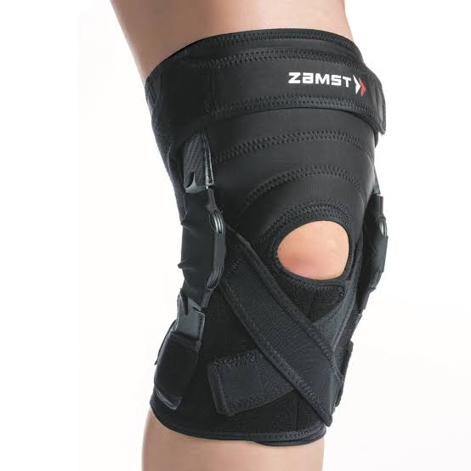
Walking Sticks
Walkers
Source: www.clinicaid.com.ng
Knee Brace
Source: www.nytimes.com
Source: www.zamst.us

Slide 23
PROGRESSION AND MONITORING
OUTCOME MEASURES
Pain: E.g. Numerical Pain Rating Scale (NPRS)
Performance: E.g. 6-minute walk test, FIM and Barthel Index
Strength: E.g. Oxford Grading, handheld dynamometry

Slide 24
PREVENTION
Maintaining a healthy weight
Exercising regularly
Preventing injuries
Using proper body mechanics
Wearing appropriate footwear
Treating joint injuries promptly

Slide 25
CONCLUSION
Movement is medicine, staying active with the right exercises is one of the best ways to manage osteoarthritis and maintain a good quality of life. OA is major global public health problem and remains the most common form of arthritis, and it is a major cause of pain and disability, but it does not have to limit a person’s life. Through appropriate physiotherapy interventions, individuals with OA can reduce pain, improve function, slow disease progression and maintain independence. Effective management requires collaboration between healthcare professionals, patients, and caregivers.

Slide 26
REFERENCES
Align Health Collective (2024). How can Physiotherapy Help Osteoarthritis. [online] Align Health Collective. Available at: https://www.alignhc.com.au/post/how-can-physiotherapy-help-osteoarthritis [Accessed 11 July 2026].
Best Hospitals in India | Medicover Hospitals. (n.d.). Osteoarthritis: Symptoms, Causes, Do’s and Don’ts, Treatment | Medicover. [online] Available at: https://www.medicoverhospitals.in/diseases/osteoarthritis/ [Accessed 10 July 2026]
Brisbane Physiotherapy Podiatry. Osteoarthritis Physiotherapy Management. [online] Brisbane Physiotherapy. Available at: https://www.brisbanephysiotherapy.com/news/osteoarthritis-physiotherapy-management [Accessed 11 July 2026].
Chen, H., Si, L., Zhang, L., Hunter, D. J., Duong, V., Wang, X., Cao, P., Cen, H., Tang, S., Chen, T., He, Y., Ding, C.\ and Zhu, Z. (2026). Temporal trends and cross-country inequalities in the burden of osteoarthritis, 1990 – 2021: Findings from the Global Burden of Disease Study 2021. International Journal of Rheumatic Diseases. 29(6), e70733. doi: https://doi.org/10.1111/1756-185X.70733.
Complete Physio (2022). What is osteoarthritis (OA) of the knee? [online] Complete Physio. Available at: https//complete-physio.co.uk/what-is-osteoarthritis-oa-of-the-knee/ [Accessed 10 July 2026].
Hunter, D. J. and Bierma-Zeinstra, S.M.A. (2019). Osteoarthritis. The Lancet, 393(10182), pp. 1745 – 1759. doi: https://doi.org/10.1016/S0140-6736(19)30417-9.

Slide 27
REFERENCES
Kolasinski, S. L., Neogi, T., Hochberg, M. C., Oatis, C., Guyatt, G., Block, J., Callahan, L., Copenhaver, C., Dodge, C., Felson, D., Gellar, K., Harvey, W. F., Hawker, G., Herzig, E., Kwoh, C. K., Nelson, A. E., Samuels, J., Scanzello, C., White, D. and Reston, J. (2020). 2019 American College of Rheumatology/Arthritis Foundation guideline for the management of osteoarthritis of the hand, hip, and knee. Arthritis & Rheumatology, 72(2), pp. 220 – 233. doi: https://doi.org/10.1002/art.41142.
Muhammad, D. G., Foster, N. E., Pelaez, M., O’Leary, K., Ackerman, I. N. and Quicke, J. G. (2026). The effectiveness of physiotherapy-led non-sugical and perioperative interventions for glenohumeral osteoarthritis: A systematic review. doi: https://doi.org/10.1177/17585732261450961.
National Institute for Health and Care Excellence (NICE) (2022). Osteoarthritis in over 16s: Diagnosis and management (NG226). London: NICE.
Ogunbona, R. A., Orimadegun, B. E., Ogunlade, S. O., Fasanmade, A. A. and Agbedana, E. O. (2020). Dyslipidemia and high adiposity are risk factors for osteoarthritis in adults in Nigeria. American Journal of \Biomedical Research. 8(1), pp. 19 – 24. doi: https://doi.org/10.12691/ajbr-8-1-4.
Qiao, L., Li, M., Deng, F., Wen, X., Deng, H., Xue, Z., Zhou, J., Lin, J., Amhare, A. F., Xiang, R., Fan, X., Wang, J. and Han, J. (2025). Epidemiological trends of osteoarthritis at the global, regional, and national levels from 1990 to 2021 and projections to 2050. Arthritis Research & Therapy, 27(1), Article 199. doi: https://doi.org/10.1186/s13075-025-03658-w.
World Health Organization (2023). Chronic musculoskeletal conditions: Osteoarthritis. Geneva: WHO.
Yahaya, I., Wright, T., Babatunde, O. O., Oladipo, B., Okechukwu, C. E., Rashid, A. M., Ekele, B. A. and Anumah, F. E. (2021). Prevalence of osteoarthritis in lower-middle and low-income countries: A systemic review and meta-analysis. Rheumatology International. 41(7), pp. 1221 – 1231. doi: https://doi.org/10.1007/s00296-021-04838-y.

Slide 28
THANK YOU

