Slide 1

ASSAY AND HAEMATOLOGICAL SIGNIFICANCE OF BILIRUBIN
BY
EDAILE, S.E
PRESENTED TO THE DEPARTMENT OF CLINICAL SERVICES,
FEDERAL NEUROPSYCHIATRIC HOSPITAL BENIN
MAY, 2026.

Slide 2

OUTLINE
Aim
Introduction
Bilirubin Metabolism
Assay Methods for Bilirubin
Haematological Significance of Bilirubin
Bilirubin Assay & Its Relevance in Psychiatric Practice
Ways to Mitigate Hyperbilirubinaemia
Conclusion
Recommendation
Selected References

Slide 3
AIM
To understand the importance of bilirubin in haematological and clinical practice as well as its relevance in psychiatry

Slide 4

INTRODUCTION
Bilirubin is a yellow compound that is a byproduct of the normal breakdown of red blood cells in the body. It is formed during the degradation of haemoglobin (the oxygen-carrying component of red blood cells). It is often divided into conjugated and unconjugated bilirubin.
The measurement of bilirubin levels in the blood can be an important diagnostic tool, as elevated levels may indicate liver dysfunction, haemolytic anemia, or blockages in the bile ducts.
(Adin, 2021).
Notes:
Bilirubin is a yellow pigment that forms from the breakdown of haemoglobin in red blood cells.
It exist as conjugated and unconjugated bilirubin
Elevated levels may indicate, liver diseae, haemolytic anaemia

Slide 5
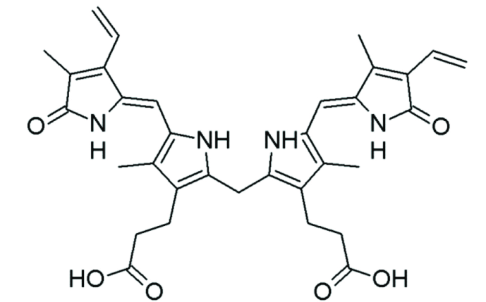
Figure 1. Structure of Bilirubin (Lin et al., 2019).
Notes:
This is a visual representation of the chemical structure of bilirubin

Slide 6
BILIRUBIN METABOLISM
Bilirubin metabolism is a complex and essential process that involves multiple steps to convert and eliminate bilirubin.
Conversion of Heme to Biliverdin and Then to Bilirubin.
Transport of Unconjugated Bilirubin to the Liver.
Conjugation of Bilirubin in the Liver.
Excretion of Conjugated Bilirubin in Bile.
(Guerra et al., 2021).
Notes:
WHILE IN THE INTESTINE , BACTERIAL CONVERT BILIRUBIN TO UROBILINOGEN.
MOST ARE CONVERT TO STERCOBILIN WHICH IS EXCRETED IN FECES.
SOME ARE REABSORBED.
SMALL AMT IS EXCRETED IN THE KIDNEY AS UROBILIN WHICH GIVE OUR URINE THE YELLOW COLOUR

Slide 7
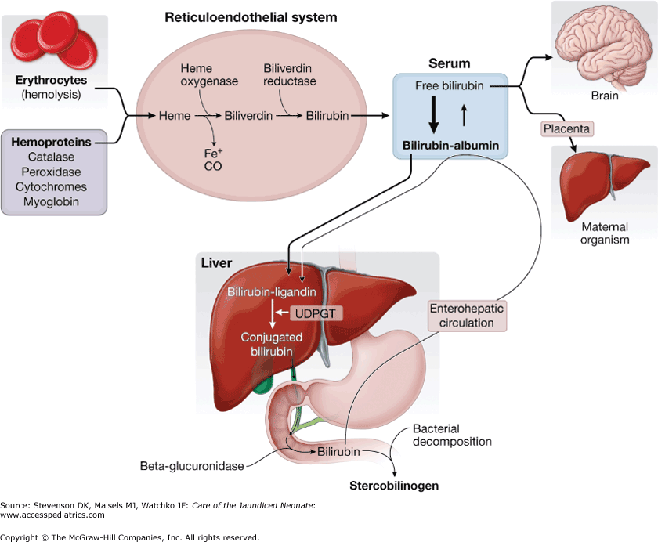
Figure 2. Bilirubin Metabolism (Guerra et al., 2021).
Notes:
Visual illustration of bilirubin metabolism showing red cell destruction, to liver conjugation and billary excretion

Slide 8
ASSAY METHODS FOR BILIRUBIN
Diazo Method
Jendrassik Grof Method
High-Performance Liquid Chromatography (HPLC)
Enzymatic Methods
(Herta and Beuers, 2022).
Notes:
The oldest method, can be affected by lipeamia, Vit C, HAEMOLYSIS[free haemoglobin] ,Phenobarbitar
Modified and more accurate with less interefrenace by lipids
Very sensitive and used in advanced research laboratories, very expensive
Usess enzymes, fast, automated and used in most modern analysers

Slide 9
HAEMATOLOGICAL SIGNIFICANCE OF BILIRUBIN
Haemolytic Anaemia
Haemolytic anaemia results from the accelerated destruction of red blood cells (haemolysis), leading to an increased release of haemoglobin into the bloodstream.
As haemoglobin breaks down, it releases heme, which is subsequently converted into unconjugated bilirubin.
The influx of bilirubin overwhelms the liver's capacity to conjugate and excrete it efficiently, resulting in elevated levels of unconjugated bilirubin in the blood.
(Obeagu, 2020).
Notes:
HAEMOLYTIC ANAEMIA RESULTS FROM THE ACCELERATED DESTRUSTION OF RED BLOOD CELL LEADING TO AN INCREASE RELEASE OF HAEMOGLOBIN INTO THE BLOOD STREAM
.Excessive red blood cell destruction increases unconjugated bilirubin levels. The liver becomes overwhelmed by the excess bilirubin, which may lead to jaundice
.HAEMATOLOGICAL SIGNIFICANCE OF BILIRUBIN CAN BE DISCUSS UNDER
1 HAEMOLYTIC ANAEMIA
2. DELAYED BLOOD TRANSFUSION REACTION
3.PAROXYMAL NOCTURNAL HAEMOGLOBINURIA
4.KERNICTERUS

Slide 10
Rapid Lysis of Red Blood cells
Release of Haemoglobin
Excess bilirubin in circulation
Figure 3. Significance of Bilirubin in Haemolytic Anaemia (Qian et al., 2022).
Notes:
This visually links haemolysis to hyperbbilirubinaemia

Slide 11
HAEMATOLOGICAL SIGNIFICANCE OF BILIRUBIN CONT’D
Delayed Blood Transfusion Reaction
Delayed blood transfusion reactions occurs days to weeks after transfusion, it results from an immune response where previously sensitized individuals produce antibodies against transfused red blood cell antigens, leading to haemolysis and increased bilirubin production.
Elevated bilirubin levels can overwhelm the liver's capacity to conjugate and excrete bilirubin, causing jaundice.
(Panch and Montemayor, 2022).
Notes:
Immune mediated destruction of transfused red blood cells can occur days or even weeks after transfusion which may result to
Increased bilirubin production and possible jaundice

Slide 12
HAEMATOLOGICAL SIGNIFICANCE OF BILIRUBIN CONT’D
Haemolytic Disease of the Newborn (HDN)
HDN occurs when maternal IgG antibodies against fetal red blood cell antigens (most commonly the Rh factor) cross the placenta and destroy fetal red blood cells, releasing haemoglobin.
The breakdown of haemoglobin increases unconjugated bilirubin production, which can overwhelm the newborn's immature liver, leading to hyperbilirubinemia.
(Hansen et al., 2020).
Notes:
HDN oocurs when maternal antibodies destroy fetal red blood cells
This increases excess bilirubin in thje circulation, neonatal jaundice and increases the risk of severe complications if left untreated

Slide 13
HAEMATOLOGICAL SIGNIFICANCE OF BILIRUBIN CONT’D
Kernicterus
Severe brain damage caused by extreme levels of unconjugated bilirubin in newborns. It occurs when bilirubin crosses the blood-brain barrier and deposits in brain tissues. It can result from haemolytic diseases, genetic disorders, and prematurity.
Maternal antibodies (IgG) in haemolytic diseases activate complement, leading to RBC lysis and bilirubin overload, crossing into the brain.
Inflammatory response in haemolytic diseases involves platelets, increasing blood-brain barrier permeability, facilitating bilirubin entry into the brain.
(Kasirer et al., 2023).
Notes:
Severe bilirubin can cause brain toxicity in newborns because bilirubin can cross the blood brain barrier and cause brain damage that could be permananet,

Slide 14
HAEMATOLOGICAL SIGNIFICANCE OF BILIRUBIN CONT’D
Paroxysmal Nocturnal Haemoglobinuria
PNH is a rare haematological disorder characterized by chronic intravascular hemolysis due to a somatic mutation in haematopoietic stem cells, resulting in deficiency of GPI-anchored proteins CD55 and CD59, leading to complement-mediated destruction of red blood cells.
This results in elevated levels of unconjugated bilirubin, contributing to the characteristic dark urine observed in affected individuals.
(Waheed et al., 2023)
Notes:
This is a rare blood disorder that causes chronic haemolysis. In this case, bilirubin is elevated and the urine passed by the patient is dark due to haemoglobin breakdown

Slide 15
BILIRUBIN ASSAY AND ITS RELEVANCE IN PSYCHIATRIC PRACTICE
Antipsychotics Medication-Induced Hyperbilirubinemia
Gilbert Syndrome – Psychiatric Mimic
                (Waheed et al., 2023)
Notes:
1. Most antipsychotic drugs are metabolized in the liver and some can damage liver cells, reduce bile flow and interfere with bilirub conjugation and excretion.
This causes bilirubin to accumulate in the blood, which can lead to jaundice. Examples are clozapine
2.GILBERT SYNDROME AS A PSYCHIATRIC MIMIC REFER TO THE FACT THAT SOME PEOPLE WITH GS MAY HAVE SYMPTOM THAT RESEMBLE PSYCHIATRIC DISORDER,EVEN THOUGH THE UNDERLYING ISSUE IS A BENIGN DISORDER OF BILIRUBIN METABOLISM
2. This is an inherited disorder caused by the reduced activity of the enzyme [UGT1A1 OR UDP GLUCURONYL TRANSFERASES]responsible for bilirubin conjugationin the liver, this may cause jaundice overtime.
Stress, fasting, sleep deprivatiuon can trigger it. It is a psychiatric mimic because it presents with syptoms like anxiety and or brain fog making clinicians to suspect depression or even anxiety disorders.

Slide 16
WAYS TO MITIGATE HYPERBILIRUBINAEMIA
Phototherapy
The principle of phototherapy involves exposing an infant's skin to blue light (460-490 nm) to reduce elevated bilirubin levels. This light penetrates the skin, inducing photoisomerization and structural isomerization.
Photoisomerization converts bilirubin into water-soluble lumirubin, excretable by the liver and kidneys. Structural isomerization changes bilirubin's chemical structure, making it water-soluble and easier to excrete in bile and urine.
(Hegyi and Kleinfeld, 2022).
Notes:
It uses blue light therapy in newborn jaundice, by converting bilirubin into water soluble forms that can be easily excreted

Slide 17
WAYS TO MITIGATE HYPERBILIRUBINAEMIA CONT’D
Exchange Transfusion
The procedure involves the systematic removal of the infant's blood, which is then replaced with donor blood.
Exchange transfusion is done when bilirubin levels exceed 20-25 mg/dL in full-term infants, particularly within the first week when the risk of severe hyperbilirubinemia is high.
Cross-matching is done to ensure compatibility and O-negative blood normally used to prevent transfusion reactions.
(Kakkar et al., 2022).
Notes:
In severe nonatal jaundice, the infact blood can be replaced with donor blood which will rapidly reduce the excess bilirubin CIRCULATION and
Prevent kernicterus

Slide 18
WAYS TO MITIGATE HYPERBILIRUBINAEMIA CONT’D
For adults, approach depends on the causes, which may include;
Drug intake
Alcohol intake
Treatment of bile duct blockage
Increase hydration

Slide 19
CONCLUSION
Elevated bilirubin levels serve as important markers in diagnosing and monitoring a range of haematological conditions, including haemolytic disease of the new born (HDN), haemolytic anemia, kernicterus, delayed blood transfusion reactions and Paroxysmal Nocturnal Haemoglobinuria (PNH), aiding in disease diagnosis, treatment planning, and patient management.
Notes:
Knowing the levels of bilirubin is important in diagnosing and monitoring haemolytic anaemia, hdn, kernicterus and other complicatiobs

Slide 20
RECOMMENDATION
Implement routine bilirubin monitoring, especially in patients with haemolytic disorders and patient who are on antipsychotic drug
Encourage research and innovation in bilirubin assay methods and their haematological significance to further enhance diagnostic accuracy.

Slide 21
RECOMMENDATION
Implement routine bilirubin monitoring, especially in patients with haemolytic disorders and patient who are on antipsychotic drugs
Encourage research and innovation in bilirubin assay methods and their haematological significance to further enhance diagnostic accuracy.

Slide 22
SELECTED REFERENCES
Adin, C. A. (2021). Bilirubin as a therapeutic molecule: challenges and opportunities. Antioxidants. 10(10): 15-36.
Guerra, A. R., Crespo, J., López, R. M., Iruzubieta, P., Casals, G., Lalana, M. and Morales, M. (2021). Measurement and clinical usefulness of bilirubin in liver disease. Advances in Laboratory Medicine. 2(3): 352-361.
Hansen, T. W., Wong, R. J. and Stevenson, D. K. (2020). Molecular physiology and pathophysiology of bilirubin handling by the blood, liver, intestine, and brain in the newborn. Physiological Reviews. 100(3): 1291-1346.
Hegyi, T. and Kleinfeld, A. (2022). Neonatal hyperbilirubinemia and the role of unbound bilirubin. The Journal of Maternal-Fetal and Neonatal Medicine. 35(25): 9201-9207.
Herta, T. and Beuers, U. (2022). A historical review of jaundice: May the golden oriole live forever. Clinical Liver Disease. 20(1): 45-56.
Kakkar, B., Agrawal, S., Chowdhry, M., Muthukumaravel, P. J., Makroo, R. N. and Thakur, U. K. (2019). Exchange transfusion in neonatal hyperbilirubinemia: A single Centre experience from Northern India. Transfusion and Apheresis Science. 58(6): 102-106.
Kasirer, Y., Kaplan, M. and Hammerman, C. (2023). Kernicterus on the Spectrum. NeoReviews. 24(6): 329-342.
Lin, Y., Wang, S., Yang, Z., Gao, L., Zhou, Z., Yu, P. and Wu, B. (2019). Bilirubin alleviates alum–induced peritonitis through inactivation of NLRP3 inflammasome. Biomedicine and Pharmacotherapy. 116(1): 108-109.
Obeagu, E. I. (2020). Erythropoeitin in sickle cell anaemia: a review. International Journal of Research Studies in Medical and Health Sciences. 5(2): 22-28.
Panch, S. R. and Montemayor, C. (2022). Hemolytic transfusion reactions. Rossi's Principles of Transfusion Medicine. 2(1): 543-552.
Qian, S., Kumar, P. and Testai, F. D. (2022). Bilirubin encephalopathy. Current Neurology and Neuroscience Reports. 22(7): 343-353.
Waheed, A., Shammo, J. and Dingli, D. (2023). Paroxysmal nocturnal hemoglobinuria: Review of the patient experience and treatment landscape. Blood Reviews. 2(1): 1-6.

Slide 23

THANK YOU

