Slide 1

ECT Equipment: Safety, Care, and Team Responsibility
By
Lawson O. Omoregbee
(Higher Biomedical Technician)
13 MAY 2026

Slide 2
Objective & Aim
Standardization: To establish a clear protocol for the clinical and technical management of ECT equipment.
Safety Assurance: To minimize procedural risks through adherence to electrical and medical safety standards.
Team Synergy: To define the specific roles of the multidisciplinary team in ensuring equipment integrity.
Maintenance: To educate staff on the proper care and daily testing required for equipment longevity.

Slide 3
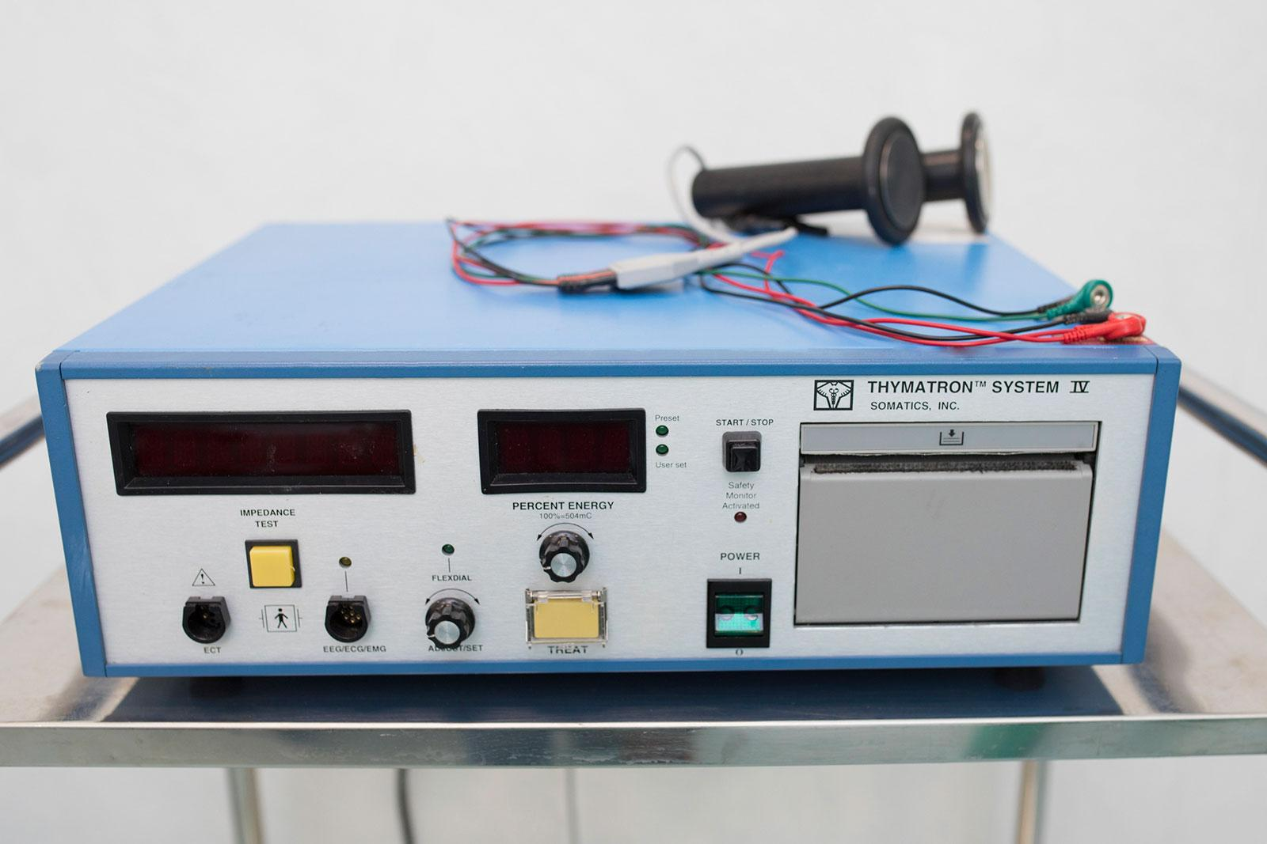
Introduction to ECT
What is ECT?
Electroconvulsive therapy (ECT) is a medical procedure used to treat severe, treatment-resistant mental health conditions, such as major depression, bipolar disorder, and schizophrenia.
It involves passing small electric currents through the brain to induce a brief, controlled seizure while the patient is under general anesthesia.
The ECT Machine: A specialized medical device used to administer a brief, controlled electrical current to the brain.

Slide 4






Key Components of ECT Equipment
ECT Stimulator
Electrodes
Monitoring System
The core device delivering controlled electric currents. Can be configured for unilateral or bilateral placement.
Pads or headsets used to deliver stimulus and monitor brain activity (EEG), typically using conductive gel or saline.
Integrated EEG and ECG modules for real-time tracking of seizure activity and cardiac rhythm.

Slide 5

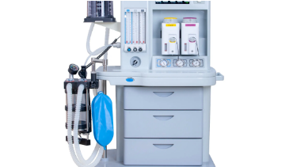

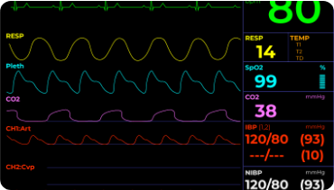
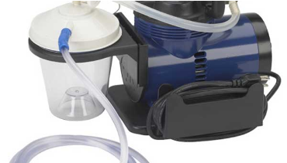
Essential Ancillary Machines
Anesthesia Machine
Vital Signs Monitor
Suction Machine
Delivers anesthesia and provides 100% Fraction of Inspired Oxygen (FiO₂ ) before and after stimulus.
Real-time tracking of SpO₂, Blood Pressure (NIBP), and Temperature.
Used to remove saliva and prevent aspiration while the patient is unconscious.

Slide 6
Procedural Safety Measures
Anesthesia: Performed under general anesthesia with a muscle relaxant to prevent musculoskeletal injury.
Oxygenation: 100% FiO₂ provided via bag-valve mask before, during, and after treatment.
Oral Protection: A bite block is placed in the oropharynx to prevent tooth and tongue injury during the seizure.
Seizure Tracking: Motor seizures are monitored via electromyography or a blood pressure cuff used as a tourniquet on one limb.

Slide 7
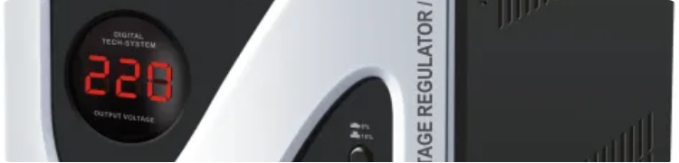

Electrical Safety Standards
Nigerian Standard Voltage
The standard regulated voltage in Nigeria is 230V-240V at 50Hz. All ECT equipment must be powered via a Medical-Grade AVR/UPS to prevent board failure during surges.
240
VOLTS / 50 HERTZ

Slide 8

Safety Warnings & Constraints
Technical Warnings
Impedance Check
Avoid Frayed Cables: Never use equipment that is damaged or has been exposed to moisture.
The stimulator measures electrical resistance before firing. If Impedance > 3000 Ohms, the machine will not fire, signaling poor electrode contact.
Pacemaker Warning: Patients with pacemakers or implantable cardioverter defibrillator (ICDs) must be evaluated by a cardiologist prior to ECT.

Slide 9
Cleaning & Handling Protocols
Exterior & Housing
Cables & Leads
Use a soft, damp cloth with a mild detergent. Avoid harsh chemicals or excessive liquid that could cause internal short circuits.
Regularly inspect for wear. Ensure they are stored loosely (not tightly coiled) to prevent internal wire breakage.
Dust Protection: Always keep the machine covered with a dedicated dust cover when not in use.
Daily Test: Run the built-in "Safety Monitor Test" before the first session of the day.

Slide 10
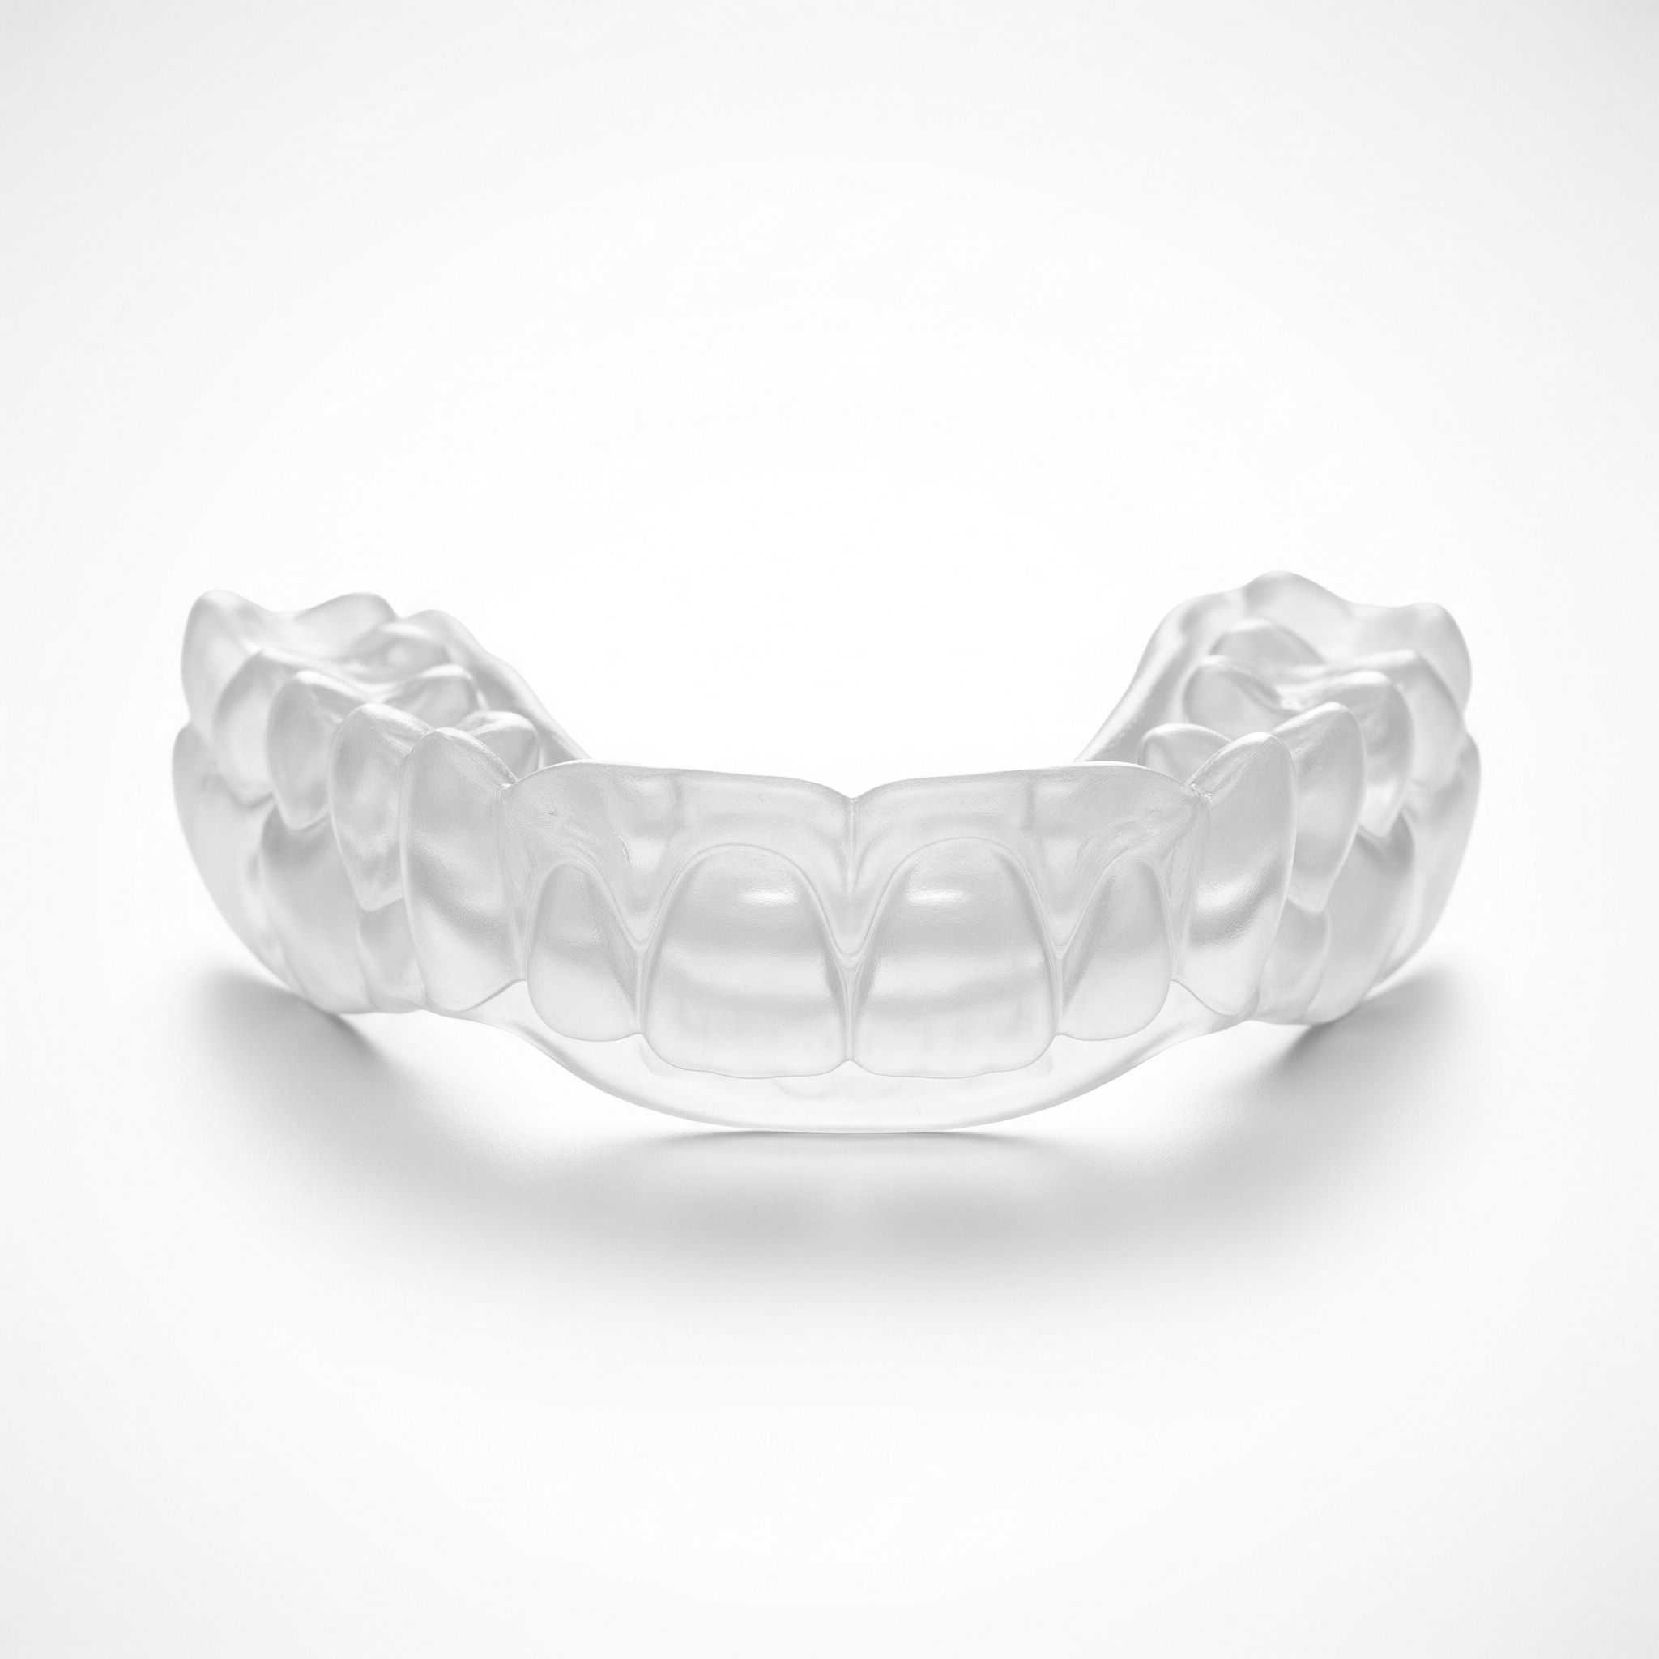
Specialized Accessory Care
Electrodes & Bite Blocks
Electrodes: Clean reusable stimulation electrodes thoroughly after each use to ensure electrical performance and adhesive integrity.
Bite Blocks: Sanitize or replace bite blocks according to clinical hygiene standards after every patient use.
Suction: Regularly check suction tubing for blockages and ensure container is emptied and sanitized.

Slide 11
Core Medical Team Responsibilities
Role | Primary Responsibility | Key Procedure Task
Psychiatrist | Clinical Indication & Assessment | Dose determination & Electrode placement
Anesthetist | Airway & Physiological Stability | Administration of induction & muscle relaxants
ECT Nurse | Patient Flow & Care Coordination | Vital monitoring & Equipment preparation
Anesthetic Tech | Anesthesia Machine Readiness | Preparing BVM, Oxygen, and Suction units

Slide 12




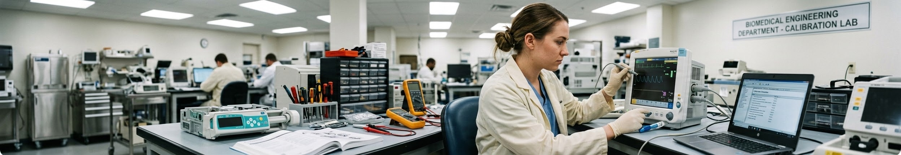
Team Responsibilities - Support Roles
Biomedical Team
Recovery Nurse
Health Attendant
Technical management. Ensure machine and accessories operate at peak performance through targeted technical audits and calibration.
Post-ECT monitoring. Manages confusion/agitation and tracks vitals until the patient is stable for transfer.
Room hygiene, patient positioning, and ensuring resuscitation equipment is easily accessible in the suite.

Slide 13

Our Critical Operational Challenges & Equipment Gaps
Category
Issue
Description
Hardware Gap
No Integrated Printing
Lacks built-in ECG/EEG printers for real-time monitoring and legal documentation, making it less advanced than modern types..
Reliability
Faulty Performance
Unreliable display performance and frequent technical issues reduce clinical effectiveness and may affect patient safety.
Clinical Limitations
Restricted Placement Support
Modern devices support precise electrode placements, including Right Unilateral (RUL), Bifrontal (BF), and Bitemporal (BT), with RUL most commonly used to reduce side effects.

Slide 14
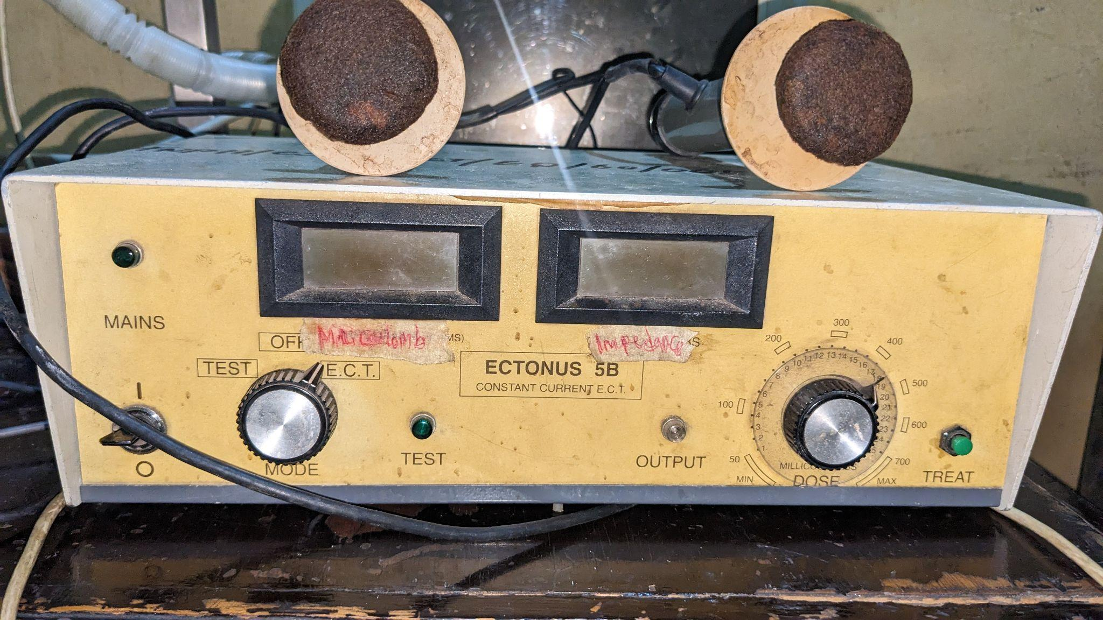
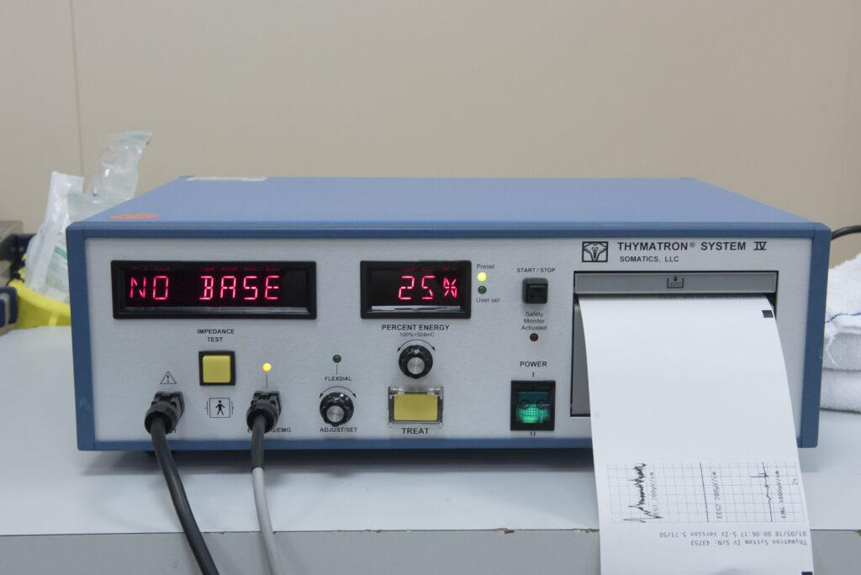
Visual Comparison of Current vs. Modern ECT Machine

Slide 15
Strategic Recommendations for ECT Optimization
biotech
monitor_heart
ECT Machine Upgrade
Patient Monitoring
We recommend a modern ECT machine for optimal procedure and to align our facility with modern best practices.
Assign a new, dedicated patient monitor to the ECT unit. The existing monitor needs an urgent backup.

Slide 16
Conclusion
Whether you are a Psychiatrist determining treatment, a Nurse or Anesthetic Technician managing the procedure, a Biomedical Engineer ensuring peak performance, or a Health Attendant assisting with care, we all hold a piece of the safety chain.
Let us continue to work together to ensure that our unit remains a gold standard for psychiatric care in Nigeria.
Let’s keep our equipment safe, so we can keep our patients safer.

Slide 17





Image sources and Reference
https://image.made-in-china.com/2f0j00OZFiKznjMTkQ/Professional-Hospital-Clinical-Anesthesia-Machine-for-Surgical-Room.webp
Source: m.made-in-china.com
https://www.cardiacdirect.com/wp-content/uploads/2021/06/patient-monitor-screen.png
Source: www.cardiacdirect.com
https://www.mountainside-medical.com/cdn/shop/files/18600-Suction-Machine.jpg?v=1708020679
Source: www.mountainside-medical.com
https://lightwaveglobal.com/media/catalog/product/cache/4d6f5cc39f29d5596848b14ee8013ffb/c/2/c281-davrc10000_1.webp
Source: lightwaveglobal.com
https://www.mountainside-medical.com/cdn/shop/products/bite-stick-seizure-patient-tongue__04422.jpeg?v=1732123350
Source: www.mountainside-medical.com

Slide 18

Image Sources
http://thefieldengineer.com/wp-content/uploads/2022/11/GK-with-equipment-and-tool-kit-1024x683.jpg
Source: thefieldengineer.com

