Slide 1


Title:
Data Analytics in Healthcare Decision-Making
Presenter:
Mrs U. D. Aguebor (HIMT)
Date: April 12, 2026
Federal Neuro-Psychiatric Hospital, Uselu
Health Information Management Unit
Clinical Presentation

Slide 2
OUTLINE
Introduction
Objectives
Definition
Types of Healthcare Data Analytics
Application of the Four Types of Healthcare Data Analytics in Psychiatry
Tools and Technologies in Heathcare Data Analytics
Important of Data Analytics in Healthcare decision making
Benefit of using Data Analytics
Challenges in Heathcare Data Analytics
The Roles of HIM Professionals
Conclusion
References

Slide 3
INTRODUCTION
In today’s world, healthcare is not just about treating patients — it’s about making informed decisions based on accurate data.
From predicting disease outbreaks to improving hospital efficiency, data analytics has become one of the most powerful tools in modern healthcare.
Every day, hospitals collect huge amounts of data — patient records, lab results, prescriptions, and billing information. When this data is properly analyzed, it can help healthcare providers improve care quality, reduce costs, and save lives.

Slide 4
OBJECTIVES
By the end of this presentation, you should be able to:
Understand the concept of data analytics in healthcare and its role in decision-making.
Identify the four main types of healthcare data analytics
Understand how data analytics supports clinical, administrative, and public health decisions.
Recognize the benefits and challenges of using data analytics in healthcare systems.
Appreciate the role of Health Information Management (HIM) professionals in ensuring data-driven healthcare outcomes.

Slide 5
DEFINITION of TERMS
DATA: Raw, unprocessed facts, figures, or observations that can be analyzed to generate meaningful information.
ANALYTICS: is the systematic process of collecting, processing, and analyzing data.
Simply means, turning raw data into useful information.
What is Data Analytics in Healthcare
Data analytics in healthcare refers to the systematic analysis of health data to uncover trends, patterns, and insights that can guide better decisions. In simple terms, it means using data to make healthcare smarter.

Slide 6
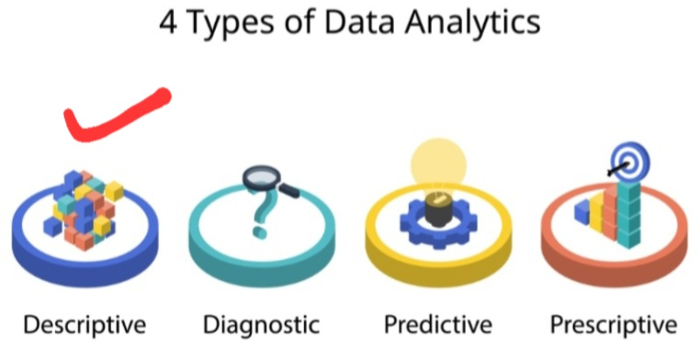
TYPES OF HEALTHCARE DATA ANALYTICS
1. Descriptive Analytics
This answers the question: “What has happened
It summarizes historical data — for example, the
number of patients treated for malaria last year.

Slide 7
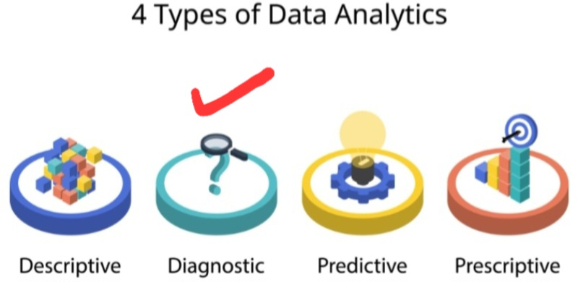
TYPES OF HEALTHCARE DATA ANALYTICS CONTD..
2. Diagnostic Analytics
This answers: “Why did it happen?’’ It helps identify the causes of trends or problems — such as why patient readmission rates increased.
7

Slide 8
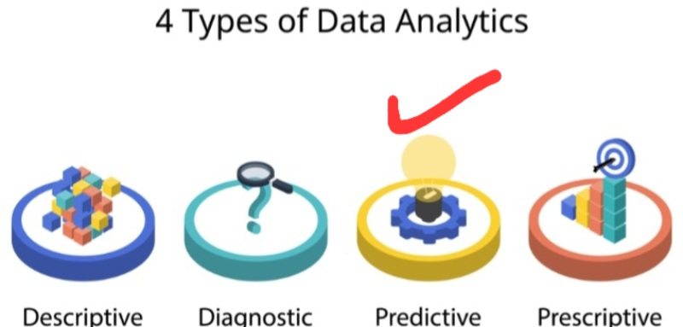
TYPES OF HEALTHCARE DATA ANALYTICS CONTD..
3. Predictive Analytics
This answers: What could happen next?
By using algorithms and past data, it predicts future
outcomes — for example, predicting which patients are
at high risk of developing diabetes.

Slide 9
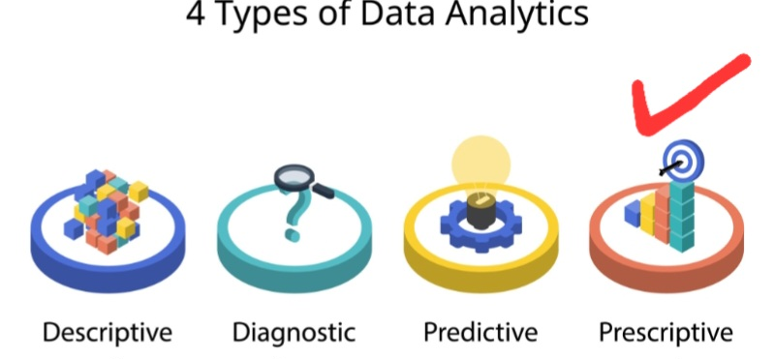
TYPES OF HEALTHCARE DATA ANALYTICS CONTD..
4. Prescriptive Analytics
This answers: What should we do about it?
recommends actions to achieve better results — for
instance, suggesting interventions to reduce infection
rates.

Slide 10
Application of the Four Types Healthcare Data Analytics in Psychiatry (Example: Schizophrenia)
🟦 Type of Analytics | 🟨 Key Question | 🟩 Psychiatric Example (Schizophrenia)
🔵 Descriptive | What happened? | Number of patients diagnosed with schizophrenia in the past year
🟠 Diagnostic | Why did it happen? | Identifying triggers such as genetic factors, substance abuse, or stress
🟣 Predictive | What could happen? | Predicting risk of relapse or hospitalization in schizophrenia patients
🟢 Prescriptive | What should we do? | Recommending treatment plans (medication, therapy, follow-up care) to prevent relapse

Slide 11
TOOLS AND TECHNOLOGIES IN HEALTHCARE DATA ANALYTICS
Modern healthcare uses several technologies for
data analysis, such as:
Electronic Health Records (EHRs) for data collection and integration.
Artificial Intelligence (AI) and Machine Learning for predictions.
Business Intelligence dashboards for visualizing trends.
Big Data platforms like Hadoop or cloud-based analytics for managing large datasets.
These tools help healthcare professionals see the “big
picture” and make decisions supported by evidence.

Slide 12
IMPORTANCE OF DATA ANALYTICS IN HEALTHCARE DECISION-MAKING
Data analytics plays a vital role in shaping decisions
` at all levels of healthcare:
a. Clinical Decision-Making
Doctors can use data to make evidence-based decisions — such as choosing the best treatment plan for a patient based on similar past cases.
b. Administrative Decision-Making
Hospital administrators can analyze data to improve workflow, reduce waiting times, and manage resources more effectively.

Slide 13
IMPORTANCE OF DATA ANALYTICS IN HEALTHCARE DECISION-MAKING CONTD..
c. Public Health Planning
Health data can reveal patterns of disease spread, helping governments and agencies prepare for outbreaks or allocate resources where they’re needed most.
d. Financial Management
Data analytics helps identify areas of waste or fraud, allowing hospitals to make smarter financial decisions.

Slide 14
BENEFITS OF USING DATA ANALYTICS
Some key benefits include:
-Reduction in relapse rates
-Better patient follow-up and continuity of care
-improved patient outcomes through personalized and timely care.
-Reduced medical errors by analyzing patterns and risks.
- Faster diagnosis using AI and predictive tools.
- Better resource management within hospitals.
- Enhanced research and innovation using real- world data.
In short, data analytics helps turn information into action — and action into better health outcomes.

Slide 15
CHALLENGES IN HEALTHCARE DATA ANALYTICS
While the benefits are great, there are also
challenges, such as:
Poor data quality due to incomplete or inaccurate
records.
- Data privacy and security risks.
- Lack of trained data analysts in healthcare settings.
Resistance to technology adoption by some healthcare workers.
To overcome these, hospitals must invest in training, secure systems, and proper data governance policies.

Slide 16
THE ROLE OF HIM PROFESSIONALS
Health Information Management professionals
play a critical role in data analytics by:
Ensuring data is accurate, complete, and reliable.
Managing health information systems and database
Supporting data analysis and interpretation
Protecting patient privacy while supporting data use for decision-making.
Bridging the gap between clinical care and data management

Slide 17
CONCLUSION
In conclusion, data analytics is transforming healthcare from reactive to proactive — from guessing to knowing.
By using data effectively, healthcare providers can make smarter decisions, improve patient care, and build stronger, and more effcient health systems.
Let’s remember:
Without data, we’re just guessing — but with data, we make a difference.

Slide 18
REFERENCES
Khanra, S., Dhir, A., Islam, A. K. M. N., & Mäntymäki, M. (2020).Big data analytics in healthcare: A systematic literature review. Enterprise Information Systems.
Islam, M. S., Hasan, M. M. Wang, X., & Germack, H. D. (2018).,A systematic review on healthcare analytics.Healthcare Journal.
Dehbozorgi, R., Zangeneh, S., Khooshab, E. et al. (2025).Application of artificial intelligence in mental health: A systematic review. BMC Psychiatry.

Slide 19


