Slide 1
Bedbug Infestation in Hospitals: Causes, Effects and Control Measures
By
Sanitarian Joshua Osazuwa Omoregie, Head, Environmental Health Unit,
Federal-Neuro Psychiatric Hospital, Benin City.

Slide 2
Outlines
Objectives
Introduction
Description of Bedbugs
Causes of Infestation
Identification/Diagnosis
Control measures
Preventive measures
Challenges
Integrated Pest Management (IPM)
Recommendations
Conclusion
References

Slide 3
Objectives
• To identify causes of bedbug infestation in hospitals
• To examine the effects on patients, staff, and healthcare delivery
• To outline effective control and preventive measures

Slide 4
INTRODUCTION
Bedbugs (Cimex lectularius) are small, nocturnal, blood-feeding insects that infest human environments, including healthcare facilities. Their presence in hospitals poses significant challenges to infection control, patient comfort, and institutional reputation.

Slide 5
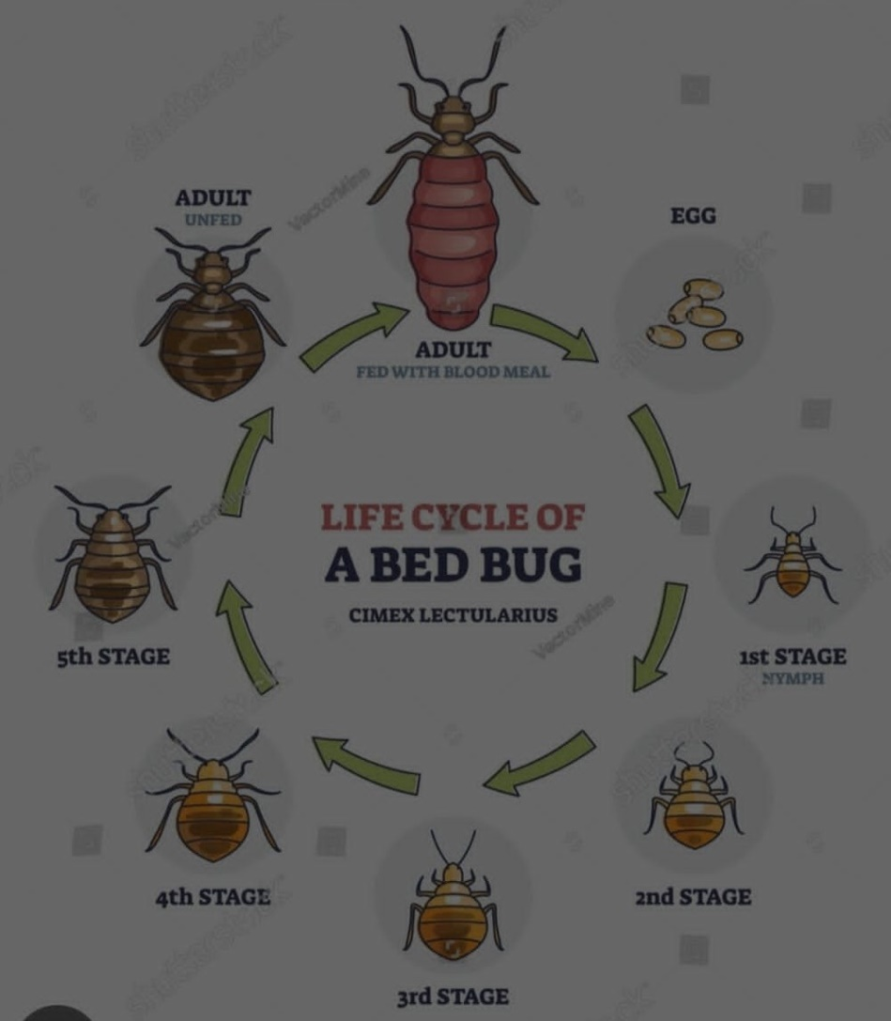

Slide 6
DESCRIPTION OF BEDBUGS
Small, oval, brownish insects (about 4-7mm long)
Nocturnal and feed on human blood
Hide in cracks, crevices, mattresses, bed frames, furniture, and walls
Reproduce quickly under favourable conditions

Slide 7
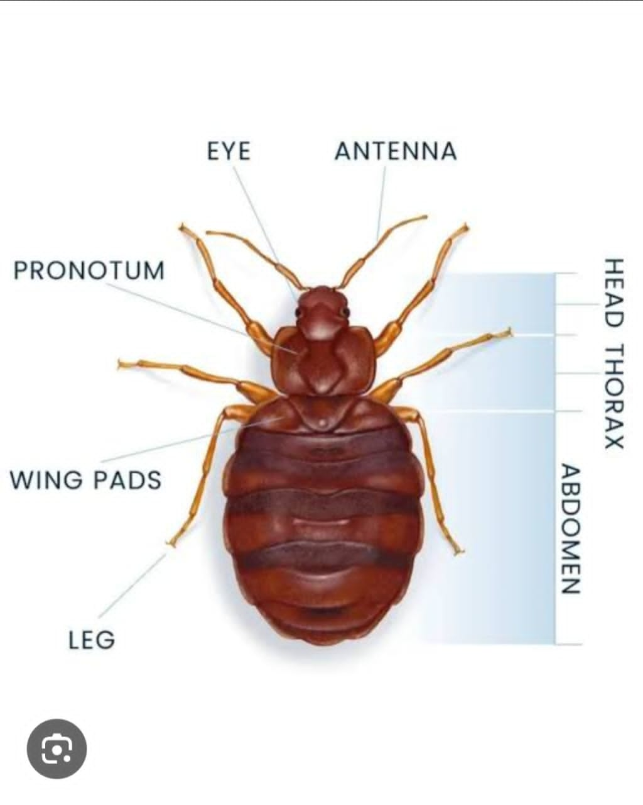

Slide 8
CAUSES OF INFESTATION IN HOSPITALS
a. Patient-related factors
Admission of infested patients or belongings
Referral or transfer from infested homes/facilities
b. Environmental factors
Overcrowding in wards
Poor sanitation and housekeeping
Cluttered surroundings
c. Structural factors
Cracks in walls and furniture
Damaged beds and mattresses
d. Operational factors
Poor routine inspection
Lack of pest control program
Improper laundry handling

Slide 9
EFFECTS OF BEDBUG INFESTATION
a. On patients
Itching, skin irritation, allergic reactions
Sleep disturbance
Secondary infections from scratching
b. On Staff
Psychological discomfort
Risk of carrying bedbugs home
c. On Hospital System
Increased operational cost
Reduced quality of care
Poor institutional image

Slide 10
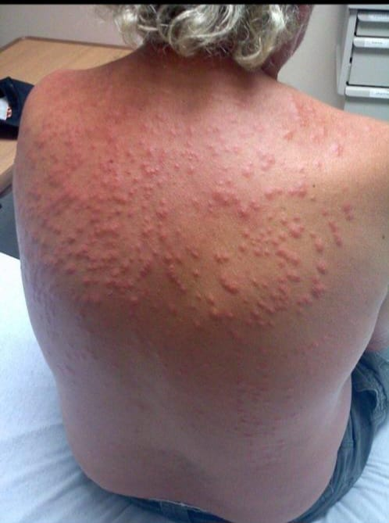

Slide 11
IDENTIFICATION/DIAGNOSIS
Live bedbugs in beds or furniture
Blood stains on bed linens
Black fecal spots
Musty odour in infested areas
Bite marks on exposed skin

Slide 12
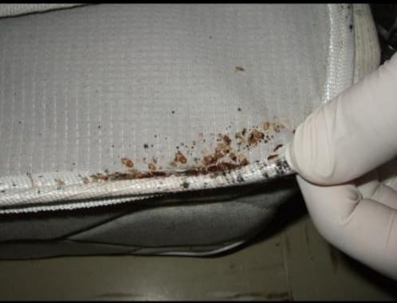

Slide 13
CONTROL MEASURES
a. Environmental Control
Regular cleaning and decluttering
Sealing cracks and crevices
Mattress encasements
b. Chemical Control
Approved insecticides (e.g. pyrethroids)
Dusting into hiding places
Fumigation by professionals

Slide 14
CONTROL MEASURES CONTD
c. Mechanical Control
Vacuuming infested areas
Heat treatment of bedding
Disposal of heavy infested items
d. Administrative Control
Routine surveillance
Staff training
Pest control policy implementation

Slide 15
PREVENTIVE MEASURES
Screening of patients and belongings
Regular fumigation schedule
Proper laundry management (hot water washing)
Health education of staff and patients

Slide 16
CHALLENGES
Insecticides resistance
High cost of control
Delayed detection
Re-infestation
Limited awareness

Slide 17
INTEGRATED PEST MANAGEMENT (IPM) For Indoor Bedbug Control
Integrated Pest Management (IPM) is a smart, step by step approach that combines different control methods to eliminate pest like bedbugs while minimizing risks to people and the environment. For bedbugs, IPM is especially effective because they hide well and resist many chemicals.
IPM is not a one – time fix- it’s a combination of cleaning, monitoring and targeted treatment overtime.

Slide 18
BEDBUG CONTROL CHECKLIST for Cleaners/Orderlies
DAILY PREVENTION – STOP INFESTATION BEFORE IT STARTS
Inspect first: check bed frames, seams, headboards, bedside furniture for live bugs, rust spots, or shed skins before cleaning.
Declutter: remove / report piled linen, cardboard, or fabric stored under beds or in corners
Seal cracks: report cracks in walls, loose wallpaper, or broken tiles to maintenance for sealing
Isolate gear: keep carts, mops, personal items off beds/upholstery. Store in designated area
Rotate furniture: pull beds/chairs 30cm from walls to inspect/clean behind them weekly

Slide 19
IF BEDBUGS ARE FOUND – CURTAIL SPREAD IMMEDIATELY
• Stop & Contain: stop cleaning that room. Do not move linen, furniture, or equipment out until advised
• Report fast: Notify Infection Prevention and Control Unit Chairman & Environmental Health Unit. Note room/bed number.
• Bag on site: Put all linen, curtains, washables from room into sealed, labelled plastic bags before moving
• Limit access: place “DO NOT USE” sign. Restrict entry to essential staff only
• Double-bag waste: All trash from infested room goes into double plastic bags, sealed, straight to external disposal.
• Clean tools: After leaving room, disinfect vacuum, change gloves/gown, heat-treat your uniform before next shift.
• Monitor nearby: increase inspection of adjacent rooms/beds for next 14 days.

Slide 20
Key Rule
Bedbugs spread by moving with things. When in doubt, bag it, seal it, report it

Slide 21
RECOMMENDATIONS
Implement integrated pest management (IPM)
Regular staff training
Adequate funding for control programs
Strengthen monitoring and reporting
Engage environmental health officers

Slide 22
CONCLUSION
Bedbug infestation in hospital remains a significant environmental health challenge. Effective control requires a coordinated approach involving sanitation, surveillance, chemical control and staff participation.

Slide 23
REFERENCES
World Health Organisation (WHO). (2018). Bed bugs: Public health significance and control. Geneva: WHO.
Centers for Disease Control and Prevention (CDC). (2024). Bed bugs (Crimex lectularis). Available at: https://www.cdc.gov/bedbugs
Environmental Protection Agency (EPA). (2023). Bed Bugs: information for Healthcare Settings. Available at: https://www.epa.gov/bedbugs
4. Doggett, S.L., Dwyer, D.E, Penas, P.F., & Russell, R.C. (2012). Bed bugs: Clinical relevance and control options. Clinical Microbiology Reviews, 25(1), 164-192.

Slide 24
REFERENCES CONTD
Hwang, S.W., Svoboda, T.J., De Jong, I.J., Kabasele, K.J., & Gogosis, E. (2005). Bed bug infestations in an urban environment. Emerging Infectious Diseases, 11(4), 533-538
National Pest Management Association (NPMA). (2022). Bed Bug Best Management Practices for Healthcare Facilities.
World Health Organisation. (2019). Guidelines on sanitation and health. Geneva: WHO.
8.Bonnefoy, X., Kampen, H., & Sweeney, K. (2008). Public health significance of urban pests. WHO Regional Office for Europe.

Slide 25
THANK YOU FOR LISTENING

