Slide 1
CANNABIS USE AMONG SECONDARY SCHOOL STUDENTS: TRENDS AND INTERVENTIONS
BY
DR OBU OGHENERO JONATHAN
15TH APRIL 2026

Slide 2
OUTLINE
OBJECTIVE
INTRODUCTION
CANNABIS USE TRENDS IN ADOLESCENTS FROM ANCIENT ERA TILL TODAY IN THE UNITED STATES, AFRICA, AND NIGERIA.
PHARMACOLOGICAL INTERVENTIONS
PSYCHOLOGICAL INTERVENTIONS
SOCIAL INTERVENTIONS
RECOMMENDATIONS
CONCLUSION
REFERENCES

Slide 3
OBJECTIVES
To present the trends of cannabis use among adolescents from ancient times till today with specific attention to the United States, Africa, and Nigeria.
To present the interventions currently being used to manage cannabis use in adolescents.

Slide 4
INTRODUCTION
Cannabis use among adolescents is a significant public health concern due to its widespread use and potential impact on developing brains.
Early use has been linked to poor academic outcomes, cognitive impairment, and increased risk of mental health disorders.
Trends show shifting patterns, including changes in prevalence, modes of use (such as edibles and vaping), and perception of risk.
Interventions like school-based programs and psychological approaches such as cognitive behavioral therapy and motivational interviewing have been developed, though their effectiveness vary.

Slide 5
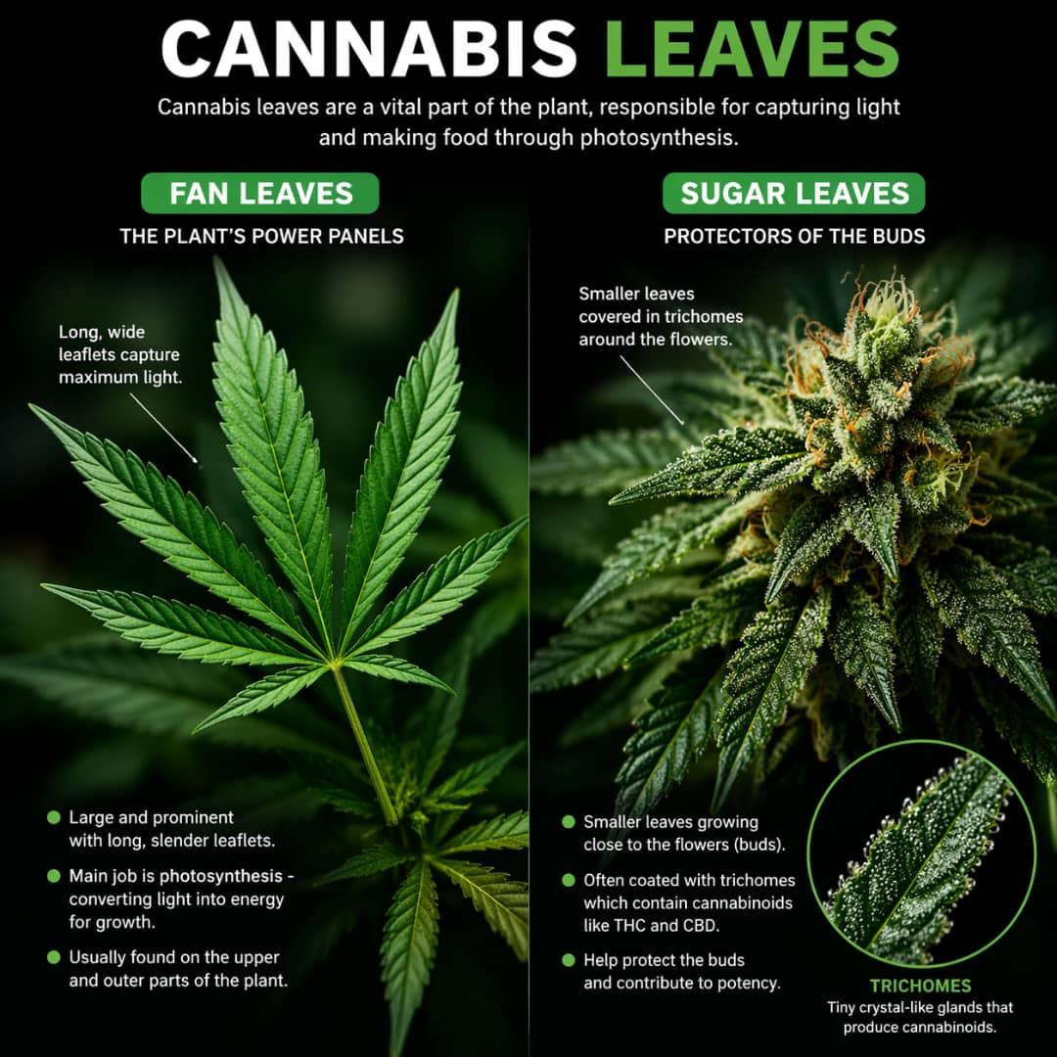
INTRODUCTION (CONT’D)

Slide 6
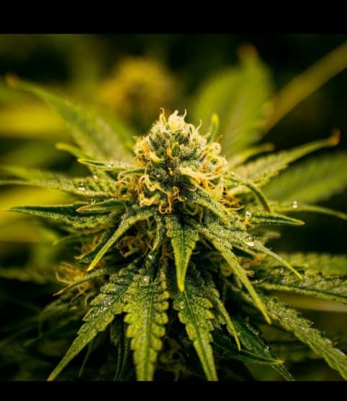
INTRODUCTION (CONT’D)(FLOWER)

Slide 7
CANNABIS USE TRENDS IN ADOLESCENTS: ANCIENT ERA TO 20TH CENTURY
Pattern of use of cannabis by adolescents during this period is unknown due to poor data collection.
Cannabis was attested to aroung 12,000 years ago in Central Asia.
2800BC-500BC: Cannabis was listed in Emperor Shen Nung's pharmacopoiea. He is ragarded as the father of chinese medicine.
Medieval to Early Era (1000AD-1800s): Hashish consumption by the Egyptian Sufis has been documented as occuring in the 13th century. Until the 1500s, hashish in the Muslim world was consumed as an edible.

Slide 8
CANNABIS USE TRENDS IN ADOLESCENTS: ANCIENT ERA TO 20TH CENTURY (CONT’D)
Industrial and colonial Era (1600s-1900s): In 17th century America, hemp production was highly encouraged for making clothes, rope, and sails.
20th Century: Marijuana-made from the dried leaves and flowers of the cannabis sativa plant-became the most widely used and readily available form of cannabis. The main method of consumption was smoking.
Pre-1970s: Historical use before this era by this specific age group (adolescents) is not well documented. However, it is believed that adolescent use before the 1970s mirrored adult use. Dried cannabis flower and leaves were the common forms consumed in the 20th Century before the 1970s. Potency during this era was low.

Slide 9
CANNABIS USE TRENDS IN ADOLESCENTS (US): 1970s-2025
Most recorded data on adolescent cannabis use begins in this period, when systematic surveys were first conducted.
Epidemiology: The 2 foundational sources for this period are National Survey on Drug Use and Health (NSDUH) and Monitoring the Future (MTF) both based in the United States of America (USA).
Annual prevalence (12th graders)(17-18 years):
--1975: 40% 2019: 36%
--1979: 50.5% 2025: 26%
--1999: 37.8%

Slide 10
CANNABIS USE TRENDS IN ADOLESCENTS (US): 1970s-2025
Parts consumed:
1970s-1990s: Dried flowers (THC conc. 15-30% of dried mass) and leaves (THC conc. 0.5-3% of dried mass) . (THC=tetrahydrocannabinol)
2000-2025: Dried flowers and leaves + hashish (extracted from the resin glands of the flowers of the cannabis plant, THC conc.-40-80%)

Slide 11
CANNABIS USE TRENDS IN ADOLESCENTS (US): 1970s-2025
Modes of use:
1970s-1990s: smoking
2000-2014: smoking + edibles (chocolate, butter, cake and other baked products)(baked products produce "highs" that are long-lasting up to 12 hours).
2015-2025: smoking + edibles + vaping
vaping (heating of parts of the cannabis plant especially the flower and hashish to a temperature that is enough to vapourize the fluids but not enough to lead to combustion (burning))

Slide 12
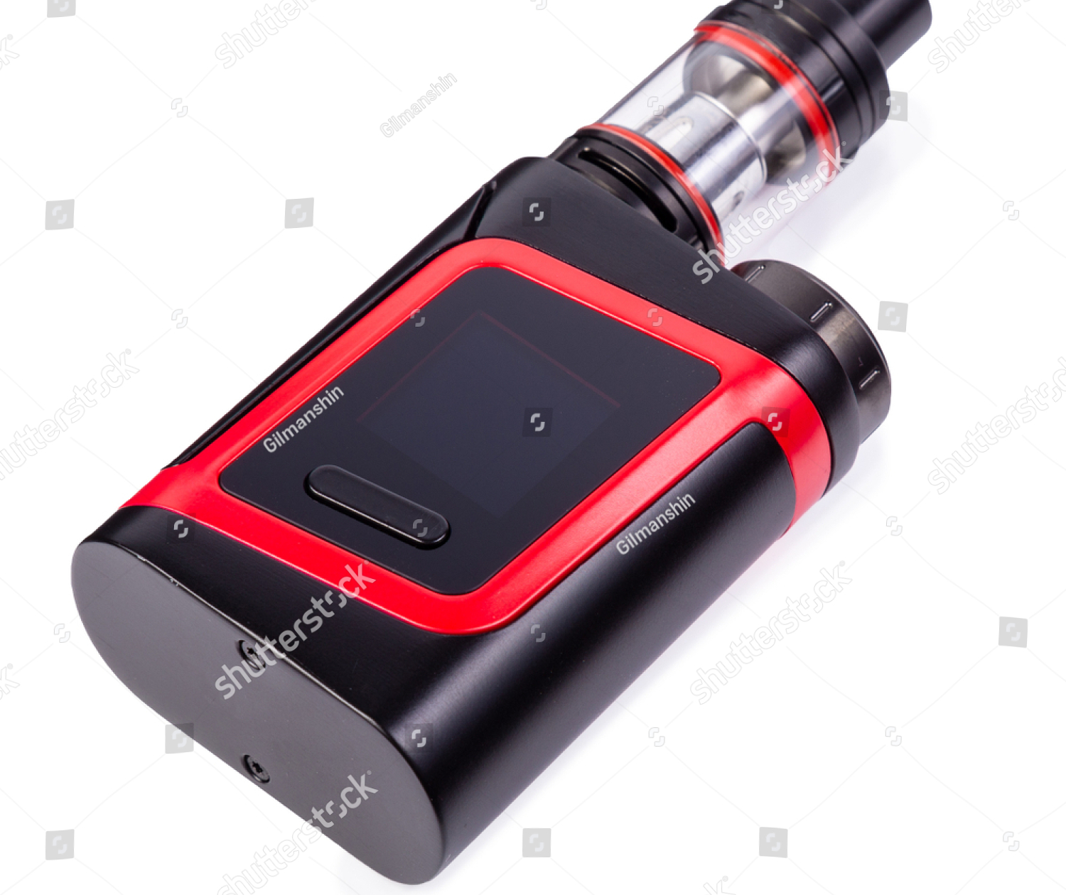
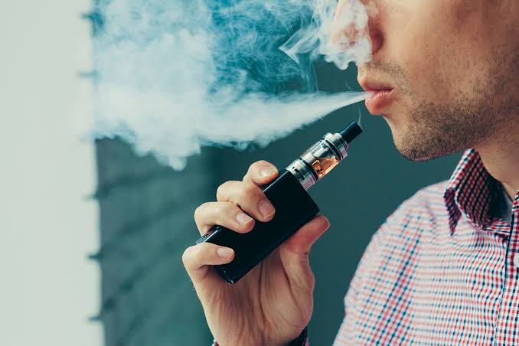
VAPING DEVICE

Slide 13
CANNABIS USE TRENDS IN ADOLESCENTS (US): 1970s-2025
Age at first use:
1970s: 17-19 years
1990s: 14 years and below
2000 till date: 14-16 years.
Perceived risk of harm from cannabis use:
Lowest in the 1970s
Increased in the 1980s and has been virtually the same since then

Slide 14
DATA FROM AFRICA: 1970s-2025
There is NO reliable year-by-year epidemiological dataset (like MTF in the U.S.) for adolescents in Africa between the 1970s–2025.
However, data suggest that from 1970-1979, Cannabis use was Mostly adult-dominated, with Limited adolescent exposure.
From 1980-2000 lifetime prevalence ranged between 6-12%
From the year 2000 to the early 2020s lifetime prevalence ranged between 5-10% and past month prevalence ranged between 2-6%.
Parts consumed: Currently across Africa, cannabis use by adolescents is almost entirely unprocessed plant material (especially the flower) because of Limited access to refined products and Low-cost street availability. It is sold as, "indian hemp", or "weed" and easy to roll up in joints (also called "wraps").

Slide 15
DATA FROM AFRICA: 1970s-2025 (CONT’D)
Modes of use: Currently, smoking is by far the most dominant method among adolescents in Africa.
Vaping is emerging in Africa but its still less common in comparison with the United States. Vaping is seen mainly in high-income urban groups, especially in South Africa.
Edibles (cakes, drinks, etc) also increasing in Africa but still not as common as in the US.
Age at first use: of cannabis in Africa from the year 2000-2025 is on average 14-16 years.

Slide 16
DATA FROM AFRICA: 1970s-2025 (CONT’D)
Perceived risk of harm: In Africa, among adults, from 2000-2009, perceived risk of harm from cannabis use was high and cannabis was widely viewed as dangerous, criminal, and socially unacceptable. Adolescent data on perceived risk during this period is limited.
From 2010 till date, available data on perceived risk of harm from cannabis use among adolescents suggest gradual but steady decline.

Slide 17
NIGERIAN DATA: 1970s-2025
Cannabis is widely known in Nigeria as "igbo", "ganja","gbana", "morocco", or "marujuana" and has been specifically illegal since 1966 that the Indian Hemp Decree was passed.
Epidemiology: As with Africa, year-by-year epidemiological data on adolescent cannabis use in Nigeria does not exist for this entire period. What exists instead is a collection of cross-sectional surveys (some of which are school-based) conducted at irregular intervals.
The first systematic school surveys were conducted in the 1980s.
From 1980-1989, the lifetime cannabis use -- 3-9% (secondary school students) . Stable till the late 2010s when it increased in some regions. Ekiti state (2019), lifetime and past 30 days prevalence 17.3% and 11% respectively among secondary school students in Ado-Ekiti.

Slide 18
NIGERIAN DATA: 1970s-2025
Parts consumed: Limited data. Few data -- flower is the most-consumed part among adolescents.
Other parts consumed include leaves and stem.
Nigerian Drug Law Enforcement Agency (NDLEA): Over the past 3-8 years, newer, high potency, imported forms -- "loud" or "colorado" -- have become common, pattern of use by adolescents uncertain.
Modes of use: Smoking remains the most dominant way of consumption among adolescents. Vaping, consumption of edibles, and inclusion in shisha are gradually becoming common among young adults.

Slide 19
NIGERIAN DATA: 1970s-2025
Age at first use: Declining based on available studies.
13-16 years in the 1980s,
12-15 years in the 1990s,
12-14 years between 2018 and 2025.
Declining perceived harm:
Urban youth areas -- substantially lower, with cannabis normalized as functional and therapeutic.
Rural areas, Northern Nigeria and female adolescents -- moderate-to-high.

Slide 20
INTERVENTIONS
Inpatient/Outpatient intervention
Pharmacological
Psychological
Social
Inpatient intervention:
cannabis-induced psychosis, suicidal ideation, suicidal attempts
severe cannabis withdrawal symptoms (restlessness, anxiety, sleep difficulties, decreased appetite with food avoidance)
failure of outpatient treatment, etc.

Slide 21
INTERVENTIONS
Pharmacological inteventions: Antipsychotics, antidepressants and anxiolytics are prescribed in cases of psychosis, depression, and anxiety respectively.
Dealing with withdrawal symptoms and craving: Recent systematic reviews show that THC analogs, cannabidiol (CBD), gabapentin, N-acetylcysteine, and antidepressants provide inconsistent benefit.
Gabapentin: blocks α2δ subunit of voltage-gated calcium channels and indirectly modulates GABA signaling. Used off-label for anxiety, insomnia, and craving associated with substance use disorders.
N-acetylcysteine (NAC): an antioxidant, that targets glutamate dysregulation — a key neurobiological mechanism in addiction.

Slide 22
INTERVENTIONS
Quetiapine (dose: 200 mg), attenuate sleep and appetite issues caused by cannabis withdrawal.
Psychological Interventions:
Cognitive Behabioral therapy (CBT)
Motivational Interviewing
Contingency Management

Slide 23
INTERVENTIONS
Cognitive Behavioral Therapy:
Underlying Principle: CBT is based on the cognitive model: Maladaptive thoughts → influence emotions → drive behaviour
Mechanism of Action
--Identify triggers (peer pressure, stress)
--Recognize automatic thoughts (“weed helps me relax”)
--Develop coping strategies
--Train relapse prevention skills
CBT reduces: Frequency of cannabis use, Severity of dependence, Often combined with Motivational Interviewing (MI) for better outcomes.

Slide 24
INTERVENTIONS
Motivational Interviewing (MI)
Underlying Principle
Based on self-determination theory.
Behaviour change occurs when intrinsic motivation increases
Ambivalence is resolvable. Ambivalence occurs when reasons for change are of equal or almost equal proportion with reasons for staying the same.
Mechanism of Action: Helping the individual to look for the benefits of change till reasons for change are strong enough to push them to do so. MI arouses the individual’s internal motivation.
MI is one of the most commonly used interventions in adolescents

Slide 25
INTERVENTIONS
Contingency Management (CM)
Underlying Principle: Based on operant conditioning (behavioral theory): Behaviour is shaped by reinforcement. Reinforcement can be positive or nagative. Desired behaviour (abstinence) are rewarded and Undesired behaviour are not reinforced.
CM has been show to improve abstinence rates, retention in treatment.
It works best when combined with CBT.

Slide 26
INTERVENTIONS
Social Interventions: Modify social environments, family dynamics, and community structures. Types: school-based, family-based, community-based.
School-Based Social Interventions: Address negative peer pressure, teach refusal skills (“how to say no”), build decision-making skills, improve emotional regulation and problem-solving skils.
Nigeria has a School-Based Intervention Program called the School Health Program (SHP) but its implemenatation appears poor.

Slide 27
INTERVENTIONS
Family-Based Interventions:
Key Components include:
---More Parental monitoring
---Communication skills-more communication (“the more you communicate with your child the more you know what is going on in their life”).
Community-Based Interventions: Include:
Youth engagement programs: Religious/community outreach (very relevant in Nigeria), Anti-drug campaigns.
Mechanism: Reinforces social norms against drug use, provides alternative activities.

Slide 28
RECOMMENDATIONS
Information on adolescent cannabis use or use in secondary schools in Nigeria is sporadic, scanty and inadequate. Therefore the following recommendations need urgent attention:
Nigeria needs to strengthen its data coordination and research capacity around adolescent cannabis use.
Data collection tools should be standardized to include type of cannabis used (flower, edibles), modes of use (e.g. vaping), and age of initiation.
Investment in longitudinal studies like those done in the United States will help to track patterns over time and identify risk factors specific to Nigerian adolescents.

Slide 29
CONCLUSION
Cannibis use among adolescents or secondary school sudents is significant with initiation at an early age and decline in perceived risk particularly in Nigeria and across Africa.
Smoking unprocessed cannabis remains the dominant mode of use among adolescents or secondary school students though newer forms like edibles and vaping are emerging.
Addressing the trend requires early interventions that are especially school and family-based to reduce use and prevent long-term harm.

Slide 30
REFERENCES
1. McHugh RK, Hearon BA, Otto MW. Cognitive behavioral therapy for substance use disorders. Psychiatr Clin North Am. 2010;33(3):511–525.
2. National Institute on Drug Abuse. Principles of drug addiction treatment: a research-based guide. 3rd ed. Bethesda (MD): NIDA; 2018.
3. Center for Substance Abuse Treatment. Substance abuse: clinical issues in intensive outpatient treatment. Treatment Improvement Protocol (TIP) Series 47. Rockville (MD): Substance Abuse and Mental Health Services Administration; 2006.
4. Liddle HA, Dakof GA, Henderson CE, Rowe CL. Implementation outcomes of multidimensional family therapy–detention to community: a reintegration program for drug-using juvenile detainees. Int J Offender Ther Comp Criminol. 2011;55(4):587–604.
5. McCrady BS, Epstein EE, editors. Addictions: a comprehensive guidebook. 2nd ed. Oxford: Oxford University Press; 2013.
6. O’Farrell TJ, Clements K. Review of outcome research on marital and family therapy in treatment for alcoholism. J Marital Fam Ther. 2012;38(1):122–144.
7. Humeniuk R, Henry-Edwards S, Ali R, Poznyak V, Monteiro M. The Alcohol, Smoking and Substance Involvement Screening Test (ASSIST): manual for use in primary care. Geneva: World Health Organization; 2010.
8. Miller WR, Rollnick S. Motivational interviewing: helping people change. 3rd ed. New York: Guilford Press; 2013.
9. Bou Nassif Y, Leclerc BS, Gagnon J, et al. Psychological interventions for cannabis use among adolescents: A systematic review. Int J Environ Res Public Health. 2023;20(14):6346.
10. Bou Nassif Y, Leclerc BS, Gagnon J, et al. Interventions for cannabis use among adolescents: Systematic review of randomized controlled trials. Adolescents. 2023;3(1):6.

Slide 31
REFERENCES CONT’D
11. Winters KC, Tanner-Smith EE, Bresani E, Meyers K. Current advances in the treatment of adolescent drug use. J Child Adolesc Subst Abuse. 2014;23(3):192–203.
12. Faggiano F, Minozzi S, Versino E, Buscemi D. Universal school-based prevention for illicit drug use. Cochrane Database Syst Rev. 2014;(12):CD003020.
13. Das JK, Salam RA, Arshad A, Finkelstein Y, Bhutta ZA. Interventions for adolescent substance abuse: Systematic review. J Adolesc Health. 2016;59(4 Suppl):S61–75.
14. Spoth R, Trudeau L, Guyll M, Shin C, Redmond C. Universal intervention effects on substance use among adolescents. Prev Sci. 2016;17(6):703–713.
15. Hogue A, Henderson CE, Becker SJ, Knight DK. Evidence base on outpatient behavioral treatments for adolescent substance use. J Clin Child Adolesc Psychol. 2018;47(4):499–526.
16. Carney T, Myers BJ, Louw J, Okwundu CI. Brief school-based interventions for substance use among adolescents. Cochrane Database Syst Rev. 2016;(1):CD008969.
17. Chazal C, Lelong-Boulouard V, Leduc K, et al. Brief interventions for cannabis use in primary care: Systematic review. Fam Pract. 2022;39(4):659–667.
18. Odeigah OW, Dumbili EW, Nelson EU. Cannabis use patterns, prevalence, and risk factors in Nigeria: a systematic review and meta-analysis. J Cannabis Res. 2025;7(1):88. doi: 10.1186/s42238-025-00337-0.
19. United Nations Office on Drugs and Crime. World Drug Report 2023. Vienna: UNODC; 2023.
20. Odejide AO, Acuda SW, Adlaf E, et al. Cannabis use in Sub-Saharan Africa: a systematic review and meta-analysis. Int J Drug Policy. 2023;117:104046.

Slide 32
REFERENCES CONT’D
21. World Health Organization. Past 30-day prevalence of cannabis use among adolescents [Internet]. Geneva: WHO; [cited 2026 Apr 11].
22. Volkow ND, Baler RD, Compton WM, Weiss SRB. Adverse health effects of marijuana use. N Engl J Med. 2014;370(23):2219–27.
23. Degenhardt L, Stockings E, Patton G, Hall WD, Lynskey M. Global, regional, and national prevalence of cannabis use among adolescents and young adults: a systematic review and meta-analysis. BMC Public Health. 2024;24:18491. doi:10.1186/s12889-024-18491-0.
24. Miech RA, Johnston LD, O’Malley PM, Bachman JG, Schulenberg JE. Monitoring the Future national survey results on drug use, 1975–2017: Secondary school students. Ann Arbor (MI): Institute for Social Research, University of Michigan; 2018.
25. Reddy P, James S, Sewpaul R, et al. Cannabis use in Sub-Saharan Africa: a review of trends and patterns. Subst Abuse Treat Prev Policy. 2021;16(1):1–12.26. Leung J, Chiu V, Chan GCK, Hall WD. Risk perception and cannabis use among adolescents: a systematic review. J Adolesc Health. 2023;73(5):879–89.
27. Fontes MA, Bolla KI, Cunha PJ, et al. Age of onset of cannabis use and neurocognitive outcomes. Addict Behav. 2023;139:107576.
28. Smith MJ, Cobia DJ, Reilly JL, et al. Adolescent cannabis use initiation and associated factors. J Am Acad Child Adolesc Psychiatry. 2024.
29. Hammond D, Wadsworth E, Reid JL, Burkhalter R. Age of initiation of cannabis use and its associations. J Cannabis Res. 2021;3(1):72. doi:10.1186/s42238-021-00072-2.
30. Mokwena KE. Cannabis use among adolescents in South Africa. S Afr J Psychiatr. 2020;26:a2244.
31. Organisation for Economic Co-operation and Development. Smoking, vaping and cannabis use among adolescents. In: Health at a Glance 2025 [Internet]. Paris: OECD Publishing; 2025.

Slide 33
REFERENCES CONT’D
32. National Academies of Sciences, Engineering, and Medicine. The health effects of cannabis and cannabinoids: the current state of evidence and recommendations for research. Washington (DC): National Academies Press; 2017.
33. Peltzer K, Phaswana-Mafuya N. Factors associated with cannabis use among adolescents in South Africa. S Afr J Psychiatr. 2020;26:21.
34. Mehanović E, Virk HK, Akanidomo I, Pwajok J, Prichard G, van der Kreeft P, Vigna-Taglianti F; Unplugged Nigeria Coordination Group. Correlates of cannabis and other illicit drugs use among secondary school adolescents in Nigeria. Drug Alcohol Depend. 2020;206:107457. doi: 10.1016/j.drugalcdep.2019.04.028.
35. Adelekan ML, Makanjuola AB, Ndom RJE, Fayeye JO, Adegoke AA, Amusan O, et al. 5-yearly monitoring of trends of substance use among secondary school students in Ilorin, Nigeria, 1988–1998. West Afr J Med. 2001;20(1):28–36.
36. Abiodun OA, Adelekan ML, Ogunremi OO, Oni GA, Obayan AO. Psychosocial correlates of alcohol, tobacco and cannabis use amongst secondary school students in Ilorin, Nigeria. West Afr J Med. 1994;13(2):91–7.
37. Adelekan ML. Self-reported drug use among secondary school students in the Nigerian state of Ogun. Bull Narc. 1989;41(1–2):109–16.
38. Adelekan ML, Abiodun OA, Obayan AO, Oni G, Ogunremi OO. Prevalence and pattern of substance use among undergraduate students of the University of Ilorin, Kwara State, Nigeria. Drug Alcohol Depend. 1992;29(3):249–56.
39. Adelekan ML, Ogunlesi AO, Akindele MO. Reliability and validity of the WHO student drug-use questionnaire among Nigerian students. Drug Alcohol Depend. 1989;24(3):245–9.
40. Adelekan ML. Psychosocial correlates of substance use among undergraduates in Ilorin University, Nigeria. East Afr Med J. 1996;73(8):541–7.
41. Obot IS. Assessing Nigeria's drug control policy, 1994–2000. Int J Drug Policy. 2004;15(1):17–26.
42. Nelson EUE. Consumption, not decriminalization: How Nigerian drug dealers/users account for cannabis harms. Int J Drug Policy. 2022;106:103763.

Slide 34
REFERENCES CONT’D
43. Substance Abuse and Mental Health Services Administration. 2013 National Survey on Drug Use and Health: detailed tables. Rockville (MD): SAMHSA; 2014.
44. National Institute on Drug Abuse Archives. 2001 Monitoring the Future survey results [Internet]. 2001.
45. Monitoring the Future. 1996 data volume [Internet]. Ann Arbor: University of Michigan.
46. ASPE/HHS. Smoking, alcohol, and substance abuse [Internet]. Washington (DC): US Department of Health and Human Services.
47. American Association for the Advancement of Science. The origins of cannabis smoking: chemical residue evidence from the first millennium BCE in the Pamirs. Sci Adv. 2019.
48. Drug Enforcement Administration. Adolescents and marijuana [Internet].
49. Keyes KM, Schulenberg JE, O'Malley PM, Johnston LD, Bachman JG, Li G, et al. The social norms of birth cohorts and adolescent marijuana use in the United States, 1976–2007. Addiction. 2011;106(10):1790–1800.
50. Lee JO, Jones TM, Kosterman R, Cambron C, Rhew IC, Herrenkohl TI, et al. Age of first marijuana use and its impact on education attainment and employment status. J Soc Work Pract Addict. 2019.
51. Tucker JS, Ellickson PL, Collins RL, Klein DJ. Trajectories of marijuana use from adolescence into adulthood: environmental and individual correlates. Dev Psychol. 2005;41(4):587–603.
52. Brook DW, Brook JS, Zhang C, Cohen P, Whiteman M. Drug use and the risk of major depressive disorder, alcohol dependence, and substance use disorders. Arch Gen Psychiatry. 2002;59(11):1039–1044.
53. Wikipedia. Cannabis edible [Internet]. 2026 [cited 2026 Apr 12].

Slide 35
THANK YOU

