Slide 1

Dietary management of Diabetes
By
Dietitian Precious Aisosa Okonkwo (RDN)
NUTRITION AND DIETETICS UNIT
FNPH BENIN

Slide 2

Content
Introduction
Types of Diabetes
Risk Factors for Diabetes
Complications of Diabetes
Dietary Management of Diabetes
Goals of Dietary Management
Principles of Medical Nutrition Therapy (MNT)
Macronutrient & Micronutrient Distribution
Special Considerations
Nutrition in Special Populations
Monitoring and Evaluation
Role of the Dietitian and Multidisciplinary Team
Key Challenges and Recommendations
Conclusion

Slide 3

Objectives
To understand the importance of nutrition in diabetes control and prevention.
To identify the goals and guiding principles of dietary management.
To outline appropriate macronutrient and micronutrient distribution for diabetic patients.
To recognize dietary considerations for special populations and comorbid conditions.
To emphasize the role of the dietitian and the multidisciplinary team in diabetes care.

Slide 4

Introduction
Diabetes mellitus (DM) is a chronic, complex metabolic disease characterized by persistent hyperglycemia due to defects in insulin secretion, insulin action, or both.
It affects millions globally and is a major cause of morbidity, disability, and premature death.
Globally, approximately 537 million people have diabetes, a number projected to rise significantly. In Nigeria, the number of adult cases is estimated to be around 2.9, with a significant number of cases remaining undiagnosed. The prevalence in Nigeria is estimated to 3.0% (WHO, 2024; IDF, 2024).
Effective management of diabetes requires medical care, lifestyle modification, and dietary regulation.

Slide 5
Types of Diabetes
Type 1 Diabetes Mellitus (T1DM):
Autoimmune destruction of pancreatic β-cells → absolute insulin deficiency.
Usually occurs in childhood or adolescence.
Requires lifelong insulin therapy.
Sudden onset with symptoms such as polyuria (excessive urine production), polydipsia (excessive thirst), polyphagia (excessive appetite), and weight loss.
Type 2 Diabetes Mellitus (T2DM):
Characterized by insulin resistance and relative insulin deficiency.
Commonly associated with obesity, sedentary lifestyle, and poor diet.
Accounts for about 90–95% of all diabetes cases worldwide.
Can be managed through lifestyle modification, oral hypoglycemics, and sometimes insulin.
Gestational Diabetes Mellitus (GDM):
Develops during pregnancy due to hormonal changes leading to insulin resistance.
Usually resolves after delivery but increases lifetime risk of Type 2 diabetes.

Slide 6
Risk Factors for Diabetes
Non-Modifiable Factors:
Family History: Genetic predisposition increases risk.
Age: Risk increases after 45 years.
Ethnicity: Black African, African Caribbean and South Asian at higher risk.
History of GDM: Women with previous gestational diabetes are at higher risk later in life.
Modifiable Factors:
Obesity and Overweight: Especially central obesity (abdominal fat).
Unhealthy Diet: High intake of refined sugars, saturated fats, and processed foods.
Physical Inactivity: Sedentary lifestyle decreases insulin sensitivity.
Smoking and Alcohol Use: Increase insulin resistance.

Slide 7
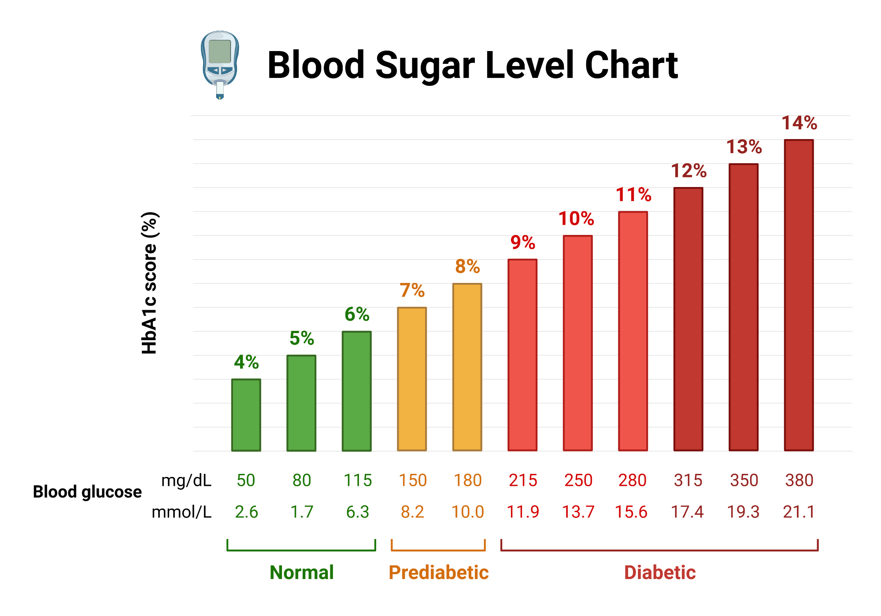
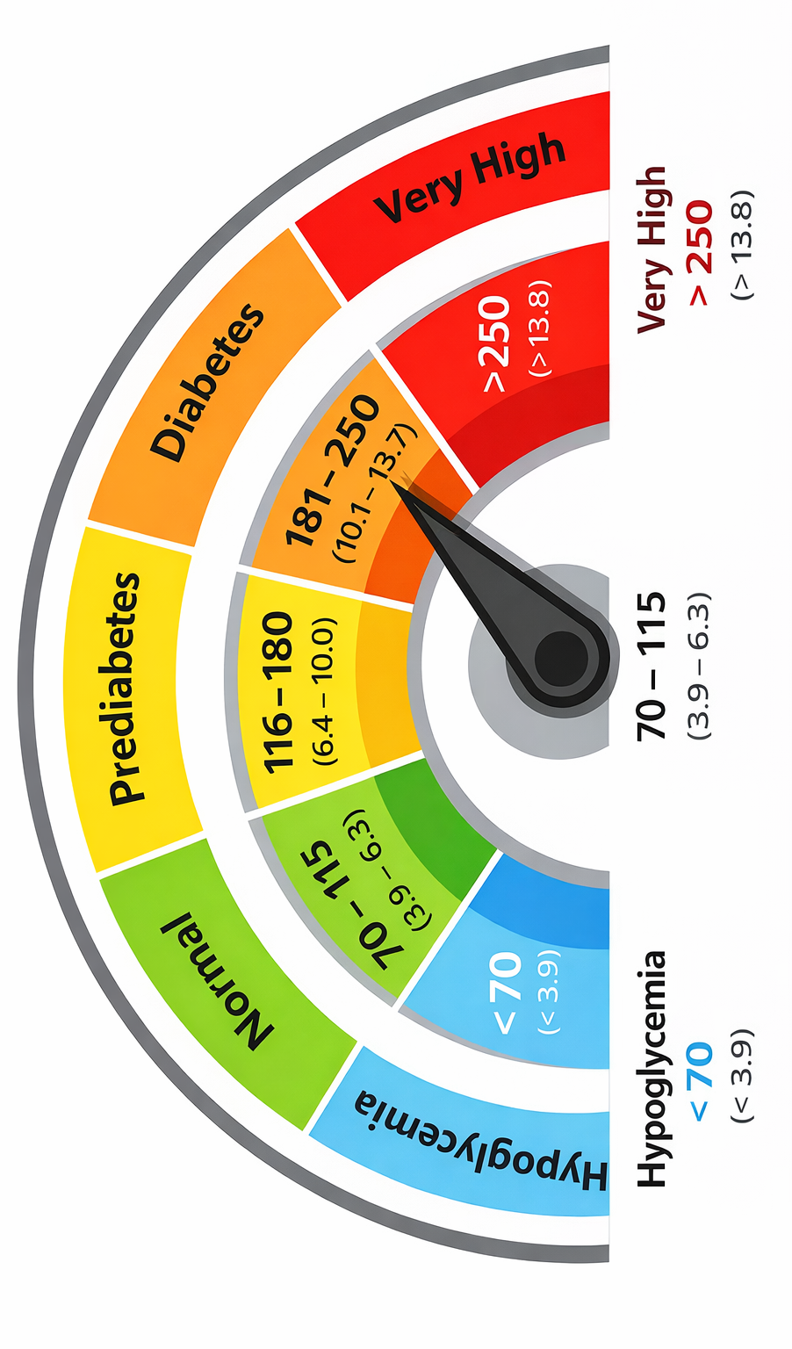
RANGES FOR BLOOD GLUCOSE LEVELS

Slide 8
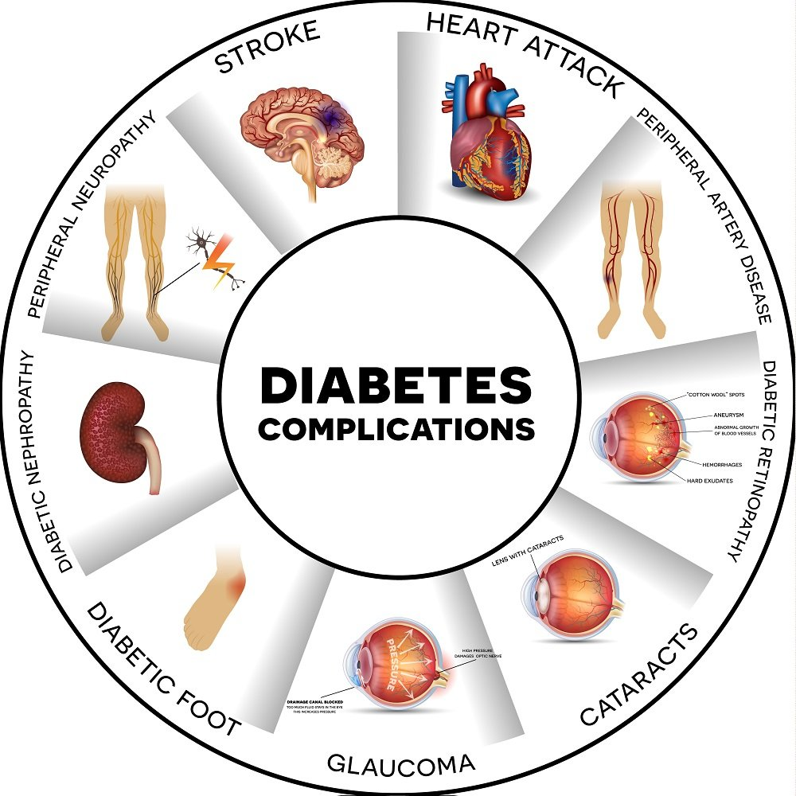
Complications of Diabetes
Microvascular Complications (Affecting Small Blood Vessels)
Diabetic Retinopathy: affects the blood vessels in the eyes, potentially leading to vision loss and blindness.
Diabetic Nephropathy: damages the kidneys' filtering system, which can result in kidney failure.
Diabetic Neuropathy: is nerve damage, often causing numbness, tingling, pain, or weakness in the hands and feet.
Macrovascular Complications (Affecting Larger Blood Vessels)
Heart Disease and Stroke:
Diabetes significantly increases the risk of heart attack and stroke due to narrowed blood vessels and poor circulation.
Poor Circulation in Legs:
This can lead to cramps when walking and, in severe cases, may require amputation of the feet.

Slide 9
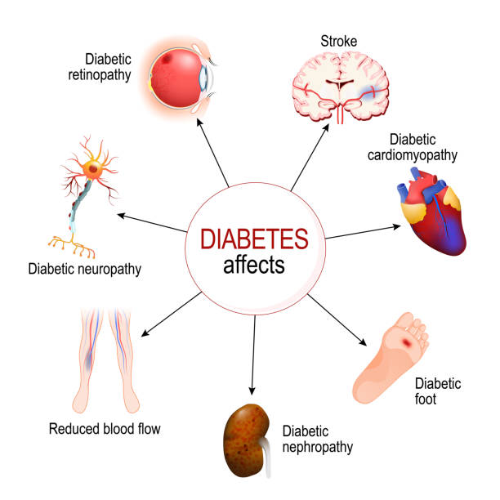
Complications of Diabetes (CONT.)
Other Complications
Skin and Oral Health Problems:
People with diabetes are more prone to infections and skin issues, as well as gum disease.
Foot Problems:
Nerve damage and poor blood flow increase the risk of non-healing sores and infections, which can lead to amputation.
Hearing Loss:
Diabetes makes hearing loss more common.
Digestive Problems:
Some individuals may develop gastroparesis, a condition that slows stomach emptying.

Slide 10
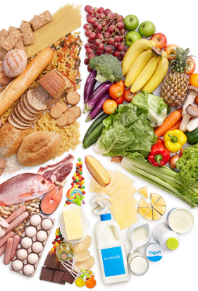
Dietary Management OF DIABETES
Why Diet Matters:
Nutrition is the cornerstone of diabetes control.
Proper diet helps:
Normalize blood glucose levels.
Manage body weight.
Improve lipid and blood pressure control.
Delay or prevent complications.
Support mental and emotional health.

Slide 11
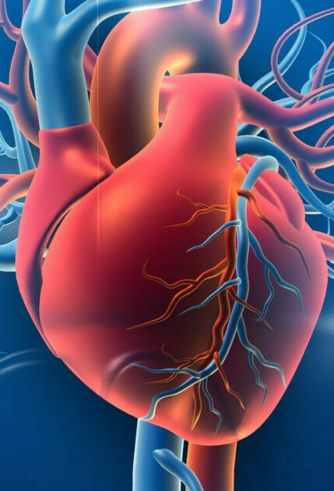
Goals of Dietary Management
Achieve and maintain optimal blood glucose levels within or close to the normal range.
Promote and sustain a healthy body weight through balanced caloric intake.
Improve lipid profile and blood pressure to lower cardiovascular risk.
Prevent or delay the onset and progression of diabetes-related complications.
Ensure adequate nutrition to meet energy and nutrient requirements.
Encourage lifestyle modification that supports long-term metabolic control.
Promote overall health, well-being, and quality of life.

Slide 12

Principles of Medical Nutrition Therapy (MNT)
DEFINITION
Medical Nutrition Therapy (MNT) is an evidence-based, individualized nutrition approach used in the management of diabetes to achieve specific clinical and health outcomes.
POINTS:
Diet plans should be tailored to personal needs, preferences, culture, age, activity level, and health status.
Adjust total caloric intake to maintain or achieve desirable body weight.
Encourage nutrient-rich foods such as whole grains, fruits, vegetables, lean proteins, and healthy fats.
Focus on carbohydrates with low glycemic index (GI) and glycemic load (GL) to reduce glucose spikes.
Maintain consistent meal timing to prevent hypoglycemia or hyperglycemia.
Promote realistic, enjoyable, and lifelong eating habits.
Integrate MNT with medication, physical activity, and self-monitoring of blood glucose.

Slide 13

nutrients Distribution
Macronutrients Distribution: Macronutrients provide the body’s main sources of energy. The goal is to ensure balanced intake while maintaining optimal glucose control.
Carbohydrates: 45-60% (Emphasize complex carbohydrates (whole grains, legumes, fruits, vegetables). Limit refined carbs and added sugars).
Protein: 15-20% (Choose lean protein sources such as fish, poultry, legumes, and low-fat dairy. Adjust for kidney function and activity level).
Fat: 20-35% (Focus on unsaturated fats (olive oil, nuts, avocado). Limit saturated fats (<10% of calories) and avoid trans fats entirely).
Fiber: 25-30g/day (Improves satiety, aids digestion, and lowers postprandial glucose levels.
Micronutrients Distribution: Micronutrients play a vital role in glucose metabolism and prevention of diabetic complications.
Chromium: Enhances insulin action and glucose tolerance. Found in whole grains, nuts, and broccoli.
Magnesium: Supports insulin secretion and glucose utilization. Sources: green leafy vegetables, nuts, and legumes.
Zinc: Aids in insulin synthesis and storage. Found in seafood, meat, and whole grains.
Vitamin D: Low levels are linked to insulin resistance; found in fatty fish, eggs, and fortified milk.
Vitamin B12: Important for nerve health, especially in patients on metformin therapy.
Antioxidants (Vitamins C & E): Protect against oxidative stress and vascular complications.

Slide 14

Special Considerations
Glycemic Index (GI) and Load (GL): Prefer low-GI foods such as legumes, oats, and whole grains to reduce post-meal glucose spikes.
Meal Frequency: 3 main meals and 1–2 healthy snacks per day help maintain steady blood glucose.
Hydration: Encourage adequate water intake; avoid sugary drinks.
Cooking Methods: Prefer boiling, grilling, or steaming over frying.
Alcohol: If taken, consume in moderation and always with food to avoid hypoglycemia.
Sodium Intake: Limit to less than 5 g (≈1 teaspoon) of salt daily to manage hypertension risk.

Slide 15
Nutrition in Special Populations
c. Elderly Individuals:
Focus on easy-to-digest, nutrient-rich foods.
Prevent malnutrition while maintaining glycemic control.
Address dental issues, reduced appetite, and limited mobility.
d. Patients with Kidney Disease:
Limit protein, sodium, and potassium depending on renal function.
Collaborate with a renal dietitian for individualized plans.
a. Children and Adolescents:
Ensure adequate calories and nutrients for growth and development.
Emphasize family-based dietary education and carbohydrate counting.
Avoid overly restrictive diets.
b. Pregnant Women (Gestational Diabetes):
Maintain balanced meals with controlled carbohydrates.
Distribute carbohydrates evenly throughout the day.
Regular blood glucose monitoring is essential.

Slide 16

Monitoring and Evaluation
Continuous monitoring ensures that dietary interventions are effective and safe.
Monitoring Parameters:
Anthropometric: Weight, BMI, waist circumference.
Biochemical: Fasting glucose, HbA1c, lipid profile, renal function.
Clinical: Blood pressure, symptoms of hypo/hyperglycemia, nutritional deficiencies.
Dietary: Food diaries, meal recall, portion control.
Behavioral: Adherence to dietary advice, physical activity, and self-monitoring of blood glucose.
Frequency:
Every 3–6 months or as clinically indicated.
Adjust the nutrition plan based on progress and lab results.

Slide 17

Role of the DIETITIAN AND Multidisciplinary Team
Role of the Dietitian:
Conduct comprehensive nutrition assessment.
Develop and implement individualized meal plans.
Provide education on food choices, label reading, and portion sizes.
Support lifestyle modification and behavioral change.
Evaluate progress and make necessary adjustments.
Multidisciplinary Team Approach:
Physician/Endocrinologist: Diagnoses and manages medical treatment.
Nurse: Reinforces dietary education, monitors glucose and weight.
Pharmacist: Reviews drug-nutrient interactions.
Physiotherapist: Designs appropriate physical activity plans.
Psychologist/Counselor: Supports behavior modification and adherence.

Slide 18
One Day sample Menu for A Diabetic Patient
BREAKFAST (7:30AM) | LUNCH (12:30PM) | DINNER (6:00PM)
300ml wrap of moi-moi with 300ml of Pap and 2dtsp filled milk | Midday snack 1pm or 2pm Cucumber (Eaten freely) Banana (2 fingers) 15dtsp of Rice with diced cabbage and carrot and 10g beef | 2 medium sized boiled plantain with bulky vegetable sauce and dried fish
Note: Meal plan is suitable for change and personalized depending on the BMI ( Body Mass Index) of the patient.

Slide 19
Key Challenges and Recommendations
Challenges:
Poor dietary adherence and limited patient education.
Socioeconomic constraints and food insecurity.
Cultural beliefs and dietary habits.
Lack of follow-up and multidisciplinary collaboration.
Inconsistent meal timing or portion sizes.
Overreliance on medications without lifestyle changes.
Recommendations:
Strengthen nutrition education and counseling at all care levels.
Encourage family and community involvement in dietary planning.
Promote affordable and locally available healthy foods.
Integrate routine nutritional monitoring into clinical follow-ups.
Train healthcare professionals on updated nutrition guidelines.
Empower patients through self-management education and goal-setting.

Slide 20
Conclusion
Dietary management is the foundation of diabetes care, complementing pharmacologic and lifestyle interventions.
An individualized, balanced, and culturally appropriate diet helps maintain glycemic control, reduce complications, and improve quality of life.
Consistent monitoring, patient education, and a coordinated multidisciplinary approach are critical for success.
Effective dietary management transforms diabetes from a life-limiting disease into a manageable condition with optimal health outcomes.

Slide 21
References
International Diabetes Federation (2024). Retrieved from: https://idf.org/our-network/regions-and-members/africa/members/nigeria/
WHO (18 November 2024). Prioritise your health by knowing your blood sugar status and living a healthy lifestyle. Retrieved from: https://www.afro.who.int/countries/nigeria/news/prioritise-your-health-knowing-your-blood-sugar-status-and-living-healthy-lifestyle
Goldney J, Barker MM, Sargeant JA, Daynes E, Papamargaritis D, Shabnam S, Goff LM, Khunti K, Henson J, Davies MJ, Zaccardi F. Burden of vascular risk factors by age, sex, ethnicity and deprivation in young adults with and without newly diagnosed type 2 diabetes. Diabetes Research and Clinical Practice. 2025 Feb 1;220:112002.
Diabetes UK (Feb 6, 2019). Ethnicity and type 2 diabetes. Retrieved from https://www.diabetes.org.uk/about-diabetes/type-2-diabetes/diabetes-ethnicity
WHO (14 November 2024). Diabetes. Retrieved from https://www.who.int/news-room/fact-sheets/detail/diabetes

Slide 22

Thank you for your audience

