Slide 1
EXTRAPYRAMIDAL PATHWAYS IN RELATION TO PSYCHIATRY
DR JOAN .O. UKAH; MBBS ILORIN
February, 2026

Slide 2
OUTLINE
INTRODUCTION
DEFINITION
COMPONENTS
NEUROANATOMY
PHYSIOLOGY
PATHOPHYSIOLOGY
CLINICAL RELEVANCE IN PSYCHIATRY
CONCLUSION
REFERENCES

Slide 3
INTRODUCTION/DEFINITION
The extrapyramidal pathways are of great relevance in Psychiatry.
Major morbidities and even mortalities can arise as a result of pathologies or iatrogenicities affecting these extrapyramidal systems.
Specific descending motor tracts majorly involved in involuntary movements and do not pass through the medullary pyramids,but via the tegmentum

Slide 4
COMPONENTS
EFFECTORS
MODULATORS
Tectospinal tract
Vestibulospinal tract
Rectospinal tract
Rubrospinal tract
Nigrostriatal pathway
Tuberoinfundibular pathway
Mesolimbic pathway
Mesocortical pathway
Direct pathway
Indirect pathway

Slide 5
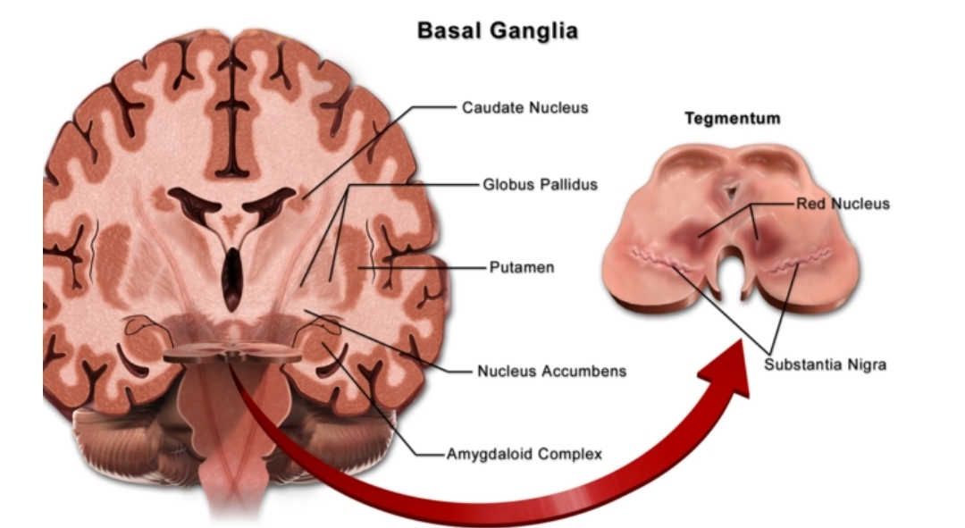
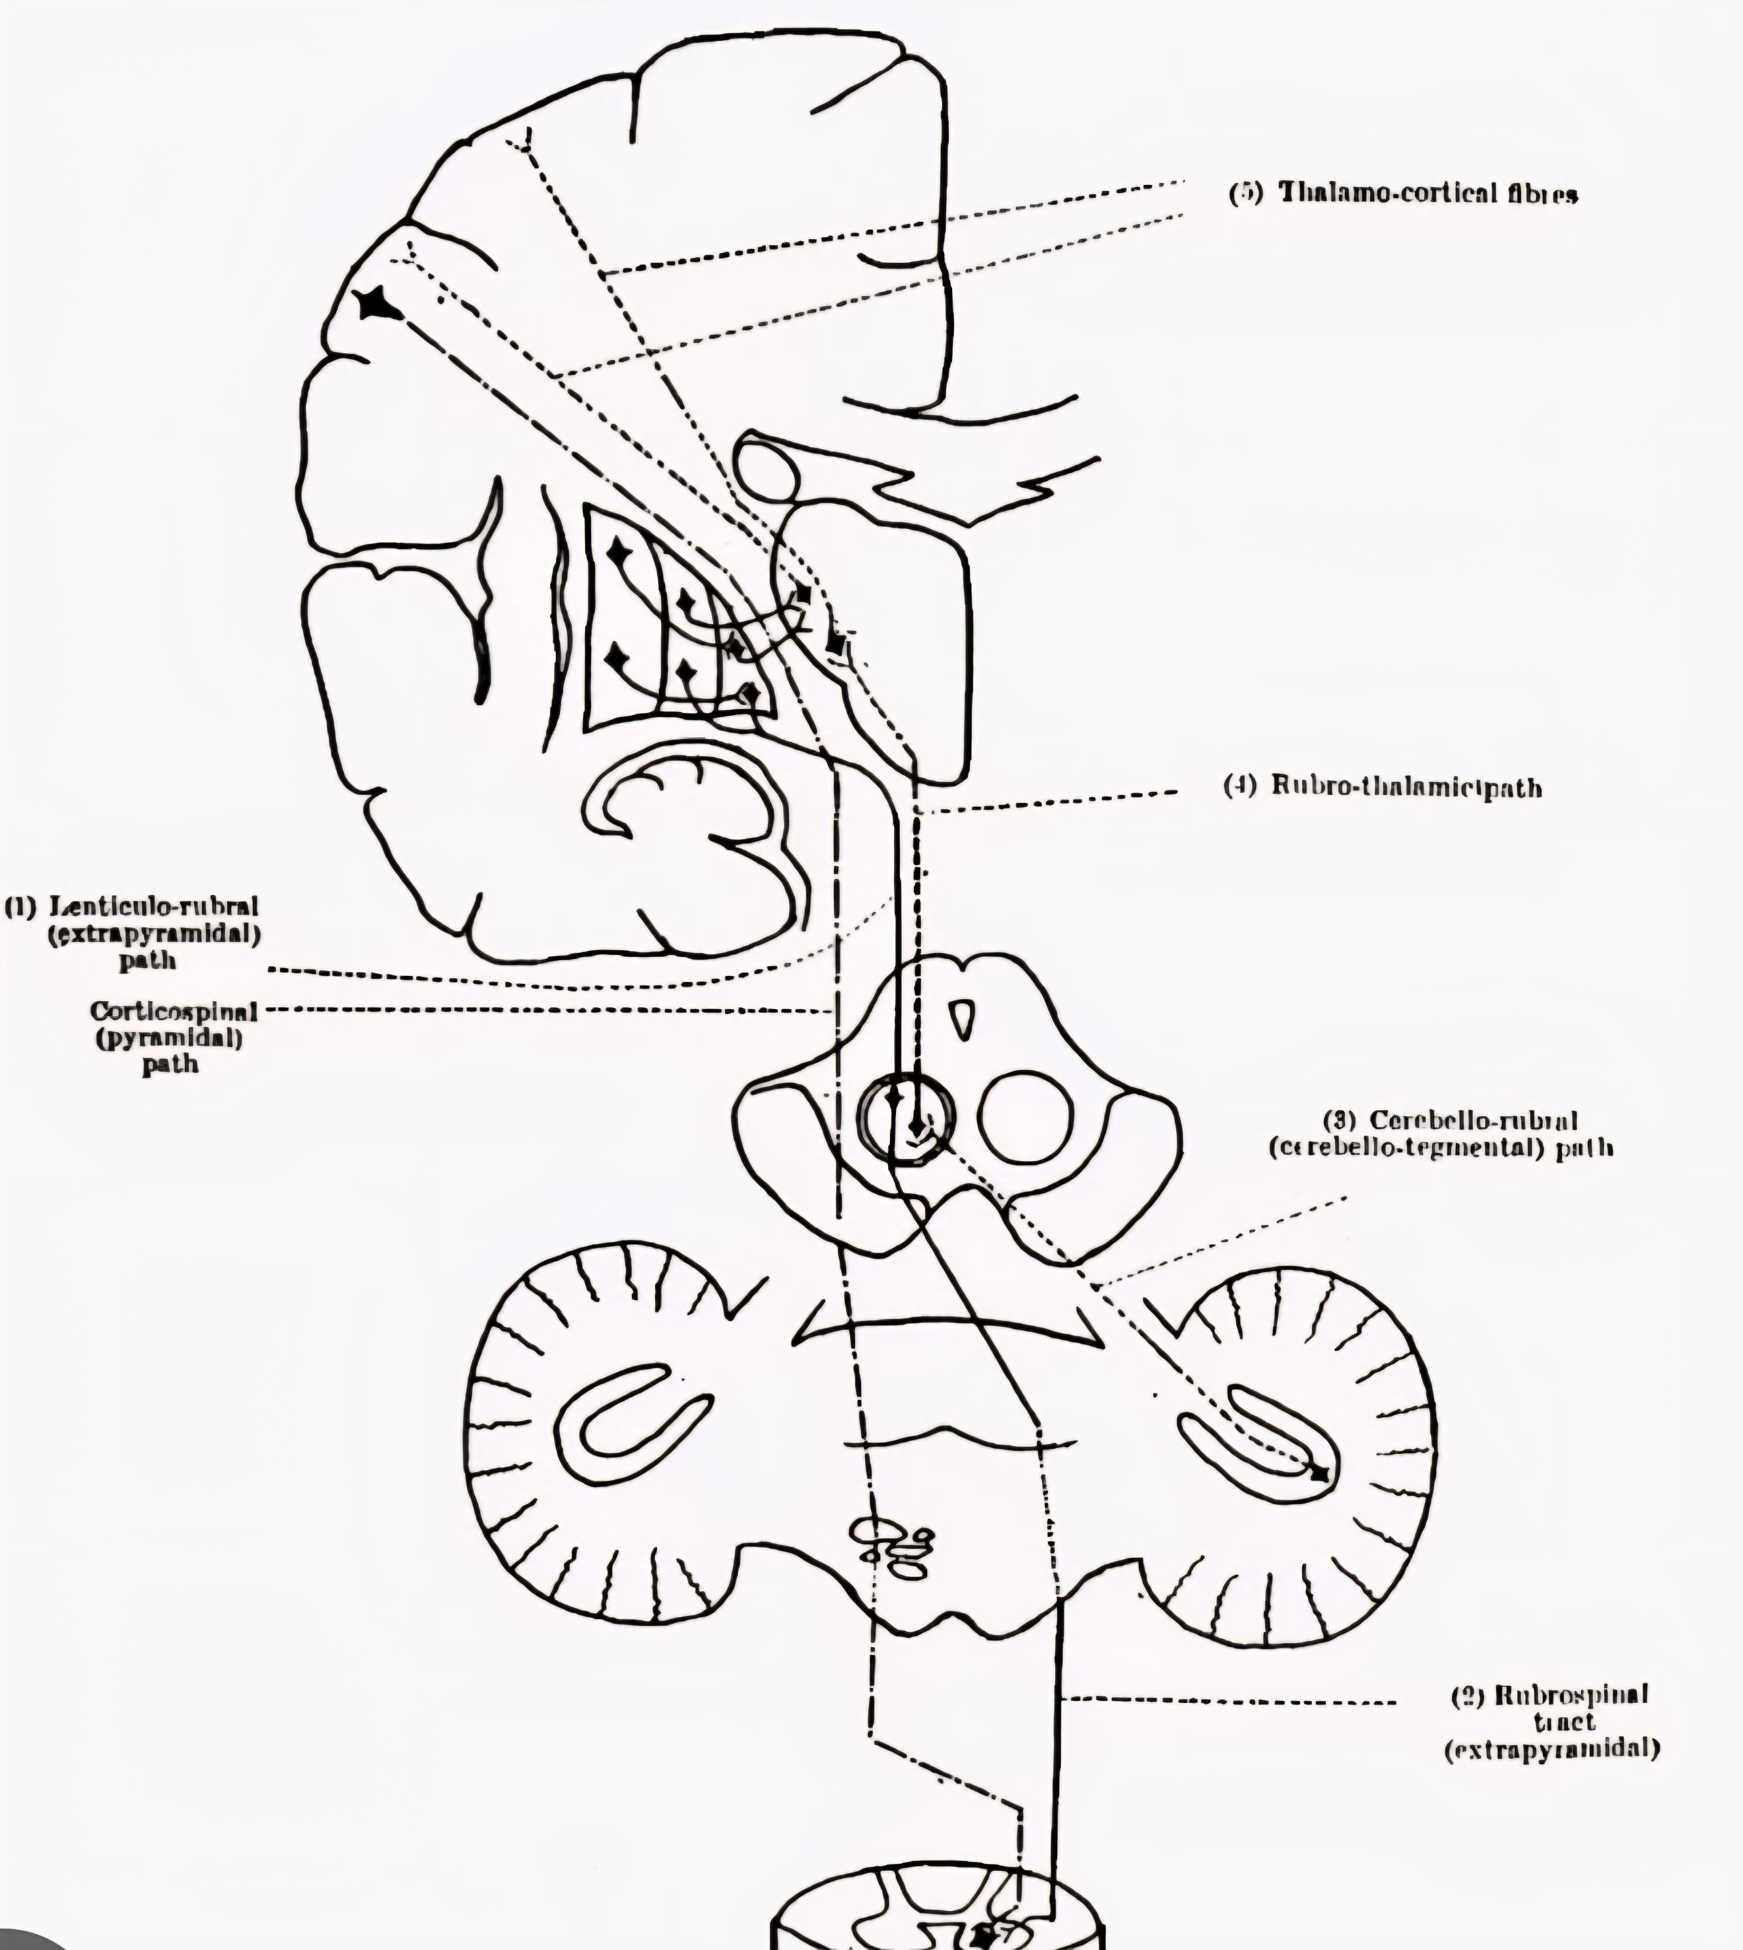
NEUROANATOMY

Slide 6
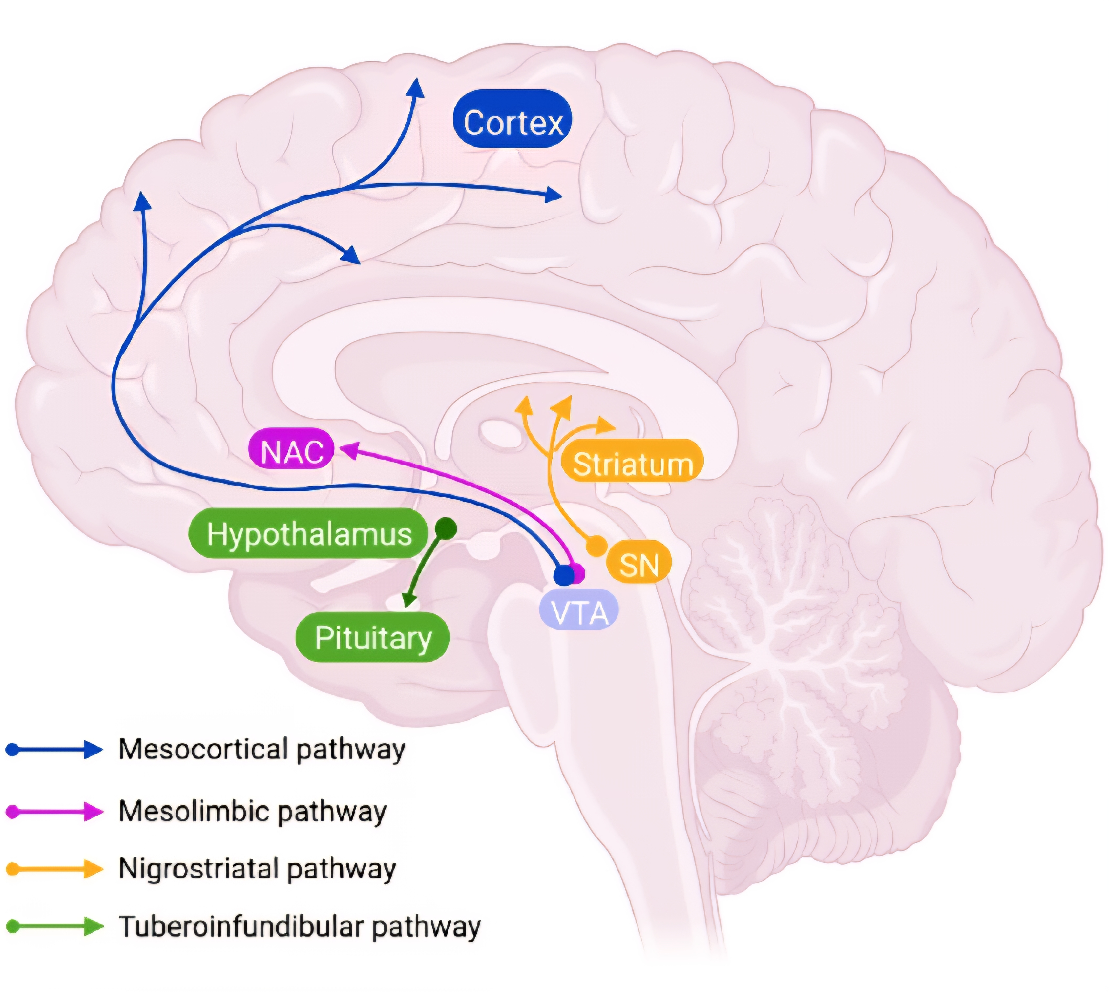
NEUROANATOMY

Slide 7
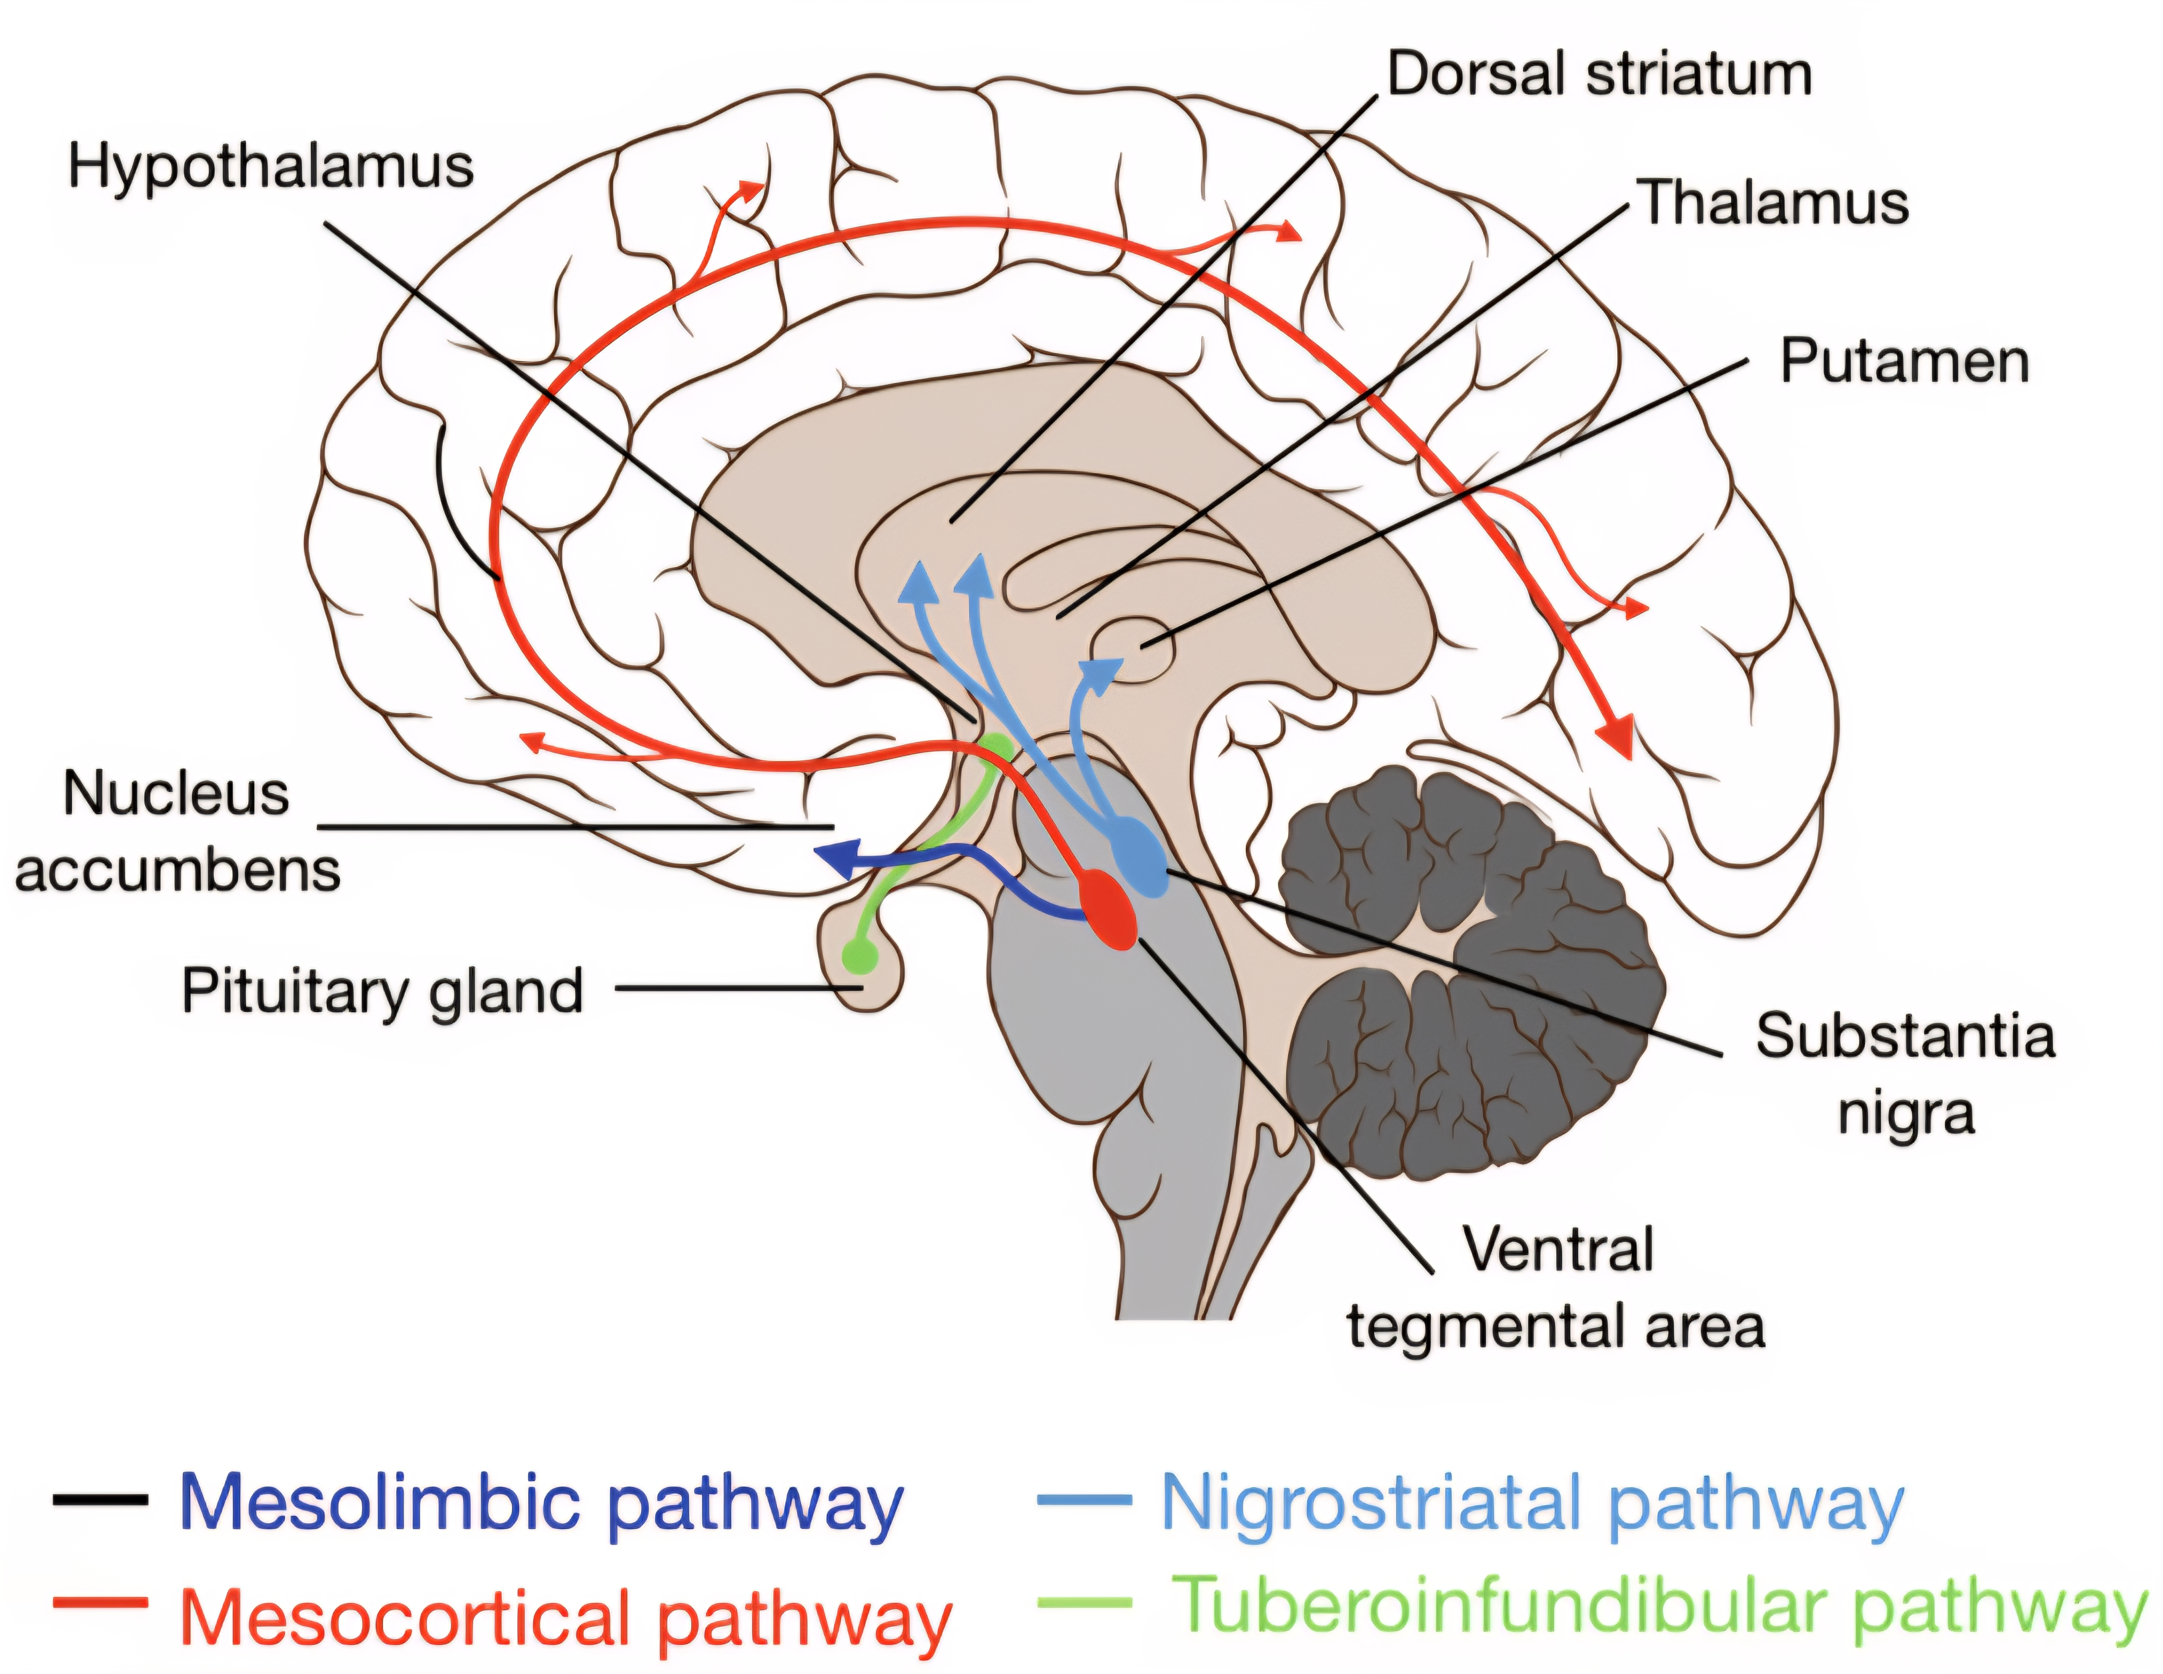
NEUROANATOMY

Slide 8
Basal Ganglia
Collection of subcortical interconnected structures
Made up of:
Caudate nucleus
Putamen
Globus pallidus
Subthalamic nucleus
Substantia nigra
Overall effect is to coordinate movement
Excitatory Glutamate (indirect pathway)
Inhibitory GABA ( direct pathway)

Slide 9
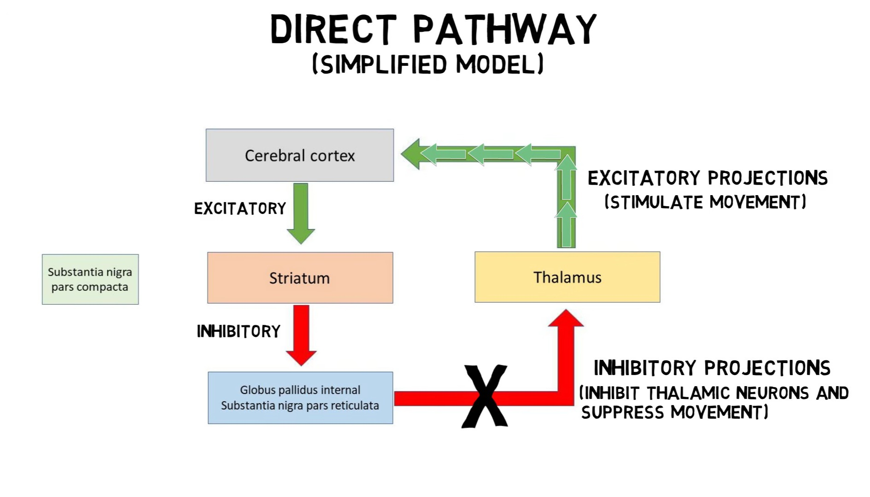
PHYSIOLOGY

Slide 10
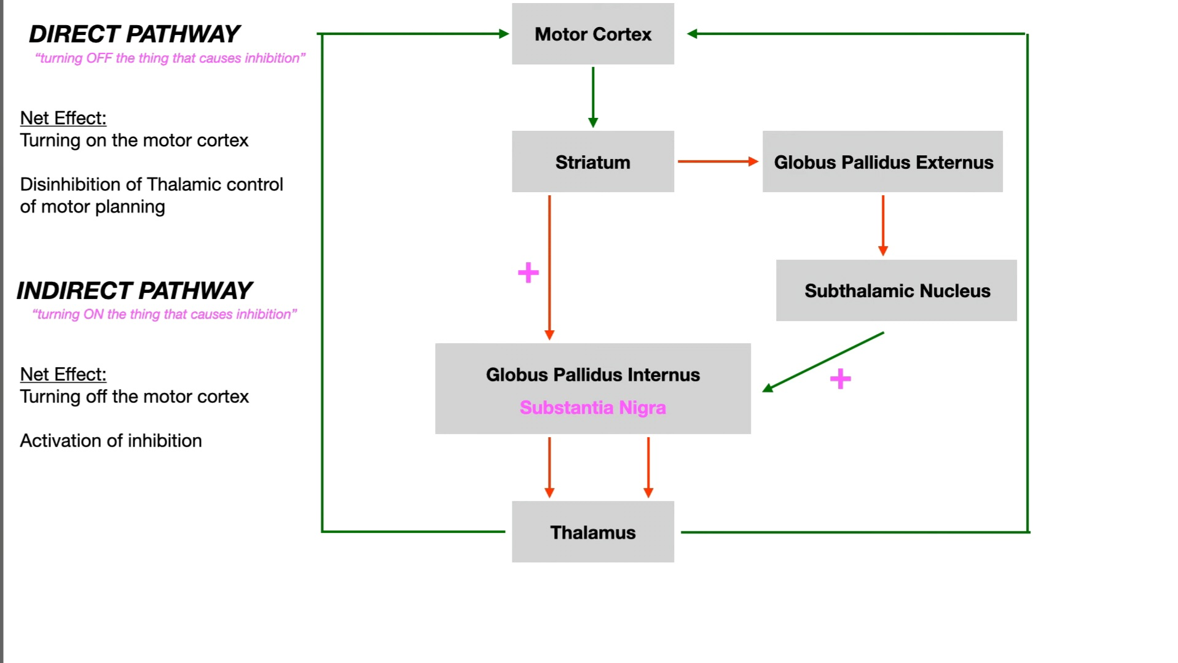
PHYSIOLOGY

Slide 11
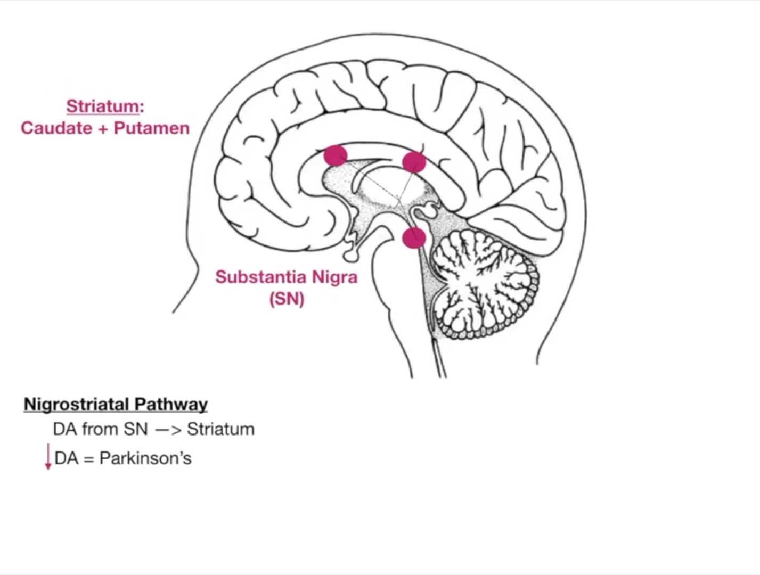
PATHOPHYSIOLOGY

Slide 12
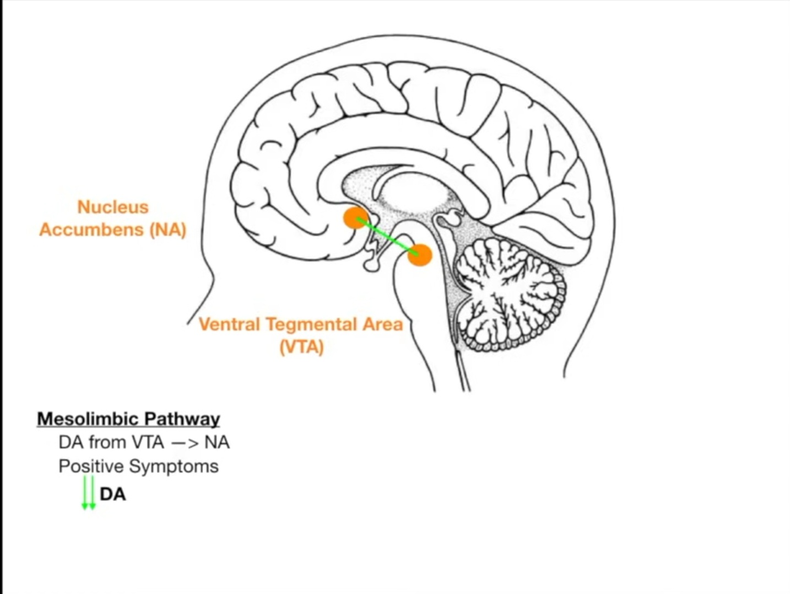
PATHOPHYSIOLOGY

Slide 13
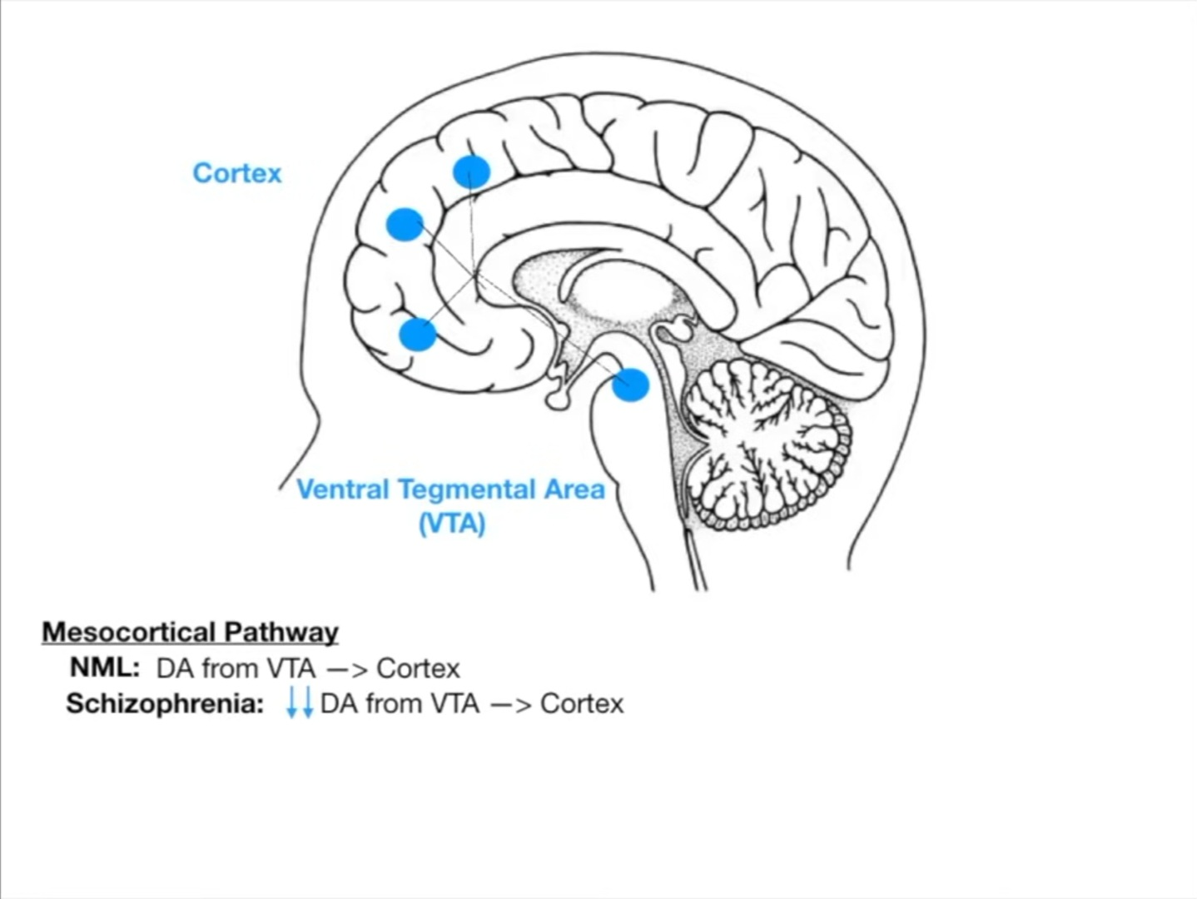
PATHOPHYSIOLOGY

Slide 14
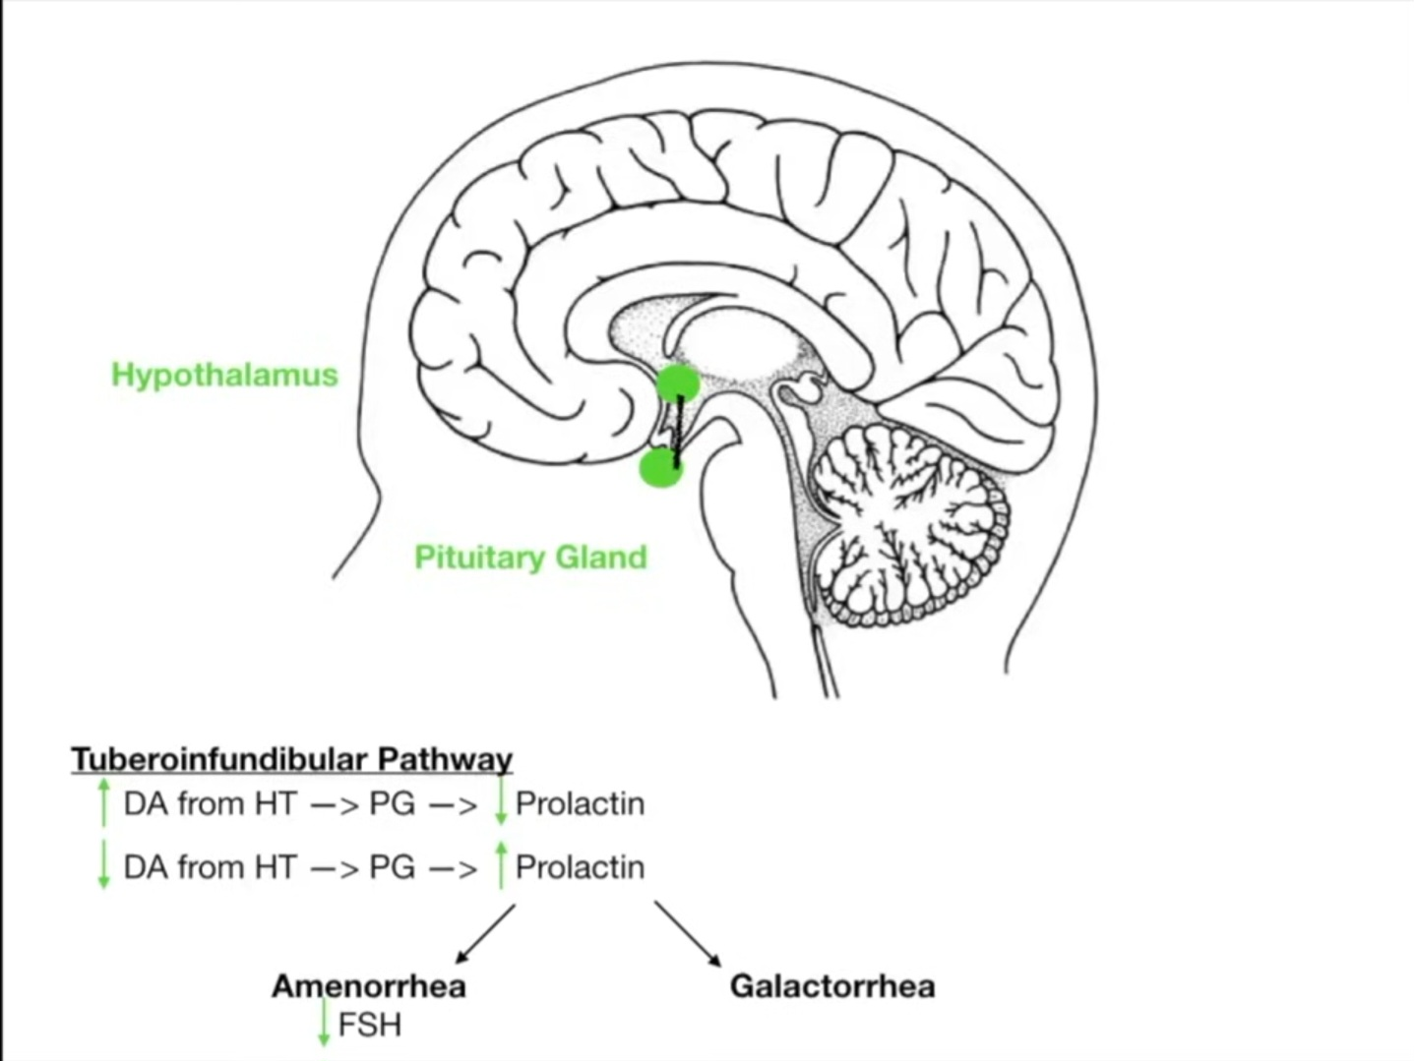
PATHOPHYSIOLOGY

Slide 15
CLINICAL RELEVANCE IN PSYCHIATRY
Antipsychotics and Antidepressants
Extrapyramidal Symptoms (EPS):
Acute dystonia
Akathisia
Parkinsonism
Tardive dyskinesia
Neuroleptic Malignant Syndrome (NMS)

Slide 16
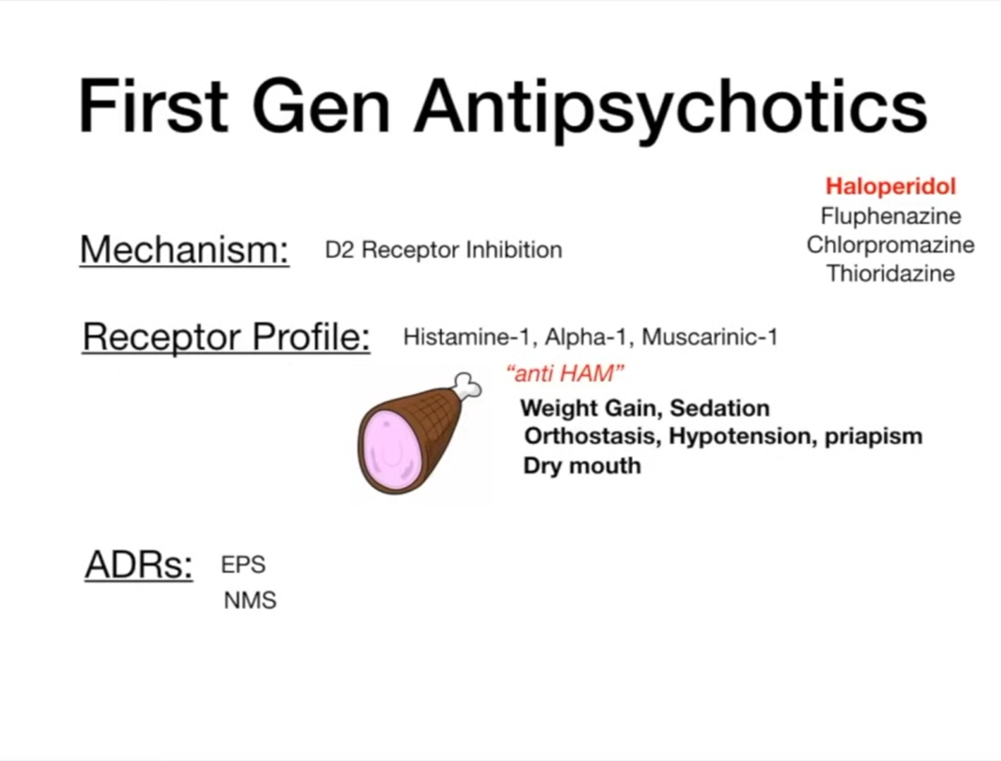
CLINICAL RELEVANCE IN PSYCHIATRY

Slide 17
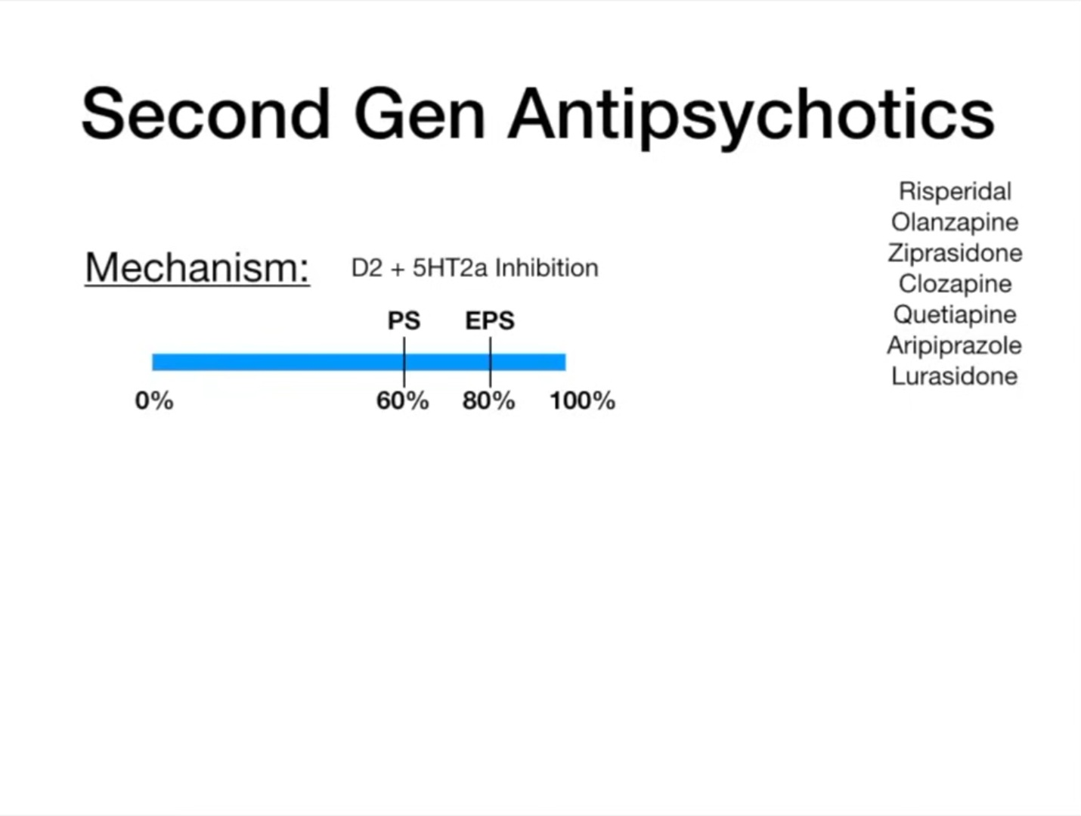
CLINICAL RELEVANCE IN PSYCHIATRY

Slide 18
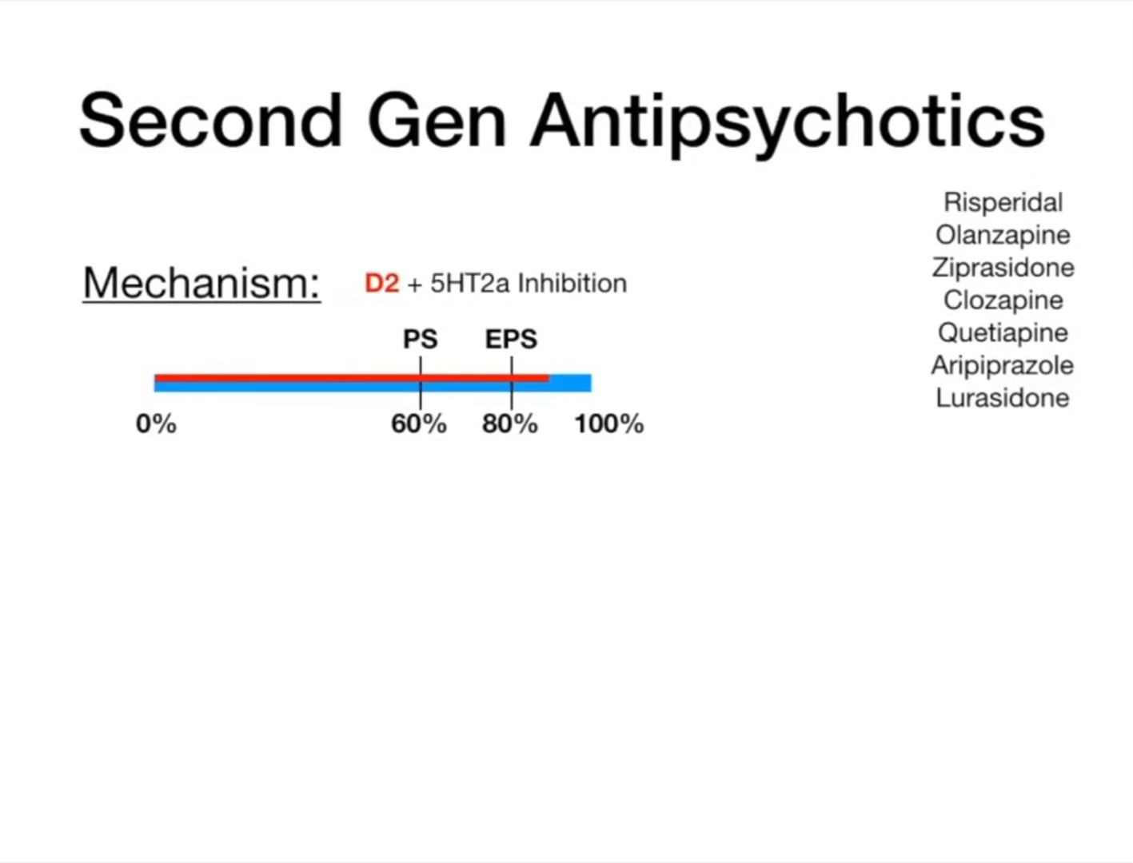
CLINICAL RELEVANCE IN PSYCHIATRY

Slide 19
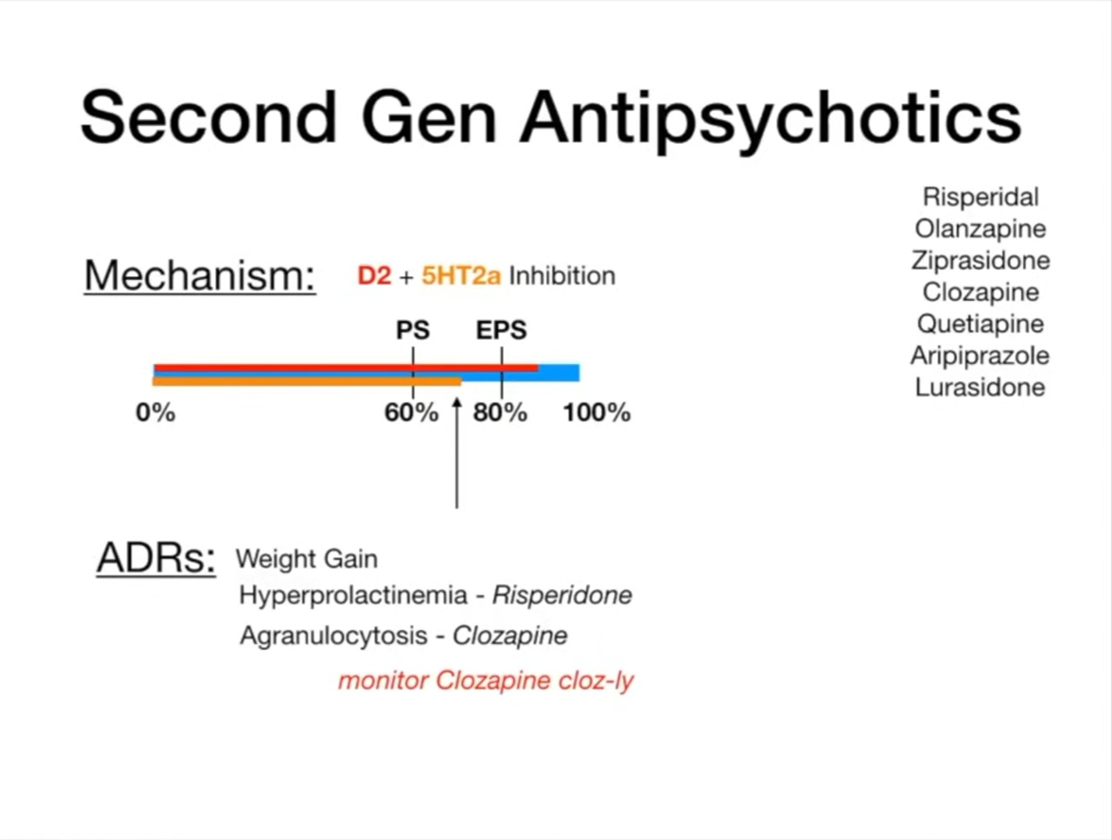
CLINICAL RELEVANCE IN PSYCHIATRY

Slide 20
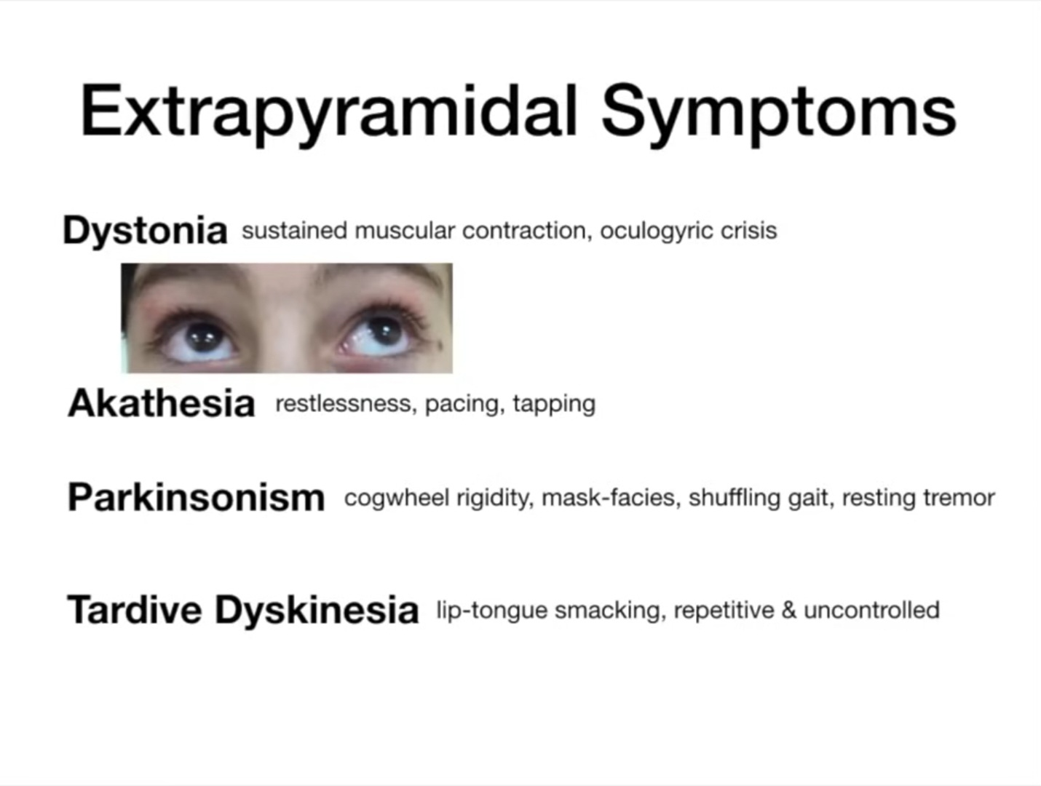
CLINICAL RELEVANCE IN PSYCHIATRY

Slide 21
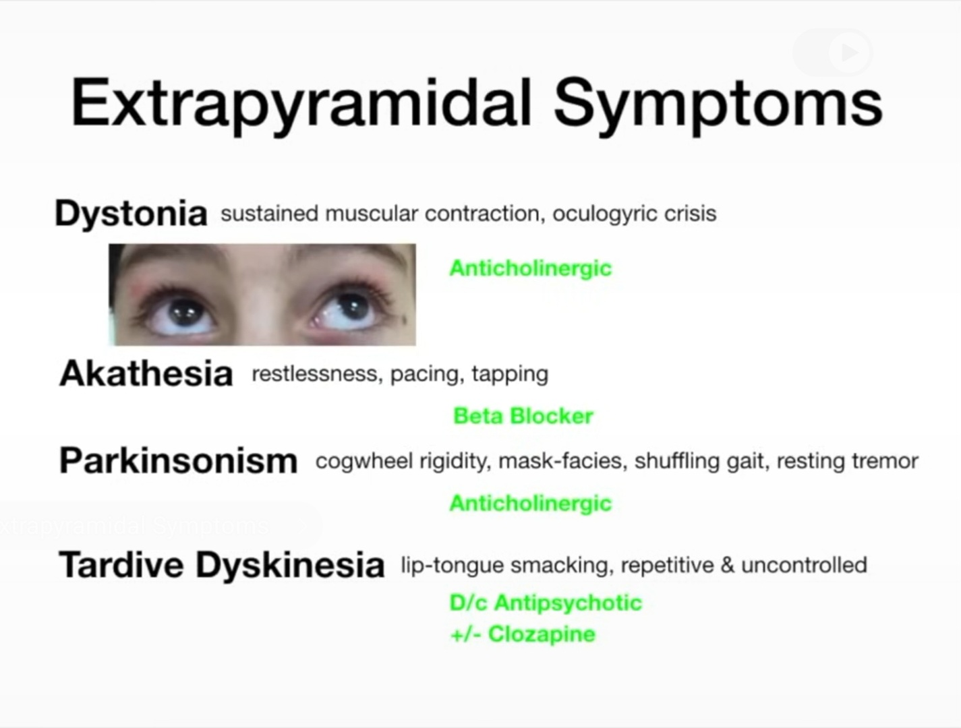
CLINICAL RELEVANCE IN PSYCHIATRY

Slide 22
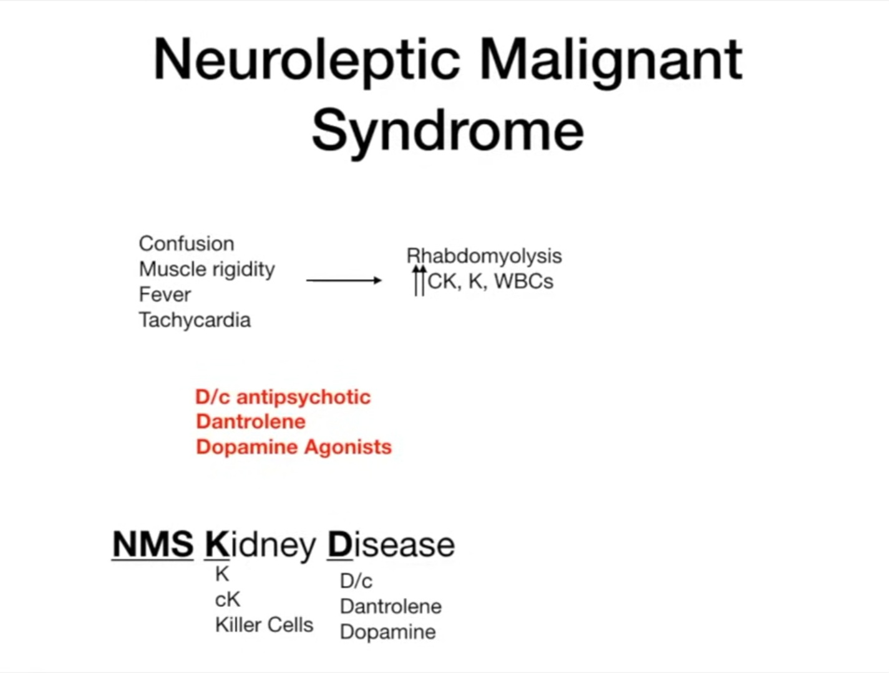
CLINICAL RELEVANCE IN PSYCHIATRY

Slide 23
CONCLUSION
A thorough understanding of the extrapyramidal pathways is important in good Psychiatric practice.
This would allow for symptom correlation to a Psychiatry disorder, appropriate management and treatment monitoring.

Slide 24
REFERENCES
Klein et al, 2019
Chapter 1, Molecular Imaging of the Human Emotion Circuit, National Library of Medicine, 2023
Dopamine Pathways, Antipsychotics and EPS, @dirtymedicine, 2020
Basal Ganglia, Direct vs. Indirect Pathways dirtymedicine, 2021
2-minute Neuroscience: Direct Pathway of the Basal Ganglia @neurochallenged, 2020

Slide 25
THANK YOU FOR YOUR ATTENTION DEAR MEDICAL ELDERS AND COLLEAGUES
Questions, corrections and comments please

