Slide 1

ERGONOMICS IN THE HEALTHCARE SETTING:
PROTECTING THE CAREGIVER’S PHYSICAL HEALTH
BY
OSADOLOR B. OSAHENI (PT)
PHYSIOTHERAPY UNIT
F.N.P.H BENIN CITY

Slide 2
OUTLINE
  INTRODUCTION
  RISK FACTORS OF WMSDs IN HEALTHCARE
  IMPACT OF POOR ERGONOMICS AND WMSDs
  IMPORTANCE OF GOOD ERGONOMICS
  ERGONOMIC SOLUTIONS AND INTERVENTION
  SETTING UP AN ERGONOMIC WORKPLACE
  BARRIERS AND CHALLENGES
  ACTION POINTS
  CONCLUSION
  REFERENCES

Slide 3
OBJECTIVES
To understand the concept of Ergonomics.
To know the importance of good Ergonomics in healthcare setting.
To know Ergonomic solutions and interventions to adopt.

Slide 4
INTRODUCTION
Ergonomics is the scientific discipline focused on understanding the interactions between humans and other elements of a system, and applying this knowledge to design workplaces, products, and systems that optimize human well-being and overall system performance (International Ergonomics Association).
It is about fitting the job to the person, not forcing the person to adapt to poorly designed work conditions, which leads to healthier, safer, and more efficient workplaces

Slide 5
INTRODUCTION
Ergonomics is the study of people in their workplace and is the process in which workplaces, products and systems are designed or rearranged so that they fit the people who use them.
It aims to improve workspaces/environments to reduce the risk of injury.
It create safe, comfortable and productive workspaces by bringing human abilities and limitations into the design of a workspace, which includes the individual’s body size, strength, skill, height and sensory abilities.

Slide 6
INTRODUCTION
Ergonomics in the healthcare setting is critical for protecting workers from injuries, enhancing their well-being, and simultaneously improving patient care quality.
Work-related musculoskeletal disorders (WMSDs) are highly prevalent among health care workers and represent a significant occupational health issue (Godsday et al., 2023).
These disorders affect muscles, tendons, nerves, ligaments, joints, or spinal discs and are caused or aggravated by work activities

Slide 7
INTRODUCTION
The prevalence of WMSDs among healthcare professionals is notably high, with some studies reporting rates between 60% and 98% among health workers (Basil Kum Meh et al., 2023).
The most commonly affected body regions include the lower back, neck, shoulders, upper back, knees, and wrists/hands.
Nurses, dentists, med lab scientists and physiotherapists have the highest prevalence of WMSDs

Slide 8
RISK FACTORS OF WMSDs IN HEALTHCARE
Repetitive tasks
Working in awkward or cramped postures and maintaining the same position for long periods (Prolonged sitting or standing).
Heavy workload and working overtime increase risk due to physical and mental fatigue.
Manual patient handling (e.g lifting, transferring, or repositioning patients).
Insufficient training on injury prevention

Slide 9
IMPACT OF POOR ERGONOMICS & WMSD
Absenteeism
Reduced productivity
Burnout and Turnover
Increased healthcare costs.

Slide 10
IMPORTANCES OF GOOD ERGONOMICS
Reduced Risk of Injury
Increased Productivity
Improved Posture and Spine Health
Decreased Fatigue
Enhanced Workplace Safety
Reduced Healthcare Cost
Improved employee engagement and job satisfaction
Improved quality of patient care

Slide 11
ERGONOMIC SOLUTIONS AND INTERVENTION
Setup a good workstation and layout
Minimize manual lifting and use mechanical lifts/transfer devices
Adopt proper body mechanics and posture
Provide Ergonomic training for staff
Rotate tasks and schedule rest breaks
Promote wellness practices such as stretching, movement breaks etc
Use of ergonomic equipments and accessories: back cushion, laptop stands etc.

Slide 12
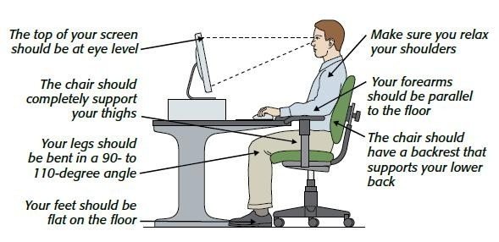
ERGONOMIC SOLUTIONS AND INTERVENTION
PROPER WORKSTATION AND SITTING POSTURE

Slide 13
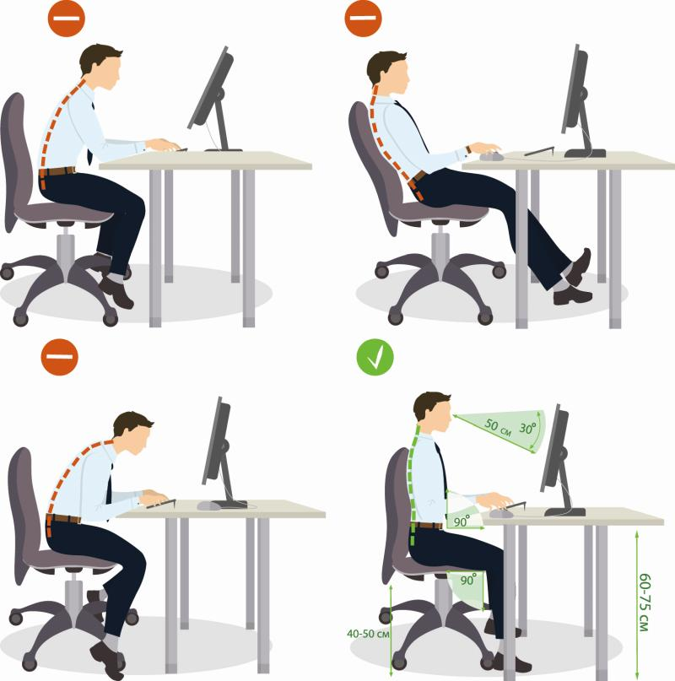
GOOD AND BAD SITTING POSTURES

Slide 14
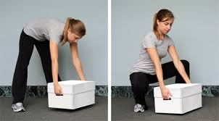
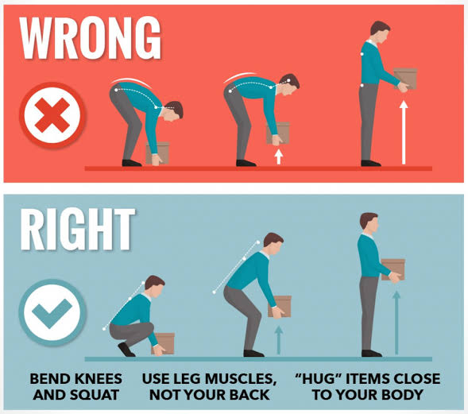
LIFTING TECHNIQUE

Slide 15
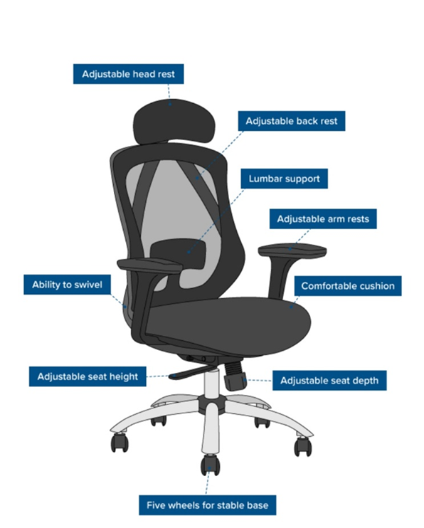
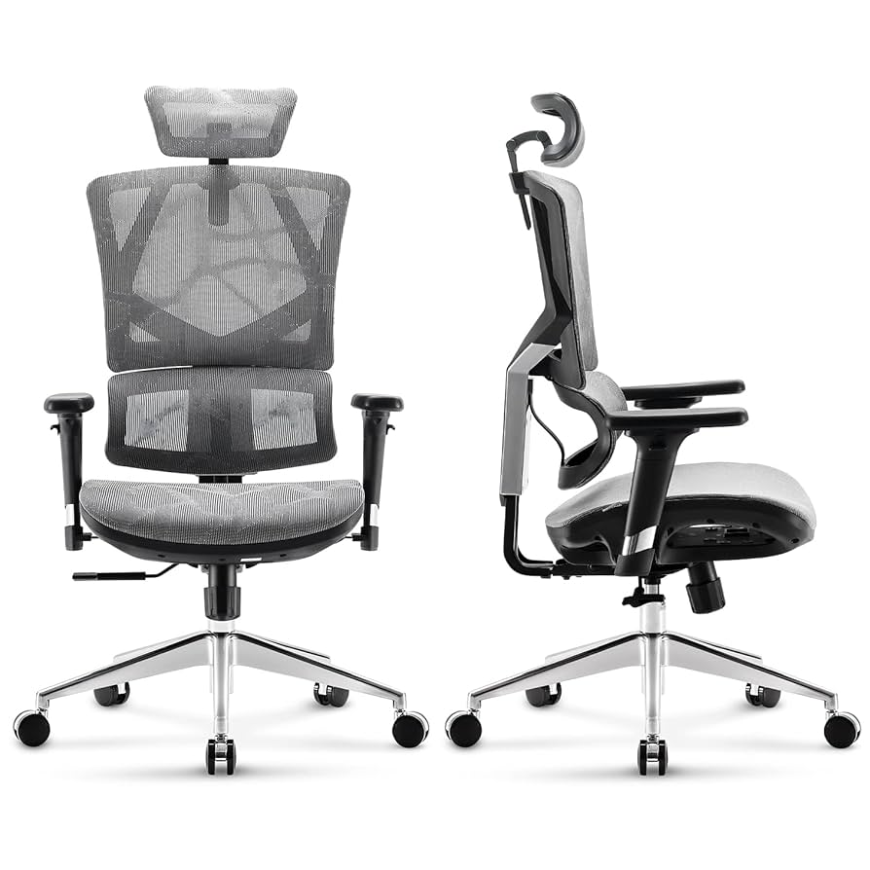
ERGONOMICS FURNITURES

Slide 16
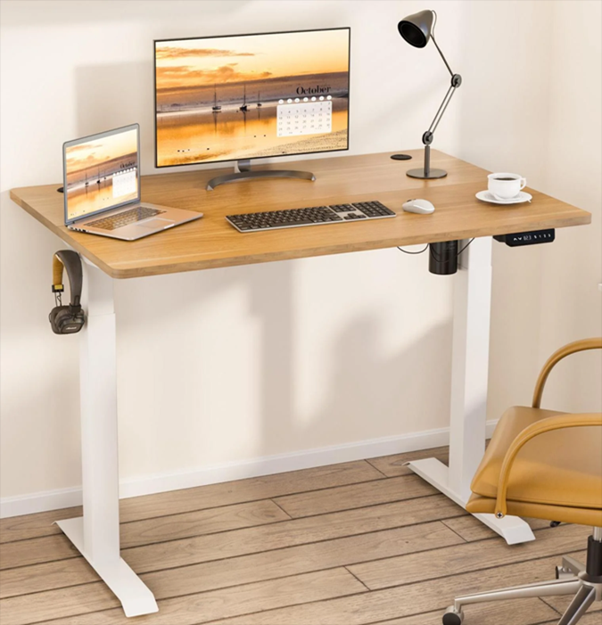
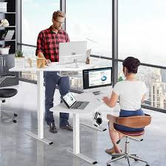
ERGONOMICS FURNITURES
WORK DESK

Slide 17
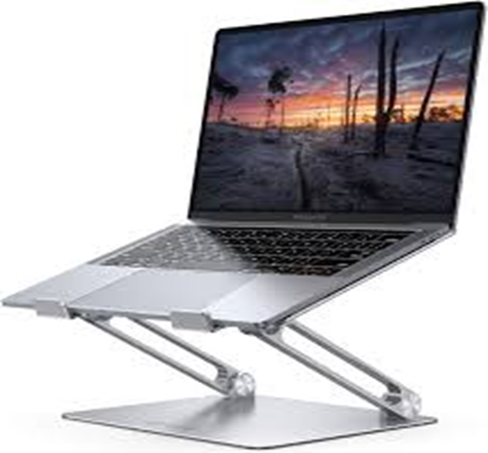
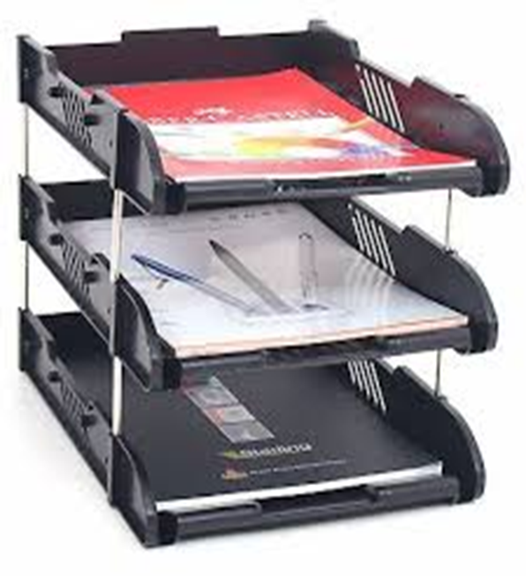
ERGONOMIC ACCESSORIES
Laptop holder, document holder and lumbar support pillow

Slide 18
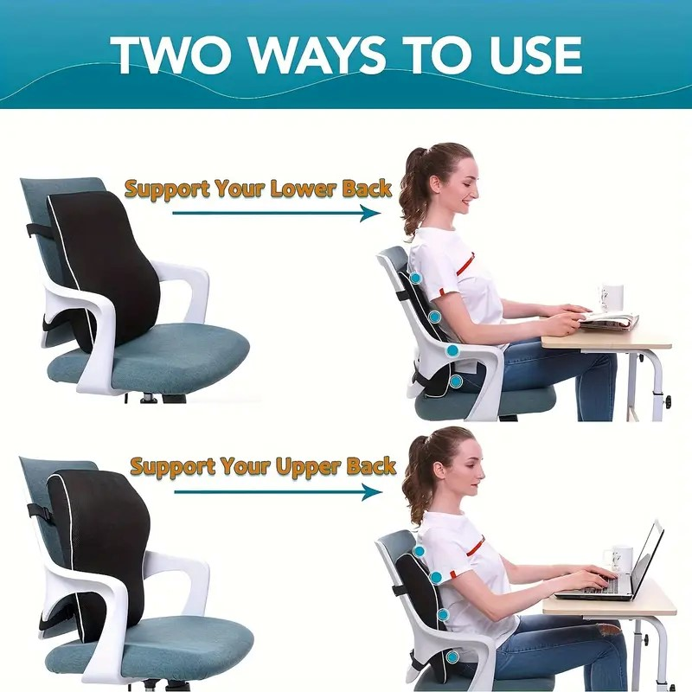
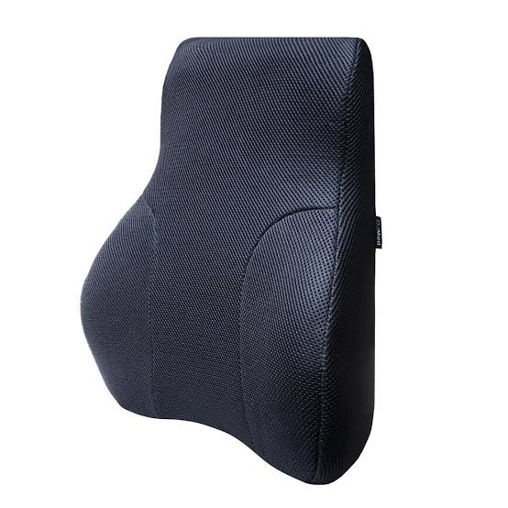
ERGONOMIC ACCESSORIES
Ergonomic back support

Slide 19
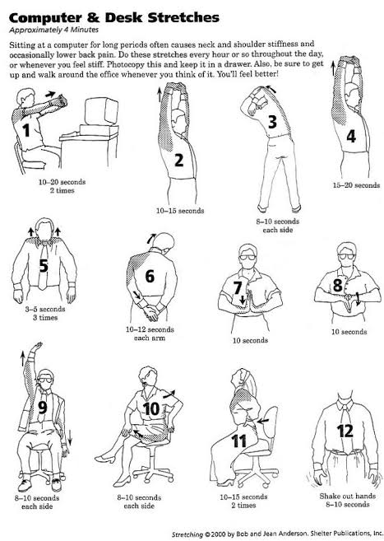
DESK STRECHES

Slide 20
SETTING UP AN ERGONOMIC WORKPLACE ENVIRONMENT
Needs analysis
Design
Development
Implementation
Evaluation

Slide 21
BARRIERS AND CHALLENGES
Resistance to change.
Budget Constraints.
Lack of training or awareness.

Slide 22
ACTION POINTS
Alternate Between Sitting and Standing
Adjust work station Height
Use Proper Lighting
Engage in Physical Activity
Use a appropriate Chair

Slide 23
ACTION POINTS
Perform Desk Stretches
Position Frequently Used Items Within Reach
Maintain Proper Wrist Position
Take scheduled Breaks

Slide 24
CONCLUSION
In conclusion, workplace ergonomics in healthcare is a critical factor in ensuring the safety, efficiency, and well-being of both healthcare professionals and patients. By designing tasks, equipment, and environments to fit the needs of healthcare workers, organizations can significantly reduce the risk of WMSDs, enhance productivity, and improve job satisfaction.
Management should invest in ergonomic interventions as it not only promote a healthier workforce but also contributes to better patient outcomes and overall healthcare quality.
As the demand on healthcare systems continue to grow, prioritizing ergonomics is essential for building a sustainable and resilient healthcare environment.

Slide 25
REFERENCES
Aullianingrum, P and Hendra (2022) ‘Risk Factors of Musculoskeletal Disorders in Office Workers‘, The Indonesian Journal of Occupational Safety and Health, 11(Special Issue), pp. 68-77
Basil K. M., Sylvan O., Jerson M. N., Franklin C. B., Elysee C., Clarisse N. A. A., Assomo B., Emmanuel H. S., Bienvenu B. and Samuel H. M. (2023). Epidemiological patterns of Work-Related Musculoskeletal Disorders among Healthcare Workers in Five Reference Hospitals in the city of Douala, Cameroon. Open Journal of Preventive Medicine. 13(5), 109-128
Dul J., Beuder R., Buckle P., CarayonP., Falzon P., Marras W. S., Wilson J. R. and Van der Doelen B. (2012) A Strategy for human factors/ergonomics: developing the discipline and profession. Ergonomics. 1;55(4):377-95
Godsday O. U., Trust O., Ezeonu N., Ephrim C., Chinyere C., Ezunu E., Ruth K.C., Colins O. and Ogbutor E. G. (2023). Prevalence of work-related musculoskeletal disorders amongst healthcare professionals at Federal Medical Center Asaba, Delta State Nigeria. J Med-Clin Res and Rev. 7(7):1-7
Robertson M. M., Huang Y., Oneil M. J., Schleifer., 2008. Flexible workspace design and ergonomics training: Impacts on the psychosocial work environment, musculoskeletal health, and work effectiveness among knowledge workers. Appl. Ergo. 39, 482-494
Wilson J. R. (2000) Fundamentals of ergonomics in theory and practice. Applied ergonomics. 1;31(6):557-52

Slide 26
THANK YOU FOR LISTENING!

