Slide 1
BURNOUT AND MENTAL HEALTH OF HEALTH WORKERS
DR JULIUS ADEDDUNTAN; SENIOR REGISTRAR II
FEDERAL NEUROPSYCHIATRIC HOSPITAL, BENIN; 23 JULY 2025

Slide 2
OUTLINE
Introduction
Epidemiology
Features
Etiology
Consequences
Interventions
Conclusion
References

Slide 3
INTRODUCTION: Mental Health¹
Mental health is a state of mental well-being that enables people to cope with the stresses of life, realize their abilities, learn well and work well, and contribute to their community.
It is an integral component of health and well-being that underpins our individual and collective abilities to make decisions, build relationships and shape the world we live in.
Mental health is a basic human right.

Slide 4
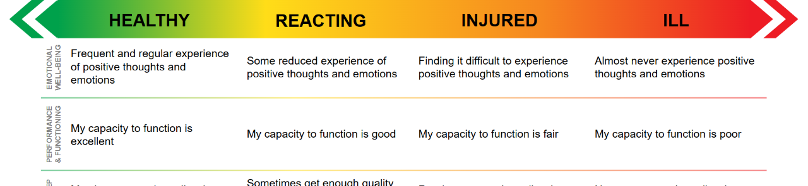
INTRODUCTION
Mental health is more than the absence of mental disorders. It exists on a complex continuum
Burnout is perhaps somewhere along this spectrum
The Mental Health Continuum

Slide 5
INTRODUCTION: Burnout^{2,3}
The term “Burnout” was first introduced by Freudenberger, a clinical psychologist who used it to describe the physical and emotional Exhaustion he observed in employees of healthcare facilities.
Burnout is a syndrome of depersonalization, exhaustion, low personal accomplishment
Results from chronic imbalance between job demands and work resources
Causes decreased effectiveness at work and impaired personal and social functioning.
Not an individual mental health diagnosis, but included in ICD-11 as factors that affect health

Slide 6
Burnout: ICD-11³
Chapter 24: Factors influencing health status or contact with health services particularly relevant to mental health services
Problems associated with employment or unemployment
QD85 “Burn-out is a syndrome conceptualized as resulting from chronic workplace stress that has not been successfully managed. It is characterized by three dimensions:
feelings of energy depletion or exhaustion;
increased mental distance from one’s job, or feelings of negativism or cynicism related to one's job; and
reduced professional efficacy.
Burn-out refers specifically to the occupational context and should not be applied to describe experiences in other areas of life.”

Slide 7
EPIDEMIOLOGY
Prevalence among health workers in the U.S.A: Nurses & Physicians 35-54%; Medical Students & Residents 45-60%; Physician Assistants 61.8%; Medical Technicians 31.9%; Administrative Staff 36.1%; as compared to 13 - 27% among the general working population.⁴
A systematic review of health worker burnout in sub-Saharan Africa also revealed high prevalence with variabilities across countries, hospitals, and in different domains/dimensions of burnout.²
A survey carried out among residents in FNPH Benin (Igbinovia, 2024) showed high scores on Emotional Exhaustion but low scores in Depersonalization and Personal achievement domains.⁵
Estimated global economic costs: >$4.6B dollars/year⁴

Slide 8
FEATURES: Christiana Maslach’s multidimensional theory⁶
A: Emotional Exhaustion (or depressive anxiety syndrome): chronic fatigue, trouble sleeping, physical problems. Unlike depression, the problems disappear outside work.
B: Depersonalization (or loss of empathy): “dehumanization” in interpersonal relations, detachment, social withdrawal, cynicism with negative attitudes to patients or colleagues, feeling of guilt.
C: Personal Achievement: Negative self-appraisal, helplessness, lack of progress, self-doubt. This aspect is a consequence of the first two
The Maslach Burnout Inventory (MBI): A high score in the first two sections and a low score in the last section may indicate burnout.

Slide 9
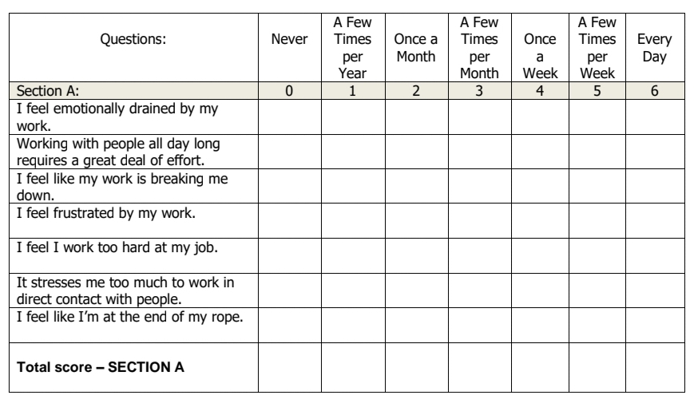
Emotional Exhaustion

Slide 10
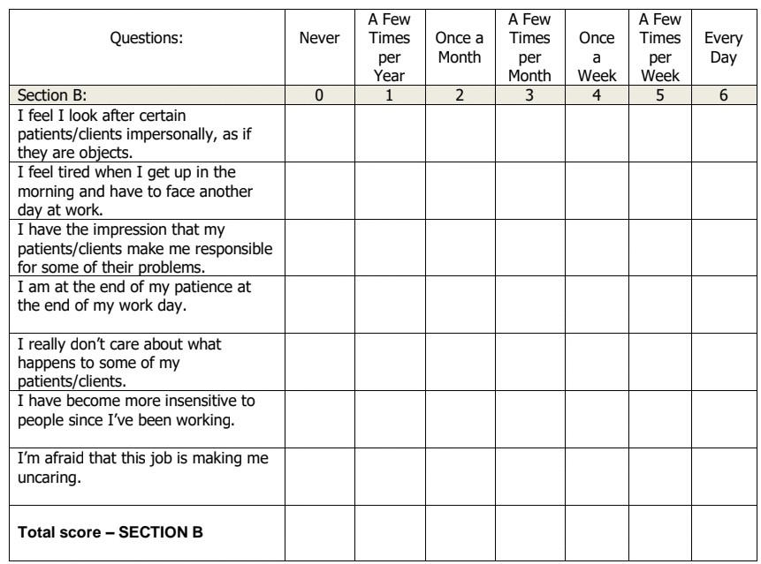
Depersonalization

Slide 11
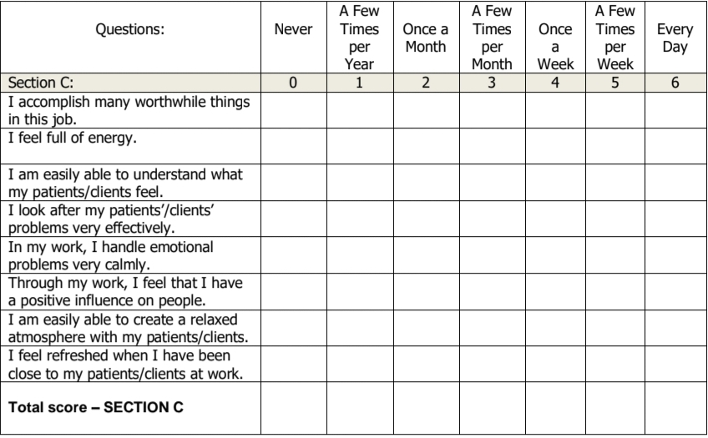
Personal Achievement

Slide 12
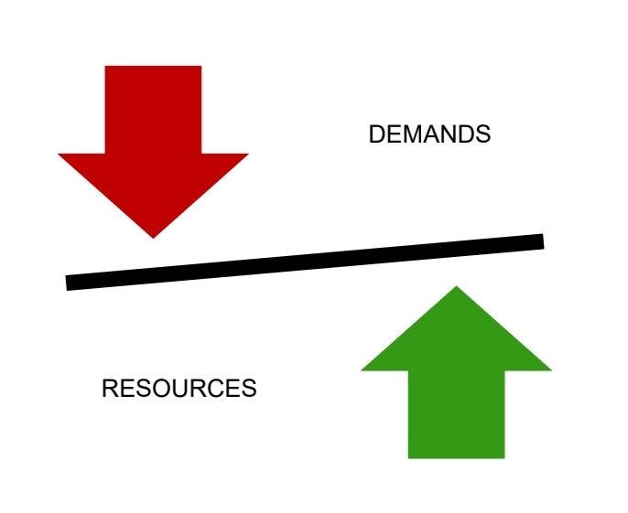
AETIOLOGY: 6 Core Drivers of Burnout at Work⁷
1. Unmanageable workload
2. Insufficient reward/recognition
3. lack of fairness/equity
4. Breakdown of community/support
5. Values disconnect/Conflict
6. Low or no autonomy
(flexibility & control)

Slide 16
CONSEQUENCIES⁸⁻¹¹
personal
WORKPLACE
Impaired Immune system: frequent illness
Mental Illnesses: depression, anxiety, manic episodes, suicidality, psychoactive substance abuse
Errors/Accidents (at work & otherwise)
Job dissatisfaction
Blunted growth in medical knowledge and professional development
Low patient satisfaction
Reduced quality of healthcare delivery/Poor clinical outcomes
Absenteeism and staff turnover
Reluctance to change/lack of flexibility
Lack of vision for the future
Conflicts

Slide 17
INTERVENTIONS: Organizational⁸
Training and Re-training
Human Resource management
Effective Communication
Infrastructures/Equipment
Design appropriate reward system
Humane policies/work culture
Holistic Strategies: Me & We Approach

Slide 18
INTERVENTIONS: Personal¹⁰
Seek peer support/consultation
Personal development
Build social support systems
Identification of personal/Organizational meaning
Reconnect to purpose—why did I choose this career?
Gratitude practices
Mindfulness/Meditation/Relaxation

Slide 19
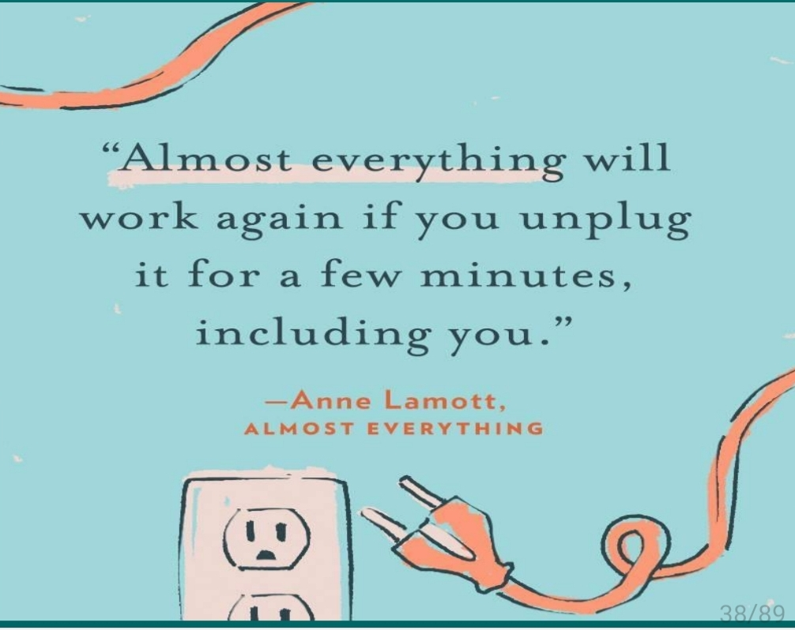
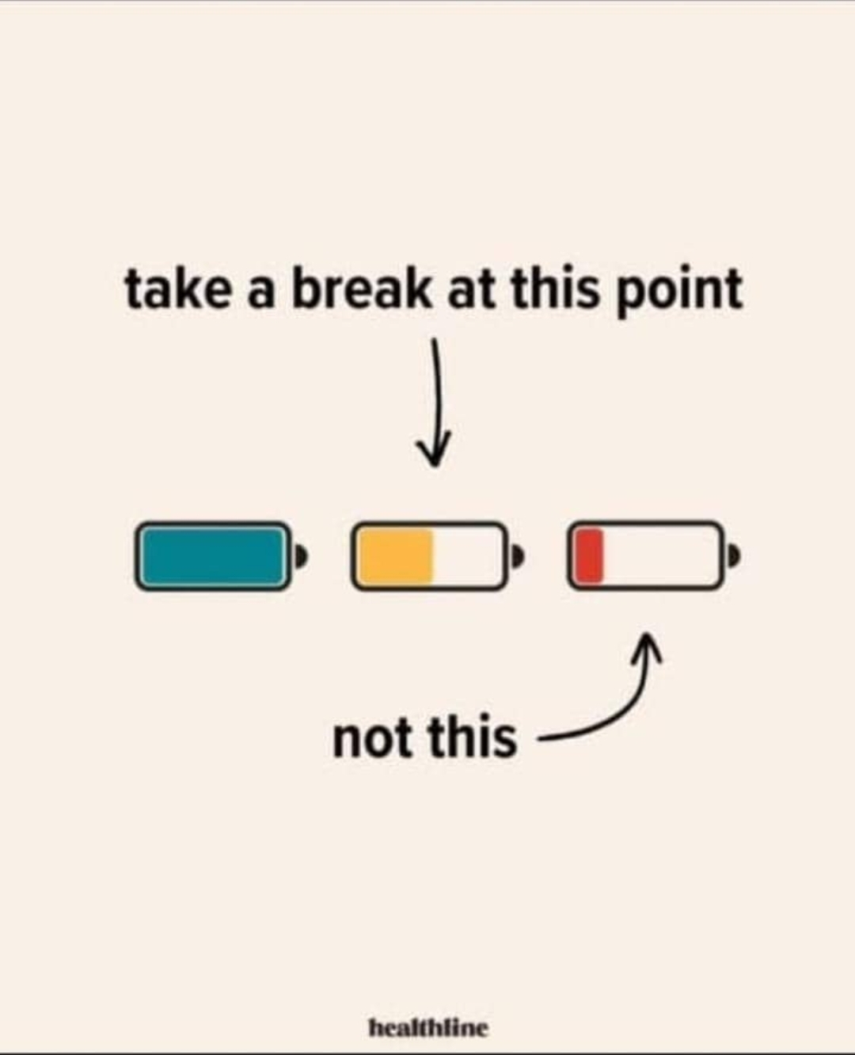
Unplug!

Slide 20
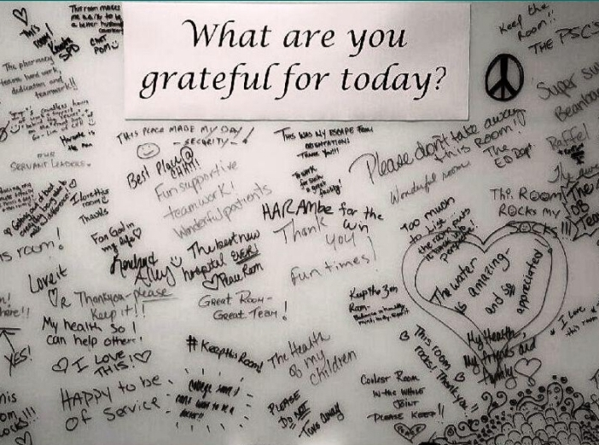
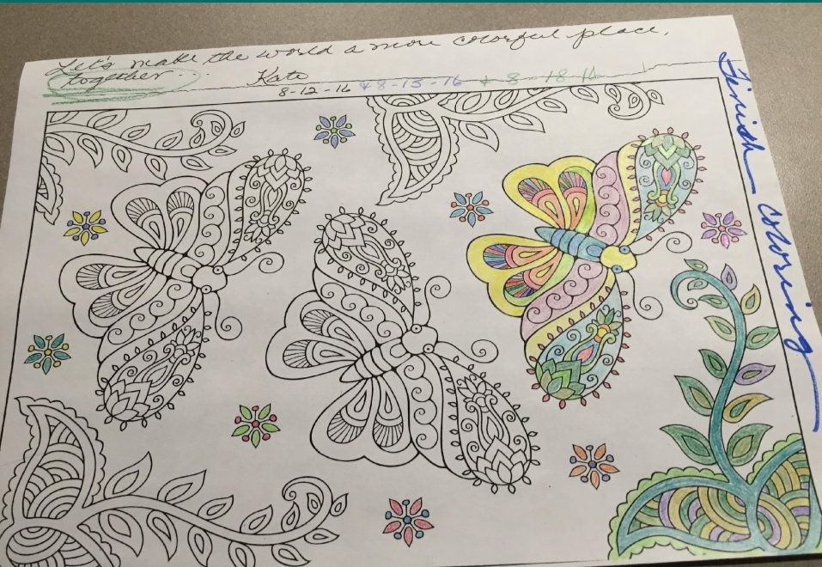
Re-energizing activities

Slide 21
CONCLUSION
Burnout is an occupational phenomenon characterized by emotional exhaustion, depersonalization and reduced personal efficacy, resulting in significant impairment in functioning, workplace ineffectiveness and economic burden to the society.
It results from chronic mismatch of work demands and available resources.
It is the individual manifestation of a workplace systems/culture problem.
Hence, a systems/holistic approach is needed to create a humane work environment while individual workers also take personal responsibilities for their wellbeing.

Slide 22
REFERENCES
World Health Organization. Mental health [online] 2022 [2025 July 23]; [1 screen]. Available from: https://www.who.int/news-room/fact-sheets/detail/mental-health-strengthening-our-response
Dubale BW., Friedman LE, Chemali Z. et al. Systematic review of burnout among healthcare providers in sub-Saharan Africa. BMC Public Health 2019; 19:1247.
World Health Organization. Clinical descriptions and diagnostic requirements for ICD-11 mental, behavioural and neurodevelopmental disorders. 2024.
Davis P. Beating Burnout at Work: Strategies for You & Your Team. Davis Laack Stress & Resilience Institute, LLC. 2022.
Igbinovia IS. An audit on risk of burnout among residents in a federal neuropsychiatric hospital in South-South Nigeria. Federal Neuropsychiatric hospital Benin 2024.

Slide 23
REFERENCES
Maslach C, Jackson SE, Leiter MP. Maslach Burnout Inventory manual (3rd ed.), Consulting Psychologists Press 1996.
Maslach C. A multidimentional theory of burnout. [Online] 2015 [2025 July 23]; [1 screen]. Available at: https://www.researchgate.net/publication/280939428
Carayon P, Cassel C, Belmont E. Taking Action Against Clinician Burnout :A Systems Approach to Professional Well-Being. National academy of medicine. 2019.
Shira Greenfield, LCPC Burn Out, Compassion Fatigue and Vicarious Traumatization: The Cost of Empathy. Shira Greenfield, LCPC
West CP. Workforce Safety and Well-being Webinar Series(Session 2): Addressing Healthcare Workforce Burnout. National action alliance for patience and workforce safety. 2024.
Ioanna V. Papathanasiou. Work-related Mental Consequences: Implications of Burnout on Mental Health Status Among Health Care Providers. ACTA INFORM MED. 2015 FEB 23(1): 22-28

