Slide 1
AUDIT OF TREATMENT OF ACUTE DYSTONIC REACTION IN THE EMERGENCY UNIT OF FNPH BENIN
BY
DR OBU O. JONATHAN
23RD JULY 2025

Slide 2
OUTLINE
INTRODUCTION
OBJECTIVE
RATIONALE
TYPES OF EPSEs
ACUTE DYSTONIC REACTION
METHODS
RESULTS
DISCUSSION
LIMITATIONS
RECOMMENDATIONS
CONCLUSION
REFERENCES

Slide 3
INTRODUCTION 1
An audit is a systematic, independent and documented process for obtaining evidence and evaluating it objectively to determine the extent to which a procedure conforms to set standards, regulations, policies, values or targets.
Audit helps to identify any of the following: areas of deficiency in procedures, practices that are below standard, and results that are unsatisfactory or inferior in comparison with desired goals or targets.
This audit is a clinical audit. Clinical audit is a quality improvement process that systematically reviews healthcare practices against established standards to identify areas for improvement in order to enhance patient care.

Slide 4
INTRODUCTION 2
Extrapyramidal side effects (EPSEs) are motor (or movement) side effects that result from the use of antipsychotic (especially typical or conventional antipsychotic) medications.
The pars compacta in the substantia nigra (located in the midbrain) contains dopamine cell bodies that send ascending projections to the dorsal striatum (especially to the caudate and putamen) and thereby modulate motor control. The extrapyramidal effects of antipsychotic drugs are thought to result from the blockade of these striatal dopamine receptors.

Slide 5
INTRODUCTION 3
Acute dystonic reaction (ADR) is one of the various types of EPSEs that can occur. It usually causes dramatic symptoms that scare both the patient and their relatives.
The internet was searched for standard or validated ADR audit tool that can be used for this audit.
Unfortunately, search for a standard audit tool for ADR yielded no positive result hence the conductor used evidence-based treatment options found in research materials like textbooks.

Slide 6
OBJECTIVE
To assess the degree to which the treatment of Acute Dystonic Reaction (ADR) among patients on antipsychotics who visit the FNPH Benin Emergency unit conforms with evidence-based treatment for ADR.
Records of patients treated for ADR in the Emergency unit from the 2nd of May 2023 to the 1st of may 2025 (a 2-year period) were reviewed.

Slide 7
RATIONALE
EPSEs affect adherence to medications. Acute dystonic reaction is usually characterized by dramatic symptoms (eg. twisting of the neck to one side). If poorly managed, it can lead to poor adherence to medications or rejection of medications out of fear that condition can lead to death or permanent disability. Poor medications adherence in turn leads to relapse and poor prognosis.

Slide 8
TYPES OF EPSEs
Acute dystonic reaction (Acute dystonia)
Parkinsonism
Akathisia
Tardive dyskinesia
Tardive dystonia
Tardive akathisia
Rabbit syndrome

Slide 9
ACUTE DYSTONIC REACTION (ADR) 1
Is charecterized by sustained, often painful contraction of muscle groups, producing repetitive, twisting movements, or abnormal postures that develop following exposure to antipsychotic medication.
Muscle groups commonly affected include sternocleidomastoid and tongue. Eye muscle involvement can lead to oculogyric crisis (involuntary deviation of both eyes (usually upwards)).
Involvement of the muscles of the head and neck leads to torticollis (twisting of the head to the left or right), trismus (lockjaw), jaw opening, forceful protrusion of the tongue, blepharospasm (involuntary twitching of the eyelids), grimacing, and opisthotonus (arching of the back and neck with the head thrown backwards).

Slide 10

opisthotonos

Slide 11
ACUTE DYSTONIC REACTION (ADR) 2
Involvement of pharyngeal and laryngeal muscles can cause serious symptoms such as dysphagia and laryngospasm. The trunk and limbs are less commonly affected.
Life-threatening ADR is characterized by airway obstruction with difficulty breathing.
Severe ADR is characterized by multiple muscle groups affected at the same time, jaw dislocation, sustained oculogyric crisis, poor response to initial treatment.

Slide 12
ACUTE DYSTONIC REACTION (ADR) 3
TREATMENT
Emergency treatment with IM anticholinergic agents (e.g. procyclidine 5mg, benzatropine 2mg, biperiden 5mg). IV administration is necessary only if dystonic reaction is life-threatening.
Continue use of anticholinergic prophylactically for 5–7 days, in addition to antipsychotic medication, and taper it off over 2–3wks to avoid cholinergic rebound characterized by nausea, sweating, urinary urgency, etc.
Reduction of dose of offending antipsychotic.
If severe, discontinue suspected agent.

Slide 13
ACUTE DYSTONIC REACTION (ADR) 4
TREATMENT CONT’D
Consider switching to antipsychotic with low propensity to cause EPSEs.
Alternative treatment includes use of amantadine (fewer side effects than other agents).
Oculogyric crisis that is unresponsive to anticholinergic drugs may benefit from treatment with clonazepam. If treatment is unsuccessful, check serum Ca2+ concentrations in order to exclude hypocalcaemia.
Routine prophylaxis should be considered for patients with a history of previous drug-induced dystonic reaction.

Slide 14
ACUTE DYSTONIC REACTION (ADR) 5
The 2 anticholinergics used in FNPH Benin to treat ADR are Biperiden and Benzhexol with Biperiden usually administered intramuscularly (IM) to abort the reaction and Benzhexol administered orally to prevent reoccurence.
Initial dose of Biperiden is 1-2mg, maximum dose is 16mg/day
Initial dose of benzhexol is 1mg, maintenance dose is 5-10mg, maximum dose is 12-15mg/day in 3-4 divided doses.

Slide 15
METHODS 1
The injections register kept by the nurses in the Emergency unit was used to make a list of files belonging to patients that have had IM Biperiden.
In the register, there were records of injections given but the file numbers were not documented. These cases were exempted from the list.
A total of 91 files were noted for retrieval. Of these, 24 were not found during the process of retrieval (91-24=67). Of the 67 that were found, no documentation was found in 25 folders to show that they had received treatment for EPSE on the date they received the IM Biperiden (67-25=42).

Slide 16
METHODS 2
Of the 42 remaining 22 were either a case of antipsychotic induced Parkinsonism or the documentation was not adequate enough to tell if it is a case of acute dystonic reaction (for example, a patient came with complaints clear enough for a diagnosis of seizure disorder but was treated with im biperiden instead of seizure medications). 42-22=20.
A case file was reviewed twice, in other words the patient had acute dystonic reaction twice making the total number of cases to be 21.

Slide 17
RESULTS
In all the cases reviewed, weight was not checked. Weight check would have aided the assessment of the dosing of the antipsychotics and the anticholinergic as to whether they are appropriate.
Of the 20 files reviewed only 2 were females (one 22 and the other 23 years old)
None of the cases was assessed to be severe or life-threatening.
In all the cases reviewed none contained documentation of the outcome after initial intervention with IM Biperiden.

Slide 18
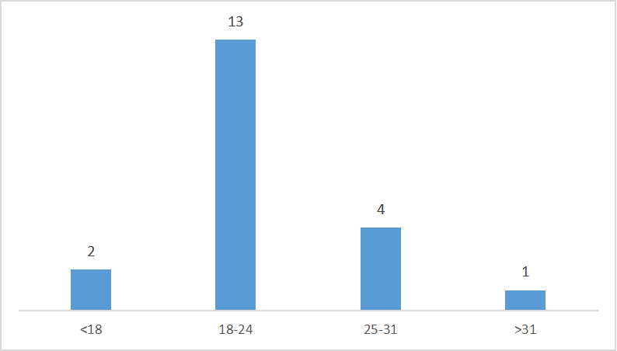
RESULTS
Distribution according to age range (figures are in years)

Slide 19
Were the symptoms described?
yes=20 (95.23%)
no=1 (4.76%)

Slide 20
Was the term “Acute Dystonic Reaction” documented as the type of EPSE?
yes=16 (76.19%)
no=5 (23.80%)

Slide 21
After the emergency intervention with im anticholinergic agent, was the treatment continued with an appropriate oral anticholinergic?
yes=18
no=3

Slide 22
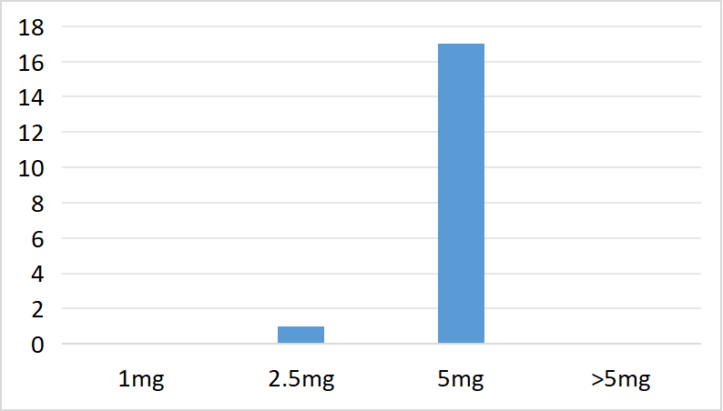


How many cases started oral Benzhexol at <2.5mg, 2.5mg, 5mg or >5mg
<2.5mg=0 (0%)
2.5mg=1(4.76%
5mg=17(80.95%)
>5mg=0 (0%)
ANP=3(14.28%)
ANP=Anticholinergic was not prescribed
<2.5mg

Slide 23
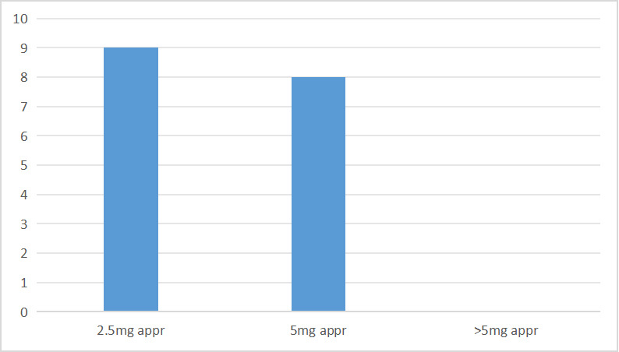
Of all the 17 cases that had 5mg of Benzhexol what dose would have been more appropriate?
9 cases (52.94%) had 5mg when 2.5mg would have been more appropriate. 8 (47.05%) appropriately had 5mg.

Slide 24
Number of cases in which oral anticholinergic was left open, not left open, or not prescribed
Not prescribed(NP)=3 (14.28%)
Left Open(LO)=4 (19.04%)
Not Left Open(NLO)=14 (66.66%)

Slide 25
Was anticholinergic tapered off?
yes = 0 (0%)
no = 14 (100%)

Slide 26
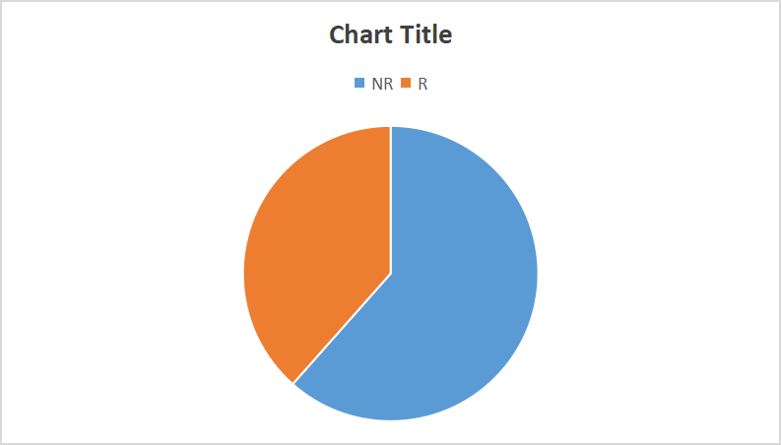
Cases in which reduction of antipsychotic was appro-priate and was either reduced or not reduced
13 cases required reduction of antipsychotic
Reduced (R)=5(38.46%)
Not Reduced (NR)=8 (61.53%)

Slide 27
Cases in which leaving the antipsychotic at current dose was more appropriate but was reduced or not reduced
In 5 cases, it would have been more appropriate to leave the antipsychotic at its current dose.
Left the way it is (L)=4 (80%)
Not left the way it is (NL)=1 (20%)

Slide 28
Was there any documentation on whether the initial emergency treatment was successful or not?
yes = 0 (0%)
no = 21 (100%)

Slide 29
DISCUSSION 1
A total of 20 case files were reviewed. A case file was reviewed twice, in other words the patient had acute dystonic reaction twice making the total number of cases to be 21.
A significantly higher number of males had ADR compared with females (18:2). This can be explained by the fact the risk of development of EPSEs, Schizophrenia and substance induced psychotic disorders is more common in males than females^{1,3,4}.
Also, a disproportionately higher number of individuals in the age range of 18 to 24 years (13) developed ADR compared with other age ranges (2 for those less than 18 years, 4 for those 25-31 years, and 1 for those above 31). This can be explained by the fact that a younger age confers an increased risk of development of EPSEs.

Slide 30
DISCUSSION 2
Only in 1 of the 21 cases (4.76%) were the symptoms not described at all. The doctor who saw this case went straight to the assessment (ADR). Possible explanation: a busy emergency unit.
In 5 of the 21 cases (23.80%), the type of EPSE was not specified (which is acute dystonic reaction). Possible explanations: lack of adequate knowledge of the various types of EPSEs, busy emergency unit.

Slide 31
DISCUSSION 3
No severe or life-threatening episode of acute dystonic reaction was found. Possible explanations: lack of adequate knowledge of EPSEs, a busy emergency unit, there is accurately no severe or life-threatening episode of acute dystonic reaction.
In 3 of the 21 cases (14.28%), after administration of IM Biperiden 5mg, treatment was not continued with an appropriate oral anticholinergic. In one of the cases patient's mother took patient away before the doctor could have time to see them. In another case file, no reason was stated (patient returned 4 days later with ADR and oral anticholinergic was subsequently prescribed).

Slide 32
DISCUSSION 4
In 4 of the 21 cases (19.04%), the oral anticholinergic prescribed after the initial administration of IM Biperiden was left open, this decision was judged to be appropriate based on the dose of the antipsychotic, the presence of psychotic symptoms, severity of the symptoms, the history of the mental illness and adherence to treatment. Prescribed dose was also judged to be adequate.
In 14 of the 21 cases the oral anticholinergic prescribed after the initial administration of IM Biperiden was not left open and the decision to not leave it open and the duration and dose of prescription were deemed appropriate. In all of the 14 cases, the oral anticholinergic was not tapered off.

Slide 33
DISCUSSION 5
In 13 of the 21 cases (61.90%), it would have been appropriate for the antipsychotic(s) to be reduced but reduction was done only in 5 and the reduction was appropriate. In the other 8 cases no reduction was done (increased the risk of reoccurence of ADR). Possible reasons: lack of adequate knowledge of the causes of the various types of EPSEs, busy emergency unit.
The maintenance dose for IM fluphenazine decanoate ranges from 12.5mg 4-weekly to 100mg every 2-weekly. Based on this information, fluphenazine can be given 12.5mg 4-weekly if a patient is having ADR and is not adherent to treatment.
In all of the cases (100%), no documentation was done to indicate whether the initial treatment offered was effective or not.

Slide 34
LIMITATIONS
All the files that were reviewed were obtained from the injection register and the cases were cases that have received IM Biperiden. This automatically means that patients who had acute dystonic reaction but did did not receive IM Biperiden were not included in the study.
Some of the results obtained are based on the auditor’s judgement so it is not an entirely objective process. In some of the cases there was little room for objectivity in deciding whether a treatment is appropriate or not.

Slide 35
RECOMMENDATION 1
Stardard audit tools for acute dystonic reaction and other EPSEs should be developed.
Adequate number of staff should be employed in areas where there is deficiency. For example, the emergency unit can be so busy it looks as if there are no doctors in there. More doctors on duty will change this situation. More doctors on duty will also mean that the doctors are not in a hurry to see a patient hence more thorough documentations will be done.
Of the 91 files noted for retrieval many were not found in the records unit. This can also be as a result of inadequate number of staff in the records unit increasing the likelihood of mistakes or delay in refiling.

Slide 36
RECOMMENDATION 2
Psychoeducation of patient and relatives is also part of the management of ADR. It should also be audited in future audits.
Adherence to medications is an important factor to consider in the management of patients with ADR. It is important for doctors to obtain information from patients who have had ADR about how adherent they have been to their oral medications as this will help in determining which medication (oral or intramuscular) to reduce after an episode of ADR. Apart from being important in managing ADR, obtaining information from patients is routinely in and important practice.
In future audits, the antipsychotic agent suspected to have caused the ADR should be noted. The time interval between the administration of the offending agent and the occurence of ADR should also be included in future audits.

Slide 37
RECOMMENDATION 3
In future audits, whether or not enquiries were made for differential diagnoses of ADR should be audited.
In making preparations for future audits, a wider consultation should be done with consultant psychiatrists to determine how best to proceed with the audit and management items that should be included or not.
In future audits more attempt should be made to review the files of all patients that have been seen during the audit period instead of auditing only the cases that have had intramuscular (IM) anticholinergic (Biperiden). Another possible approach is reviewing the cases that have had both intramuscular anticholinergic (Biperiden) and oral anticholinergic agents (Benzhexol).

Slide 38
RECOMMENDATION 4
More effort should be put in full documentation (in the injection register) of information of patients that have received injection (file number noticed to be missing in quite a lot of the documentations).
Doctors seeing patients with EPSEs including acute dystonia should put in more effort in documentation of their findings and the treatment administered.
The doctors shoould also document the outcome of the initial emergency treatment for ADR.
This audit should be done again some time in the future to compare the standard of care and see if it is improving or deteriorating.

Slide 39
CONCLUSION
A audit is a process meant to assess whether a procedure conforms to set standards, regulations, policies, values or targets.
A clinical audit of treatment of acute ADR has been done and the methods and results presented.
The results show that there are areas in the management of patients with ADR that need to be improved on in FNPH Benin.

Slide 40
REFERENCES
Sadock B. J., Sadock V. A., and Ruiz P. (2015) Synopsis of Psychiatry. 11th edn. ®Wolters Kluwer
Paul H., Philip C., Tom B., Mina F. (2018) Shorter Oxford Textbook of Psychiatry. 7th edn. © Oxford University Press
Semple D. Smyth R., Ocford Handbook of Psychiatry. 4th edn. © Oxford University Press
Kozak K., et. al. Asystematic review and meta-analysis of sex differences in cannabis use disorder amongst people with comorbid mental illness.

Slide 41
THANK YOU

