Slide 1
OVERVIEW OF DYNAMIC PSYCHOTHERAPY
BY
DR. IYAMU, CLEMENT OSASERE.
FEDERAL NEUROPSYCHIATRIC HOSPITAL, BENIN.
WEDNESDAY, 18TH JUNE 2025.

Slide 2
OBJECTIVES
To give an overview on the goals, techniques and application of dynamic psychotherapy.

Slide 3
OUTLINE
Introduction.
Historical background.
Goal.
Prerequisites.
Techniques.
Structure.
Applications and limitations.
Conclusion.
References.

Slide 4
INTRODUCTION
Dynamic psychotherapy also called psychodynamic psychotherapy- talking treatment of a ‘’mind in motion’’.
It is a therapeutic approach that focuses on exploring the unconscious motivation and underlying causes of an individual thoughts, feelings and behaviour.
This therapy aims to help patients understand and resolve unconscious conflicts leading to improved mental health.

Slide 5
HISTORICAL BACKGROUND
Sigmund Freud (1856-1939) founded psychoanalysis, introducing concepts like the unconscious mind and the structure of personality.
In the early 20th century psychoanalysis evolved with contribution from Carl Jung and Melanie Klein.
Late 20th century relational psychoanalysis and contemporary psychodynamic therapy developed, emphasizing the therapeutic relationship and complexity of human experiences.

Slide 6
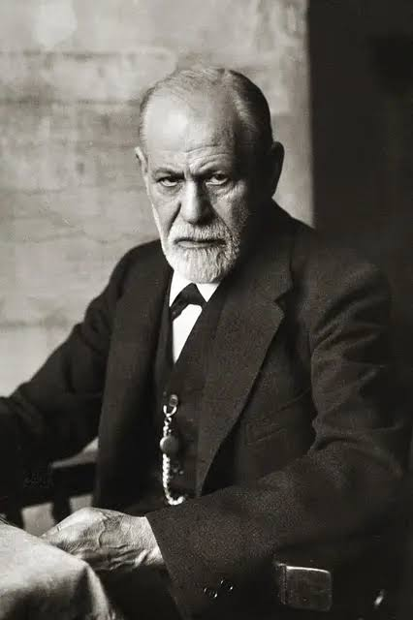
HISTORICAL BACKGROUND

Slide 7
GOALS OF DYNAMIC PSYCHOTHERAPY
Understanding elements of patient’s unconscious, that are affecting conscious thoughts, feelings and behaviours.
Support mental functions or interpret unconscious material in a way that will best accomplish goals.
Providing insight into patient problems.
Ultimately leading to client feeling good, having good relationship and have satisfying work.

Slide 8
PRE-REQUISITIES
Patient highly motivated and wishes to understand self and not just wish for symptomatic relief.
Must have a reasonable mature superego that allows them to be honest with therapist and being able to examine their thoughts, feelings and behaviour without excessive self criticism.
Must have at least average intelligence.

Slide 9
TECHNIQUES OF DYNAMIC PSYCHOTHERAPY-1
Free association: ‘’ verbal wandering’’. The client is asked to state the thoughts and feelings that spontaneously come to their mind without editing.
Resistance: Breaks in free associations. This signals the presence of difficult material and the defenses that are keeping it out of conscious awareness.
It can be- silence, hiding feelings, being too agreeable, hesitation, rapid change of topic, missing sessions.

Slide 10
TECHNIQUES OF DYNAMIC PSYCHOTHERAPY- 2
Interpretation: The therapist provide interpretations of the patient’s thoughts, feelings and behaviours, helping them gain insight and understanding.
Dream analysis: The therapist explore patient’s dream to gain insight into the unconscious mind.
Catharsis: Is a process of releasing strong emotions/ unconscious conflicts often related to traumatic or stressful experiences. This can lead to a sense of renewal.

Slide 11
TECHNIQUES OF DYNAMIC PSYCHOTHERAPY-3
Transference: The sum of all the feelings that a patient has and the way they relate to the therapist as though they are relating to an important figure in their past.
Counter-transference: Is a psychological phenomenon where a therapist redirects their own feelings, attitudes or desires towards a patients often in response to a patient transference

Slide 12
STUCTURE OF THERAPY
One on one session with therapist
Each session lasting for 45-60 minutes
1-3 session/ week, lasting few weeks to several months or years.
PHASES OF THERAPY
Evaluation
Induction
Mid-phase
Termination.

Slide 13
PHASES OF DYNAMIC PSYCHOTHERAPY
PHASE | GOALS
Evaluation | Making an assessment: create safe environment for patient to talk freely, start with open ended question, history, past and present psychiatric history, developmental history, assess for strength and weaknesses.
Induction | Beginning the treatment: includes establishing the treatment, informed consent, setting goals and time frame, explaining cost developing therapeutic alliance, boundaries and confidentiality.
Mid phase | The main work time of the treatment: the patient and therapist are working well together on achieving therapeutic goals.
Termination | Ending the treatment: include consolidating goals, reviewing the treatment, realistic appraisal of change and possibility for future change, planning for future treatment if necessary.

Slide 14
APPLICATION OF DYNAMIC PSYCHOTHERAPY
Anxiety disorder: It can help patients understand and manage their anxiety symptoms.
Depressive disorder: It can help patients work through underlying conflicts and improve their mood.
Personality disorder: It can help patients develop more adaptive coping mechanism and improve their relationship.
Trauma: It can help patients process and work through traumatic experiences.

Slide 15


Slide 16
LIMITATIONS OF DYNAMIC PSYCHOTHERAPY
Time consuming.
Expensive.
Emotionally challenging.
Therapist-patient relationship leading to dependency on tharapist.

Slide 17
CONCLUSION
Dynamic psychotherapy is a comprehensive approach to mental health that focuses on exploring the unconscious motivations and underlying causes of an individual’s thoughts, feelings and behaviours.
Understanding the principles, techniques and the benefits of this therapy can enable patients gain a deeper insight and understanding of themselves and develop more adaptive coping mechanism.

Slide 18
REFERENCES
Powers T.A., Alonso A. Dynamic psychotherapy and the problem of time. Journal of contemporary psychotherapy; 2004;11 (6);327-391.
Fonagy P, Roth A, Higgit A. Psychodynamic psychotherapies: evidence based practice and clinical wisdom, Bull Meninger Clin ;2005;69 (1); 1-58.
Book H.E. How to practice brief psychodynamic psychotherapy, Washington DC. American Psychological Association.

Slide 19
THANKS FOR LISTENING

