Slide 1
OVERVIEW OF ACCEPTANCE AND COMMITMENT THERAPY
BY
MR. JULIUS OGUNDARI
Clinical Psychologist, FNPH, Benin City

Slide 2
OBJECTIVE
To enhance our knowledge of Acceptance and Commitment Therapy.

Slide 3
OUTLINES
Objectives
Introduction/Definition
Brief history
Uses
Benefits
Theoretical Framework
Core – Processes of ACT
ACT Techniques
ACT Session Structure
Conclusion
References

Slide 4
INTRODUCTION / DEFINITION
Acceptance and Commitment Therapy (ACT) is a mindfully oriented behavioral therapy that uses an eclectic and humanistic approach to help people accept and move on from negative experiences.
Unlike other modes of psychotherapy that primarily operate on the concept of healthy normality, ACT therapy accepts the so – called “abnormality” as part of the human psyche and lays more emphasis on change through acceptance.
The myriad of ACT techniques and interventions develop psychological flexibility and mental plasticity resulting in positive actions and life choices.

Slide 5
INTRODUCTION / DEFINITION (2)
ACT is a psychological intervention based on modern behavioral psychology, that applies mindfulness and acceptance processes, and commitment and behavior change processes, for the creation of psychological flexibility.

Slide 6
BRIEF HISTORY
ACT was developed in 1986, by Dr. Stephen Hayes. Its roots lie in earlier theories such as behavior theories, Existentialism and Humanistic approaches and Relational Frame Theory by Hayes.
It’s a “third – wave” Cognitive Behavioral intervention aimed at enhancing our Psychological flexibility (Hayes et al., 2006)
When ACT was developed, CBT was the leading treatment of choice.
ACT challenged certain assumptions of CBT model, especially that thoughts and feelings are symptoms and can be controlled.
Hayes believed thoughts and feelings are normal and trying to control them lead to suffering.

Slide 7
WHAT DO YOU USE ACT FOR?
ACT may help you manage the following mental health conditions:
Addiction
Alcohol use disorder
Anxiety disorders
Mood disorders
OCD
PTSD
Stress
Marital problem etc.

Slide 8
HOW BENEFICIAL IS ACT?
The main benefit of ACT is psychological flexibility. This means you can recognize how your emotions play a role in your life, but you don’t feel overwhelmed by them.
You learn to accept the things within your control and stay true to yourself and your values.
Other benefits include: mental clarity, reduced symptoms of depression, anxiety and stress, willingness to set and work towards your goals, improved quality of life and functioning.

Slide 9
THEORETICAL FRAMEWORK
The theoretical framework of ACT addresses the basic human needs of happiness and pleasure.
It helps individuals accept their flaws and trains them to outgrow unwanted feelings.
The ACT has been created to help us achieve Psychological flexibility.
ACT is comprised of 6 - core processes and these components are what drives the ACT Techniques.

Slide 10
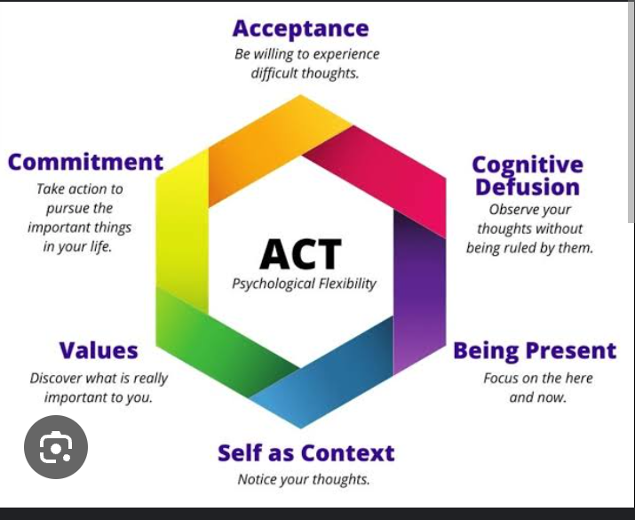

Slide 11

TECHNIQUES IN ACT: ACCEPTANCE TECHNIQUE
It involves full recognition and awareness of ones feelings, without trying to change them.
Acceptance exercise, urge surfing, physical acceptance, emotional acceptance are used to drive this technique.

Slide 12

COGNITIVE DEFUSION TECHNIQUE
Looking at thoughts rather than from them.
Noticing thoughts rather than getting caught up or buying into the thoughts.
Letting thoughts come and go rather than holding unto the thoughts.

Slide 13
MINDFULNESS PRACTICES
Is used to promote mindful awareness in individuals by making their thoughts and actions more consistent and aligned with the present. Can be visually represented through pictorials by illustrating key concepts and exercises.
This technique is practiced using mindful breathing, walking meditation and sensory exploration.

Slide 14
SELF-AS-CONTEXT TECHNIQUE
ACT sees the self from three dimensions:
Self-as-context – our sense of self in relation with other people, situations, or time.
Self as a concept – existential and deep – rooted beliefs about who we are.
Self as a process – evolving ideas about the self in the present, past, and future.
Observer exercise, Self – compassion, Perspective – taking, the “I Am” Exercise are been used to drive this technique. ACT aims to create a balance between all the aspects of self

Slide 15
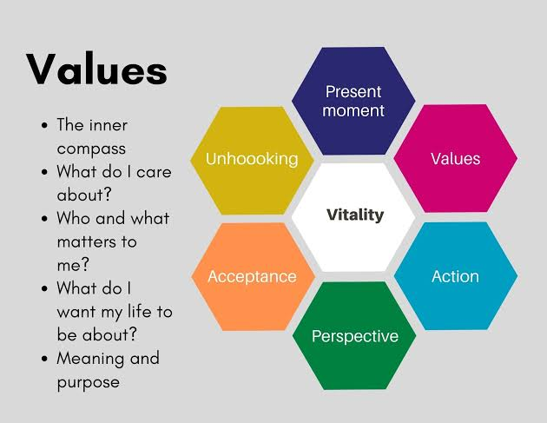
VALUES – BASED ACTION TECHNIQUES
This is driven by values clarifications, action planning, committed action and self-compassion

Slide 16
EFFECTIVENESS OF ACT
Twohig & Woods (2004) used ACT to help treat behaviors associated with OCD
At the end of the session, ACT was found to have helped in creating a harmonious relationship with the client’s innermost feelings and build a secure connection to reality.
Studies have shown that ACT, both as primary and secondary lines of therapy, works well for uplifting mood and self-worth (Hayes et al., 1996).
McLean & Follette used ACT in treating survivors of trauma and it was found beneficial.
Also Woidneck used ACT for posttraumatic stress and it was found to have significantly reduced the stress level of patient.

Slide 17
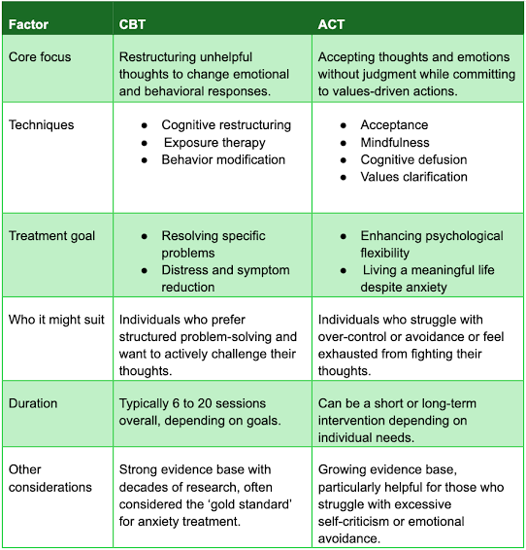
CBT VS ACT

Slide 18
APPLYING ACT IN DAILY LIFE
Mindfulness Practices: Simple daily exercises like mindful breathing can help ground you in the present.
Values Journal: Keep a journal where you note down actions that align with your values, and how they make you feel.
Defusion Techniques: When overwhelmed by negative thoughts, practice stepping back and observing them without judgement.

Slide 19
LIMITATIONS OF ACT
Potential difficulty for some individuals with:
Poor insight
Severe cognitive impairments
Acute mental / emotional crisis
Intellectual disability
While it’s a valuable approach, it’s not a one – size – fit – all solution and may not be suitable for everyone.

Slide 20

ACT IN PRACTICE
Typically involves weekly sessions with a trained therapist.
Typically lasts between 8 – 16 weeks.
This can vary depending on the individual needs and goals of each client.
May include individual or group therapy.
Often incorporates mindfulness exercises, values – based action plans and cognitive defusion techniques.

Slide 21
ACT SESSION STRUCTURE
SESSION 1
SESSION 2
History Taking
Brief assessment, Goals /Values
Introduction to ACT
When to start, stop
Review strategies
Review of previous session
Addressing issues from previous session
Confronting the Agenda
Control as the problem
Mindfulness / defusion

Slide 22
ACT SESSION STRUCTURE (2)
SESSION 3 & 4
SESSION 5 & 6
Review of previous session
Addressing issues from previous session
Major focus on defusion
Acceptance / present moment / willingness
Values
Review of previous session
Addressing issues from previous session
Self as context exercise
Values more in - depth

Slide 23
ACT SESSION STRUCTURE (3)
SESSION 7 & 8:
Review of previous session
Addressing issues from previous session
Values, Committed action
Identify barriers
Need for further sessions

Slide 24
CONCLUSION
ACT is not just a therapeutic tool. It is a journey towards embracing life in all its complexity.
It teaches us that our greatest strength lies in acknowledging our vulnerabilities and moving forward with a heart full of acceptance and a mind aligned with our deepest values.
Using ACT as part of treatment can help alleviate life issues.

Slide 25
REFERENCES
Hofmann, S. G., & Hayes, S. C. (2019). The future of intervention science: Process – based therapy. Clinical Psychological Science, 7(1), 37-50.
Follette, V.M., & Pistorello, J. (2007). Finding life beyond trauma: Using acceptance and commitment therapy to heal from posttraumatic stress and trauma – related problems. New Harbinger.
Blackledge, J. T. (2007). Disrupting verbal processes: Cognitive defusion in acceptance and commitment therapy and other mindfulness-based psychotherapies. The Psychological Record, 57(4).
Woidneck, M., Morrison, K., & Twohig, M. (2014). Acceptance and commitment therapy for the treatment of posttraumatic stress,38.

Slide 26
REFERENCES (2)
Bluett, E.J., Homan, K.J., Morrison, K.L., Levin, M.E., Twohig, M.P. (2013). Acceptance and commitment therapy for anxiety and OCD spectrum disorders: An empirical review. Journal of Anxiety Disorders,28, 612-624.
Eifert, G.H., Forsyth, J.p. (2005). Acceptance and Commitment Therapy for anxiety disorders: A practitioner’s treatment guide to using mindfulness, acceptance, and value based behavior change strategies. New Harbinger: Oakland, C A.

Slide 27
THANK YOU FOR LISTENING

