Slide 1
Personal Protective Equipment In The Workplace,
Importance, Types And How To Properly Use Them
By
Sanitarian Abieyuwa Okoro
Staff Environmental Health Unit
Federal Neuro Psychiatric Hospital
Benin City

Slide 2
Objectives
To prevent injuries and illnesses
Reduce risk of exposure
Protect against harm
Comply with regulation
Promote a safe work environment
Prevent occupational diseases

Slide 3
Introduction
In today’s world, safety and protection in the workplace are paramount. Whether working in construction, healthcare, manufacturing, or any other industry, individuals face various hazards that could potentially cause harm. To mitigate these risks, Personal Protective Equipment (PPE) plays a vital role. In this presentation, I will be highlighting the importance of PPE, the different types, their applications, and the benefits they provide in ensuring a safe working environment.

Slide 4
Outline
Meaning Of PPE
Basic Types And Examples Of PPE
Importance Of PPE
Guideline For Proper Use Of PPE
Key Implication on PPE Non-Compliance
Factors To Consider When Using PPE
Who Responsible For Providing And Compliance Of PEE
Conclusion
Reference

Slide 5

Personal Protective Equipment PPE
Personal protective equipment (PPE) Is a term that defines any piece of protective clothing, helmets, goggles, or other garments or equipment designed to minimize or protect the wearer's body from injury or infection in a work place. This includes being conscious and up to date with infection prevention and control measures and the appropriate implementation of personal protective equipment. According to the World Health Organization (WHO), personal protective equipment "...consists of garments placed to protect the health care workers or any other persons from getting infected.
Protective equipment may be worn for job-related occupational safety and health purposes, as well as for sports and other recreational activities. Protective clothing is applied to traditional categories of clothing, and protective gear applies to items such as pads, guards, shields, or masks, and others.

Slide 6
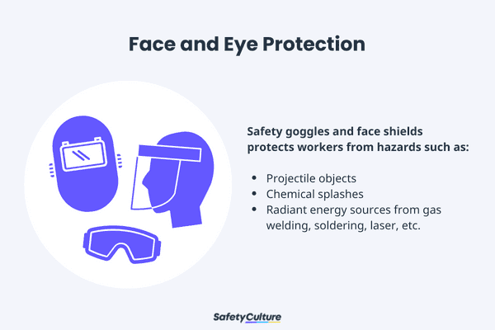
BASIC TYPES OF PPE AND THEIR EXAMPLES
This type of PPE protects against eye damage or loss of vision, splashes, burns, and any toxic liquid sprays etc.
Safety Tips:
Ensure that there are no cracks or deformities on the lenses.
Ensure the strap is in good working condition and is firmly sealed to the cheek and forehead.
Clean and disinfect after use.

Slide 7
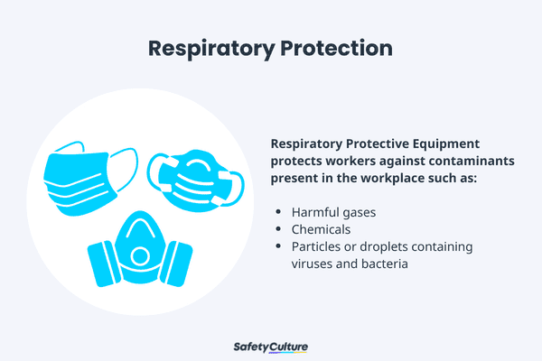
RESPIRATORY PROTECTION
Respiratory protection can include full-face respirators or breathing apparatus, or even masks, such as the N95 respirators, to protect against the inhalation of harmful materials. This can include gases, chemicals, toxic sprays, or airborne contagions such as viruses or bacteria that could cause infections.
Safety Tips:
Ensure that the equipment is fit-tested and the employee has undergone proper training before wearing one.
Carefully read the instructions to determine if it is designed to help protect against the hazards you may face.
Change filters on half-mask or full-mask respirators frequently.
Replace disposable respirators after use.
Surgical masks are not to be shared with anyone.
Avoid touching the surgical mask after wearing it.
Change surgical mask timely and should be disposed of after use.
Replace the mask immediately if it is damaged or soiled.

Slide 8
Skin and Body Protection
Body Protection like gowns and aprons, create a barrier that prevents bodily fluids and other substances from reaching the wearer’s skin and clothing. This protection helps prevent the transmission of infectious agents and minimizes the risk of infection for healthcare workers
Safety Tips:
Ensure that they are clean and free from cuts and burns.
Always get a good fit to ensure full body protection.
Foot Protection: PPE includes knee pads and safety boots and should be used for tasks that can cause serious foot and leg injuries from falling or rolling objects, hot substances, electrical hazards, and slippery surfaces.
Safety Tips:
Ensure boots have slip-resistant soles that can protect against compression and impact.
Ensure the sole plate is in good condition to prevent punctures.

Slide 9
Head Protection: PPE includes hard hats and headgears and should be required for tasks that can cause any force or object falling to the head.
Safety Tips:
Ensure that there are no dents or deformities on the shell and connections are tightened inside.
Do not store in direct sunlight as extreme heat can cause damage.
Choose appropriate cleaning agents as it can weaken the shells of hard hats and may eliminate electrical resistance.
Always replace a hard hat if it was used for any kind of impact, even if the damage is unnoticeable.

Slide 10
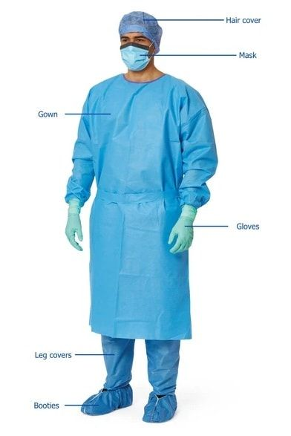
Hand Protection: like gloves act as barrier, preventing against direct touch of potentially infectious materials such as body fluids, blood, and contaminated surfaces to minimize the risk of transmission of infectious agents.
Safety Tips:
Ensure hand protection fits perfectly with no spaces and is free from cuts.
Always replace them if any sign of contamination is been observed.
Use rubber gloves when working with heat and electricity to reduce the risk of burn or electrical shock.

Slide 11
IMPORTANCE OF PPE
PPE is an individual’s first line of defense against a wide range of workplace accidents, injuries and illnesses.
Wearing and utilizing the correct PPE significantly reduces the risk of severe injuries and long-term health issues caused by exposure to various hazards.
PPE provides an additional layer of safety, offering protection even in circumstances where other safety measures might fall short.
The proper use of PPE can give workers confidence, empowering them to carry out their duties effectively, knowing they have reliable protection against potential harm.
This sense of security fosters a safer work culture, and can even boost employee morale and motivation.
As well as this, strict adherence to PPE guidelines showcases an employer’s commitment to their employees’ well-being and safety.
As such, a proactive approach to safety can enhance the workplace reputation and contribute to improved employee loyalty and retention

Slide 12
PPE is mostly important in high-risk industries such as construction, manufacturing, healthcare, and laboratories, where exposure to hazardous substances and potential accidents is much more prevalent.
The use of PPE ensures the continuity of business operations by minimizing work disruptions due to accidents or illnesses.
When workers remain safe and healthy, absenteeism decreases, leading to enhanced productivity and reduced downtime.

Slide 13
GUIDELINE FOR PROPER USE OF PPE
Understand When to Use PPE: PPE should be used when there is a risk of exposure to hazards. Training should cover the specific situations where PPE is necessary.
Select the Right Equipment: Choose appropriate PPE based on the type of hazard. This includes gloves, masks, goggles, and gowns, depending on the task.
Proper Usage: Ensure that PPE is worn correctly. For example, when using gloves, avoid touching your face and ensure they fit snugly.
Training: Receive training on how to put on (doffing) and remove (donning) PPE safely to avoid contamination. This includes hand hygiene before and after use.
Maintenance and Disposal: Follow guidelines for the maintenance and proper disposal of PPE to ensure safety and compliance with regulations.
By adhering to these practices, you can effectively use PPE to protect yourself and others from potential hazards.]

Slide 14
KEY IMPLICATIONS ON PPE NON-COMPLIANCE
Increased risk of injuries:
Not wearing appropriate PPE, like safety glasses, gloves, or other PPE gadget due to work nature, can directly expose workers to hazards and significantly increasing the likelihood of injuries.
Health problems:
Inhaling harmful substances, exposure to extreme temperatures, or contact with hazardous chemicals due to lack of proper PPE can lead to respiratory illnesses, skin irritation, burns, airborne diseases and other long-term health complications that may even result to lose of lives
Legal consequences:
In most developed countries, employers have a legal obligation to provide and enforce the use of appropriate PPE. Failing to do so could result in fines, lawsuits, and damage to the company's reputation if a worker is injured due to non-compliance.
Reduced worker morale:
When employees feel unsafe due to inadequate PPE or lack of enforcement, it can lead to decreased job satisfaction, productivity, and overall morale.

Slide 15
Conclusion
Any item of PPE imposes a barrier between the wearer/user and the working environment. This can create additional strains on the wearer, impair their ability to carry out their work and create significant levels of discomfort. Any of these can discourage wearers from using PPE correctly, therefore placing them at risk of injury, ill-health or, under extreme circumstances, death. Good ergonomic design can help to minimize these barriers and can therefore help to ensure safe and healthy working conditions through the correct use of PPE.
Personal Protective Equipment plays a pivotal role in safeguarding employee from workplace hazards
Hopefully from this article you have gained an answer to the question why PPE is important
The diverse range of PPE options, from protective clothing to eye, respiratory, hearing and head protection, ensures a comprehensive defence against potential accidents and illness when implemented and use correctly
Using PPE is not only vital for protecting individual workers but it can also contribute to a safe work environment overall.
The benefit of proper PPE implementation are manifold, ranging from reduced injury rates and medical expenses to improved employee moral and enhanced productivity.
The key to effective PPE usage lies in comprehensives training, easy access to equipment, regular inspection and a culture that prioritises safety.
Employer, employee and organizational leaders must work together to foster a safety-first mindset.

Slide 16
Reference
https://safetyculture.com/topics/ppe-safety/
https://ecampusontario.pressbooks.pub/introductiontoipcp/chapter/63/
Importance of PPE & Workplace Hazards | BETAFIT PPE Ltd
internationalfireandsafetyjournal.com/why-is-ppe-important/
Safety culture.com
Stjohnvic.com.au+1
Who.int+1

Slide 17
THANK YOU
`

