Slide 1
MENINGITIS
Dr. Gabriel Osatohanmwen AIGBOKHAE
General Medical Services Unit,
FNPH.
Benin City, Edo State.

Slide 2
OUTLINE
Introduction
Definition
Aetiology
Pathogenesis
Management
Complications
Psychiatric complications of meningitis
Differentials
Prognosis
Conclusion

Slide 3
INTRODUCTION
Meningitis from the Greek word (“meninx”) membrane
It is an acute inflammation of the meninges caused by either bacteria, virus or other agents.
The inflammation is usually caused by an infection of the fluid surrounding the brain and spinal cord
It can be fatal especially in children (U5) and immunocompromised individuals.

Slide 4
DEFINITION
Meningitis refers to the Inflammation of the protective coverings/membranes (meninges) surrounding the brain and spinal cord.

Slide 5
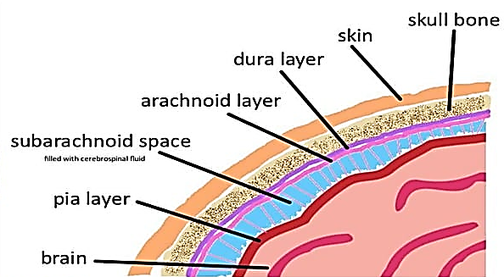
Definition…
Anatomy

Slide 6
EPIDEMOLOGY
Although meningitis is a notifiable disease, the exact incidence rate is unknown
In 2022 – 2023, Nigeria reported 1,686 suspected cases of meningitis, with 124 deaths.
Occurring mainly in Jigawa State, affecting mainly children aged 1 – 15yrs.
Incidence can reach 1,000 cases in 100,000 people in Africa
But approximately 20 cases in 100,000 people are reported on a global scale.

Slide 7
AETIOLOGY
1. Viral meningitis. (also called Aseptic Meningitis)
2. Bacterial meningitis.
Pyogenic Meningitis
Tuberculous meningitis: Mycobacterium tuberculosis
3. Fungal meningitis.
4. Parasitic meningitis.

Slide 8
Aetiology…
1. Viral Meningitis – Enteroviruses, Coxakie B3 Virus, Herpesviruses, Arboviruses.
2. Bacterial meningitis. Almost any organism can cause meningitis but commonly it varies with age –
Neonate (or <2months); Kliebsela,Staph aureus, E. coli.
>2months – 1yr; Heamophilus Influenza, Strep. Pneumonia, Neisseria Meningitides.
> 12yrs (uncommon); Strep. Pneumonia, Neisseria Meningitides.
Notes:
- Viral Meningitis is Most common type - Usually mild and self-limiting-

Slide 9
Aetiology…
3. Tubaculous Meningitis – occurs 2 - 6 months after the primary Infection.
Dissemination of TB from primary foci
Heamatogenous route
Forms a Tuberculoma which ruptures into the sub-arachnoid space to cause Meningitis.

Slide 10
Aetiology…
4. Fungi Meningitis – Rare and usually affects immuno-compromised individuals
Cryptococcus neoformans, Candida spp. Hystoplasma, Blastomyces, Coccidioides, Sporothrix.
5. Parasitic/Protozoan Meningitis – Rare and usually affects individuals traveling to endemic areas
Toxoplasmosis, ameoba, Naegleria fowleri, Plasmodium spp, Cystercacus

Slide 11
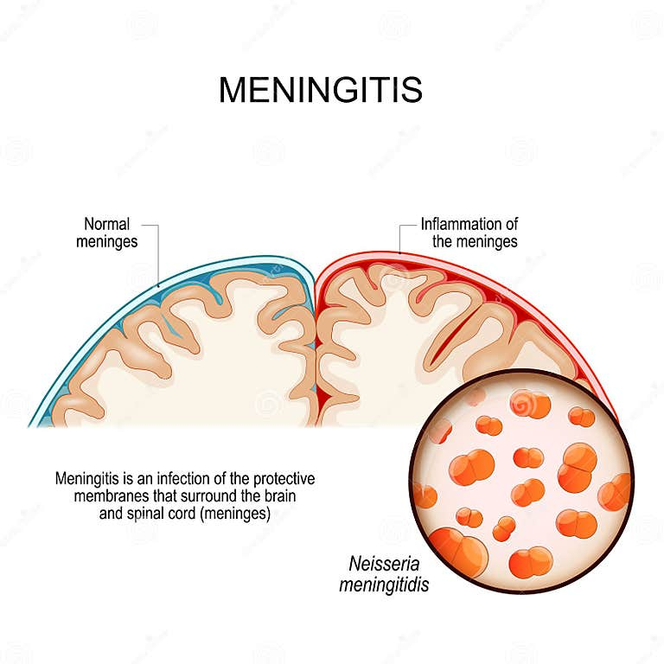
PATHOLOGY
Diagramatic Illustration of The Pathology Of Meningitis.

Slide 12
Pathology…
CSF infection
Infection of the Meninges
Meningeal Inflammation
Adhesion & obstruction of CSF flow
Increased ICP
Increase in CSF Proteins
Obliteration of leptomeningeal end arteries
Cerebral infarcts, Nerve Damage…

Slide 13
Pathology…
Routes of Infection
Haematological Route – most common route
Contagious Sites –
Sinusitis.
Mastoiditis.
Otitis Media.
Cerebral Abscesses.
Trauma – eg. Skull Fracture resulting in a direct innoculation of bacteria.
Direct Invasion.

Slide 14
CLINICAL PRESENTATION/DIAGNOSIS.
A good clinical history and a high index suspicion is key to management.
Stage I – Hx of non specific symptoms such as
URTI; fever, cough, sore-throat respiratory distress,
GIT; Vomitting
Irritability, Weight loss or drowsiness.
Stage II – Evidence of Meningeal Irritation; Anorexia, Nausea & Vomiting. Headaches, Photophobia, Neck Stiffness, Seizures( common clinical presentations).

Slide 15
Stage III – Hemiplegia or Paraplegia, Coma, Decerebrate Rigidity, Opisthotonus, Papilloedema.
Waterhouse-Friedrichsen Syndrome Characterised by
Haemorrhage into the Adrenal Gland.
Bleeding into skin (purpura, ecchymosis)
Occur in Children <10yrs
Meningococcemia – presence of Neisseria meningitides in bloodstream.

Slide 16
Physical examination;
CNS – conscious or unconscious
May be confused.
+ve Kernings sign or Brudzinski’s sign
Pupillary response to light

Slide 17
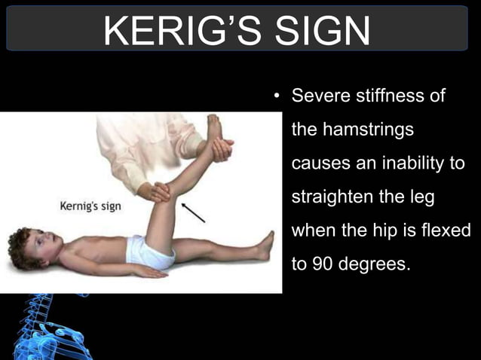
Kernings Sign
Severe stiffness of the Hamstrings causes an inability to straighten the leg when the hip is flexed to 90 degrees
Notes:
Severe stiffness of the Hamstrings causes an inability to straighten the leg when the hip is flexed to 90 degrees

Slide 18
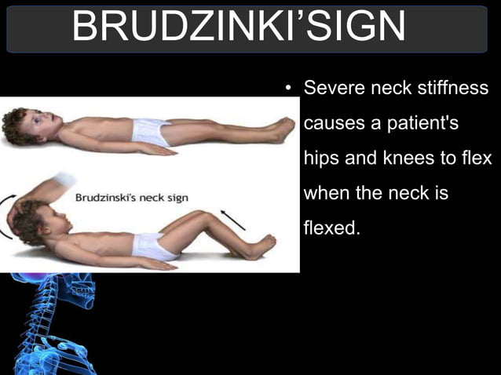
Brudzinski’s Sign
Severe Neck stiffness causes the patients Hip and Knees to flex when the neck is flexed.
Notes:
Severe stiffness of the Hamstrings causes an inability to straighten the leg when the hip is flexed to 90 degrees

Slide 19
Lumber Puncture For CSF Analysis
(Gold Standard For Diagnosis of Meningitis)
Index | Normal | Pyogenic | Tuberculosis | Viral | Partially Treated
colour | Colourless | Cloudy/Turbid | Slightly Turbid (Xanthochromis) | Clear | Variable
ICP | <180mmH2O | Increased | Increased | Increased | Variable
Microscopy (WBC) | <5cells/cmm | >1000cells/cmm |  |  | mixed
Gram Stain | Negative | Positive | Negative, (Positive on Lowenstein Johnson Medium) | Negative | Negative
Culture | Negative | Positive | Negative, (Positive on Lowenstein Johnson Medium) | Negative | Negative
Protein | 15 – 60mg/dl
Glucose | 50 -80mg/dl | <40mg/dl | <40mg/dl | Normal | Normal
Notes:
In a partially tx Meningitis, in which a patient is already on anti-biotics therapy before presentation, the CSF Finding is Variable

Slide 20
Adjunt Investigations;
Medical Cranial Imaging – Xrays, Cranial CT Scan &/or MRI,
FBC – Leukocytosis seen in bacteria meningitis,
E/U/Cr – due to >risk of SIADH,
Blood Culture – 80-90%, is +ve for Bacteria meningitis,
Tuberculine Skin Test/Gene Expert,
HIV Screening
PCR – to identify DNA of Bacteria.

Slide 21
MANAGEMENT
ABC of Resuscitations depending on clinical presentations;
Monitor input &output of this Patient closely.
Medications,
Corticosteroids; Betamethasone/Dexamethasone, 20 – 30mins before commencement of antibiotics and continues till 4days after stoppage of antibiotics.
Caution!!!
There is no room for Per Oral or Intramuscular medications.
Notes:
Cortical Steroids will help reduce Inflammatory responses to causative organisms; which is the major cause of complications.
Caution is to ensure correct antibiotics as steroids further lowers body’s immune system.

Slide 22
Management…
Antibiotics should be able to cross the BBB and should cover causative organisms relative to age, pending labouratory findings.
Duration of IV antibiotics administration depends on patients Response,
Gram +ve Organisms – Tx for 10 - 14 days,
Gram -ve Organisms – Tx for 21 days,
Or continue for 5 days after fever has disappeared.

Slide 23
Management…
Choices of Antibiotics
Age | Antibiotics | dosage | frequency
0- 3 months | I.V Cloxacillin IV Gentamicin | 100mg/kg/day 5mg/kg/day | 6Hrly 12Hrly
3mnths - 5yrs | IV Ampicillin. | 400 - 500mg/kg/day | 6Hrly
> 5yrs | 1st Choice IV Crystalline Penicillin + Chloramphenicol | 300,000i.u/kg/day 100mg/kg/day | 6hrly
 | 2nd Choice Ceftriazone Cefotaxime Ceftaxidine Cefuroxime Ofloxacine | 100mg/kg/day Max 4g/dose | 12hourly
Adjunct. | Vancomycin can be added in case of resistance.

Slide 24
Management…
Diuretics – to reduce raised ICP
IV Manitol, 0.5mg/kg/dose.
IV Furosemide, 1mg/kg/dose
Anticonvulsants – for seizures
I.V Diazepam, 0.1 – 0.2mg/kg/dose.
I.V Lorazepam 0.05mg/kg/dose.
IV fluids should be 2/3rd maintenance to prevent Cerebral Oedema due to the risk of SIADH.
MHC measuring to monitor cerebral oedema

Slide 25
COMPLICATIONS FROM MENINGITIS
Complications from meningitis may be immediate, short-term, and long-term:
IMMEDIATE COMPLICATIONS; (Within Hours to Days)
1. Septic shock: Life-threatening condition caused by severe infection.
2. Respiratory failure: Inability to breathe properly, requiring mechanical ventilation.

Slide 26
Complications From Meningitis…
3. Cardiac arrest: Heart stops beating, requiring emergency medical intervention.
4. Seizures: Convulsions caused by inflammation in the brain.
5. Cerebral edema: Swelling of the brain, which can lead to increased intracranial pressure.

Slide 27
Complications From Meningitis…
SHORT-TERM COMPLICATIONS; (Within Days to Weeks)
1. Hydrocephalus: Accumulation of cerebrospinal fluid (CSF) in the brain, leading to increased intracranial pressure.
2. Subdural effusion: Collection of fluid between the brain and the skull.
3. Brain abscess: Collection of pus in the brain tissue.

Slide 28
Complications From Meningitis…
4. Cerebral vasculitis: Inflammation of blood vessels in the brain.
5. Hearing loss: Temporary or permanent hearing impairment due to inflammation in the inner ear.

Slide 29
Complications From Meningitis…
LONG-TERM COMPLICATIONS (Within Months to Years)
1. Cognitive impairment: Difficulty with memory, attention, and learning.
2. Seizure disorders: Recurring seizures due to scarring in the brain.
3. Hydrocephalus: Persistent accumulation of CSF in the brain, requiring surgical intervention.

Slide 30
Complications From Meningitis…
4. Chronic headaches: Recurring headaches due to inflammation or scarring in the brain.
5. Emotional and behavioural changes: Mood swings, anxiety, depression, or personality changes.
6. Physical disabilities: Weakness, paralysis, or loss of coordination due to damage to motor areas of the brain.

Slide 31
Complications From Meningitis…
7. Vision problems: (Cortical) Blindness, double vision, or loss of peripheral vision due to damage to the optic nerve.
8. Hormonal imbalances: Disruption of hormone production due to damage to the pituitary gland.

Slide 32
PSYCHIATRIC COMPLICATIONS OF MENINGITIS
Meningitis can also lead to various psychiatric complications, for instance:
Short-term Complications;
1. Delirium: Confusion, disorientation, and altered mental status can occur during the acute phase of meningitis.
2. Anxiety: Patients may experience anxiety, fear, and apprehension due to the severity of their condition.

Slide 33
Psychiatric Complications Of Meningitis…
3. Depression: Depressive symptoms, such as low mood, loss of interest, and changes in appetite or sleep, can arise during the acute phase.
Long-term Complications;
1. Cerebral palsy in children <2yrs
2. Epileptic Disorder
3. Mental Retardation/Cognitive Impairment: Meningitis can lead to cognitive deficits, including memory loss, attention problems, and decreased processing speed.

Slide 34
Psychiatric Complications Of Meningitis…
4. Mood Disorders: Depression, anxiety, and bipolar disorder can occur as a result of meningitis, particularly if there is damage to the brain's limbic system.
5. Personality Changes: Some patients may experience changes in personality, such as increased irritability, emotional lability, or apathy.

Slide 35
Psychiatric Complications Of Meningitis…
6. Psychosis: In rare cases, meningitis can trigger psychotic episodes, including hallucinations and delusions.
7. Post-Traumatic Stress Disorder (PTSD): Survivors of meningitis may develop PTSD, characterized by flashbacks, nightmares, and avoidance of triggers that remind them of their illness.

Slide 36
Psychiatric Complications Of Meningitis…
Risk Factors for Psychiatric Complications
1. Age: Children and older adults are more susceptible to psychiatric complications.
2. Severity of Illness: More severe cases of meningitis increase the risk of psychiatric complications.
3. Presence of Comorbidities: Underlying medical conditions, such as diabetes or hypertension, can increase the risk of psychiatric complications.

Slide 37
Psychiatric Complications Of Meningitis…
4. History of Mental Health Conditions: Patients with pre-existing mental health conditions are more vulnerable to psychiatric complications.

Slide 38
DIFFERENTIAL DIAGNOSIS
Other types of Meningitis – CSF is used to differentiate them.
Brain abscess – Collection of pus in the brain tissue
Encephalitis – Inflammation of the brain tissue
Cerebritis – Inflammation of the brain tissue, often caused by bacterial or fungal infections.
Cerebral vasculitis: Inflammation of blood vessels in the brain

Slide 39
Differential Diagnosis…
6. Intracranial heamorrhage – Hx of Sudden Headhaches with bloody CSF.
7. Malignant meningitis: Cancer cells spreading to the meninges.
8. Brain Tumour – Sub-acute or Chronic Hx, Raised ICP, +/- Focal Neurological Signs.
9. Epidural abscess – Collection of pus in the epidural space surrounding the spinal cord.

Slide 40
Differential Diagnosis…
10. Subdural empyema – Collection of pus in the subdural space surrounding the brain.
11. Chemical meningitis: Exposure to toxic substances, such as chemicals or medications
12. Autoimmune meningitis: Conditions like lupus or rheumatoid arthritis causing meningitis.
13. Meningismus/Meningism – Meningeal irritation +/- inflammation. Occur in the young.

Slide 41
PROGNOSIS
Depends on,
Patients Age – the younger the age the worse the prognosis
Duration of onset before commencing therapy
Type of organism involved – worse with Strep pneumonia.
Number of organisms involved.

Slide 42
PREVENTION
Vaccination,
Hib vaccine – As part of DPT immunization schedule in most part of the world,
Pneumococcal vaccine – Available but not yet a routine. It’s given to targeted populations eg. SCDx, Immuno-compromised Px, Splenomegaly, Nephrotic Syndrome, AIDS Px.
Meningococcal vaccine – Not a routine vaccine, it’s given every 3yrs in northern Nigeria where epidemics is high.

Slide 43
Prevention…
Chemoprophylaxis,
Such as Rifampicin, given to exposed contacts to H. Influenza & N. Meningitides.
Good hygiene practices,
Hand washing,
avoiding close contact with infected individuals.
Where possible, avoiding travel to endemic areas

Slide 44
Prevention of Psychiatric Complications Of Meningitis.
1. Early Recognition and Treatment: Prompt recognition and treatment of meningitis can reduce the risk of psychiatric complications.
2. Multidisciplinary Care: Collaboration between healthcare professionals, including psychiatrists, psychologists, and social workers, is essential for managing psychiatric complications.

Slide 45
Prevention of Psychiatric Complications Of Meningitis.
3. Supportive Care: Providing emotional support, counselling, and cognitive rehabilitation can help alleviate psychiatric complications.
4. Monitoring and Follow-up: Regular monitoring and follow-up appointments can help identify psychiatric complications early, ensuring timely intervention.

Slide 46
Conclusion
Meningitis is a serious and potentially life-threatening infection- Prompt medical attention is essential for effective treatment and prevention of complications- Vaccination and good hygiene practices can help prevent meningitis

Slide 47
REFRENCES
Harrison’s PRINCIPLES OF INTERNAL MEDICINE Eighteenth Edition
Textbook of Preventive and Social Medicine 19th Edition
Smeltzer, Suzzanne C., et al, Textbook of Medical Surgical Nursing, 12th edition
UpToDate (http://www.uptodate.com)
eMedicine (http://www.emedicine.com)
Current recommendations for treatment of meningitis, WHO technical Note.

Slide 48
References
Mace SE. Acute bacterial meningitis. Emerg Med Clin North Am. 2008;26:281-317, viii
Lucas MJ, Brouwer MC, van de Beek D. Neurological sequelae of bacterial meningitis. J Infect. 2016;73:18-27.
Luksic I, Mulic R, Falconer R et al. Estimating global and regional morbidity from acute bacterial meningitis in children: assessment of the evidence. Croat Med J. 2013;54@510-518

Slide 49
Thank You For Listening!

