Slide 1

Introduction to Nutrition and Dietetics
Presented by
Dietitian Precious Aisosa Okonkwo
Nutrition And Dietetics Unit
Federal Neuro-Psychiatric Hospital, Benin City.

Slide 2
Outline
INTRODUCTION
BRIEF HISTORY OF NUTRITION AND DIETETICS
AREAS OF SPECIALIZATION
SETTINGS FOR NUTRITIONIST PRACTICE
FUNCTIONS OF A NUTRITIONIST IN A HOSPITAL
PATIENTS THAT SHOULD BE REFERRED TO A DIETITIAN
ASSESSMENT AND TOOLS
NUTRITION CARE PROCESS
CONCLUSION
REFERENCE

Slide 3
Introduction to Nutrition and Dietetics
Nutrition is the scientific study of how organisms obtain and utilize food to support their life processes. It encompasses the intake of nutrients, their digestion, absorption, transport, and metabolism within the body. Proper nutrition is essential for maintaining health, supporting growth and development, and preventing various diseases.
Dietetics is the science of applying nutritional principles to the planning and preparation of foods and regulation of the diet in relation to both health and disease. It involves understanding how food and nutrition impact human health, with an emphasis on public health and educating individuals on making proper dietary choices.

Slide 4
Introduction (Cont.)
Dietitians in hospital care teams significantly enhances patient outcomes. They offering personalized dietary plans that address individual health conditions, thereby promoting recovery and disease management.
Beyond direct patient care, dietitians contribute to cost-effective healthcare by reducing complications and shortening hospital stays through proper nutritional support. Their involvement in interdisciplinary teams ensures comprehensive care, as they collaborate with physicians, nurses, and other healthcare professionals to develop and implement effective nutrition strategies.

Slide 5
Brief History of Nutrition and Dietetics
The profession of nutrition and dietetics has its roots in ancient civilizations, where scholars like Hippocrates emphasized the importance of diet in health. However, it wasn't until the 19th and 20th centuries that the field gained formal recognition. In 1917, the American Dietetic Association (now the Academy of Nutrition and Dietetics) was established to promote the role of dietitians in healthcare.
In Nigeria, the advancement of nutrition and dietetics began in the 1960s. The University of Nigeria, Nsukka, pioneered academic programs in this field, establishing the Department of Home Economics in 1961, which later evolved to include specialized courses in Nutrition and Dietetics. To unify professionals and address the nation's nutritional challenges, the Nutrition Society of Nigeria was founded in 1963 at the University of Ibadan.
Dietitians Association of Nigeria (DAN) is a national professional association of dietitians and assistant dietitians in Nigeria. The Association promotes health through food, nutrition and diet planning.

Slide 6
Areas of Specialization
Clinical Nutrition – Working in hospitals to manage disease through diet.
Community Nutrition – Educating the public on healthy eating habits.
Sports Nutrition – Enhancing athletic performance through diet.
Food Service Management – Overseeing hospital meal planning.
Research & Education – Studying the impact of food on health.

Slide 7
Functions of a Nutritionist/Dietitian in a Hospital
Attend Outpatient clinic to counsel and arrange further follow-up of patients.
Attend ward rounds with the Medical Consultants and other health teams.
Draw up monthly menu plan for In-patients (Both normal and Therapeutic).
Attend food procurement meetings (If any).
Supervise food items purchased, and meals prepared in the kitchen.
Attend to referrals from the wards for In-patients.

Slide 8
Patients that should be referred to a Dietitian
Diabetic patients.
Hypertensive Patients.
Overweight or Obese Patients.
Underweight Patients.
Renal Patients.
Children and Adolescents with Dietary Related conditions.
Adults with Dietary Related conditions

Slide 9
Important Assessment needed before the patient is referred to see a Dietitian
Fasting Blood sugar(FBS)
Random Blood Sugar(RBS)
Blood pressure(B.P)
Weight
Height
Medical History

Slide 10
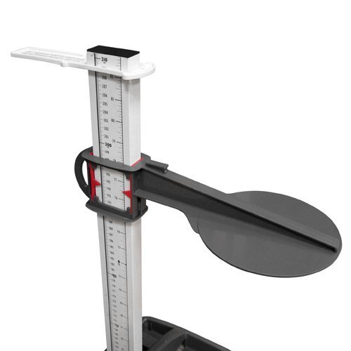
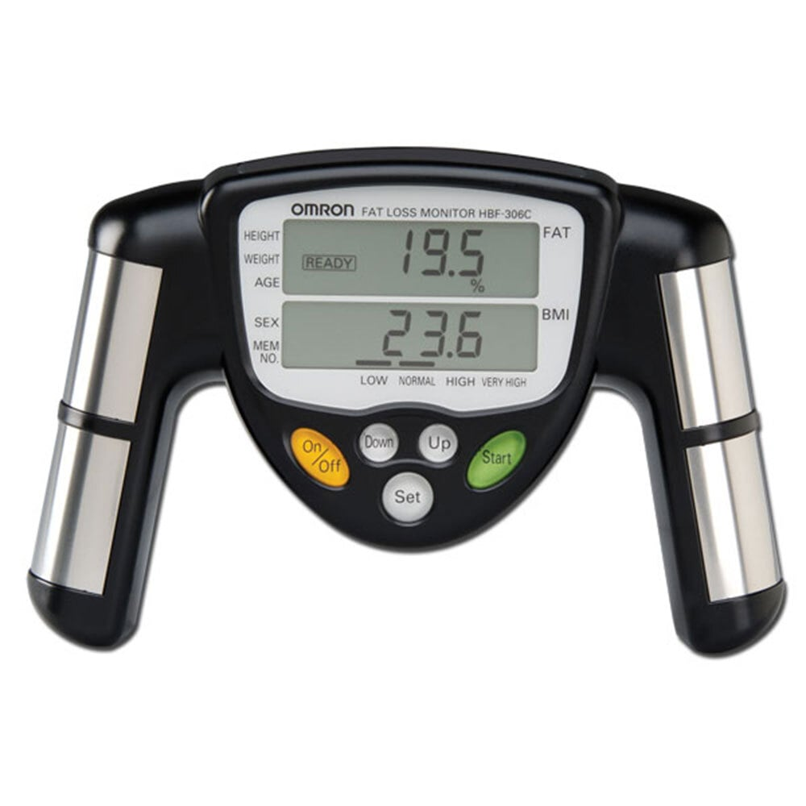

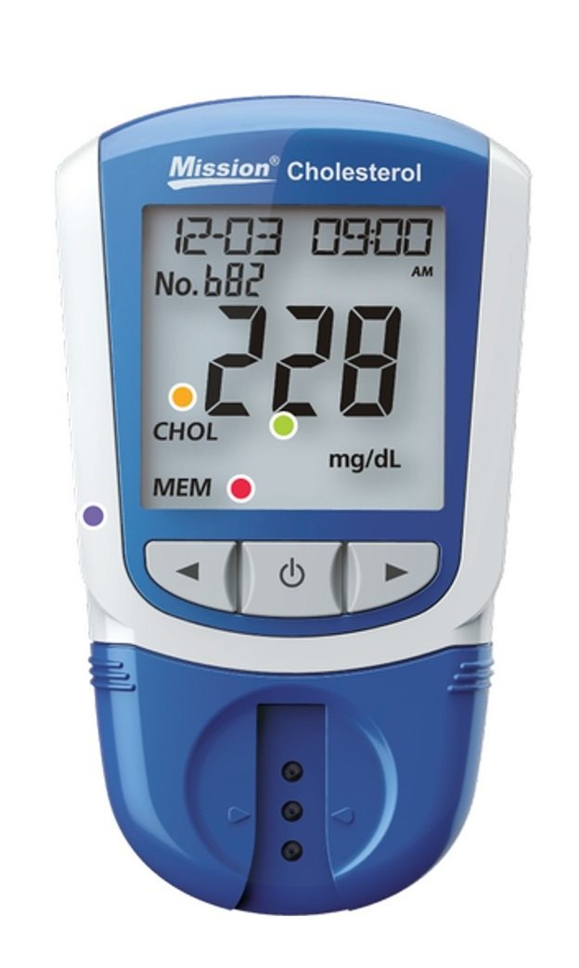

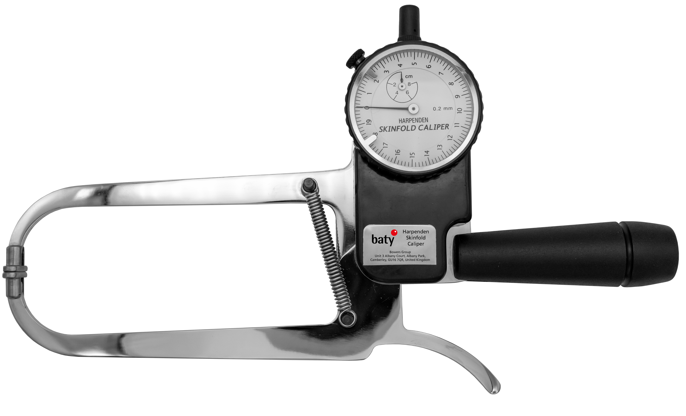
Key tools for effective monitoring
Bioelectrical Impedance Analysis
Infantometers
Stadiometer
Handgrip Dynamometers
Lipid Profile Analyzers
Skinfold Calipers

Slide 11
Steps in Nutrition Care Process (NCP)
Assessment: Collecting patient data.
Diagnosis: Identifying nutritional problems.
Intervention: Implementing diet plans.
Monitoring & Evaluation: Tracking patient progress.

Slide 12
Designing Personalized Meal Plans
Factors to be considered:
Age
Medical condition
Food preferences
Culture.

Slide 13
Nutritional Counseling Techniques
Effective communication strategies.
Motivational interviewing.
Behavior modification techniques.

Slide 14
Conclusion
Nutritionists and dietitians play a crucial role in healthcare, public health, research, and food industries by providing evidence-based nutritional guidance to individuals and communities. Their expertise in medical nutrition therapy, dietary planning, and nutrition education helps manage diseases, promote wellness, and improve overall health outcomes. Whether working in hospitals, private practice, research institutions, or government agencies, their impact is significant in preventing malnutrition, chronic illnesses, and lifestyle-related health issues. As the field continues to evolve, nutrition professionals remain essential in shaping healthier societies through informed dietary choices and sustainable nutrition policies.

Slide 15
References
Academy of Nutrition and Dietetics. (n.d.). Academy history. Retrieved from https://www.eatrightpro.org/about-us/who-we-are/about-the-academy/academy-history
Nutrition Society of Nigeria. (n.d.). History of the Nutrition Society of Nigeria. Retrieved from https://nutritionnigeria.org/history
Institute for Dietetics in Nigeria. (n.d.). About us. Retrieved from https://www.institutefordieteticsinnigeria.org/about
American Academy of Family Physicians. (2021). Enteral nutrition: Indications, benefits, and management. American Family Physician. Retrieved from https://www.aafp.org/pubs/afp/issues/2021/1200/p580.html
Healthline. (n.d.). What is medical nutrition therapy (MNT)? Retrieved from https://www.healthline.com/nutrition/nutrition-therapy

Slide 16
THANK YOU

