Slide 1
DIAGNOSIS AND Management of
TETANUS
Dr. Gabriel Osatohanmwen AIGBOKHAE
General Medical Service Unit,
FNPH.
Benin City, Edo State.

Slide 2
OUTLINE
INTRODUCTION
CAUSATIVE AGENT
EPIDOMIOLOGY
TRANSMISSION, HOST FACTORS, ROUTE OF ENTRY
MECHANISM OF ACTION OF TOXIN
CLINICAL FEATURES
TYPES OF ETANUS
DIAGNOSIS
DIFFRENTIAL DIANOSIS
TREATMENT
PREVENTION-ACTIVE & PASSIVE IMMUNIZATION

Slide 3
INTRODUCTION
Derived from the Greek word ‘ to stretch’
It was first described by Hippocrates and Susruta
It is an acute disease caused by anaerobic Clostridium tetani bacteria
Tetanus is a rare and often fatal neurological disease that causes increased tone and muscle spasms due to the bacteria

Slide 4
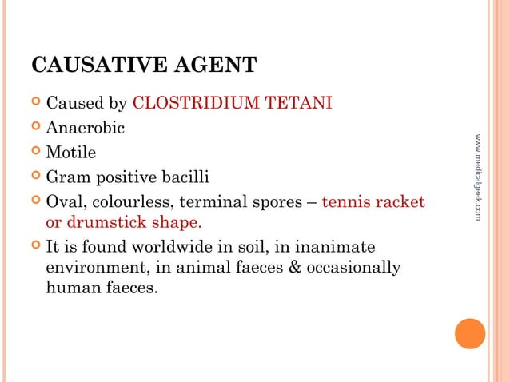

Slide 5
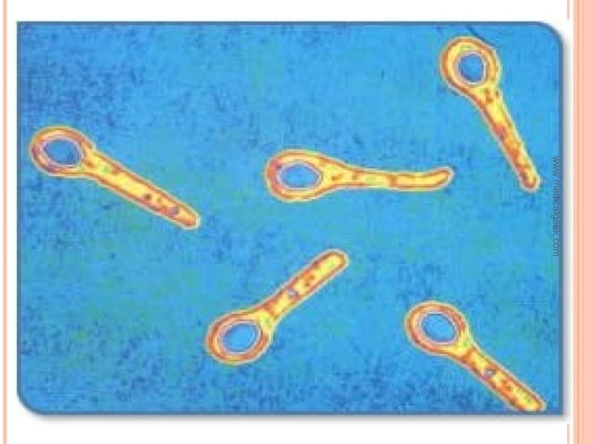
Clostridium Tetani

Slide 6
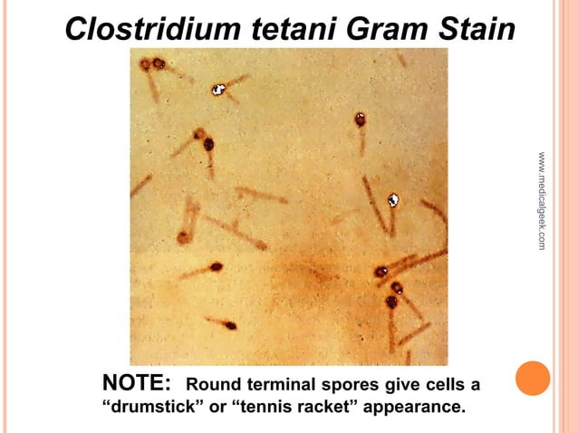

Slide 7
epidemiology
Tetanus is an international health problem, as spores are ubiquitous. The disease occurs almost exclusively in persons who are unvaccinated or inadequately immunized.
Entirely preventable disease by immunization
Tetanus occurs worldwide but is more common in hot, damp climates with soil rich in organic matter.
More common in developing and under developing countries.
More prevalent in industrial establishment, where agricultural workers are employed
Tetanus neonatorum is common due to poor umbilical cord care.

Slide 8
TRANSMISSION:
Tetanus is not transmitted from person to person. Infection occurs when C. tetani spores are introduced into wounds from trauma, surgeries and injections, or chronic skin lesions and in infections.
The incubation period of tetanus is usually between three and 21days (median 7 days). Shorter incubation periods (<7days) along with delays in seeking treatment are associated with fatal outcomes.

Slide 9
HOST FACTORS
Age: It is the disease of active age (5-40years)
New born baby
Sex: Higher incidence in males than females
Occupation: Agricultural workers are at a higher risk
Rural-Urban difference: Incidence of tetanus in urban areas is much lower than in rural areas
Immunity: Herd immunity does not protect the individual.
Environmental and social factors: unhygienic custom habits, unhygienic delivery practises

Slide 10
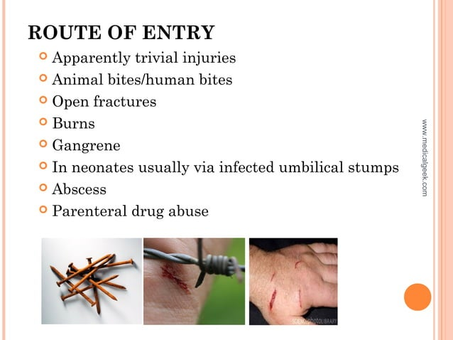

Slide 11
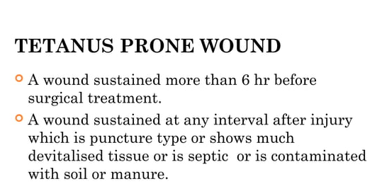

Slide 12
PATHOGENESIS
C. tetani enters
Body from through wound.
2. Stays in sporulated form until anaerobic conditions are presented
3. Germinates under anaerobic conditions and begins to multiply and produce tetanospasmin.
4. tetanospasmin spreads using blood and lymphatic system, and binds to motor neurons
5. Travels along the axons to the spinal cord.
6. Binds to sites responsible for inhibiting skeletal muscle contraction.

Slide 13
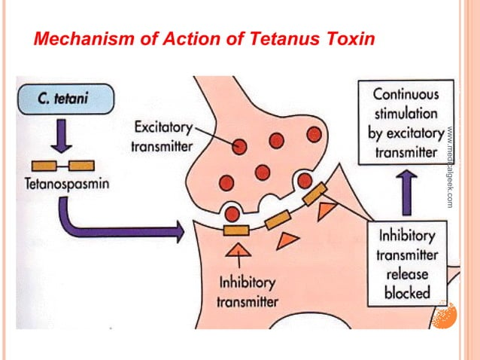

Slide 14
Pathogenesis…
Tetanolysin
Tetanospasmin
Hemolytic toxi
Binds to NM junction at the site of injury and undergoes retrograde axonal transport to reach presynaptic nerve terminal where it prevents the inhibitory neurotransmitters
Potentiates infection but does not cause disease process
In normal states these neurotransmitters prevent release of Ach from excitatory neurons thus prevent muscle contraction. In the presence of toxins these inhibitor impulses are prevented leading to uncontrolled contraction of muscles.

Slide 15
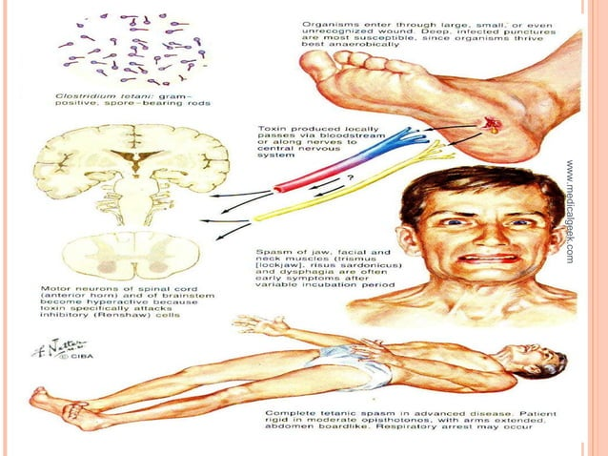

Slide 16
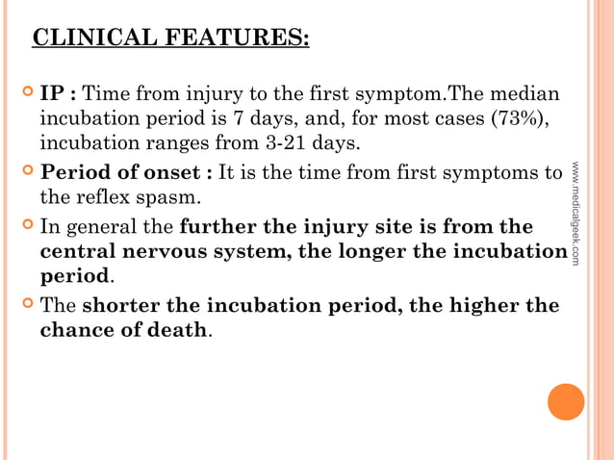

Slide 17
Types Of tetanus
Generalized Tetanus
Local Tetanus
Cephalic Tetanus
Maternal Tetanus
Neonatal Tetanus

Slide 18
GENERALIZED TETANUS
Generalized tetanus attacks muscles throughout the entire body
The most common form of tetanus (about 80% of the cases)
Generalized Muscular rigidity and spasms
Tetanospasmin attacks and inhibits mostly the motor neurons of the CNS and later the neurons of the ANS as well.
As a result patient experiences uncontrollable intense muscle contractions

Slide 19
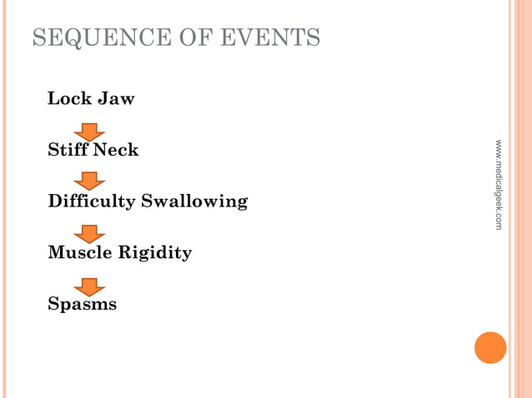

Slide 20
generalized tetanus…
Triad of muscle rigidity, spasms & autonomic dysfunction
Early symptoms are neck stiffness, sore throat and poor mouth opening.
Patients with generalized tetanus present with trismus (ie, lockjaw) in 75% of cases.
Other presenting complaints include neck stiffness,rigidity, dysphagia, restlessness, and reflex spams, spasms usually continue for 3-4 weeks.

Slide 21
generalized tetanus…
Subsequently, muscle rigidity becomes the major manifestation. Rigid Abdomen.
Muscle rigidity spreads in a descending pattern from the jaw and facial muscles over the next 24-48 hours to the extensor muscles of the limbs-stiff proximal limb muscles & relatively sparing hand & feet.

Slide 22
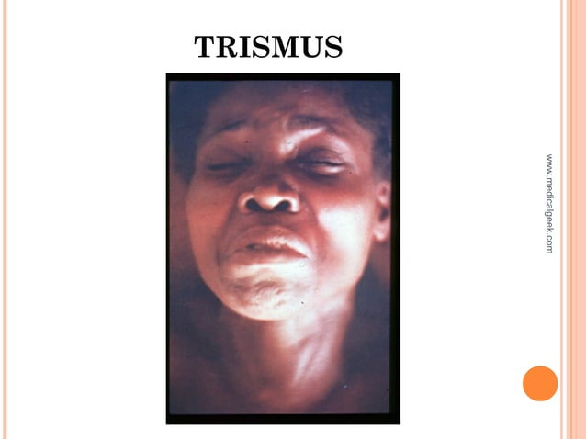

Slide 23
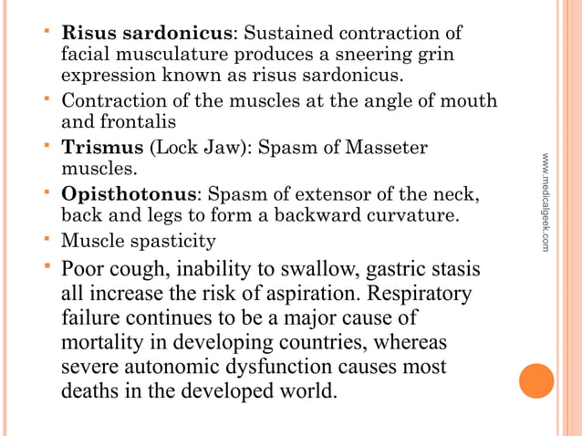
generalized tetanus…

Slide 24
generalized tetanus…

Slide 25
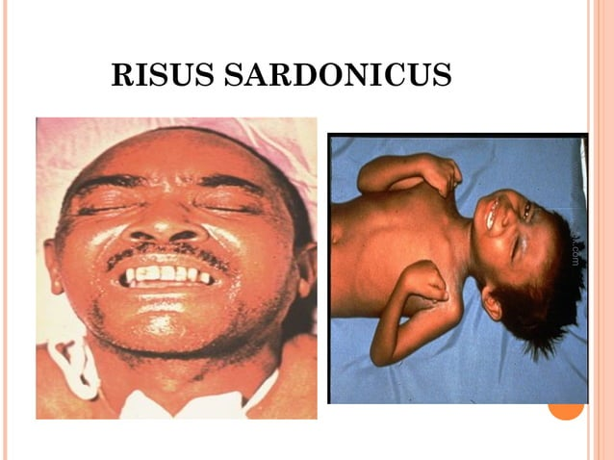

Slide 26
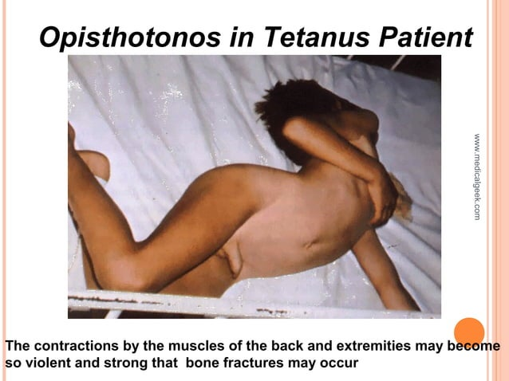


Slide 27
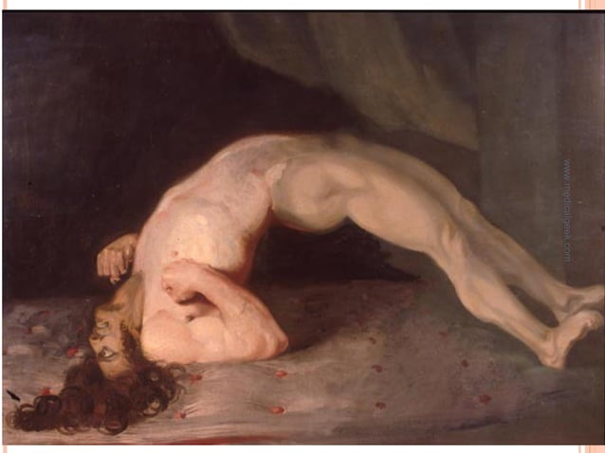

Slide 28
AUTONOMIC DYSFUNCTION
Tetanospasmin has a disinhibitory effect on the autonomic nervous system (ANS) due to increased release of catecholamines it causes:
Occasional hyperpyrexia
Sweating
Peripheral vasoconstriction
Labile/Sustained Hypertension
Episodic tachycardia, dysrhythmias and cardiac arrest
Occasionally period of bradycardia & hypotension

Slide 29
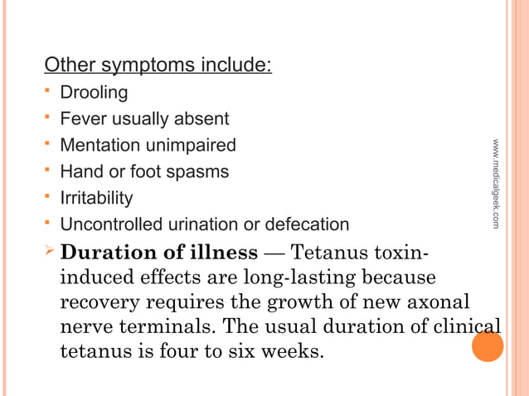

Slide 30
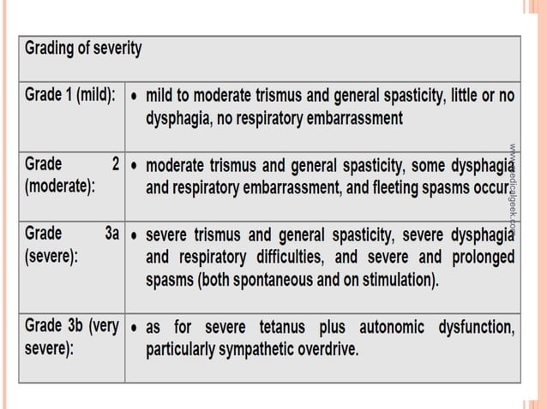

Slide 31
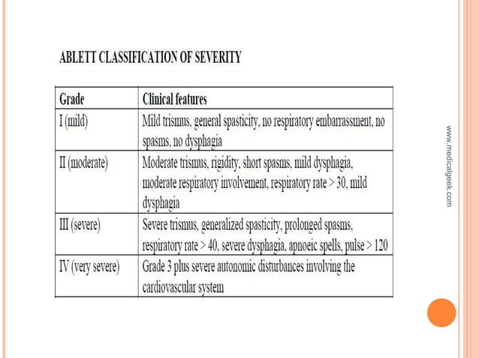

Slide 32
Maternal Tetanus
Tetanus occurring during pregnancy or within 6 weeks after any type of pregnancy termination, is one of the most easily preventable causes of maternal mortality.
It includes postpartum or puerperal tetanus
(i) postpartum or puerperal tetanus, usually resulting from septic procedure during delivery.
(ii) postabortal tetanus, following septic maneuvers during induced abortion
(iii) Tetanus during pregnancy, generally resulting from inoculation through a non-genital portal of entry.

Slide 33
NeONATAL TETANUS
Neonatal tetanus (which is found in newborn babies) is a form of generalized tetanus which also has a high fatality rate.
It is very common in developing and under developing countries.
Children born to inadequately immunized mothers, after unsterile treatment of umbilical stumps
The diagnosis is determined from the symptoms that present.
When the baby is born, they are able to suck and swallow normally for 2-3days and then lose that ability.

Slide 34
Nnt…
The symptoms of neonatal tetanus are muscle rigidity and spasms which appear around “4-14 days after birth”.
It is easily preventable by 2 doses of tetanus toxoid during pregnancy and usage of sterilized instruments for cutting umbilical stump.

Slide 35
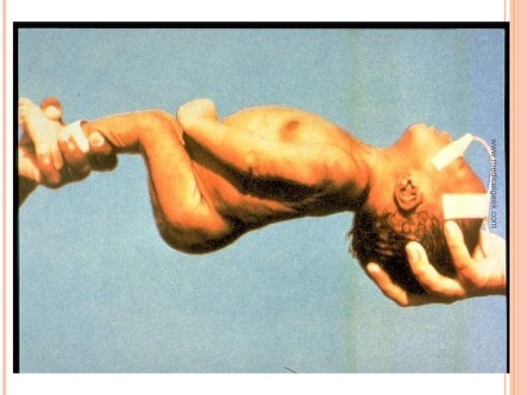

Slide 36
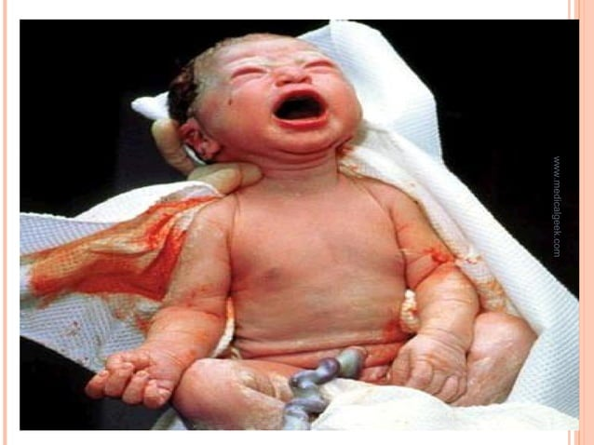

Slide 37
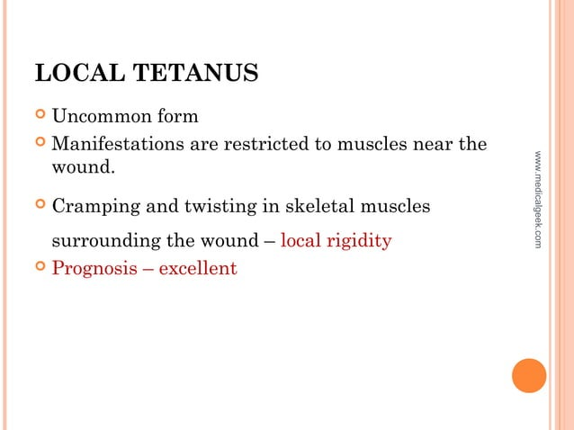

Slide 38
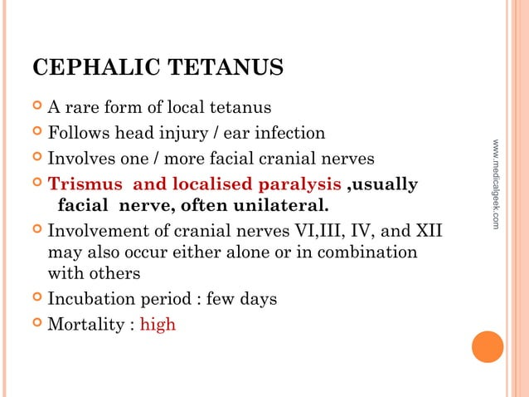

Slide 39
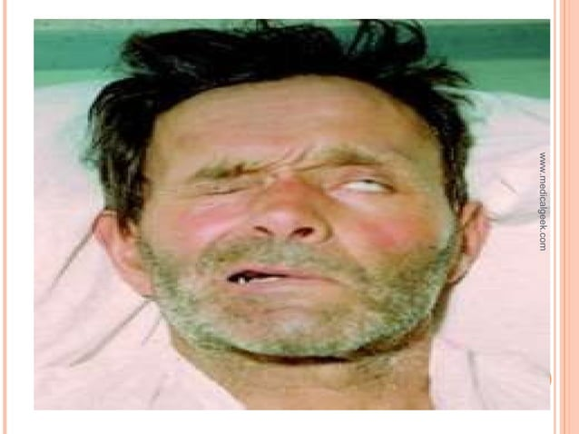

Slide 40
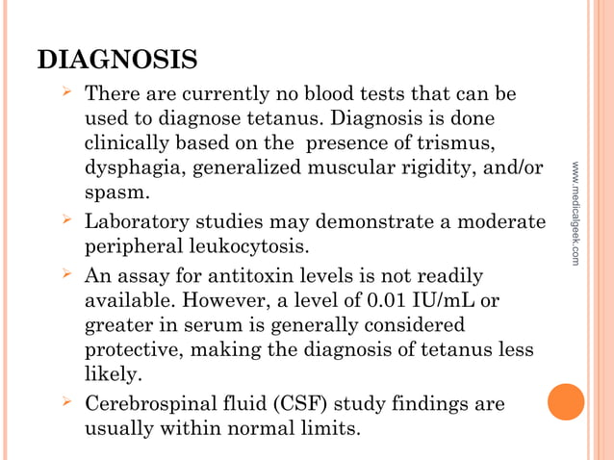

Slide 41
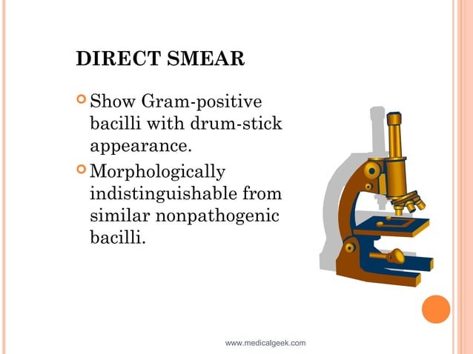

Slide 42
Differential diagnosis
Infections of the head, neck and central nervous system (eg meningitis)
Orofacial infection
Dystonic drug reaction (Haloperidol, Metoclopramide)
Anti-depressants, Anti-epileptics, Midazolam
Hypocalcaemia
Strychine poisoning
Seizures
Dislocation (mandible)
Neuroleptic malignant syndrome

Slide 43
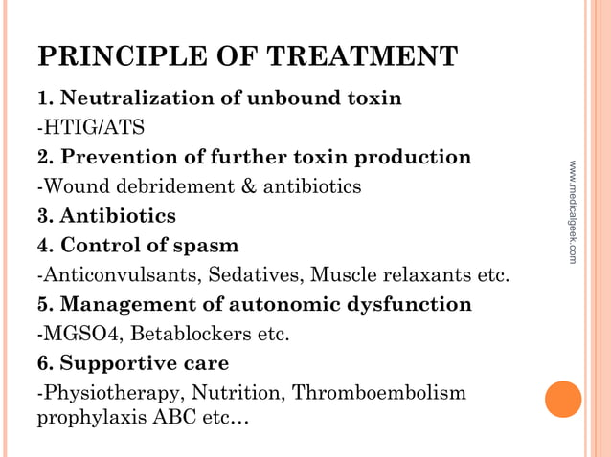

Slide 44
TOXIN
A single intramuscular dose of 1000-1500 units is generally recommended for children and adults, with part of the dose infiltrated around the wound if it can be identified.
The WHO recommends TIG 500 units by IM/IV (depending on the available preparation) as soon as possible; in addition, administer age-appropriate TT-containing vaccine(Td, Tdap, DT, DPT) 0.5 cc by intramuscular injection at separate site with HTIG.
TIG can only help remove unbound tetanus toxin, but it cannot affect toxin bound to nerve endings.

Slide 45
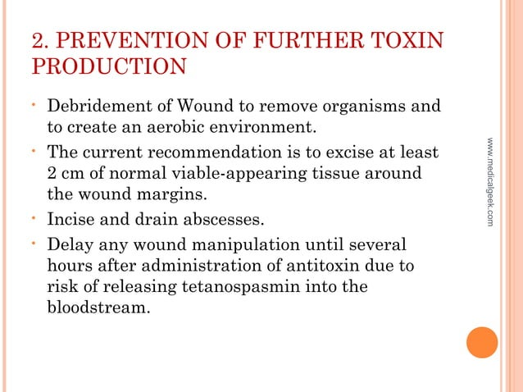

Slide 46
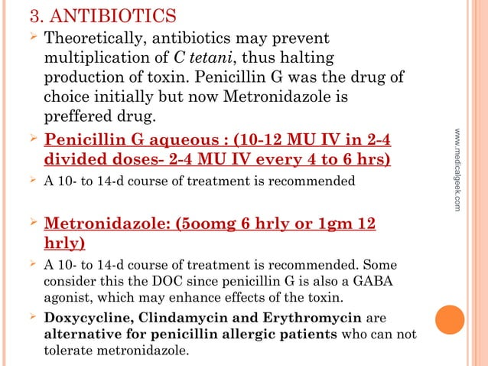

Slide 47
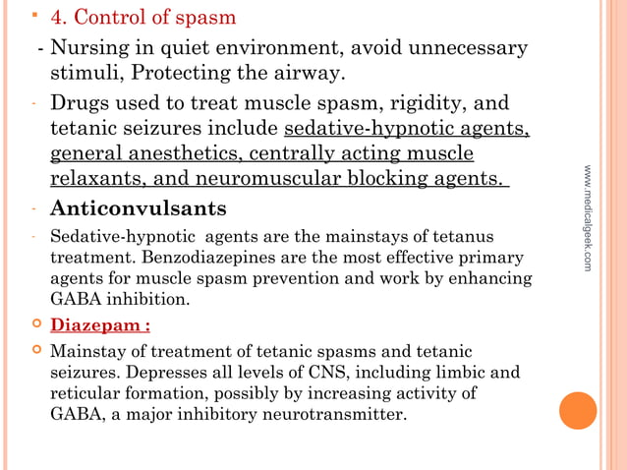

Slide 48
Control of spasm…
Diazepam:
Mainstay of treatment of tetanic spasms and tetanic seizures. Depresses all levels of CNS, including limbic and reticular formation, possibly by increasing activity of GABA, a major inhibitory neurotransmitter.
Diazepam reduces anxiety, produces sedation, and relaxes muscles. Lorazepam is an effective alternative. Large amounts of either may be required (up to 600 mg/d).

Slide 49
Control of spasm…
Diazepam or Midazolam can be used as 5-10mg iv/im every 1-4 hrly.
Midazolam can be given as an intravenous infusion (5-15 mg/hr).
Diazepam may also be given by continuous infusion, because of precipitation in IV fluids & absorption of drug into infusion bags & tubing, high dose is needed. Usually 10-40mg every 1-8 hours needed.

Slide 50
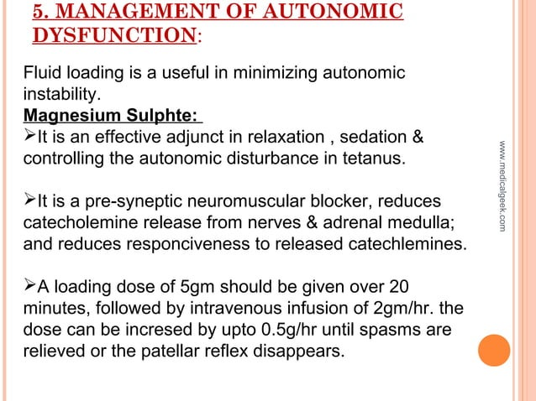

Slide 51
6. Supportive care
Airway management and other supportive measures- since tetanus toxin cannot be displaced from the nervous system once bound to neurons, supportive care is essential
Nurse in a dark quiet and noise isolated rooms since bright
lights, noises and pains can easily trigger spasm
Control fluid and electrolyte balance
Maintain adequate hydration.
Patient with severe tetanus, prolonged immobility in ICU is indicated.
Endotracheal intubation where necessary in ICU

Slide 52
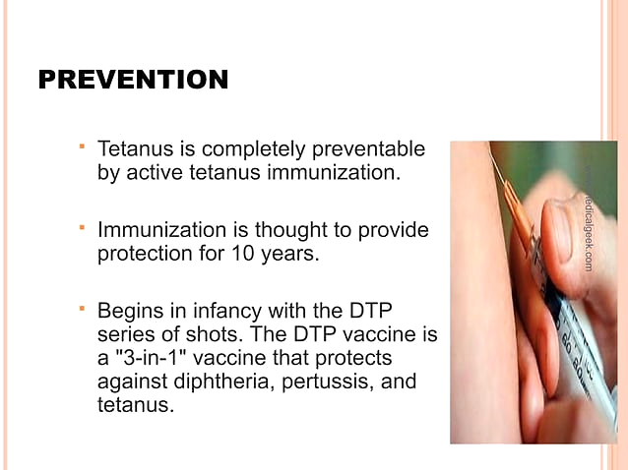

Slide 53
ACTIVE AND PASSIVE IMMUNIZATION
Active immunization occurs when the body produces antibodies to fight a pathogen, while passive immunization occurs when antibodies are transferred to the body from an outside source.
Whereas active immunity refers to the process of exposing the individual to an antigen to generate an adaptive immune response, passive immunity refers to the transfer to antibodies from one individual to another. Passive immunity provides immediate but short-lived protection, lasting several weeks up to 3 or 4 months.

Slide 54
ACTIVE IMMUNIZATION
Nigeria National Immunization Schedule
Birth | HBV, OPV and BCG
6 weeks | Penta Valent Vaccines (PVV), OPV, Pneumococcal Conjugate Vaccine (PCV), Rota Virus.
10 weeks | PVV, OPV, PCV Rota Virus Meningococcal Conjugate
14 weeks | PVV, OPV, PCV, Inactivated Polio Vaccine.
18weeks | Meningococcal Conjugate
6 months | Vitamin A
9 months | Measles and Yellow Fever Vaccine
12 months | Measles, Mumps and Rubella (MMR) Vaccine, Chicken Pox, Vitamin A and Meningococcal Conjugate
13 months | MMR, Chicken Pox
18 months | Hepatitis A and B. Vitamin A
19 month | Hepatitis A and B.
24 months | Typhoid, Hepatitis A and B.

Slide 55
Active Immunization…
Nigeria National Immunization Schedule for Pregnant women and women of child bearing age
VACCINE | WHEN TO RECEIVE THE VACCINE | EXPECTED DURATION OF PROTECTION
TT1 | At first CONTACT or as early as possible in pregnancy | None
TT2 | At least 4 weeks after TT1 | 1 – 3 years
TT3 | At least 6 MONTHS after TT2 OR During subsequent pregnancy within 3 years. | 5 years
TT4 | At least 1 year after TT3 OR During subsequent pregnancy. | 10 years
TT5 | At least 1 year after TT4 OR During subsequent pregnancy. | All the child bearing years

Slide 56
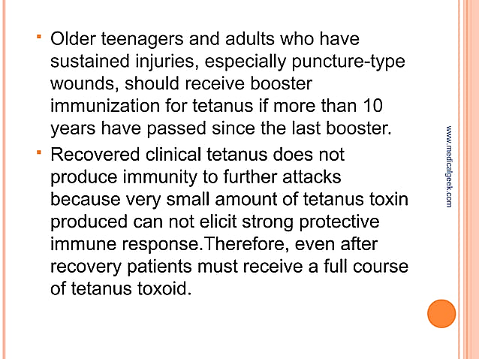
Active Immunization…

Slide 57
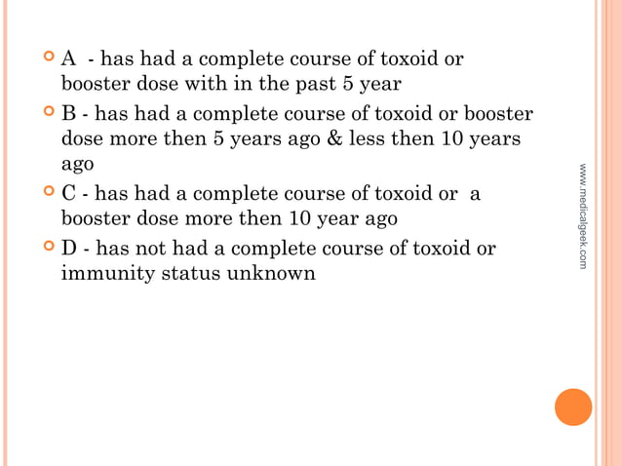
Post exposure prophylaxis

Slide 58
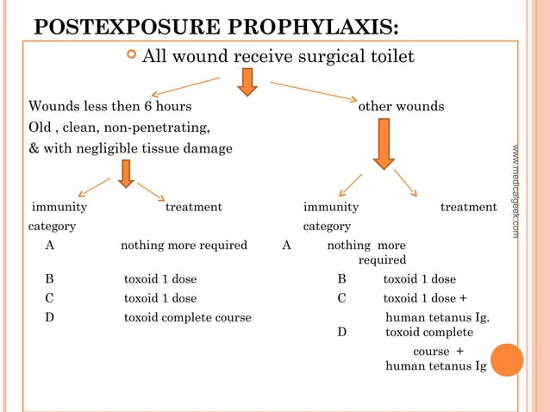

Slide 59
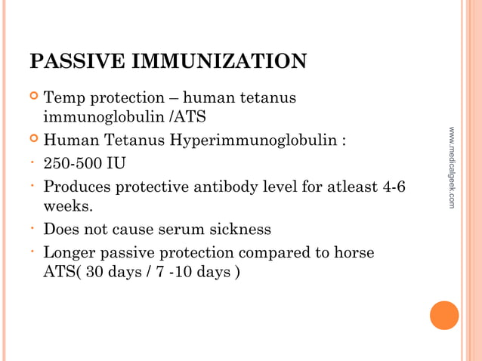

Slide 60
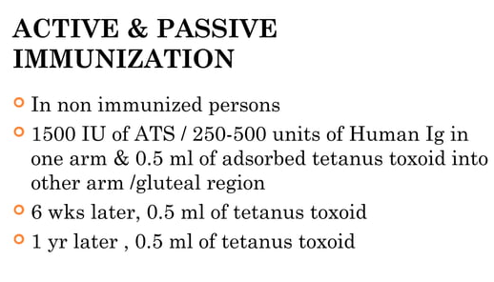

Slide 61
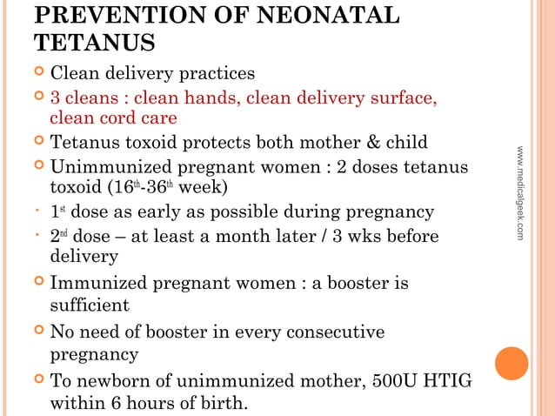

Slide 62
Prevention of neonatal tetanus…

Slide 63
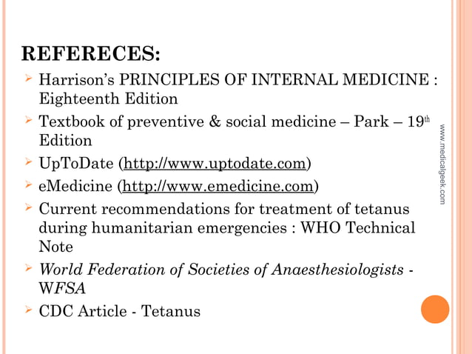


Slide 64
Thanks For Listening

