Slide 1
CRISIS MANAGEMENT AND COUNSELLING
DR JULIUS ADEDUNTAN
FEDERAL NEUROPSYCHIATRIC HOSPITAL, BENIN CITY
12 February 2025

Slide 2
OUTLINE
OBJECTIVES
INTRODUCTION
CRISIS
CRISIS MANAGEMENT
PSYCHOLOGICAL FIRST AID
CRISIS COUNSELLING
CONCLUSION
REFERENCES

Slide 3
OBJECTIVES
To explore the concept of Crisis
To describe Principles of Crisis management and Counselling

Slide 4
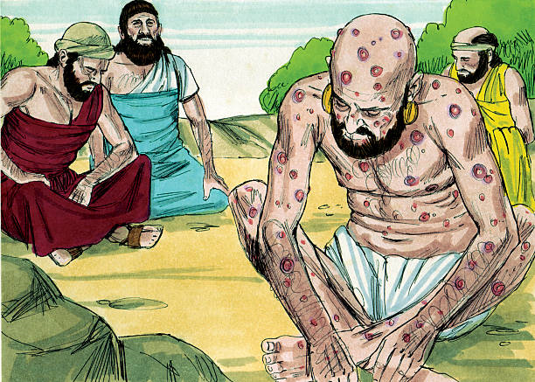
Crisis intervention since antiquity
"You, however, smear me with lies; you are worthless physicians, all of you! If only you would be altogether silent! For you, that would be wisdom.” ~ Job (1)
(Job 13:4-5)
When crisis counselling goes wrong…!

Slide 5
Introduction
Crisis is considered to be a fact of life and a common event in human experience.
Different methods are deployed in various socio-cultural and religious context since antiquity
Crisis in so many forms is now visibly present locally, nationally, and internationally.
Crisis intervention, is currently moving in the direction of being seen as a social movement in response to personal and communal tragedy

Slide 6
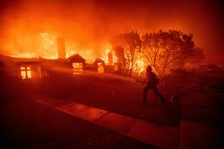
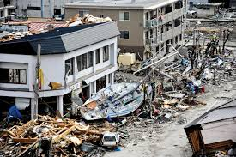


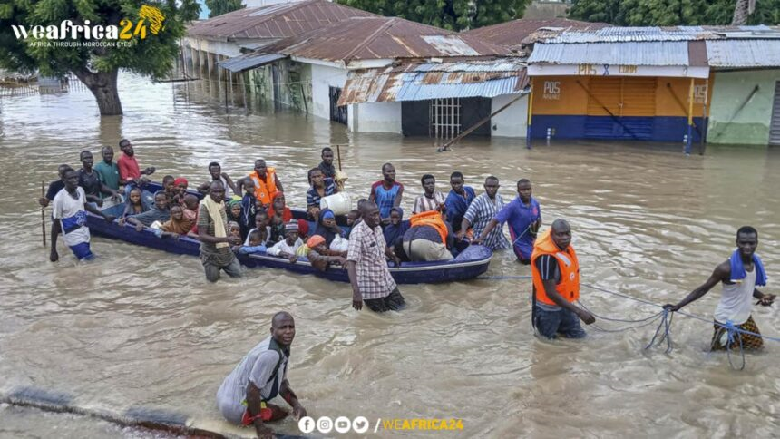



CRISIS

Slide 7




CRISIS

Slide 8

CRISIS(2)
James and Gilliland (2005) define crisis as “the perception of an event or situation as beyond the coping mechanisms of the individual”
Three components can be discerned from this definition:
  A precipitating event occurs,
  The perception of the event leads to subjective distress
  The usual coping mechanisms fail
Results in a state of disequilibrium and
dysfunction.

Slide 9
CRISIS
It is assumed that all people experience psychological stress that can turn into crisis at different times in their lives. Only when the event is subjectively experienced as a threat to need fulfillment, safety, or meaningful experience does the individual enter into a state of crisis (2).
“I’m in a crisis when I say that I am.”
The difference between stress and crisis is hence not merely of the magnitude of the stressor, but also of the presence of other vulnerability factors

Slide 10
CRISIS: Vulnerability Factors(3)
The nature and severity of the event(s)
Previous distressing events
Existing Psychosocial support
Physical health status
Personal and family history of mental health problems
Cultural background and traditions
Age

Slide 11
Crisis: Types
Developmental Crisis: dramatic shifts within the context of normal growth and development
e.g. marriage, having a first child, mid-life crisis
Situational Crisis: uncommon dire events that cannot be forcasted
e.g. Road Traffic Accident, natural disaster, bereavement
Existential Crisis: inner conflicts about existential issues like joy, fulfillment, purpose etc.
  e.g. Sudden realization that certain life dreams may never be accomplished
Systemic Crisis

Slide 12
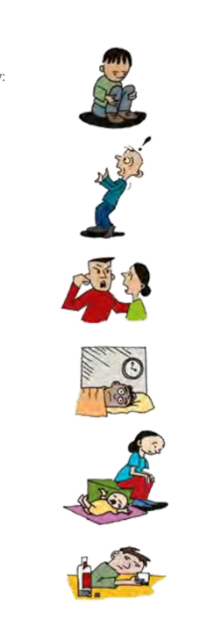
Profile of a person in Crisis(4)
Emotional Responses: Sadness, anger, despair, fear, apathy, guilt
Cognitive Responses: impaired concentration, confusion, disorientation, cognitive distortions
Behavioral Responses: social withdrawal, aggression, sleep and eating difficulties, neglect of self care and responsibilities, mal-adaptive coping mechanisms and defense mechanisms
Physical Responses: tachycardia, palpitations, headache, dizziness, fainting, fatigue
Spirituality: doubts about religious believes, increased religious activities

Slide 13
CRISIS MANAGEMENT
Refers to methods used to offer immediate short term help to people in crisis
Temporary but active and supportive interventions that provide relief for distresses, restore functionality, and prevent development of other long term problems.
A wider perspectives includes measures in preventing disasters/crisis

Slide 14
CRISIS MANAGEMENT(2)
Crisis intervention operates under the fundamental notion that an individual’s resistance to stress is finite and idiosyncratic, so that under certain circumstances, every person will find his or her coping mechanisms inadequate to sustain psychological equilibrium.
Crisis treatment involves systemic efforts to supplement the personal resources of the individual who is failing under stress, rather than assuming that the individual is in the presence of a disease process.
The successful resolution of the crisis may lead to positive and constructive outcomes, such as self-enhancing coping ability, a decrease in negative, self-defeating, dysfunctional behavior, and a return to the precrisis level of functioning

Slide 15

Crisis Management: Goals(5)
The outcome/goals of contemporary crisis practice is defined in terms of
  Restoration of the individual’s pre-traumatic level of overt functioning
  Return to pre-crisis equilibrium
  Incorporation of the immutable changes caused by the crisis event.

Slide 16
Models of Crisis Interventions(6)
Roberts’ Seven-Stage Crisis Intervention Model
Conduct a thorough survey of the person’s emotional, cognitive and behavioral reactions to the crisis and assess their risk of suicide or imminent danger
Rapidly establish rapport with the client
Identify major problems, including crisis precipitants
Encourage exploration of feelings and emotions
Develop a list of alternative resources and coping strategies
Implement an action plan to restore functioning
Agree on follow-up and booster sessions

Slide 17
Models of Crisis Interventions(6)
SAFER-R Model
S) Stabilize
A) Acknowledge
F) Facilitate understanding
E) Encourage adaptive coping
R) Restore functioning
R) Refer

Slide 18
Models of Crisis Interventions
Gilliland’s six step model
ABC Model
ACT model

Slide 19
Crisis Management: Modalities
Crisis hotlines
Mobile Crisis Intervention Units
Institution based Crisis management Team
National and multinational Agencies e.g. Nigeria's National Emergency Management Agency (NEMA)
Socio-culturally and Religiously prescribed interventions

Slide 20
Psychological First Aid (PFA) (7,8)
Psychological first aid (PFA) describes a humane, supportive response to a fellow human being who is suffering and who may need support.
PFA is often part of a broader response to large humanitarian emergencies, hence need for coordination with other emergency services.
PFA targets factors that seem to be most helpful to people’s long-term recovery. These include:
  Feeling safe, connected to others, calm and hopeful
  Having access to social, physical and emotional support
  Feeling able to help themselves, as individuals and communities

Slide 21
PFA involves the following themes:
Providing practical care and support, which does not intrude
Assessing needs and concerns
Helping people to address basic needs (for example, food and water, information)
Listening to people, but not pressuring them to talk
Comforting people and helping them to feel calm
Helping people connect to information, services and social supports
Protecting people from further harm.

Slide 22
PFA: Who, When, Where?
Who needs PFA: people recently exposed to a serious crisis event, and needs help. Do not force help on people who do not want it.
When: during or immediately after an event. However, it may sometimes be days or weeks after, depending on how long the event lasted and how severe it was.
Where: wherever it is safe enough for you to do so; community settings, scene of an accident, health centers, shelters or camps, schools and distribution sites for food etc.

Slide 23
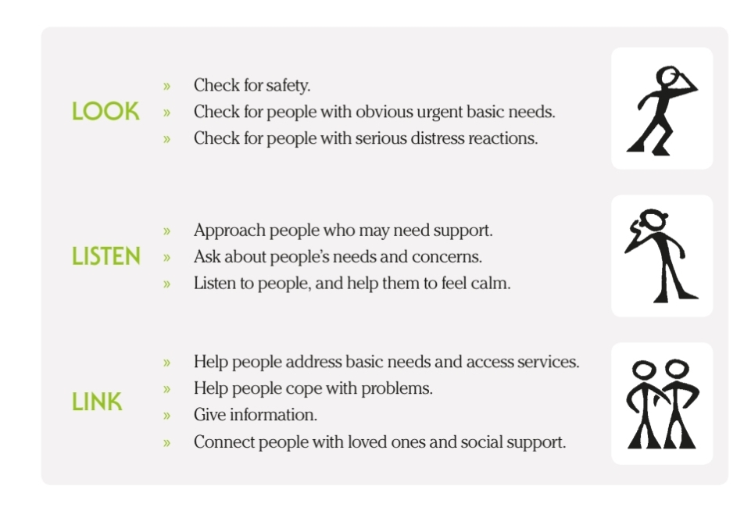
WHO Action Principles of PFA: Look, Listen, and Link (3)

Slide 24
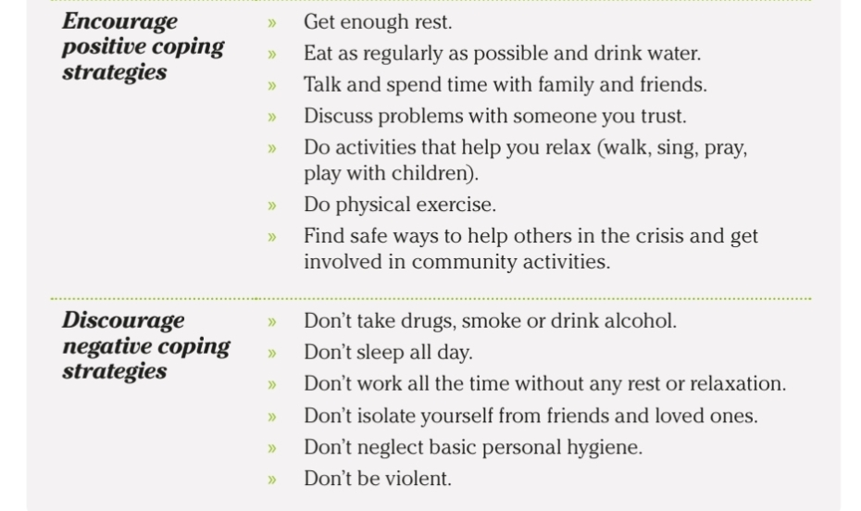
Coping… (3)

Slide 25
Crisis Counselling(5)
Crisis counseling is a specific type of psychological counseling that provides psychological support and assistance to a healthy but emotionally, intellectually and physically exhausted person in difficult, challenging circumstances.
Developed based on observations made of soldiers during World War 1 and 2
Specific counselling has been described for different types crisis: e.g. grief counselling, suicide, sexual assault, natural disaster, terminal illnesses, etc.
Incorporates principles/themes of crisis intervention described above into the counselling sessions.

Slide 26
Crisis Counselling
Crisis counseling is a short-term intervention for “healthy” people in crisis.
It has a specific goal of dealing with the specific crisis event that is presently bothering the person.
A typical crisis counseling session can last anywhere from 15 minutes to two hours and the individual usually attends between one and three sessions.
It deploys cognitive-behavioral, interpersonal, Gestault, existential, and problem solving principles(2)

Slide 27
General Principles of Counselling(2)
Therapeutic Relationship
Empathy
Unconditional Positive Regard
Genuineness
Active Listening

Slide 28
Conclusion
Crisis occurs when negative perception of distressing events overwhelm existing coping resources resulting in disequilibrium and dysfunction
Crisis management aim to restore equilibrium and functionality
Different principles, models, and modalities have been described which should be adapted to various socio-cultural, religious, and institutional settings.
Skills for crisis intervention and Psychological first aid should be considered a necessity for everyone, in much the same way as physical first aid.

Slide 29
THANK YOU!

Slide 30
References
https://www.bible.com/bible/111/JOB.13.NIV#:~:text=4You%2C%20however%2C%20smear%20me,you%2C%20that%20would%20be%20wisdom
Jackson R., Frieder B. Crisis Counselling and therapy. Taylor and Francis group: (2007). 1-25
Psychological first aid: Guide for field workers. World Health Organization: 2011.
Harrison P, Coventry P, Burns T, Fazeley M. Shorter Oxford textbook of Psychiatry. 7th ed. Oxford(UK): Oxford University press; 2018. p. 135-8.
Demchenko, I., Sımko, R., Hudyma, O., Levchuk, N., Shportun, O., & Samara, O. (2022). Psychological Counseling of Clients in Crisis Situations. BRAIN., 13(3), 104-118.

Slide 31
References
6. Crisis Intervention Counseling, Techniques & Model. Study.com, 18 March 2024, study.com/academy/lesson/crisis-intervention-counseling-techniques-model.html
The Sphere Project (2011) Humanitarian Charter and Minimum Standards in Disaster Response. Geneva: The Sphere Project. http://www.sphereproject.org.
Inter-Agency Standing Committee (IASC) (2007). IASC Guidelines on Mental Health and Psychosocial Support in Emergency Settings. Geneva: IASC. http://www.who.int/mental_health_psychosocial_june_2007.pdf

