Slide 1
OCCUPATIONAL THERAPY INTERVENTION FOR CHILDREN WITH ATTENTION DEFICIT HYPERACTIVE DISORDER
BY
EJIMADU EBERE
O.T UNIT

Slide 2
OUTLINE
Objective
Introduction
Definition
Types
Causes
O.T Management/Intervention
Conclusion
Reference

Slide 3
OBJECTIVES
To understand the importance of occupational therapy management for children with attention deficit hyperactive disorder (ADHD).
To educate other healthcare professionals about occupational therapy roles in treatment of children with ADHD.

Slide 4
INTRODUCTION
WHAT IS OCCUAPTIONAL THERAPY?
Occupational therapy is a client centered health profession that is concern in promoting health and wellbeing through occupation.
The primary goal of occupational therapy is to enable people to participate in the activity of daily living (WFOT, 2012).
Occupational therapist addresses co-existing physical or sensory integration concerns, such as motor planning, balance, coordination problem and hand-writing difficulties.

Slide 5
INTRODUCTION
An occupational therapist considers the effect of learning and attention problems, have on children’s ability to perform valued activities.
Occupational therapist provides support to parents to help their children, using occupation (activities) as the means to promote health and general well-being.

Slide 6
DEFINITION
ATTENTION DEFICIT HYPERACTIVE DISORDER:
This is a neurodevelopmental disorder that’s characterized by a persistent pattern of inattention, hyperactivity, or impulsivity that negatively impacts a person’s academic, occupational performance, interpersonal relationship and their activity of daily living, or social functioning (ICD-11).

Slide 7
Both adults and children can be diagnosed with ADHD . The symptoms vary from individual to individual, They may experience all or just some of the symptoms of attention deficit hyperactive disorder (According to DSM-V).

Slide 8
CAUSES OF ADHD
The causes of attention deficit hyperactive disorder is unknown but there appears to be a combination of genetic and environmental factors which include:
Premature birth or Blood relatives, such as parent or sibling with ADHD.
Maternal smoking or alcohol exposure during pregnancy.
Exposure to environmental toxins such as leads found mainly in paint and pipes in older buildings

Slide 9
TYPES OF ADHD
According to Diagnostic and Statistical Manual of Mental Disorder (DSM-V) identified 3 types of ADHD :
Inattentive type: symptoms of inattention.
Hyperactive/Impulsive type: symptoms of hyperactive and impulsive behavior.
Combined types: both inattention and hyperactivity.

Slide 10
Inattention Disorder: This refers to challenges with staying on tasks, focusing and organization.
CLINICAL FEATURES
Unable to pay attention to details in tasks or play activities/makes careless mistakes.
Doesn't seem to listen when spoken to (seems to be elsewhere).
Unable to follow through instruction and fails to finish schoolwork, chores or jobs ( may start the task but quickly loses focus).

Slide 11
Has difficulty organizing tasks (doesn't manage time well, has messy disorganized work).
Often loses items necessary for completing a task or daily living (toothbrush, shoes), schoolpappers, books, keys, wallet, cell phone and eyeglasses.
Easily distracted/forgetfulness in daily activities.

Slide 12
HYPERACTIVE/IMPULSIVE DISORDER: refers to excessive movement such us fidgeting, excessive energy while Impulsivity refers to decision or action taken without thinking through the consequences.
CLINICAL FEATURES
Hyperactive/Impulsive Disorder:
The child appear to be in motion and “on the go” as if driven by a motor.
Difficulty keeping their bodies still-moving about excessively, fidgeting hands and their feet.

Slide 13
Restless behavior.
Talk excessively, interrupt others, not letting others talk.
Can’t remain seated at school or workplace
Has difficulty waiting his or her turn, or while waiting in line.
Runs about/climbs extensively when inappropriate.
Blurts out answer before question is finished (may finish peoples sentences, can’t wait to speak in conversation).

Slide 14
COMBINED TYPE:
This is when children experience both inattention and hyperactive/impulsive symptoms of ADHD. Unlike the other type of ADHD.

Slide 15
TREATMENT TEAM
Psychiatric management, Nursing management, clinical psychology management speech therapy management, pharmacologist, pediatrician and occupational therapy management.

Slide 16
O.T ASSESSMENT/EVALUATION
O.T ASSESSMENT
BIO-DATA
ANTE-NATAL HISTORY
PERI-NATAL HISTORY
MEDICAL HISTORY
FAMILY HISTORY
PHYSICAL EXAMINATION
SELF-HELF SKILLS
SPEECH AND LANGUAGE
PROBLEM IDENTIFIED

Slide 17
O.T EVALUATION
Evaluate the child using the information gotten from the parents/caregivers. During the evaluation process O.T looks at how the disorder (ADHD) has affect the child’s:
ADL (Activity Of Daily Living).
Academic performance.
Cognitive function (attention, concentration and ability to follow command).
Social interaction.

Slide 18
OCCUPATIONAL THERAPY TREATMENT INTERVENTIONS
Occupational therapist aim to improve the child ability to learn self-care skills such as:
Feeding.
Bathing.
Toileting.
Dressing/undressing.
Buttoning/unbuttoning and unzipping.
Grooming (brushing, combing, shinning shoes, cleaning nails/ nose when sneezing/coughing).

Slide 19
Occupational therapist engages the child in activities to improve the child sensory integration it helps children with ADHD who have sensory processing disorder by developing adaptive response to sensory input which can improve attention and self-regulation. The activities used in sensory integration included:
To provide tactile stimulation
To provide proprioceptive stimulation
To provide vestibular stimulation
To provide auditory stimulation.
Which in turn organize the sensory system

Slide 20
Occupational therapist engages the child in activities to improve the child tactile stimulation such as:
Play dough: manipulating and molding play dough engages the sense of touch and texture.
Sand play: Playing in sand pits.
Texture board: Exploring different texture on boards or surfaces.

Slide 21


Tactile Sensory Stimulation:

Slide 22
Occupational therapist aims at improving the child Proprioceptive Stimulation with the use bouncing on a trampoline this helps to provide extra body awareness and the use of Weighted Blankets, the deep pressure and weight of a weighted blanket can help to improve body position and boundaries, provide resistant, promote relaxation, and help children with ADHD feel more calm.

Slide 23
Occupational therapist engages the child in activities to improve the child’s vestibular stimulation such as, balance, spatial orientation, and eye/hand coordination with the use of Swing and rocking. The therapist makes their own swing by having two people hold a blanket and swing the child back and forth.

Slide 24
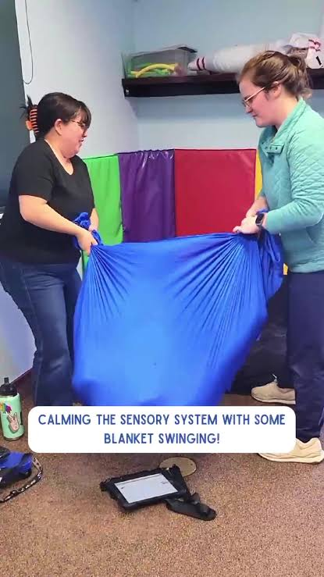

Slide 25
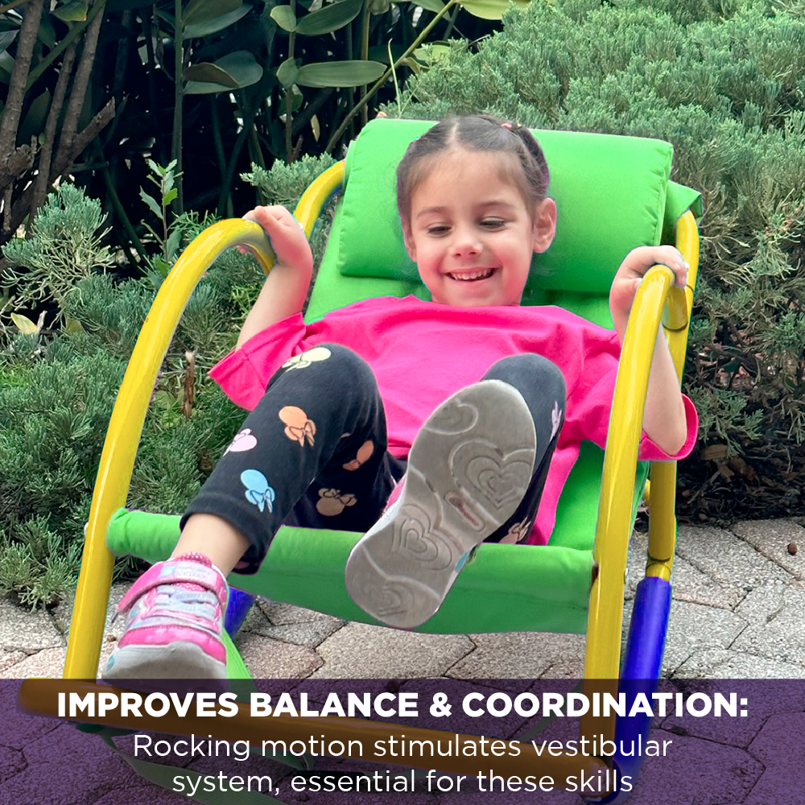
Rocking: Rock in a rocking chair, or rocking on an exercise therapeutic ball.

Slide 26

Occupational therapist uses neutral warmth (the use of blanket) in other to reduce the child’s hyperactive behavior and to improve relaxation.

Slide 27
Occupational therapist helps to improve the child’s auditory stimulation by removing distracting stimuli such as providing a quiet spaces during performing an activities, in other to improve the child's attention, concentration, and the ability to follow ones command.

Slide 28
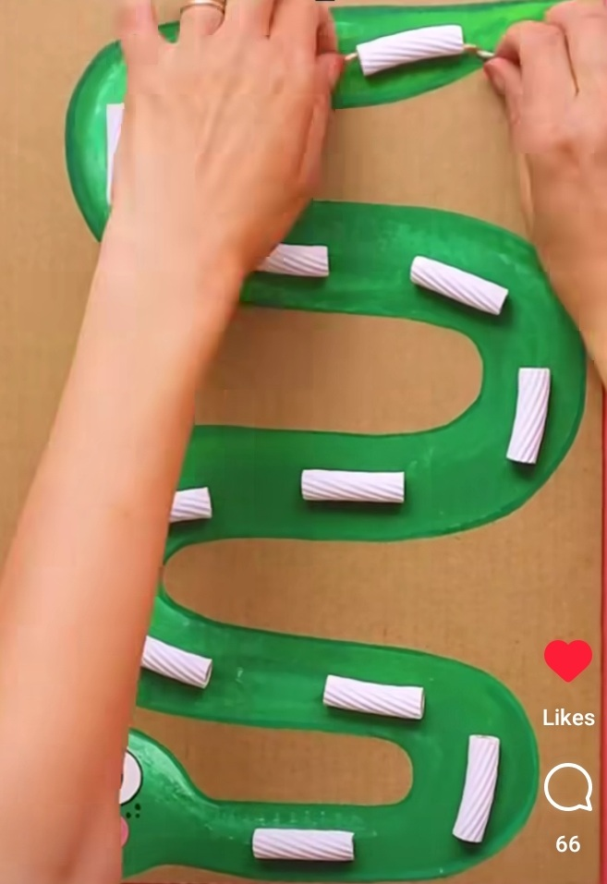


Slide 29

Occupational therapist engages the child in social skill activities with peers in other to improve the child play and social interaction.

Slide 30
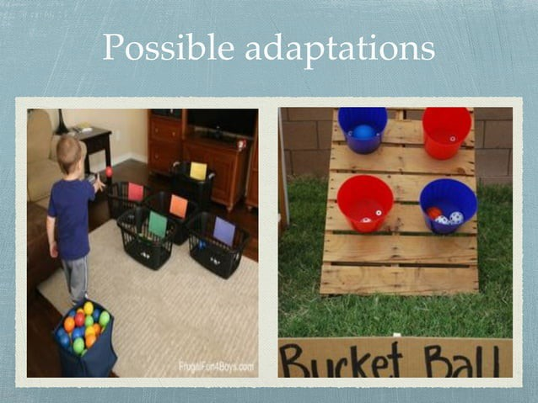

Slide 31

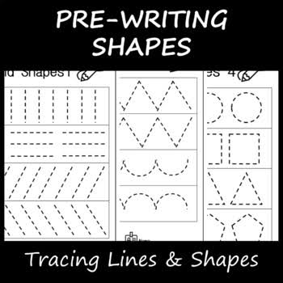
Occupational therapist aim to improve the child’s writing, reading and spelling skills by engaging the child in activities to be able to improve the child Academic performance in school.

Slide 32
Occupational therapist aim to improve the child behavior by using behavioral modification technique such as:
Positive/negative reinforcement.
Activity analysis.
Educating parents/caregivers.

Slide 33
Method/Approaches by O.T
Sensory Integration Therapy.
Cognitive Behavioral Therapy.
Play therapy.
Activity analysis.

Slide 34
Conclusion
Children with this challenge (ADHD) can thrive and succeed in all areas of their lives and Occupational therapy management is most effective and beneficial when parents play an active role in the treatment process such as preparing and supporting their child with ADHD during the therapy sessions, providing feedback and celebrating the child’s success.

Slide 35
REFERENCE
World Federation of Occupational Therapy (WFOT) (2012).Definition of occupational therapy.
International Classification of Disease 11th Revision; world health organization, (2019).
Larsson, H., Chang, Z., D’Onofrio, B. M., et al., (2014). The heritability of clinically diagnosed attention deficit hyperactivity disorder across the lifespan. Psychol. Med 44(10):2223-9.
Post, R.E. & Kurlansik, S.L. (2012). Diagnosis and management of adult attention-deficit/hyperactivity disorder. Am Family Physician. 85(9):890-6.

Slide 36


