Slide 1
OVERVIEW OF PHYSIOTHERAPY MANAGEMENT
nnbnnnnjjjjh
PRESENTED BY
OSADOLOR BENEDO OSAHENI
PHYSIOTHERAPIST
FEDERAL NEURO-PSYCHIATRIC HOSPITAL, BENIN

Slide 2
OBJECTIVES
To understand the definition of physiotherapy
To know the areas of specialization in physiotherapy.
To know the settings physiotherapists practice
To know the roles of physiotherapy management
To identify some physiotherapy treatment modalities

Slide 3
OUTLINE
INTRODUCTION
BRIEF HISTORY OF PHYSIOTHERAPY
AREAS OF SPECIALIZATION
SETTINGS FOR PHYSIOTHERAPY PRACTICE
ROLES OF PHYSIOTHERAPY IN HEALTHCARE
PHYSIOTHERAPY TREATMENT MODALITIES
PHYSIOTHERAPY IN MENTAL HEALTH
CONCLUSION
REFERENCE

Slide 4
INTRODUCTION
Physiotherapy, also known as physical therapy (PT), is a healthcare profession that focuses on the assessment, diagnosis, treatment, and prevention of physical impairments, disabilities, and pain through various physical means.
Physical therapy are services provided by physical therapists to individuals to develop, maintain and restore maximum movement and functional ability throughout the lifespan (WCPT 2017).

Slide 5
INTRODUCTION CONT’D
The major goal of physiotherapy is to restore movement and function that has been impaired by injury or diseases to normal or a near normal state.
PT interventions are tailored to the individual needs of patients and can vary widely depending on the condition being treated.

Slide 6
INTRODUCTION CONT’D
Benefits of PT management include alleviation of acute and chronic pain, improves mobility, function, coordination, strengthen muscles and aid recovery from injury.
PT is a key player in the healthcare team, collaborating with doctors, nurses, occupational therapists, and other professionals to provide comprehensive care.

Slide 7
Brief history of physiotherapy
Hippocrates and Galen are believed to have been the first practitioners of physical therapy, advocating massage, manual therapy techniques and hydrotherapy to treat people in 460 BC.
In the 19th century, catastrophes such as the polio outbreak and world wars resulted in the rapid advancement of physiotherapy on a global scale.

Slide 8
Brief history of physiotherapy cont’d
Physiotherapy was introduced into Nigeria in 1945 by two British Chartered Physiotherapists employed by the government.
They were attached to the National Orthopedic Hospital, Igbobi, Lagos, to treat wounded and disabled soldiers after second world war.
They also started a training program in physiotherapy.

Slide 9
AREAS OF SPECIALIZATION
Orthopedics; Osteoarthritis, spondylosis
Neurology; CVA, Spinal cord injuries
Pediatrics; Erb’s palsy, cerebral palsy
Geriatrics; Falls

Slide 10
AREAS OF SPECIALIZATION CONT’D
Cardiorespiratory; Bronchopnemonia
Sports; Sprain, Strain
Women's health; Pelvic floor dysfunction
Community physiotherapy.

Slide 11
SETTINGS FOR PHYSIOTHERAPY PRACTICE
Educational and Research Institutions
Hospitals
Nursing and Geriatric homes
Out-patient clinics
Private practices/clinics
Sport centres/clubs

Slide 12
Roles of physiotherapy in healthcare
Assessment and Diagnosis:
PT conduct a thorough assessment, including medical history, physical examination, and functional assessments to identify the patient's needs.
Medical Rehabilitation:
PT help patients recover from injuries, surgeries, and illnesses by designing personalized treatment programs.

Slide 13
ROLE OF PHYSIOTHERAPY IN HEALTHCARE CONT’D
Patient Education and Prevention of Illness:
Ergonomics, Activity Modification and Health promotion.
Research and Evidence-based practice

Slide 14
Physiotherapy treatment modalities
Exercise Therapy
Electro-physical Agents
Manual Therapy

Slide 15
Physiotherapy treatment modalities
EXERCISE THERAPY
Strengthening exercise
Stretching exercise
Breathing exercise
Gait and balance training
Coordination exercises

Slide 16
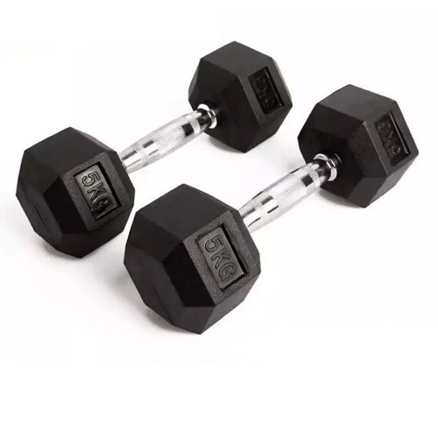
EXERCISE THERAPY
A
B
C

Slide 17
Physiotherapy treatment modalities
ELECTRO-PHYSICAL AGENTS
Transcutaneous Electrical Nerve Stimulation (TENS)
Functional Electrical Stimulation (FES)
Infra-Red Radiation
Therapeutic Ultrasound
Hydrocollator Packs
Cryotherapy; Ice packs, Vapocoolant spray
LASER

Slide 18
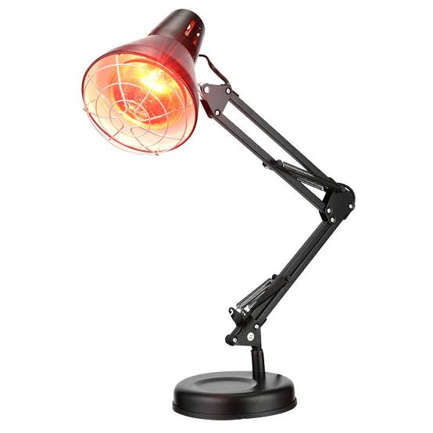
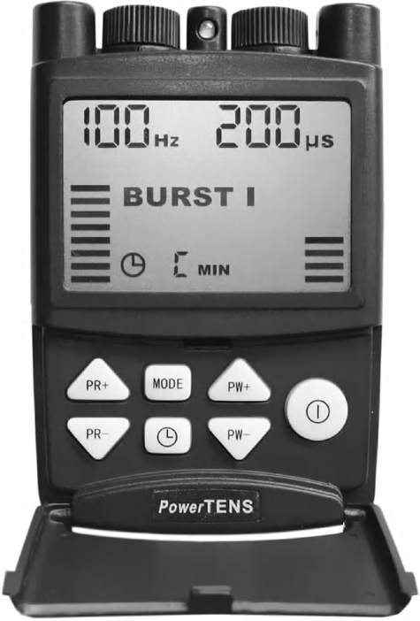
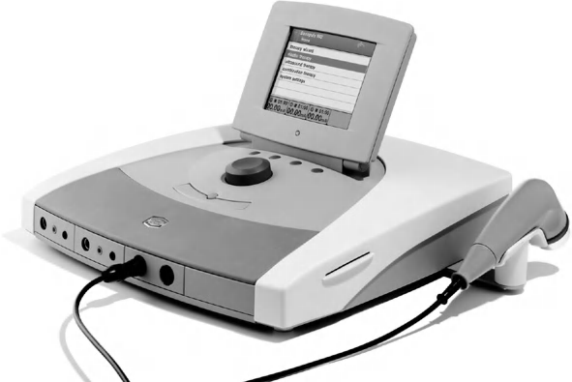
ELECTRO-PHYSICAL AGENTS
A
B
C

Slide 19
Physiotherapy treatment modalities
MANUAL THERAPY
Soft Tissue Mobilization
Joint Mobilization
Manipulation

Slide 20
Physiotherapy treatment modalities
ASSISTIVE AND ORTHOTIC DEVICES
Splints
Braces
Crutches
Zimmer’s frame
Walking cane

Slide 21
PHYSIOTHERAPY IN MENTAL HEALTH
Stress Reduction and Anxiety Management; Regular exercises boost endorphin level. Breathing exercises help to relieve tension and promote relaxation.
Pain Management for co-existing physical condition; Chronic pain can exacerbate symptoms of depression and psychological distress.
Exercise therapy for Depression; Moderate to high intensity exercises are effective in reduction of depressive symptoms (Xie et al., 2021).
Management of Co-morbid conditions

Slide 22
CONCLUSION
Physiotherapy is an integral component of healthcare that addresses a wide range of physical issues. Physiotherapy interventions are diverse and can be adapted to meet the specific needs of individuals across various age groups and conditions.
The ultimate goal is to enhance physical function, reduce pain, and improve the quality of life for patients.

Slide 23
REFERENCES
Tidy, N. M.(2013). Tidy’s Physiotherapy (S. B. Porter, Ed.; [15th ed.]). Saunders Elsevier
Singh, J. (2012). Textbook of Electrotherapy, 3rd Edition, Jaypee Brothers Medical Publishers.
Physiotherapy/ Physical Therapy. Physiopedia. Retrieved October 29th, from https://www.physio-pedia.com/Physiotherapy_/_Physical_Therapy
WCPT. Policy statement: Description of physical therapy. Retrieved October 29th,http://www.wcpt.org/policy/ps-descriptionPT#appendix_1
History of Development of Physiotherapy in Nigeria. Nigeria Physiotherapy Network. Retrieved October 26th, 2024 from https://www.nigeriaphysio.net/history-of-development-of-physiotherapy-in-nigeria.
Xie, Y., Wu, Z., Sun, L., Zhou, L., Wang, G., Xiao, L., & Wang, H. (2021). The Effects and Mechanisms of Exercise on the Treatment of Depression. Frontiers in psychiatry, 12, 705559. https://doi.org/10.3389/fpsyt.2021.705559

Slide 24
THANK YOU!!!

