Slide 1
COMPARISON OF MERCURY SPHYGMOMANOMETER AND DIGITAL ALTERNATIVES BY IFIONAYI PRECIOUS (BIOMEDICAL TECH.) ON 23RD OCTOBER, 2024

Slide 2
OUTLINES
INTRODUCTION
TYPES OF SPHYGMOMANOMETERS
COMPARISON
PROPER HANDLING AND MAINTENANCE OF SPHYGMOMANOMETERS
CONCLUSION
REFERENCES

Slide 3
OBJECTIVE
To understand the significant differences in sphygmomanometers.
To understand the proper handling of sphygmomanometers for durability.

Slide 4
INTRODUCTION
Sphygmomanometers are essential medical tools used in both clinical settings and home healthcare. The sphygmomanometer, commonly referred to as a blood pressure monitor plays a critical role in diagnosing and managing cardiovascular conditions. It is used to measure arterial blood pressure, which reflects the force of blood pushing against the walls of arteries.
Accurate measurement of blood pressure cannot be overemphasized, as it is crucial for identifying conditions like hypertension, which can lead to more serious health issues such as heart disease, stroke, and kidney failure.

Slide 5
Blood pressure readings consist of two numbers:
Systolic pressure: The first (higher) number, representing the pressure in the arteries when the heart beats.
Diastolic pressure: The second (lower) number, indicating the pressure in the arteries when the heart rests between beats.
There are 3 types of sphygmomanometers:
Mercury sphygmomanometers
Digital sphygmomanometers
Aneroid sphygmomanometers

Slide 6
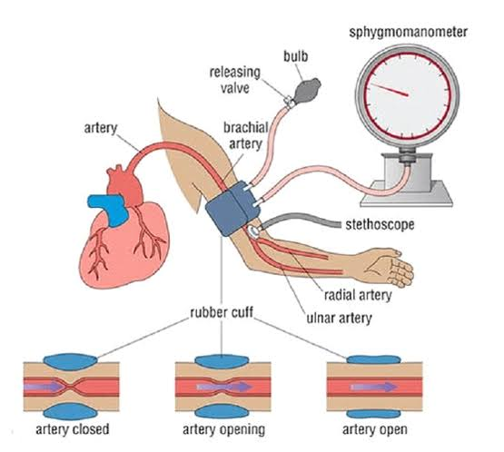

Slide 7
TYPES OF SPHYGMOMANOMETERS
Mercury Sphygmomanometer This is the gold standard for accuracy. It uses a column of mercury to measure blood pressure. The mechanism is based on the height of the mercury column in a graded glass tube containing mercury, which measures the pressure applied by the bladder of the inflatable rubber cuff on the upper arm. The use of this device has decreased due to concerns about mercury toxicity and technological advancements.

Slide 8
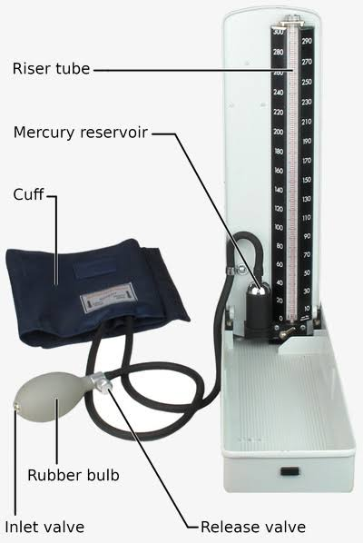

Slide 9
Digital Sphygmomanometer Digital blood pressure monitors represent a reliable, accessible, and environmentally friendly alternative for hypertension management. Due to advancements in medical health technology, clinical engineers/biomedical engineers developed this device, which offers a promising solution by allowing individuals to monitor their blood pressure conveniently and regularly. Its mechanism electronically measures blood pressure, with the cuff directly connected to the device.

Slide 10
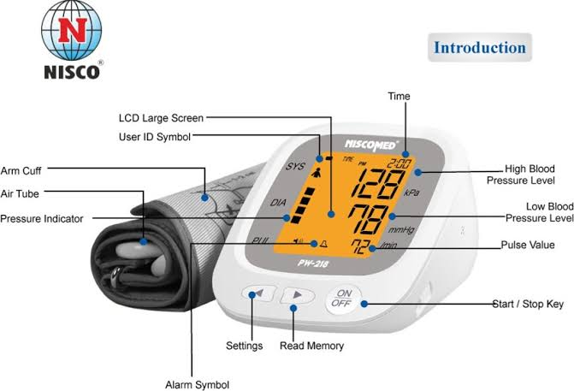

Slide 11
Aneroid Sphygmomanometer This device operates mechanically and features a dial gauge with a needle/point instead of mercury. It requires regular calibration for accuracy since it can lose precision over time. However, it is widely used due to its portability and cost-effectiveness.

Slide 12
COMPARISON
CRITERIA | MERCURY SPHYGMOMANOMETER | DIGITAL SPHYGMOMANOMETER
ACCURACY | Considered the gold standard, very accurate, particularly in detecting systolic pressure | Accurate but can be affected by motion, irregular heartbeat, or calibration issues
EASE OF USE | Requires training to use effectively. Manual readings can be challenging for non-professionals | User-friendly and easy to use. Automatic display processes make it accessible for both professionals and non-professionals
ENVIRONMENTAL IMPACT | Contains mercury, which is toxic and hazardous to the environment if not properly disposed of | Mercury-free and generally safer for the environment

Slide 13
MAINTENANCE | Requires regular calibration and careful handling to avoid mercury spills | Requires periodic calibration and battery replacement. Electronic components may wear out over time
DURABILITY | Highly durable if well-maintained | Durability depends on the make/quality, but mercury sphygmomanometers are generally more durable
COST | Less expensive to purchase but more expensive to maintain | Wide range of prices and generally lower maintenance costs
CLINICAL USE | Preferred in clinical settings for its accuracy, particularly in high-risk patients | Increasingly used in both clinical and home settings due to ease of use and accessibility
REGULATORY COMPLIANCE | Some regions have phased out mercury devices due to environmental concerns | Generally compliant with modern regulatory standards, containing no hazardous materials

Slide 14
PROPER HANDLING AND MAINTENANCE OF SPHYGMOMANOMETERS
To ensure a long service life for sphygmomanometers:
Regular calibration should be carried out frequently if the device is heavily used, as this will ensure its accuracy.
Inspect the tubing and bulb for air leaks or cuts. Clean the cuff periodically with a mild disinfectant, especially in clinical settings, to prevent the spread of infections.
Service the device periodically and replace damaged parts, such as the bulb, gauge, or cuff.

Slide 15
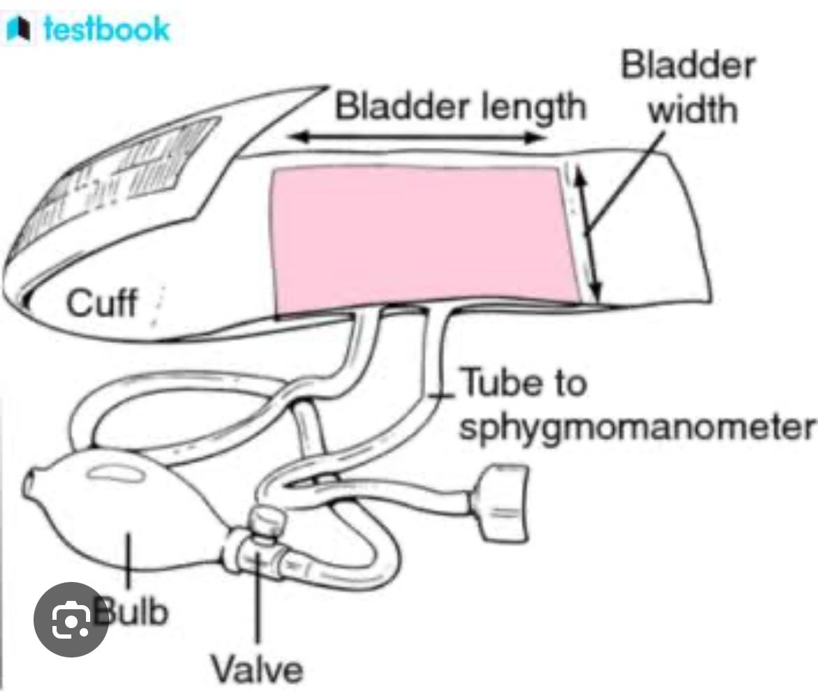

Slide 16
Ensure that aneroid or digital sphygmomanometers are not exposed to moisture and store the cuff loosely to avoid damage to the inner bladder.
Regularly check the battery level and replace or recharge as needed. Avoid exposure to magnetic fields, which can interfere with digital accuracy.
Close the sphygmomanometer properly after use.

Slide 17
CONCLUSION
The sphygmomanometer, though simple in design, is a powerful tool in preventive healthcare. Its role in monitoring blood pressure helps in managing chronic conditions and reducing the risk of life-threatening cardiovascular events. Understanding how to handle, maintain, and use is essential for both healthcare professionals and individuals monitoring their blood pressure at home.
In a country like Nigeria, where economic pressures affect the population, it is highly recommended that every home have at least a digital sphygmomanometer.

Slide 18
REFERENCES
Booth J (1977). "A short history of blood pressure measurement". Proceedings of the Royal Society of Medicine. 70 (11): 793–9. doi:10.1177/003591577707001112. PMC 1543468. PMID 341169.
"Turning Mercury Into Solid Gold". The New York Times. 27 March 2005. Retrieved 5 July 2018.
"Comparing Mercury and Aneroid Sphygmomanometers". Sustainable Hospitals / Lowell Center for Sustainable Production. 2003. Retrieved 23 February 2015.
Misrin J. "Aneroid Sphygmomanometer: A Battle for Safer Blood Pressure Apparatus". Archived from the original on 10 August 2015. Retrieved 27 February 2012.
"Oscillometry, Explanation of oscillometric detection in Medical Electronics, N Townsend, p48-51" (PDF). Archived from the original (PDF) on 22 May 2013. Retrieved 10 February 2013.
"Oscillometric Method - Methods of Blood Pressure Measurement - Measurement of Blood PressureMethods of Blood Pressure Measurement -". www.severehypertension.net. 22 December 2007. Retrieved 13 April 2017.

Slide 19
Hamzaoui O, Monnet X, Teboul JL (2013). "Pulsus paradoxus". Eur. Respir. J. 42 (6): 1696–705. doi:10.1183/09031936.00138912. PMID 23222878.
O'Brien E, Asmar R, Beilin L, Imai Y, Mallion JM, Mancia G, Mengden T, Myers M, Padfield P, Palatini P, Parati G, Pickering T, Redon J, Staessen J, Stergiou G, Verdecchia P (2003). "European Society of Hypertension recommendations for conventional, ambulatory and home blood pressure measurement". J. Hypertens. 21 (5): 821–48. doi:10.1097/00004872-200305000-00001. PMID 12714851. S2CID 3952069.
Mourad A, Gillies A, Carney S (2005). "Inaccuracy of wrist-cuff oscillometric blood pressure devices: an arm position artefact?" (PDF). Clinical Methods and Pathophysiology. 10 (2): 67–71. doi:10.1097/00126097-200504000-00003. PMID 15812253. S2CID 6100566.
"Blutdruckmessgerät - Handgelenk - Blutdruckmessgerät - Test" (in German). Blutdruckmessgeraet-vergleich-test.de. Retrieved 27 September 2016.
Chandrasekhar A (7 March 2018). "Smartphone-based blood pressure monitoring via the oscillometric finger-pressing method". Science Translational Medicine. 10 (431): eaap8674. doi:10.1126/scitranslmed.aap8674. PMC 6039119. PMID 29515001.

Slide 20
THANKS
FOR
LISTENING

