Slide 1
NEUROBIOLOGY OF ADDICTION.
DR IYAMU CLEMENT.O
FEDERAL NEUROPSYCHIATRIC HOSPITAL, BENIN-CITY.
15TH MAY, 2024.

Slide 2
OBJECTIVE
Understanding the term ‘’addiction’’ and the addiction circuitry.

Slide 3
OUTLINE
Introduction
Diagnostic criteria
Definition of terms
Addiction cycle
Phases of addiction process
Factors that increases risk of addiction
Theories of addiction
Treatment
Complications of addiction
Conclusion
References.

Slide 4
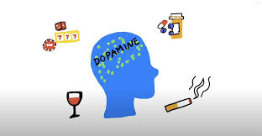

Slide 5
INTRODUCTION
Addiction is a state of dependence produced either by the habitual taking of drugs or by regular engaging in certain behavior. ( Advanced oxford dictionary).
It is a chronically relapsing disorder characterized by:
Compulsion to seek and take the drug.
Loss of control in limiting intake.
Emergence of a negative emotional state when access to the drug is prevented. (e.g irritability, dysphoria, anxiety).
The term “addiction” - negative stigma, hence the term dependence.

Slide 6
INTRODUCTION
DEPENDENCE- It is a cluster of physiological, behavioural and cognitive phenomenon in which the use of a substance or a class of substance take a much higher priority for a given individual than other behaviour that ones had greater value.

Slide 7
DIAGNOSTIC CRITERIA (ICD-10)
A strong desire or sense of compulsion to take the substance.
Difficulties in controlling substance taking behaviour in terms of its onset, termination, or levels of use.
Physiological withdrawal state when substance use has ceased or been reduced, as evidenced by: the characteristic withdrawal syndrome for the substance, or use of the same (or closely related) substance with the intention of relieving or avoiding withdrawal symptoms.

Slide 8
DIAGNOSTIC CRITERIA (ICD-10)
Evidence of tolerance, such that increased doses of the psychoactive substance are required to achieve effects originally produced by lower dose.
Progressive neglect of alternative pleasures or interests because of psychoactive substance use and increased amount of time necessary to obtain or take the substance or to recover from its effects.
Persisting use of substance despite clear evidences of overtly harmful consequences (physical or mental).

Slide 9
DEFINTION OF TERMS.
IMPULSIVITY: An inability to resist urges and making unreflective decisions without regard for consequences.
POSITIVE REINFORCEMENT: The process by which presentation of a stimulus such as drug increases the probability of a response like drug taking.
NEGATIVE REINFOREMENT: The process by which removal of a stimulus produces negative feeling or emotion and then increases the probability of a response like taking drugs.

Slide 10
DEFINITION OF TERMS
COMPULSIVITY: Repeated behaviour in the face of adverse consequences and repetitive behaviour that are inappropriate to a particular situation.
The transition from casual drug use to addiction has been neuro-biologically conceptualized as a shift from impulsive to compulsive use and driven by a transition from positive to negative reinforcement mechanisms.

Slide 11
ADDICTION CYCLE
The development of addiction can be described as a three-stage cycle:
Binge/intoxication stage.
Withdrawal/negative affect stage.
Preoccupation/anticipation stage.
Addiction to drugs work on three primary circuits:
Homeostatic impairment of the dopamine system.
Extra-hypothalamic actions of Corticotrophin releasing factor (CRF).
Cortical “hypo-frontality.

Slide 12
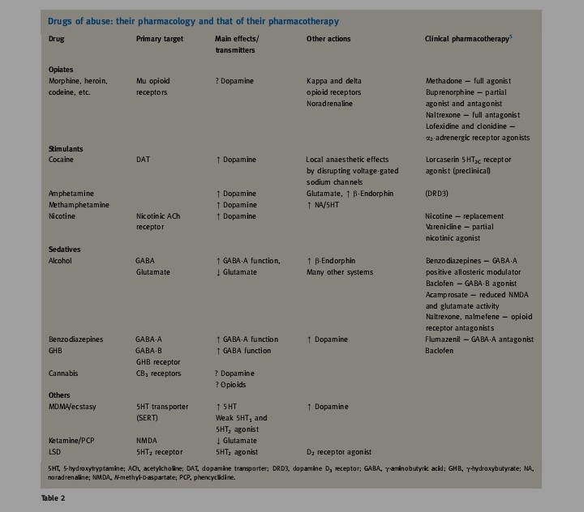
ACTIONS OF ADDICTIVE SUBSTANCES.

Slide 13
BINGE/INTOXICATION STAGE
Individual consume drug of choice.
This stage involves the basal ganglia, nucleus accumbens, dorsal striatum, VTA.
Initial drug use may begin in vulnerable individuals.
Addictive substance taken is sensed by the VTA (motivational area) causing release of dopamine to the nucleus accumbens (reward system).
Neurons that releases dopamine are activated directly or indirectly by all additive substances particularly stimulants.

Slide 14
BINGE/INTOXICATION STAGE
Feeling of pleasure, satisfaction and "high“.
Addictive substance cause an unusual high level of dopamine to be released.
This surpasses previous stored memory in the hippocampus.
The feeling of pleasure is positively reinforcing and the use of the substance continues.
The reward gotten from use of drug now surpassed every other previous memory.

Slide 15
BINGE/INTOXICATION STAGE.
In addition, the brain opioid systems play a role in mediating rewarding effect of other addictive substances (opioids, alcohol).
This activation of the opioid system directly or indirectly stimulates the VTA to release dopamine to the nucleus accumbens which reinforces the addiction.
Cues, places, person, drug paraphernalia, mood can activate dopaminergic system to cause release of dopamine, resulting in motivation to seek drug use.
Relapse prevention.

Slide 16
WITHDRAWAL/NEGATIVE AFFECT STAGE.
It follows the binge/intoxication stage and build up future binge and intoxication.
Happens in the extended amygdala.
Over time due to continued substance use the level of dopamine release from a certain dose of addictive substance reduces.
The individual will need more dose to achieve the previous level of pleasure (Tolerance).
When this happens or the drug is withdrawn temporarily or stopped, withdrawal and negative affect ensue.

Slide 17
WITHDRAWAL/NEGATIVE AFFECT STAGE
People with addiction have described withdrawal states as a “hunger” or a primary need that is only satisfied by taking more drug (i.e., negative reinforcement).
The negative feelings associated with withdrawal are thought to come from 2 sources:
1. Diminished activation of the reward circuitry of the basal ganglia doperminergic system.
2. Activation of the brain stress system in the extended amygdala.

Slide 18
WITHDRAWAL AND NEGATIVE AFFECT STAGE
The first process lead to tolerance.
The second process, by the process of activating the body stress system, stress NT are released (CRF/NE/dynorphin).
These play a role in the negative feelings associated with withdrawal, and in stress triggered substance use.
In a bid to removed the negative feelings is a strong motivation for continued substance use.
Negative reinforcement becomes compulsive.

Slide 19
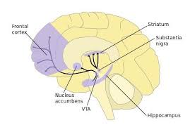

Slide 20
PREOCCUPATION/ANTICIPATION STAGE
In the prefrontal cortex- the executive region of the brain.
It is a stage where the person may begin to seek substance again after a period of abstinence (craving).
Prefrontal cortex- "Go system" "Stop system"
"Go system" help in decision making planning and reacts to substance associated environmental cues (incentive salience).
Exposure to cue dramatically increase the "Go system" prefrontal cortex activity.

Slide 21
PREOCCUPATION/ANTICIPATION STAGE
This causes stimulation of the nucleus accumbens to release glutamate (excitatory NT) to cause craving and a urge to use substances.
The "stop system" area of the prefrontal cortex cause inhibition of the "Go system" and control the dorsal striatum and nucleus accumbens, the part associated with binge/intoxication stage of addiction.
This stage of the addiction cycle is characterized by a disruption of executive function caused by a compromised prefrontal cortex.

Slide 22
PREOCCUPATION/ANTICIPATION STAGE
The over activation of the "Go system" in the prefrontal cortex promote habit like substance seeking and under activation of the "Stop system" of the prefrontal cortex promote impulsive and compulsive substance seeking.

Slide 23
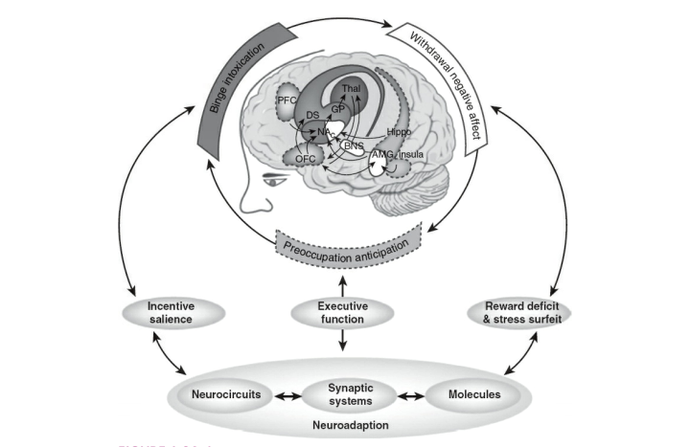

Slide 24
PHASES OF ADDICTION PROCESS
Initial use
Abuse
Tolerance
Dependence
Addiction
Treatment
Relapse.

Slide 25
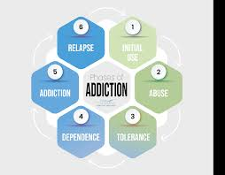
PHASES OF THE ADDICTION PROCESS

Slide 26
FACTORS THAT INCREASES THE RISK OF ADDICTION.
Not all person uses substances, and even among those who use them, not all are equally likely to become addicted.
Many factors influence the development of substance use disorders, including developmental, environmental, social, and genetic factors, as well as co-occurring mental disorders.

Slide 27
FACTORS THAT INCREASES THE RISK OF ADDICTION
Genetic: 40-70% individual differences at risk for addiction.
Multiple gene implicated.
Rapid metabolizing individuals
Parental/family history of substance abuse.
Biological factors - alcohol use > M: F. However female progresses faster to substance use disorder than female.
Early use.
Withdrawal symptoms - > F:M

Slide 28
FACTORS THAT INCREASES THE RISK OF ADDICTION
Developmental - Early life experiences (physical, emotional, sexual abuse, neglect, household instability, early mental illness, poverty)
Adolescent age group highly vulnerable- risk taking, experimentation, underdeveloped prefrontal cortex.
Environmental factors: FMRI studies show that African American smokers show increased activation of the prefrontal cortex upon exposure to cues than white.
Co-occuring mental illnesses- schizophrenia and nicotine use, alcohol use and PTSD.

Slide 29
THEORIES OF ADDICTION
Aberrant learning theory.
Psychomotor stimulant theory.
Incentive sensitization theory.
Fronto-striatal dysfunction theory.
Hedonic-allostasis theories.

Slide 30
ABERRANT LEARNING THEORY.
This theory holds that repeated exposure to drugs heightens responsiveness to drug-associated cues by modulating neural systems that control normal responses to non-drug associated cues.
This aberrant learning process is thought to represent changes in associative brain structures such that drug seeking and taking becomes automatic or habitual

Slide 31
PSYCHOMOTOR STIMULANT THEORY.
Addictive drugs share common features: they cause psychomotor activation, are reinforcing, and elicit approach behaviors.
In this theory, people initiate and maintain drug-taking behavior because drug-induced dopamine release has reinforcing effects and activates motor systems that result in repetitive drug approaches.

Slide 32
INCENTIVE SENSITIZATION THEORY.
This attributes that drugs are hypothesized to hijack neural systems (e.g.mesocorticolimbic dopamine system) that motivate animals to approach stimuli with salience (importance) for preservation of the species.
This theory posits that repeated exposure to drugs of abuse results in persistent neural adaptations in these systems such that the animal becomes hypersensitive to drugs and to any cues that have become associated with the drug.

Slide 33
FRONTOSTRIATAL DYSFUNCTION THEORY.
It proposes that repeated drug exposure leads to alterations in cortical and limbic circuits such that an individual displays pathological responses to drugs and drug cues while simultaneously displaying impaired inhibitory, “top-down” executive control over drug-taking behavior.
This leads to loss of impulse control, poor decision-making, heightened responsiveness to drug-associated cues and compulsive drug use.

Slide 34
HEDONIC-ALLOSTASIS THEORIES.
It postulates that initial drug abuse is motivated by the positive reinforcement obtained from the drug’s rewarding effects.
Whereas chronic drug abuse is motivated by the negative reinforcement resulting from the recruitment of stress-related systems and emergence of negative hedonic states.

Slide 35
TREATMENT OF DRUG ADDICTION
Psychotherapy/motivational interviewing
Medication- eases withdrawal symptoms
Hospitalization/ rehabilitation
Contingency management
Support groups.

Slide 36
COMPLICATIONS OF ADDICTION
Infectious disease.
Effect of physical and mental health.
Accidents.
Suicide.
Financial problem.
Functionality issues.
Legal issues.

Slide 37
CONCLUSION
Addiction is not just a compulsive behavior, it affects brain circuitry which includes the prefrontal cortex, extended amygdala, VTA, nucleus accumbens, hippocampus and striatum.
Teatment must be tailored towards these circuits as they are the neurobiological basis for addiction.
The best way to preventing addiction to addictive substance is not to take the substance at all.

Slide 38
REFERENCES-1
Bossert JM, Marchant NJ, Calu DJ, Shaham Y. The reinstatement model of drug relapse: recent neurobiological findings, emerging research topics, and translational research.
Psychopharmacology (Berl). 2013;229:453–476.
Benjamin James sadock, Virginia Alcott sadock, Pedro Ruiz Kaplan and Sadock’s comprehensive textbook of psychiatry 10th edition
Badiani A, Belin D, Epstein D, Calu D, Shaham Y. Opiate versus psycho stimulant addiction: the differences do matter. Nat Rev Neuroscience. 2011;12:685–700.

Slide 39
REFERENCES-2
Prescott CA, Kendler KS. Genetic and environmental contributions to alcohol abuse and dependence in a population-based sample of male twins. American Journal of Psychiatry. 1999;156:34–40. [PubMed]
Dick DM, Agrawal A. The genetics of alcohol and other drug dependence. Alcohol Research & Health. 2008;31(2):111–119. [PMC free article] [PubMed]
Squeglia LM, Tapert SF, Sullivan EV, Jacobus J, Meloy MJ, Rolfng T, Pfefferbaum A. Brain development in heavy-drinking adolescents. American Journal of Psychiatry. 2015;172(6):532–542. [PMC free article] [PubMed]

Slide 40
REFERENCES-3
Drgonova J, Walther D, Singhal S, Johnson K, Kessler B, Troncoso J, Uhl GR. Altered CSMD1 expression alters cocaine-conditioned place preference: Mutual support for a complex locus from human and mouse models. PLOS ONE. 2015;10(7) [PMC free article] [PubMed]
Zhong X, Drgonova J, Li CY, Uhl GR. Human cell adhesion molecules: Annotated functional subtypes and overrepresentation of addiction-associated genes. Annals of the New York Academy of Sciences. 2015;1349(1):83–95. [PMC free article] [PubMed]

Slide 41
REFERENCES-4
Teicher MH, Samson JA. Childhood maltreatment and psychopathology: A case for ecophenotypic variants as clinically and neurobiologically distinct subtypes. American Journal of Psychiatry. 2013;170(10):1114–1133. [PMC free article] [PubMed]
Giedd JN, Blumenthal J, Jeffries NO, Castellanos FX, Liu H, Zijdenbos A, Rapoport JL. Brain development during childhood and adolescence: A longitudinal MRI study. Nature Neuroscience. 1999;2(10):861–863. [PubMed]

Slide 42
THANKS FOR LISTENING.

