Slide 1
EVALUATION AND MANAGEMENT OF THE UNCONSCIOUS PATIENT
Dr. Gabriel Aigbokhae
GMS UNIT,
FNPH, Benin

Slide 2
Outline
Introduction
2. Definition of unconsciousness
3. Components of unconsciousness
4. Causes of coma
5. Pathogenesis of coma
6. Approach to the unconscious patient
7. Prognosis
8. Differential diagnosis of coma
Brain death
References

Slide 3
Introduction
Consciousness is the state of being aware and responsive to one’s surroundings.
The Reticular Activating System (RAS) of the brainstem and thalamus and its broad connections to the cerebral hemisphere maintains wakefulness
Unconsciousness arise by distortions (functional or metabolic) of the neurons the RAS
Unconsciousness is a state in which a patient is totally unaware of both self and external surroundings and unable to respond meaningfully to external stimuli.

Slide 4
Definition
The term unconsciousness can be defined as “an abnormal loss of awareness of self and one’s surrounding due to a reduced level of activity in the reticular formation of the brainstem”.
It is a sleep-like state in which the patient makes no purposeful response to the environment and from which he or she cannot be easily aroused.
An unconscious patient can be roused only with difficulty or not at all.
It aroused from a disturbance of either;
-Brainstem RAS above the mid-pons or
-Both cerebral hemispheres

Slide 5
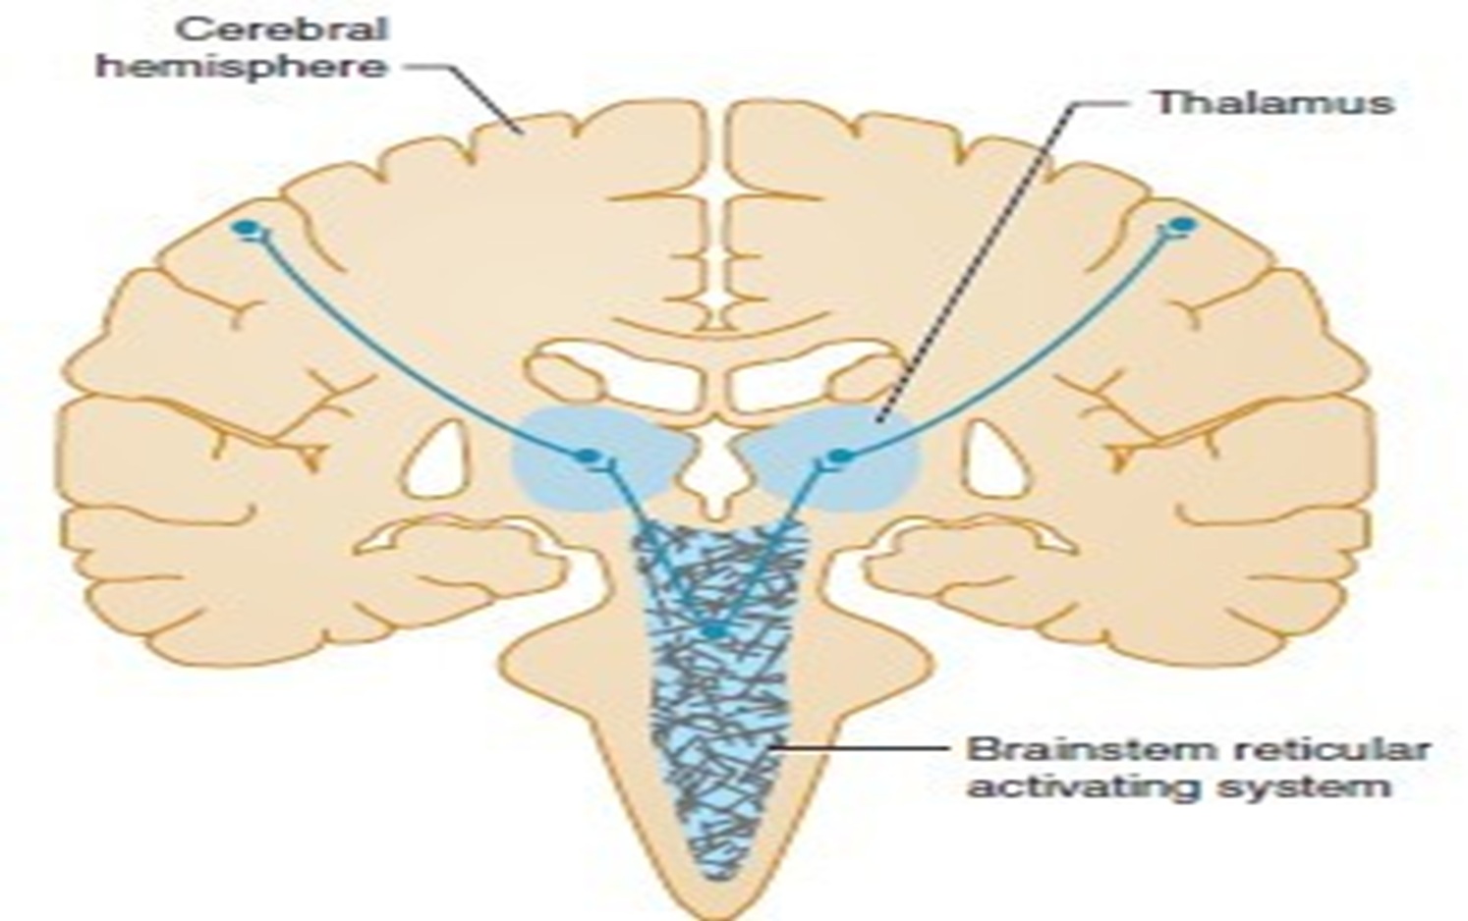
Anatomic basis of coma

Slide 6
Definition continue
Unconsciousness may be brief or light as in fainting (syncope)
Or concussion, deep or prolonged.
When it becomes prolonged or persistent it is termed COMA.
Coma is a medical emergency which present diagnostics as well as therapeutic challenges
Incidence of coma are poorly reported.
Incidence of non traumatic coma 30/10,000 per year and traumatic coma 670/10,000 per year.
CNS infections is the most common cause of non traumatic coma in children.

Slide 7
Components of consciousness
Consciousness has two components;
Arousal(or wakefulness)
Awareness(or responsiveness)
Coma is characterized by the absence of arousal and awareness
These two components are used to identify the major conditions of abnormal consciousness such as;
Coma
Vegetative state
Locked in state

Slide 8
Causes of coma
The causes of coma can be classified under two broad groups:
Structural or Metabolic

Slide 9
STRUCTURAL CAUSES OF COMA
Tumors: primary brain tumors, metastasis.
Trauma: Subdural hematoma (SDH), Epidural hematoma (EDH), traumatic Subarachnoid hemorrhage (SAH).
Vascular: Ischemic stroke, hemorrhagic stroke,
Infections: Meningitis, encephalitis, brain abscess.
Demyelination: Multiple sclerosis (MS), Acute disseminated encephalomyelitis (ADEM)

Slide 10
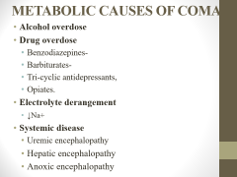
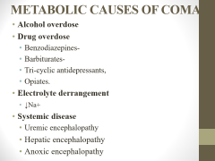
METABOLIC CAUSES OF COMA
Alcohol overdose
Drug overdose
  Benzodiazepines-
  Barbiturates-
  Tri-cyclic antidepressants,
  Opiates.
Electrolyte derangement
  ↓Na+
Systemic disease
  Uremic encephalopathy
  Hepatic encephalopathy
  Anoxic encephalopathy

Slide 11
Metabolic Causes Of Coma
  Endocrine
Hypoglycemia,
DKA, HHS, Lactic acidosis
Myxedema coma
  Gases
CO poisoning
Organophosphate
  Toxins
Cyanide
Disordered temperature regulation-
Hypothermia,
Hyperthermia.

Slide 12
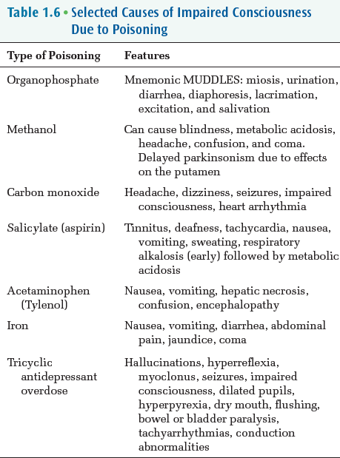

Slide 13
Pathogenesis of coma
Coma arises by one or a combination of two main mechanisms:
1. Structural transection or destruction of neuronal tracts and or structures of the RAS, thalamo-cortical projections or cerebral hemispheres.
2. Metabolic alteration of the function of cells of the RAS and its projections.
eg, hypoglycemia, hypoxia, drug overdose, etc

Slide 14
Anatomic basis of coma

Slide 15
Approach to evaluating coma
This consists of:
Emergency assessment.
Basic life support (BLS)
Initial stabilization measures.
Focused history.
Focused neurologic and physical examination.
Perform relevant diagnostic tests to establish an etiologic diagnosis.
Treatment of the cause where possible.

Slide 16
Emergency Assessment
ABCDE!
A-Airway
B-Breathing
C-Circulation
D-Disability and drugs to stabilize patient emergently
E-exposure/environment looking out for physical clues that could point to cause of coma

Slide 17
Airway
Head tilt, chin lift, jaw thrust
Clearance(suction secretions)
Oro/nasal airway(nasopharyngeal/oropharyngeal airway)
Intubation
To maintain a patent airway, the left lateral recumbent position is advised to prevent the occlusion of the airway from the tongue falling back against the pharyngeal wall.

Slide 18
Breathing
Look, listen and feel for normal breathing.
Symmetry(Chest wall symmetry) and bilateral chest wall expansion.
Breath sounds
Respiratory rate
Give supplemental oxygen to all patient with LOC
Abnormal breathing occurs shortly after the heart stops in up to 40% of cardiac arrest.
Abnormal breathing described as barely, heavy, noisy or gasping.

Slide 19
Breathing 2
Some common abnormal breathing seen in coma patients are;
Ataxic breathing (Biot’s respiration): quick shallow breaths followed by regular or irregular periods of apnoea suggesting a lesion in the lower pons.
Cheyne stoke breathing : rhythmic increase or decrease in depth punctuated by regular episodes of apnoea commonly seen in stroke, trauma, carbon monoxide poisoning.
Hypopnea breathing: abnormal decrease in rate and depth commonly seen in sleep apnoea, drugs or alcohol intoxication.
Kussmaul’s breathing: rapid deep laboured breathing seen in metabolic acidosis

Slide 20
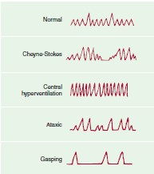
Respiratory patterns in coma patients
Normal
Kussmaul’s
Cheyne-Stokes
Central neurogenic hyperventilation or pontine respiration

Slide 21
Circulation
Check for carotid pulse
Pulse oximetry, rate, rhythm
Arterial pressure
-Hypertension
-Hypotension
Fluid resuscitation
Sample collections for relevant investigations
Indwelling urinary catheter (for incontinence an monitoring of fluid balance)

Slide 22
Disability
Disability is determined from patient level of consciousness according to the Alert Voice Pain Unresponsiveness (AVPU) or Glasgow Coma Scale (GCS).

Slide 23
AVPU
Alert: Patient is fully awake( not necessarily oriented), will have spontaneously open eyes and will respond to voice.
Voice: patient makes some sort of response when you talk to them, this could be eyes opening or a limb when prompted to do so.
Pain: A patient may respond by using any of the 3 components when pain stimulus is used on them (eyes, voice, movement)
Unresponsiveness: This outcome is noted if the patient does not give any eye, voice or motor response to pain.

Slide 24
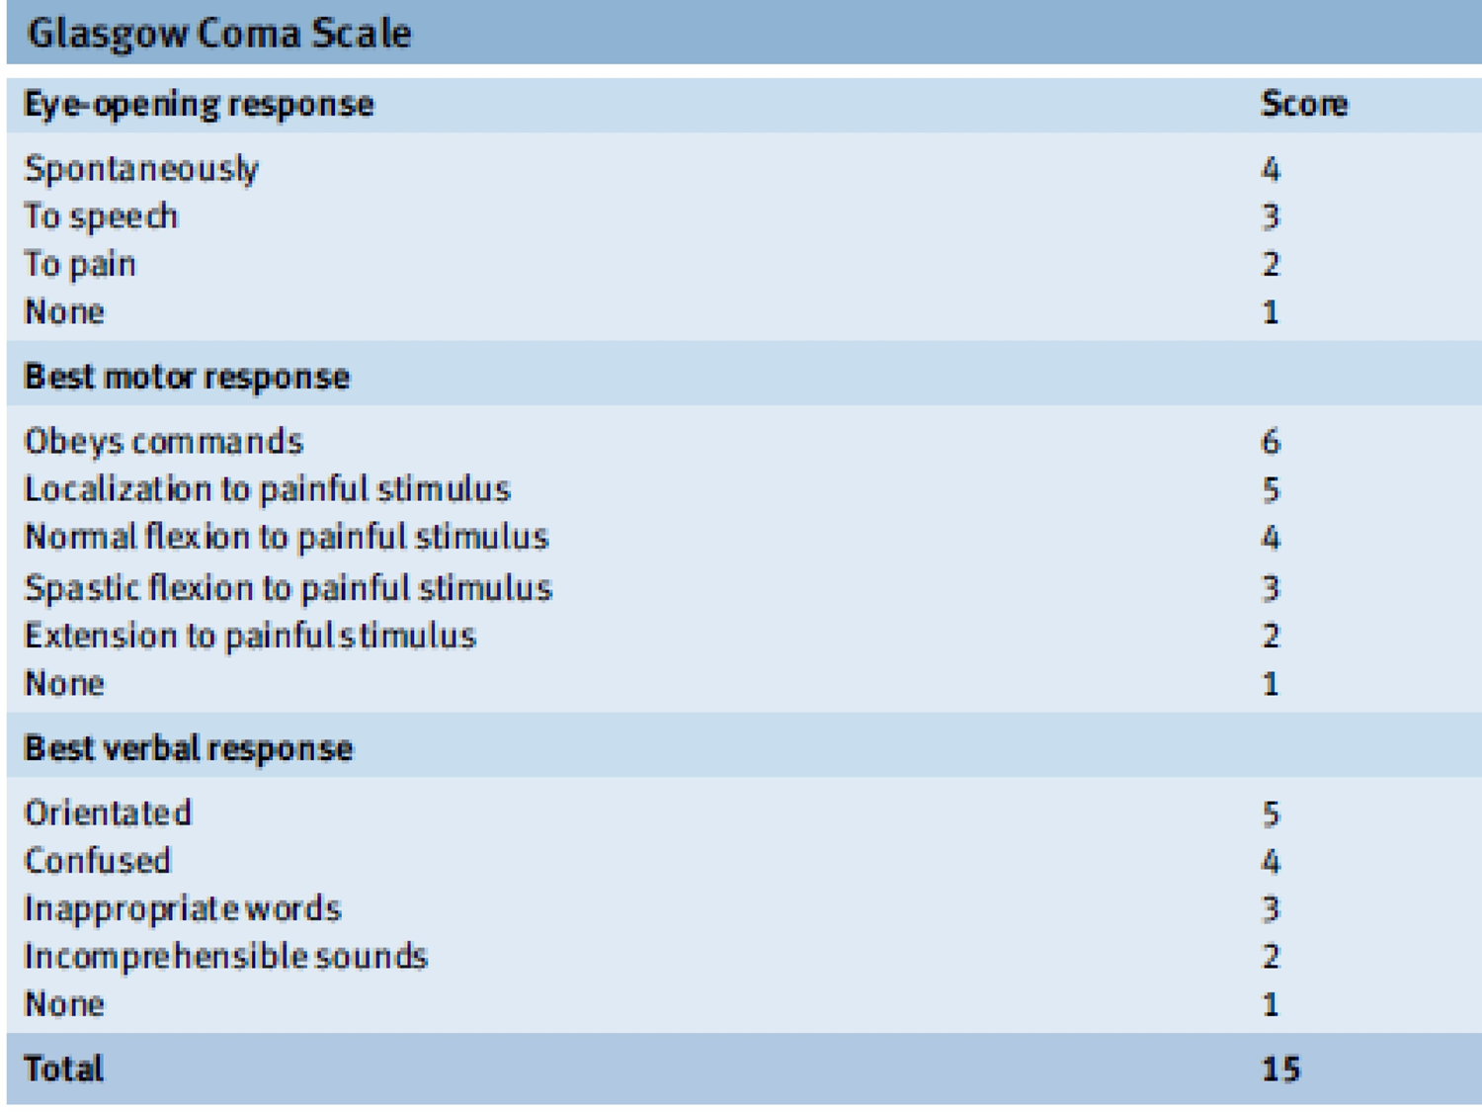

Slide 25
D-Drugs for stabilization
IV mannitol → to reduce cerebral edema
50% DW (50mls)→ hypoglycemia
Naloxone (0.4-1.2mg)→ opiate overdose
Thiamine (100 mg, IV) →alcoholics and malnourished
Flumazenil (1-10mg) →benzodiazepine overdose
CO Poisoning- high flow oxygen
Antipyretics →fever, hyperthermia

Slide 26
Exposure and Environment
Patient’s clothes should be removed or cut in an appropriate manner so that injuries can be seen.
Petechial rash= meningococcal meningitis, endocarditis
Multiple injection marks = drug addiction
Head injury=Trauma

Slide 27
Exposure
•Signs of basilar skull fracture
-Racoon eyes- periorbital ecchymoses
-Battle sign-swelling and discolouration of mastoid bone behind the ear
-Hemotympanum-blood behind the tympanic membrane
-CSF rhinorrhoea or otorrhoea
• Depressed skull fracture
• Soft tissue swelling

Slide 28
Basic Life Support (BLS)
BLS defines sequences of procedures performed to restore the circulation of oxygenated blood after a sudden pulmonary or cardiac arrest.
BLS is useful and necessary in the management of the unconscious patient.
For any unconscious patient who is confirmed to be breathing and has a palpable carotid pulse the priority of resuscitation is the care of the airways, breathing and circulation (ABC).
For those who have no palpable carotid pulse, the recent American heart association (AHA) guidelines recommended CAB- compression, airways and breathing.
STEP 1. Check scene safety and place the patient supine on a firm surface. Ensure that you as rescuer does not face any harm in form of live electric wire, fire hazard etc. Lay the patient flat on his back in a firm surface.

Slide 29
STEP 2
STEP 2. Check responsiveness and breathing. In case the patient has not moved or opened his eyes yet tap him firmly on the shoulders from the front and call his name out loudly. If there is no response, carefully inspect the chest for 2 seconds looking for signs of normal breathing. Abnormal effort (like gasping) should be treated as absence of breathing.
If your patient is breathing well with good regular chest excursion and you can feel the air going in and coming out of the nostrils, then assess the carotid pulse. If both the breathing and carotid pulse are good, place him in the recovery position to prevent airway obstruction and aspiration. Proceed to investigate the case

Slide 30
BLS Continue
STEP 3. Call for help and get an Automated External Defibrillator (AED). Managing a patient who is unresponsive will invariably require manoeuvre which needs extra hands. The more trained ,the better.
Step 4. Check for definite pulse (10 seconds) Put your fingers in the groove at the side of the trachea to feel the carotid pulse. Inability to feel a definite pulse within 10 seconds should be treated as absence of pulse.
STEP 5(a). If definite pulse is present with ineffective breathing, give 1 breath every 5-6 seconds and access, proceed to care for ab.
STEP 5(b). If definite pulse is not present begin cycles of 5 chest compression and 2 breaths. If AED arrives attach the AED and deliver a shock if advised, else continue CPR

Slide 31
BLS Continue
STEP 6. Wait for the advanced life support team to take over other aspect of treatment where they need to now intubate and manage the patient in ICU.
Supplemental oxygen-by mask or tube
Intravenous fluid- as indicated and required.
Close monitoring- by pulse oximetry. Blood pressure and temperature
Capillary blood glucose must be done at regular intervals
Nasogastric tube to prevent aspiration of vomitus

Slide 32
Management
History
General physical/neurologic examination
Investigations
Treatment
Differential diagnosis
Prognosis

Slide 33
History
In many cases, cause of coma is immediately evident. Trauma, cardiac arrest, drugs intoxication.
•Temporal progression of coma is crucial
Rapid onset → vascular origin e.g. Stroke, SAH
Protracted course (days to weeks or more)→ tumors, abscess, chronic SDH.
•Circumstances of the patient at the time of onset

Slide 34
History con’t
Fever → meningitis, encephalitis, brain abscess, septicaemia.
Headaches → meningitis, SAH, stroke, tumour [Fever+ headache+
neck stiffness + photophobia → meningitis]
Trauma → SDH, SAH, EDH
Renal symptoms → uremic encephalopathy
Hepatic symptoms → hepatic encephalopathy
Exposure to toxins, gas fumes → possible CO/cyanide
Alcohol → possible alcohol overdose
Exposure to toxins, gas fumes → possible CO/cyanide

Slide 35
History con’t
Iv drug use/empty drug bottles → Drug overdose
Suicidal notes →failed suicide attempt
Last meal/ Known DM → hypoglycaemia, DKA
Known HTN → haemorrhagic stroke, ischaemic stroke, SAH

Slide 36
Neurologic examination of coma
1. Glasgow coma score
2. Signs of meningeal irritation
3. Fundoscopy
4. Pupil examination
5. Oculocephalic responses
6. Oculovestibular responses
7. Limb posture/motor response to pain
Tone
8. Reflexes

Slide 40
Eye examination
Pupillary abnormalities in coma generally herald structural changes in brain, where as in metabolic coma such abnormalities are not present viz;
Small pupil (<2mm) ; opioid toxicity or a pontine lesion
Middle pupils (4-6mm); unresponsive to light ; midbrain lesion
Pinpoint pupils; Narcotic overdose, bilateral pontine damage
Fixed and dilated pupils (>7mm) unreactive to light. Present in the terminal stage of brain death.

Slide 41
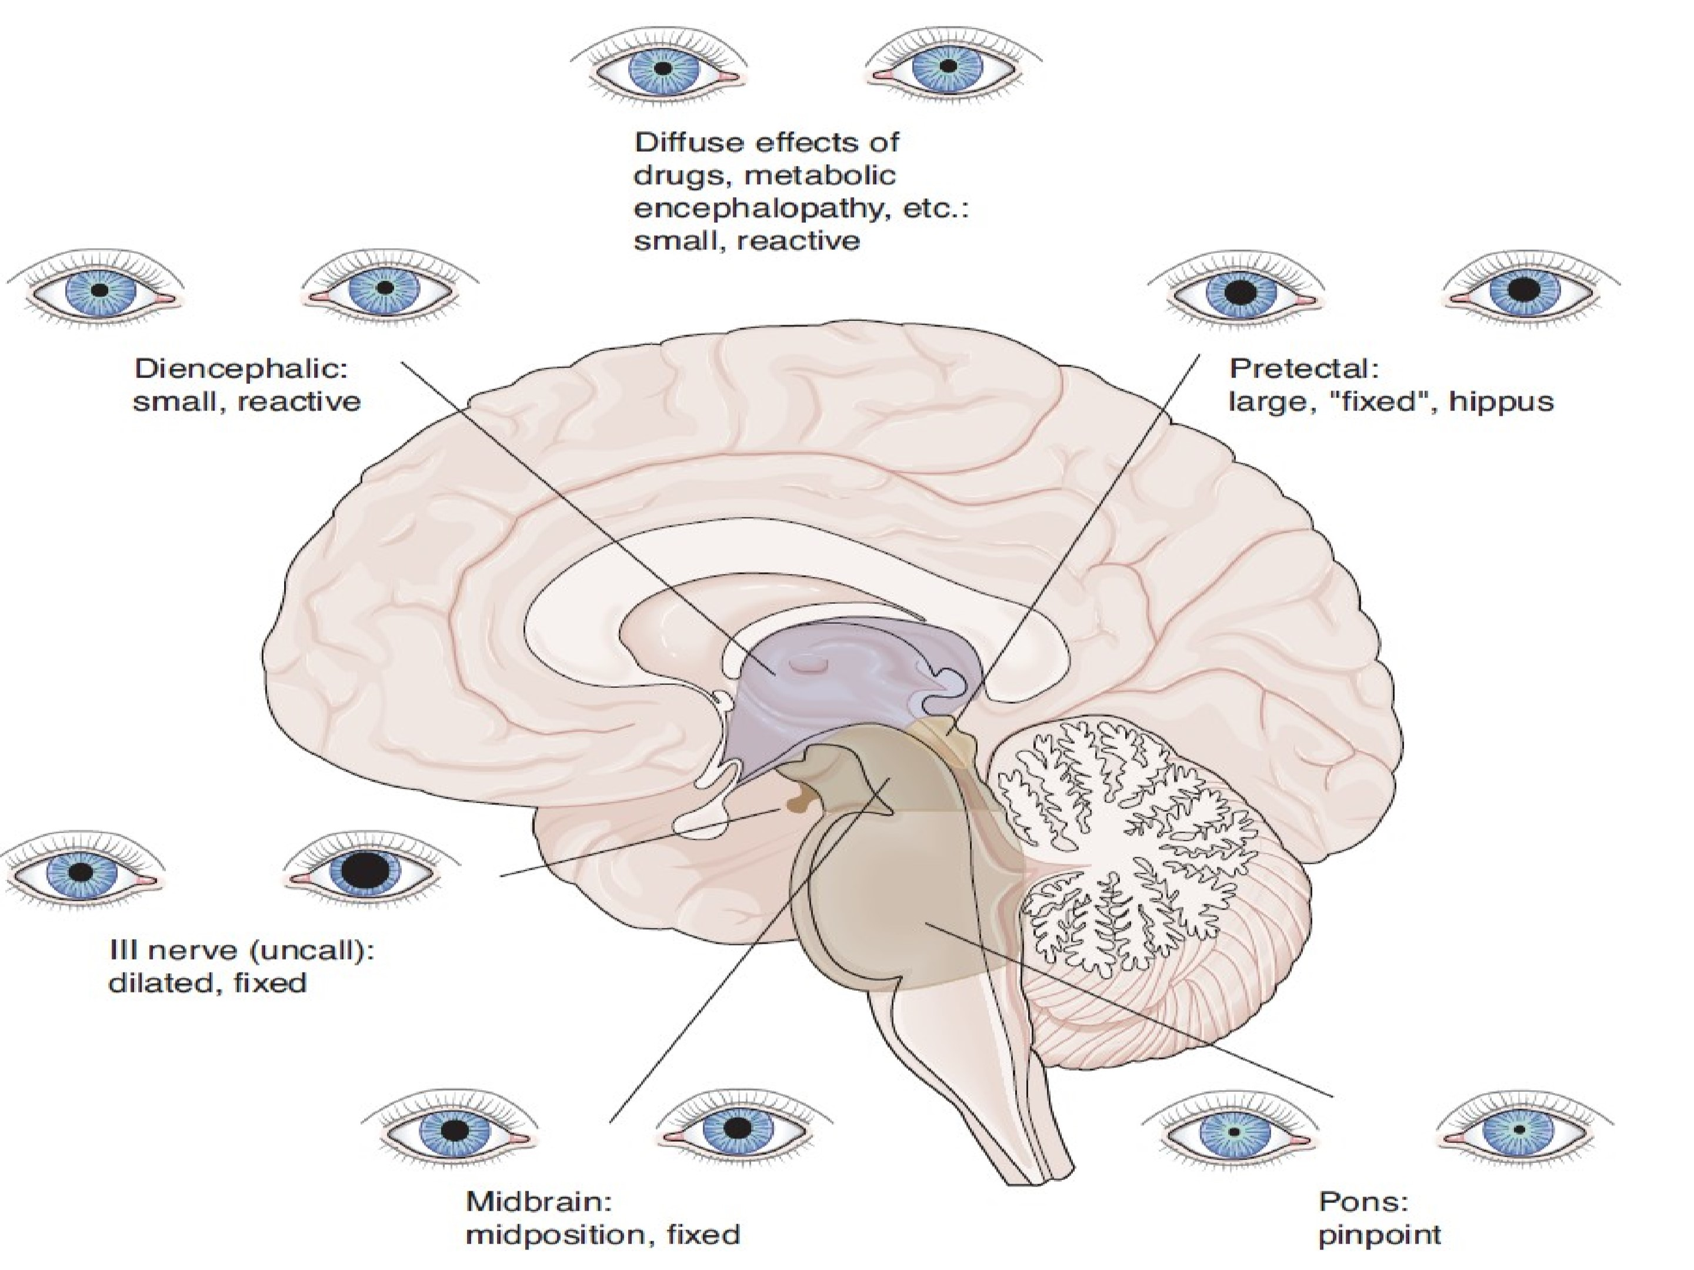

Slide 42
Oculocephalic reflex(doll’s eyes)
Used to access intact brainstem in comatose patients
Patient’s eyes are held open.
The head is briskly turned from side to side with the head held briefly at the end of each turn.
Positive response occurs when the eyes rotate to the opposite side to the direction of head rotation
Also when the head is flexed and extended – a positive result is downward deviation of the eyes during extension.
Negative response occurs when eyes remain midline or move in same direction of head movement indicating a severe brainstem

Slide 43
Oculovestibular reflex (caloric stimulation)
For this reflex, check that the tympanum is intact and that the external ear canal is clear.
Introduce cold or warm water into the external ear canal through a small catheter until one of (nystagmus, ocular deviation or 200ml of water has been instilled).
If the brainstem is intact, cold water causes the eyes to deviate downwards and warm water causes the eyes to deviate upwards.
Both oculocephalic and oculovestibular positive responses described above are only seen in comatose patient with intact brainstem.

Slide 44
Limb posturing
Assessed by applying strong pressure on the supraorbital ridge, sternum or nail beds.
Limb posturing/motor response to pain is observed.
Response can indicate whether condition causing the coma affects the brain symmetrically (metabolic or diffuse encephalopathy) or asymmetrically (unilateral focal cause)
Decorticate posturing- associated with lesions that involve the thalamus directly or large masses that compress the thalamus from above
Decerebrate posturing- occurs when brain dysfunction has descended to the level of the midbrain

Slide 45
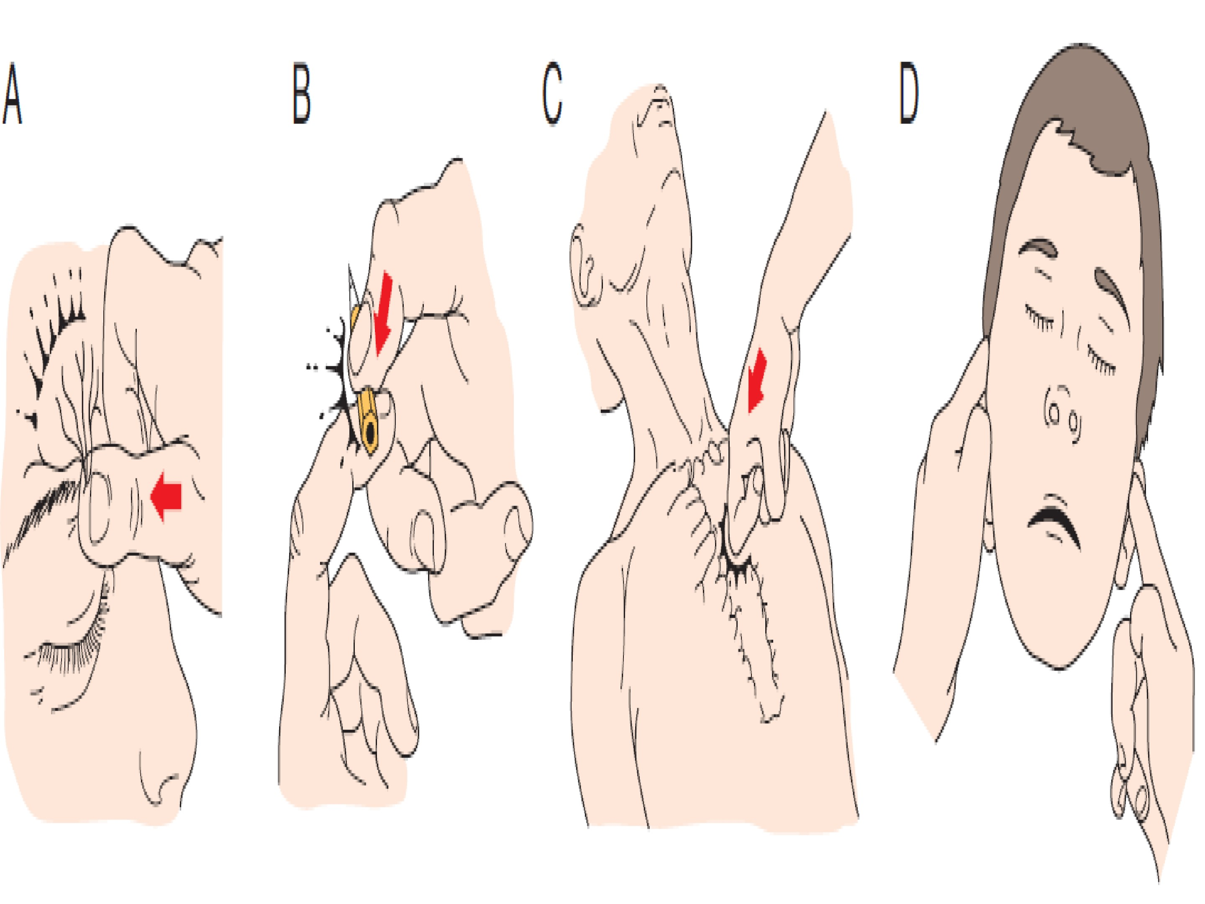

Slide 46
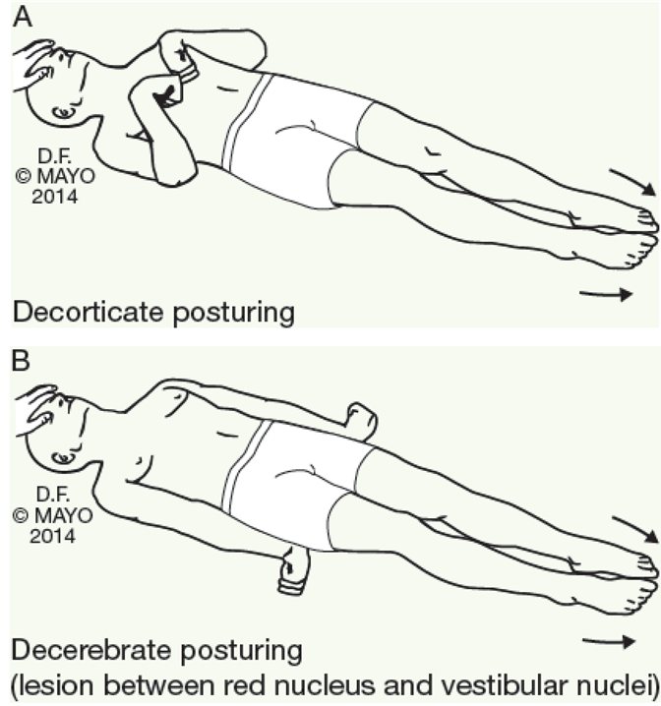

Slide 47
Investigations
Blood/Imaging
BLOOD
Complete blood count
Blood culture
Blood glucose(RBG)
E/U/CR, serum calcium, magnesium
Liver function test
Arterial blood gases(ABG)
Others are
-LP for CSF analysis
-Toxicology analysis of blood and urine
-Blood alcohol concentration test
-Tumour markers assay

Slide 48
Imaging
Cranial CT scan/ MRI
Chest X-ray
Electrocardiography(ECG)
Echocardiography(Echo)
Electroencephalography(EEG)

Slide 49
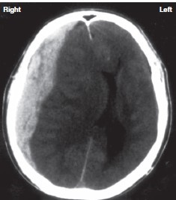
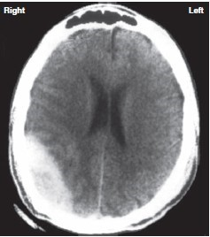
Some brain CT findings in coma

Slide 50
Treatment of coma
This depends on the underlying cause viz;
Acute bacterial meningitis → antibiotics
Septicemia → antibiotics
Subdural hemorrhage → burr hole drainage
Extradural hemorrhage → surgical drainage
Hypoglycemia → 50%DW, IM glucagon
Seizures → AEDs

Slide 52
Differential diagnosis of coma
Locked-in state
Persistent vegetative state
Brain death

Slide 54
Vegetative State
Vegetative state(vs) is a chronic state of brain dysfunction in which a person shows no sign of awareness.
VS is a disorder of consciousness in which patients with severe brain damage are in a state of partial arousal rather than awareness.
After four weeks in a vegetative state, the patient is classified as being in a Persistent Vegetative State(PVS)
PVS is classified as a permanent vegetative state 3-6months after a non traumatic brain injury or one year after a traumatic brain injury.

Slide 56
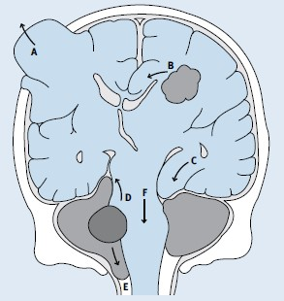
BRAIN HERNIATION SYNDROMES
Occurs when brain tissues, CSF and blood shift from their normal position inside the skull resulting from bleeding(head injury), stroke or brain tumor.
BRAIN DEATH
• This is the irreversible cessation of all brain and brainstem function due to a known, irreversible, and mostly supratentorial injury.

Slide 57
RECOMMENDATIONS
Need to have an effective ambulance service placed in strategic places all over the city.
Need to have AED in various public places including motor parks, schools, churches, mosques, beaches, markets etc.
Need for training and re-training of all in the skill of BLS
Incorporation of BLS in all curriculum from elementary school.

Slide 58
References
1.Joint Royal Colleges of Physicians Training Board Specialty training curriculum for Acute Internal Medicine. (2009) amended (August 2012)
2.Erickson,T.B, Thompson, T.M, & Lu, J. J (2007). The approach to the unconscious patient
3.Malik, K., & Hess, D. C. (2002) Evaluating the comatose patient. www.postgradmed.com/issues/2002/02_02/malik.htm(10 jul 2007).
4. Young, G.B. “Stupor and coma in adults.” (2006).
5.Edlow J. Rabinstein, A. Diagnosis of reversible causes of coma (2014)
6.Wijdicks, E. The bare essentials practical Neurology (2010) .

Slide 59
Refrences cont’
7.Cooksley T. Holland M. The management of coma (2017)
8 Braum M. Schmidt WU, Mockel M. Romer M, et al. Coma of unknown origin in the emergency department .
9.Kamanyire R. Karalliedde L. Organophosphate toxicity and occupational exposure(2004) (pub med) Google scholar
10.Giza C, Hovda D. The new neurometabolic cascade of concussion Neurosurgery 2014.
11.Forsberg S. Hojer., J. Ludwigs., U. Nystom Metabolic vs structural coma in the ED, an observational study 2012
12.Horsting M., Franken M., Meulenbelt J., Van Klei de Lange., The etiology and outcome of non-traumatic coma in critical care, a systemic review 2015
13.Zubler F., Koenig C. Steimer A et al prognostics and diagnostic value of EEG signal coupling measures in coma

Slide 60
THANKS FOR LISTENING

