Slide 1
Harm Reduction In Addiction Psychiatry
By
Amadasu L.O. (Dr.)
FNPH, Uselu
27th, July 2022

Slide 2
Outline
Objectives
Introduction
Historic background
Harm reduction strategies and goals
Principles of harm reduction
Current harm reduction practices
Substance-specific harm reduction practices
The role of clinicians in harm reduction
Harm reduction practice in DATER, FNPH, Uselu
Recommendations
Conclusion
References

Slide 3
Objectives
To explain the concept of harm reduction.
To outline the goals, principles and current practices of harm reduction.
To discuss the role of clinicians in harm reduction.

Slide 4
Introduction
“In 2020, at least 130 people will die of an opioid overdose/day and every single one will be preventable deaths (National Institute of drug abuse).
Shame and stigma are keeping people from assessing the services that they need, from reaching out and asking for help.
Drug laws intended to arrest dealers are often times targeting drug users too.
We lock up drug users and get surprised when they are released and get over-dosed and die.
We can no longer pretend that drug use problem does not exist and we cannot arrest our way out it any longer.
What are we missing?”
-Lyndsay Hartman, 2020
(Point-to-Point Foundation, USA)

Slide 5
Definition
Harm Reduction
Policies, programs and practices that aim to minimize negative health, social and legal impacts associated with drug use, drug policies and drug laws (Harm Reduction International, 2019).

Slide 6
Historic Background
1912-1923: Narcotic maintenance clinics (USA).
1960s: -Emergence of ‘controlled drinking’.
-Methadone maintenance treatment (Europe).
-Grass-roots work on reducing harms.
1986: (UK) Needle and syringe Programs (NSPs).
1989: Syringe vending machines and pharmacy-based schemes.
1990: NSPs operated in 14 European countries.
2000-2004: ‘Drugs strategy’ and ‘Action plan’.
2009: Support for harm reduction in national policy documents (EU).

Slide 7
Historic Background
Globally:
1986: Endorsement of the underlying principles of harm reduction (WHO, Stockholm).
2001: ‘Declaration of Commitment’ (UN, General Assembly).
2005: Methadone and Buprenorphine added to list of ‘essential medicines’ by WHO.
2020: 86 countries implement NSPs and 86 have Opioid Substitution Therapy (OST).

Slide 8
General harm reduction strategies
Education.
Provision of a safe environment.
Promotion of social and community support.
Intervention to change high-risk behaviours.

Slide 9
Goals of harm reduction
Minimize the harm associated with substance use.
Minimize risk of: -Contracting infectious Disease.
-Overdosing.
Reduce negative outcome of drug use (e.g. violence, crime).
Reduce harm to users’ families and the broader society.

Slide 10
Principles Of Harm reduction
Based on pragmatism and humanistic principles.
Emphasis on immediate and realistic goal.
Assess individuals’ risks.
Familiarity with potential harms attributable to various drugs.
Collaboration with the user.
Focus on users’ own risk behaviours.
Support users to access the information.
Tailor interventions to users’ risks and harm.
Involve team of various specialties in care of User.

Slide 11
Current Harm Reduction Practices
Needle and Syringe Programmes (NSPs).
Opioid Substitution Therapy (OST).
Drug Consumption Rooms.
Prison Needle and Syringe programmes.
Prison Opioid Substitution Therapy.
Stimulants Harm Reduction.

Slide 12
Needle and Syringe Programmes (NSPs)
NSPs can be delivered through:
Permanent sites.
Secure dispensing units e.g. monitored vending machines.
Mobile services.
Pharmacies.
Community health clinics.

Slide 13
Needle and Syringe Programmes (NSPs) - (continue)
Essential considerations:
Ensure the provision of a full range of sterile injecting equipment.
Consider providing other supplies.
Distribution models should not require “one-for-one” exchange.
Consider differentiated service delivery.
Establish a protocol for the collection and disposal of used needles and syringes.
Ensure staff safety.

Slide 14
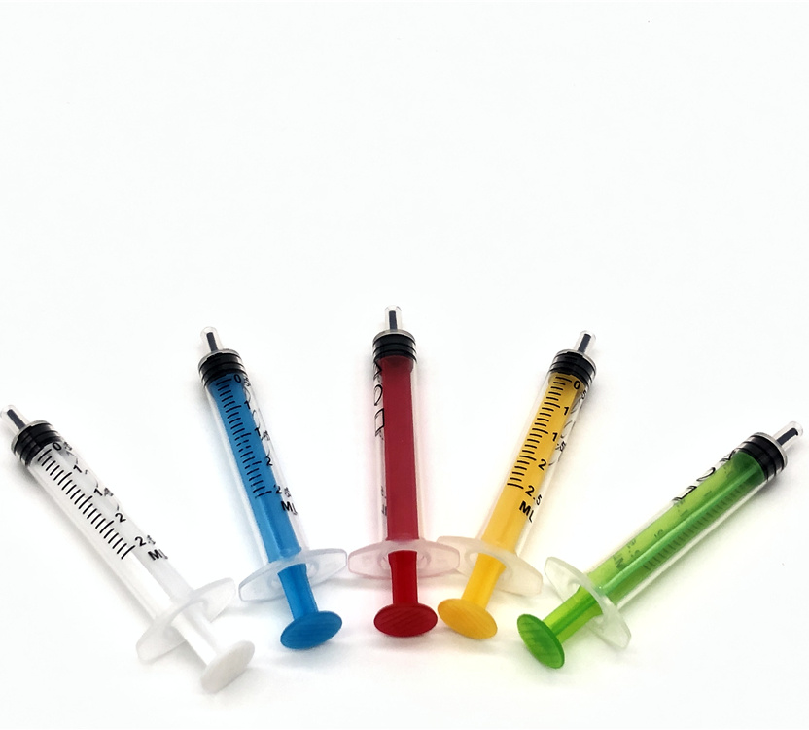
Needle and Syringe Programmes (NSPs) – (continue)
-Low-dead space needles

Slide 15
Needle and Syringe Programmes (NSPs) - (continue)
Other Important Supplies:
Safe disposal boxes for used equipment.
Single-use cooking utensils.
Filters.
Tourniquets.
Sterile water.
Iodine and gauze for wound care.
Male and female condoms.

Slide 16
Opioid substitution therapy (OST)
Longer-acting (oral) opioid for the shorter-acting heroin.
Methadone maintenance treatment (MMT).
Buprenorphine (mixed agonist-antagonist).
Heroin maintenance treatment (HMT).

Slide 17
Opioid substitution therapy (OST) (continue)
Essential considerations:
Develop a national clinical guideline for delivery of OST.
Develop training.
Offer psychosocial support to OST clients.
Facilitate take-home dosages for patients.
Consider differentiated service delivery.

Slide 18
Advantages of methadone maintenance over heroin use
(On its own) unlikely to result in an overdose.
Individual is stable while making life positive changes.
Health problems are reduced or avoided.
Once daily dosage required.
Cheaper than heroin.

Slide 19
Drug consumption rooms
Supervised drug consumption facilities.
Strategies:
Reduce the acute risks of disease transmission.
Prevent drug-related overdose deaths.
Connect high-risk drug users with addiction treatment.
Reduction in drug use and/or presence of discarded needles in public places.

Slide 20
Drug consumption rooms (continue)
Services:
Sterile injecting equipment.
Counselling services.
Emergency care.
Primary medical care and referral.

Slide 21
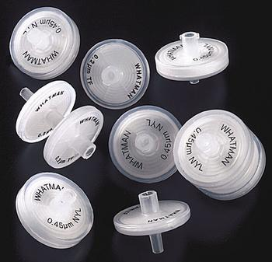
Stimulants Harm Reduction
Amphetamine-type stimulants (ATS), cocaine and its derivatives and new psychoactive substances (NPS)
Wheel Filter

Slide 22
Stimulants Harm Reduction (continue)
Services:
Needle and syringe programs.
Safer smoking kits (e.g. glass stems, rubber mouthpieces).
Drug consumption rooms (proper ventilation system).
Substitution therapies.
Outreach and peer-based interventions.
Drop-in centres.
Housing and other social support.
Drug-checking services.

Slide 23
Substance-specific Harm Reduction Practices
Injecting drug Use
HIV/ HCV counselling and testing.
HBV vaccination.
Overdose intervention and prevention (e.g. Naloxone).
Substitution therapy with opioid agonists for opioid dependence (e.g. methadone and buprenorphine).
Prevention of Sexually Transmitted Infections (STIs) (e.g. Use of Condoms).
Ready access to screening and treatment for STIs.

Slide 24
Substance-specific Harm Reduction Practices (cont.)
Alcohol
Campaigns against drinking and driving.
Brief interventions and advice for problematic drinkers, pregnant
women, or young people.
Thiamine supplements to reduce brain damage.
Serving alcohol in shatter- proof glass to prevent injuries.
Sobering- up shelters for heavily intoxicated individuals or homeless drinkers.

Slide 25
Substance-specific Harm Reduction Practices (cont.)
C. Tobacco
Reduced- exposure products.
Reducing consumption.
Long- term nicotine replacement therapy (e.g. e-cigarettes).
Smokeless tobacco products.
Using replacement products for temporary abstinence (e.g. Nicotine patches).

Slide 26
The role of clinicians in Harm Reduction
Familiar with, open and up to date on harm reduction principles and interventions.
Help promote the interventions through partnerships with various stakeholders.
Help in dissemination of information and materials about harm reduction, and development of scientific and the regulatory frameworks needed to deliver harm reduction interventions.

Slide 27
Harm Reduction Practice In DATER Unit, FNPH, Uselu
General harm Reduction Practices
Education on: -Substance use disorders
-Overdose prevention.
-STD prevention.
-Blood Borne Viruses (BBV) counseling and testing.

Slide 28
Harm Reduction Practice In DATER Unit, FNPH, Uselu
Specific Harm reduction Practices
Alcohol: -Brief intervention for problematic drinking.
-Thiamine supplement.
Tobacco: -Nicotine replacement therapy.
Injecting drug use: -Education on overdose prevention.
-BBV counseling and testing.
4. Opioid Substitution Therapy (OST): -Development of National Clinical Guidelines for OST delivery by the UNODC.

Slide 29
Recommendations
Address stigmatization and discrimination.
Removing human rights-related barriers to access.
Drug law reform toward ending criminalization of drug use.
Community involvement and community systems strengthening.
Gender- and age-responsive programming.

Slide 30
Conclusion
Since the mid-1980s, harm reduction has transformed from a peer-driven, grass-roots approach to an official policy of the United Nations.
At the same time, definitions of harm reduction are expanding to embrace the need to protect the rights to health and access to services of people who use drugs, and to protect them from harmful drug policies.
However, Nigeria is still far behind most countries in harm reduction practice and policy.
Harm reduction saves lives.
Thus, the responsibility falls on everyone to ensure the need for global networking, exchange and coordination remains if policies of harm reduction are to be defended, strengthened and properly evaluated.

Slide 31
Thank you for listening

Slide 32
References
Harm Reduction International [Internet]. Available from: https://www.hri.global/
2. Cook C, Bridge J, Stimson G V. The diffusion of harm reduction in Europe and beyond. EMCDDA Monogr Hard Reduct evidence, impacts, challenges [Internet]. 2010;37–51.
3. International HR. The Global State Of Harm Reduction 2020. SpringerReference. 2020;
4. GlobalFund TG. Harm reduction for people who use drugs. 2020;(March).
5. European Monitoring Centre for Drugs and Drug Addiction. Drug Consumption Rooms: An Overview of Provisions and Evidence. Perspect Drugs [Internet]. 2018;1–8.
6. NACA. An Assessment of the Pilot Needle and syringe programme for People Who Inject Drugs in Nigeria. 2021;(April).
7. International HR. Harm reduction for stimulant use. 2019;(April).

