Slide 1
CURRENT MANAGEMENT OF DIABETES MELLITUS
DR. EBARE C KELVINS
SENIOR MEDICAL OFFICER
NHIS/GMS
FEDERAL NEUROPSYCHIATRIC HOSPITAL, BENIN.

Slide 2
OUTLINE
Definition
Epidemiology
Classification
Pathogenesis
Clinical features
Investigations
Diagnosis
Complications
Treatment

Slide 3
DIABETES MELLITUS - Definition
Group of metabolic disorders characterized by:
  Hyperglycaemia due to
  Deficiencies of Insulin action and/or secretion leading to
  Disturbances in metabolism of:
    Carbohydrate
    Fat
    Protein
Associated with long term damage, dysfunction and failure of various organs: Eyes, Kidneys, Nerves, Heart & blood vessels
In other words, failure of insulin secretion, action or both lead(s) to rise in blood glucose and other metabolic changes, which if uncorrected cause complications.

Slide 4
Epidemiology
The latest prevalence figure published by the International Diabetes Federation (IDF) is 537 million persons living with DM worldwide, with nearly 50% of these undiagnosed. About 24 million people in the AFR Region; by 2045 it will be around 55 million. Between 2000 and 2016, there was a 5% increase in premature mortality from diabetes.
In 2019, diabetes was the ninth leading cause of death with an estimated 1.5 million deaths directly caused by diabetes.
The developing economies of Africa and Asia contribute a significant fraction of this figure. There is also a rising burden from the complications of DM alongside the ever-increasing prevalence of the disease.

Slide 5
Epidemiology
We now see high rates of DM-related amputations, cerebrovascular disease, heart-related problems, and kidney disease in populations that were not previously known for these challenging health problems.
In Nigeria, research shows that the prevalence of DM is about 5.77% . The prevalences of DM in the six geopolitical zones of Nigeria were 3.0% in the North-West, 5.9% in the North-East, 3.8% in the North-Central zone, 5.5% in the south-west, 4.6% in the south-east, and 9.8% in the south-south zone.

Slide 6
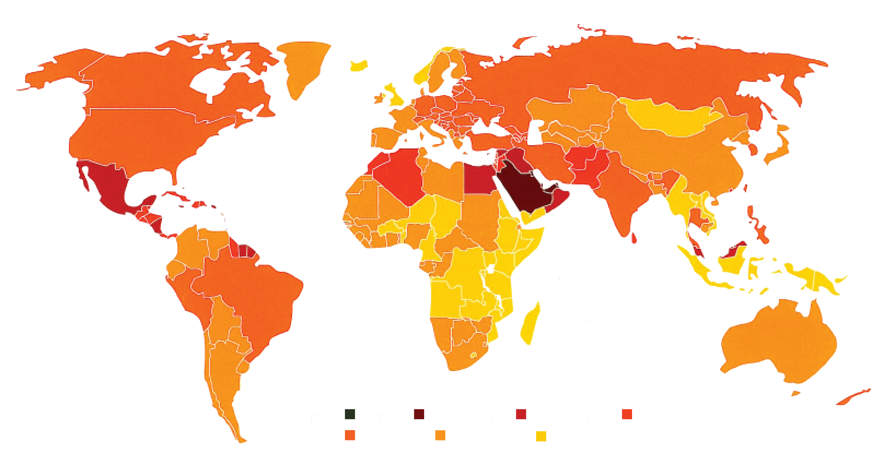
Diabetes* Affects 247 Million People Worldwide (2007)
Europe
2007: 53 million
Africa, Eastern
Mediterranean
and Middle East
2007: 35 million
The Americas
2007: 45 million
Global prevalence of diabetes, 2007
SE Asia and
W Pacific
2007: 114 million
>20%
14–20%
10–14%
8–10%
6–8%
4–6%
<4%
Nationwide Diabetes Prevalence Categories
*Type 2 diabetes mellitus represents ~90–95% of cases (Centers for Disease Control and Prevention. National Diabetes Fact Sheet, 2005. Atlanta, Ga: US Department of Health and Human Services; 2005).
Adapted from International Diabetes Federation. Diabetes Atlas. 2nd ed. 2003; 3rd ed. 2006.
Notes:
Prevalence of Diabetes*: Worldwide
According to data published in 2006 by the International Diabetes Federation, the number of people suffering from diabetes worldwide in 2007 is ~246 million.¹ It is projected that by 2025 this number will rise to >380 million,¹ with most of the increase occurring in developing countries.²
*Type 2 diabetes mellitus represents ~90–95% of cases
References
International Diabetes Federation. Diabetes Atlas. 3rd ed; 2006.
King H, et al. Global burden of diabetes, 1995–2025: prevalence, numerical estimates, and projections. Diabetes Care. 1998; 21: 1414–1431.

Slide 7
Global Prevalence of Diabetes* Projected to
More Than Double between 1995 and 2030
1995
2000
2030
Nations with highest projected prevalence in 2030 within their own region
130
135 million
366 million
120
110
100
India
90
80
United
States
70
China
Estimated Prevalence (millions)
60
Turkey
Pakistan
50
40
Nigeria
30
20
10
0
Africa
Americas
Eastern
Mediterranean
Europe
Southeast
Asia
Western
Pacific
*Type 2 diabetes mellitus represents ~90–95% of cases.
Adapted from World Health Organization. Country and regional data. Available at: www.who.int/diabetes/facts/world_figures/en/
Accessed February 17, 2009. King H, et al. Diabetes Care. 1998; 21: 1414–1431.
Notes:
Global Prevalence of Diabetes* Projected to More Than Double between 1995
and 2030
The projections illustrated in this slide, based on World Health Organization data, are for the year 2030, when diabetes is predicted to affect ~366 million people – more than twice as many as in 1995, when 135 million patients had (documented) diabetes.^{1,2}
Individual sets of bars display estimates and projections by region. Although the prevalence of diabetes is expected to increase worldwide, the greatest increases are expected to be found in Southeast Asia, followed by western Pacific countries and the Americas.
Within each region, the 2030 projection (pink bar) displays a subdivision for the nation with the highest expected prevalence.
*Type 2 diabetes mellitus represents ~90–95% of cases
References
Wild S, et al. Global prevalence of diabetes: estimates for the year 2000 and projections for 2030. Diabetes Care. 2004; 27: 1047–1053.
King H, et al. Global burden of diabetes, 1995–2025: prevalence, numerical estimates, and projections. Diabetes Care. 1998; 21: 1414–1431.

Slide 8
Classification
Based on cause rather than treatment
Type 1 diabetes (β-cell destruction → insulin def.)
  A. Immune mediated
  B. Idiopathic
Type 2 diabetes (predominant insulin resistance → predominant secretory defect)
Other Specific types
Gestational diabetes mellitus

Slide 9
Other specific types of DM
Genetic defects of Beta-cell function e.g. MODY 1-4
Genetic defects of insulin action. e.g. Type A insulin resistance
Diseases of exocrine pancreas. e.g. fibrocalculous pancreatopathy
Endocrinopathies. e.g. Acromegaly, Cushing’s syndrome
Drug/chemical- induced. e.g. glucocorticoid
Infections. e.g. congenital rubella.
Uncommon forms of immune mediated DM. e.g. Stiff man syndrome
Other genetic syndromes

Slide 10
Pathogenesis of Type 1 DM
HLA-associated, immune-mediated 1A)
-Concordance rate varies, up to 50%
-multiple genetic loci contributes to diabetes risk
-Both HLA DR3 and DR4- haplotypes contribute to diabetes risk (DQ2 and DQ8 strongest susceptibility)
-strongest protective haplotype is DQB1*0602
Autoimmunity: occurs early in life e.g. anti-GAD, AIA, anti-Islet cell antibody
Environmental factors: congenital rubella, CMV, bovine milk etc.

Slide 11
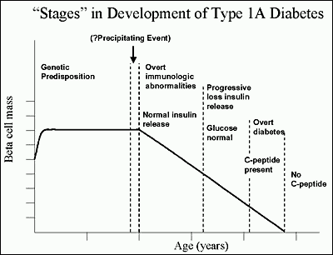
Stages in development of type 1 diabetes

Slide 12
TYPE 2 DIABETES MELLITUS
Previously – NIDDM, Adult onset diabetes
Usually Individuals:
  Account for up to 90% of persons with diabetes ( most prevalent endocrine disease)
  Have Insulin resistance & β cell defect
  Have relative rather than absolute insulin deficiency
  Are obese or have ↑ % body fat in esp. in abdominal region
  Seldom develop spontaneous ketoacidosis
  Undiagnosed for several years b/c hyperglycemia develops slowly
  May have insulin levels in normal range but inadequate relative to high blood glucose level (insulin secretion defective & insufficient to compensate for insulin resistance)
  Insulin resistance may improve with weight reduction +/- pharmacological treatment but seldom restored to normal

Slide 13
TYPE 2 DIABETES
Mechanisms:
Resistance to insulin action in target tissues
  Liver
  Muscle
  Adipose tissue
Progressive insulin secretory defect (beta cell defect)

Slide 14
Metabolic Defects in Diabetes
Progressive Insulin
Secretory Defect
Pancreas
Hyperglycemia
↑ Hepatic Glucose
Production
↓ Glucose
Uptake
Insulin
Resistance
=
Liver
Muscle
Adapted from Dr. T. Kedijang
Notes:
While much remains unknown about the pathogenesis of diabetes, the understanding of the mechanisms that contribute to hyperglycemia has improved.
The pathogenic process leading to diabetes is a progressive insulin secretory defect. In some individuals, especially in those who are overweight or obese, there is an abnormality of insulin action on target tissues (insulin resistance), causing abnormalities in carbohydrate, fat, and protein metabolism. Either of these processes can occur in a patient with diabetes, and often both are present.
A third pathogenic process contributing to hyperglycemia is endogenous glucose production. Normally after glucose ingestion, insulin is released into the portal vein and carried to the liver, where it binds to specific receptors on the hepatocyte and suppresses hepatic glucose output. Insulin resistance in the liver results in an impaired suppression of hepatic glucose production and consequent hyperglycemia.
Recognition of the pathogenic roles played by these elements in the development of hyperglycemia has provided avenues for therapeutic manipulation in order to enforce glycemic control.
The Expert Committee on the Diagnosis and Classification of Diabetes Mellitus. Report of the
Expert Committee on the Diagnosis and Classification of Diabetes Mellitus. Diabetes Care.
1998;21(suppl 1):S5-S19.
DeFronzo RA, Bonadonna RC, Ferrannini E. Pathogenesis of NIDDM: a balanced overview.
Diabetes Care. 1992;15:318-368.

Slide 15

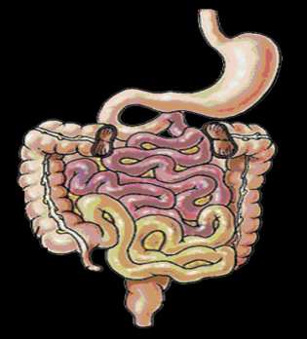
Pancreatic Islet Dysfunction Leads to Hyperglycemia in T2DM
Fewer
β-cells
α-cells
hypertrophy
Insufficient insulin
Excessive glucagon
+
–
+
↑ Glucose
↓ Glucose uptake
↑ HGO
HGO=hepatic glucose output; T2DM=type 2 diabetes mellitus
Adapted from Ohneda A, et al. J Clin Endocrinol Metab. 1978; 46: 504–510; Gomis R, et al. Diabetes Res Clin Pract. 1989; 6: 191–198.
Notes:
Pancreatic Islet Dysfunction Leads to Hyperglycemia in T2DM
In type 2 diabetes mellitus (T2DM), the defective pancreatic islets exhibit decreased response to ambient glucose levels from both α- and β-cells.^{1,2}
Early in the disease process, glucose-induced insulin secretion and suppression of glucagon release are impaired.
In more advanced disease, there may be a paradoxical inhibition of insulin³ and stimulation of glucagon² in response to intravenous or oral glucose challenge. Patients with long-standing T2DM may also lose the ability to mount a glucagon response to hypoglycemia.⁴
The loss of islet glucose sensing in patients with T2DM contributes to hyperglycemia and can also predispose a patient to hypoglycemia.⁴
The progressive loss of β-cell function over time also contributes to decreased insulin secretion.
One study reported a 40% deficit in relative β-cell volume in obese subjects with impaired fasting glucose (fasting plasma glucose between 5.6 mmol/L [100 mg/dL] and 6.9 mmol/L [125 mg/dL]) and a 63% deficit in obese patients with T2DM, compared with nondiabetic obese subjects.⁵
Loss of β-cell function has been linked to a marked increase (3- to 10-fold) in the rate of
β-cell apoptosis.⁵
References
Ohneda A, et al. Abnormal response of pancreatic glucagon to glycemic changes in diabetes mellitus. J Clin Endocrinol Metab. 1978; 46: 504–510.
Ferrannini E, Mari A. Beta cell function and its relation to insulin action in humans: a critical appraisal. Diabetologia. 2004; 47: 943–956.
Gomis R, et al. Suppression by insulin treatment of glucose-induced inhibition of insulin release in non-insulin-dependent diabetics. Diabetes Res Clin Pract. 1989; 6: 191–198.
Bolli GB, et al. Defective glucose counterregulation after subcutaneous insulin in noninsulin-dependent diabetes mellitus. J Clin Invest. 1984; 73: 1532–1541.
Butler AE, et al. Beta-cell deficit and increased beta-cell apoptosis in humans with type 2 diabetes. Diabetes. 2003; 52: 102–110.

Slide 16
TYPE 2 DM
Believed to develop as a consequence of interaction between genetic and environmental factors
- Strong genetic influence - type 2 DM in a first degree relative is an established risk factor for the disease
- (The environmental factors include-a high fat diet and excessive caloric consumption, obesity, physical inactivity, excessive alcohol consumption, smoking, stress)
Usually seen in middle age or beyond (after the age of 40 years) but may be seen in younger persons
Many patients with this form of diabetes are overweight or obese.

Slide 17
Risk factors- type 2
Risk factors for development of type 2 diabetes:
Increasing age
Family history of diabetes (i.e., parent or sibling with T2DM)
Obesity (BMI 25 kg/m2)
Race/ethnicity (e.g., African American, Hispanic American, Native
American, Asian American, Pacific Islander)
Habitual physical inactivity
Previously identified IFG or IGT
History of GDM or delivery of baby 4 kg (9 lb)

Slide 18
Risk factors-type 2 (contd)
Hypertension (blood pressure 140/90 mmHg)
HDL cholesterol level 35 mg/dL (0.90 mmol/L) and/or a triglyceride
level 250 mg/dL (2.82 mmol/L)
Polycystic ovary syndrome or acanthosis nigracans
History of vascular disease
IUGR/intrauterine malnutrition

Slide 19
Pathogenesis of Type 2 DM
Complex aetiology
  Genetic
  Environmental
Genetic
  Polygenic & multifactorial
  Concordance in identical twins 70-90%
  ↑risk if one parent has DM & if both, risk up to 40%
Environmental (Modulate phenotypic expression of disease)
  Nutrition
  Physical activity

Slide 20
Pathophysiology of Type 2 DM
3 main metabolic disorders:
Insulin resistance
  60-80% ↓glucose uptake by skeletal muscle
↓ Pancreatic β cell function (Insulin secretory defects)
  Altered pulsatility of insulin release
  Loss of 1st phase insulin release
  ↓insulin release in response to a glucose level
↑ Hepatic glucose output

Slide 21
Stages of Type 2 Diabetes
Progressive Beta-cell dysfunction
Page 21
Oral agents require the
body to produce insulin to work.
As natural insulin production fails,
the oral agents also fail.
100
At diagnosis
there is
50% of
normal insulin
production
75
6yrs after
insulin
Production
reduced to 25%
Beta Cell
Function
(%)
50
IGT
Type 2
Phase 1
Type 2
Phase 3
25
Postprandial
Hyperglycemia
Type 2
Phase 2
0
-12
-10
-6
-2
0
2
6
10
14
Years From Diagnosis
Adapted from Lebovitz HE. Diabetes Reviews. 1999;7(3):139–153.
Notes:
21
Stages of Type 2 Diabetes
In both Type 1 and Type 2 diabetes, there is a genetic predisposition as well as environmental factors that contribute to the expression of the genetic predisposition. In Type 2 diabetes, insulin resistance occurs, and the marked compensatory increases in insulin secretion necessary to maintain normal glucose tolerance cannot be achieved or maintained. As beta cell function continues to decrease, the individual progresses from normal glucose tolerance to impaired glucose tolerance to diabetes with primarily postprandial hyperglycemia to diabetes with fasting hyperglycemia.
Adapted from Lebovitz HE. Insulin secretagogues: old and new. Diabetes Reviews. 1999;7(3):139–153.

Slide 22
Stages in DM
Normal glucose tolerance
IGT and/or IFG (impaired fasting glycemia)
Diabetes mellitus:
A). Not insulin requiring
B). Insulin requiring for control
C). Insulin requiring for survival

Slide 23
Clinical features
-Classical symptoms:
polyuria,
polydipsia and
weight-loss
- type 1 lean; type 2 overweight
- Onset: short in type 1; insidious type 2
- ± features of long-term complications in type 2
- ± other autoimmune diseases in type 1

Slide 24
PHYSICAL EXAM
General and Systemic Examination especially
Weight & BMI
Dehydration
Air Hunger
Hands
Skin
Blood Pressure
Neck
Head
Eyes
Abdomen
Legs
Feet

Slide 25
INVESTIGATION
Blood Glucose
OGTT (Borderline & Gestational DM)
Other Tests
  Urinalysis
    Glucose
    Ketones
    Albumin
  FBC
  Urea & Electrolytes
  Serum Lipids
  Thyroid Function
  C-peptides, auto antibodies
Tests for Diagnosis and management of complications
  ECG

Slide 26
DIAGNOSIS
Fasting Plasma Glucose > 7.0 mmol/L (126 mg/dl)
Random Plasma Glucose > 11.1 mmol/L (200mg/dl)
  Symptomatic Patient - One abnormal lab test adequate
  Asymptomatic Patient - Two abnormal lab tests
  OGTT only required for:
    Borderline cases
    Diagnosis of Gestational Diabetes
NOTE: Nothing like “mild diabetes”
  All who meet criteria for DM liable to disabling long term complications
Notes:
Corresponding values for capillary plasma differ only for the 2-hour values: for diabetes mellitus, 2 hours ≥12.2 mmol/L (> 220 mg/dl); for IGT, 2 hours ≥ 8.9 mmol/L (≥ 160 mg/dl) and < 12.2 mmol/L (< 220 mg/dl).

Slide 27
OGTT
The Glucose Tolerance Test – WHO Criteria
 | Normal (mmol/L) | IFG (mmol/L) | IGT (mmol/L) | DM (mmol/L)
Fasting | ≤6.0 | 6.1 – 6.9 | <7.0 | >7.0
2 hr Post Glucose load | <7.8 | <7.8 | 7.8-11.0 | ≥11.1
IFG=impaired fasting glucose; IGT=impaired glucose tolerance; DM=diabetes mellitus
Notes:
Corresponding values for capillary plasma differ only for the 2-hour values: for diabetes mellitus, 2 hours ≥12.2 mmol/L (> 220 mg/dl); for IGT, 2 hours ≥ 8.9 mmol/L (≥ 160 mg/dl) and < 12.2 mmol/L (< 220 mg/dl).

Slide 28
Guide to Diagnosis of Type 1 DM
Generally < 30 years of age at presentation
Rapid onset
Moderate-to-severe symptoms
Lean
Significant weight loss
Ketonuria or ketoacidosis
Low fasting or post-prandial C-peptide
Immune markers
  (anti-GAD, ICA, IA-2)

Slide 29
Comparative Features of Type 1 and Type 2 DM
 | Type 1 | Type 2
Age of onset | <40 yrs | >50 yrs
Duration of symptoms | Weeks | Months to years
Body Weight | Normal or low | Obese
Ketonuria | Yes | No
Rapid Death without insulin | Yes | No
Auto-antibodies | Yes | No
Diabetic complications at diagnosis | No | 25%
Family History of Diabetes | Uncommon | Common
Other autoimmune diseases | Common | Uncommon

Slide 30
Diabetic Complications
Can be classified broadly into two:
Acute/metabolic complications
Chronic complications

Slide 31
Acute complications
Metabolic
a) Diabetic ketoacidosis
b) Hyperosmolar hyperglycaemic state
c) Lactic acidosis
d) Iatrogenic hypoglycaemia
Infections: usually bacteria e.g. UTI, acute chest infections, abscess, sepsis, malignant otitis externa, mucormycosis

Slide 32
Chronic complications:
Vascular: microvascular and macrovascular
Neurologic
Others: skin, eye, bones and joints, pregnancy-related

Slide 33
Vascular complications
Microvascular:
i) Retinopathy
ii) Nephropathy
iii) Neuropathy
Macrovascular:
i) Stroke
ii) Peripheral vascular disease
iii) Coronary artery disease
iv) Cardiomyopathy

Slide 34
Neurological complications
Peripheral neuropathy
-Distal symmetric polyneuropathy
-Motor neuropathy (diabetic amyotrophy, foot drop, wrist drop)
Cranial neuropathy: CN III, IV, VI and VII
Autonomic neuropathy: postural hypotension, impotence, GI dysfunction, bladder atony, loss of sweating, resting tachycardia

Slide 35
Other complications
Skin
a) non-infectious: diabetic dermopathy, necrobiosis lipoidica diabeticorum
b) infectious e.g. candidiasis
c) mixed: diabetic foot syndrome
Eye: cataract, glaucoma, diabetic ophthalmoplegia
Bones and joints: dupuytren’s contracture, diabetic cheirarthropathy, Charcot’s joint
Pregnancy-related:
a) maternal: recurrent abortions, polyhydramnious, infertility
b) fetal: macrosomia, congenital malformations, hypoglycaemia

Slide 36
Treatment of DM
GOALS:
Secondary prevention:
  achieve glycaemic control to prevent the development of long-term complications.
Good quality of life
Tertiary prevention:
  achieve control to diminish or halt progression of complications
NOTE:
  Multidisciplinary team approach often needed for success

Slide 37
Treatment
Aims
To alleviate symptoms
Blood glucose control
Prevent, delay or minimise complications
Reduce morbidity and mortality

Slide 38
Comprehensive targets
Blood glucose:
  FPG: <110mg/dl (6.0 mmol/L)
  Postprandial: <140mg/dl (8.0mmol/L)
  HBA1c: <7%
Lipid profile:
  Triglycerides <150mg/dl
  LDL-C: <100mg/dl
  Total cholesterol: < 150mg/dl
  HDL-C: Males- >40mg/dl; Females > 50mg/dl
Blood Pressure: Systolic <130mmHg; Diastolic < 80mmHg
BMI: 20-25kg/m²
Waist circumference: Males <100cm; Females < 88cm

Slide 39
Targets for Metabolic control
BMI: <25 (i.e. ≥18.5 and <25)
WC: <80cm (IDF), for females and <94cm (IDF), for males.
WHR: <0.85 for females and <0.90 for males (universal)
BP: <130/80

Slide 40
Glycaemic targets
 | Ideal (mg/dl) | Good (mg/dl)
FPG | 70-100 | <110
2HPP | <140 | <160
HBA1c | <7% | 7-8%

Slide 41
Glycaemic control
FPG: <6.0mmol/L
2HrPP: <8.0mm0l/L
HbA1C: <6.5%(ADA, AACE); <7.0%(IDF, WHO)

Slide 42
Lipids
Total cholesterol: <4.5mmol/L
HDL-cholesterol: >1-2mmol/L
Triglycerides: <1.7mmol/L
LDL-cholesterol: <2.5mmol/L

Slide 43
Monitoring
Urine testing
Blood glucose – lab or glucometer
Glycated Hb
- addition of glucose moiety to β-chain of Hb
- test control in the last 2-3 months
Glycosylated proteins: (fructosamine): test control for about 2-3 weeks

Slide 44
DM Monitoring
Initial visit
Complete physical exam.
Anthropometric measurements
BP
Urinalysis, microalbuminuria
FBC, ESR
FPG, 2HPP, HbA1c
Lipid profile
Blood urea, creatinine
Every 3 months
Repeat physical +BP
Weight, WC, HC
FPG, 2HPP, or review log book of SMBG
HbA1c
Renal function/lipid profile if initially abnormal
Annually
Repeat all as for initial visit

Slide 45
Challenges in management
Obesity (particularly android)
Dyslipidemia
Hyperglycemia
Ignorance

Slide 46
Education
Remains kernel of management
Main goal is patient empowerment:
  Self-monitoring of blood glucose, blood pressure
  Immediate management of hypoglycaemia
  Foot care and foot wear
  Cooperation with physician in meeting goals
  Lifestyle adjustments

Slide 47
Diet/ Exercise
Decreases HGO
Increases insulin action (improve insulin action)
Increases insulin secretion (improve insulin secretion)
Individualized exercise
Ideal diet
protein: 10 – 20% of total calories
fat: <30% of total calories
CHO: >50- 60%

Slide 48
Lifestyle measures
Exercise: programme planned with the Physician
  At least 30 minutes thrice weekly (if no C/I)
  Avoid weight bearing or lifting. Examples of recommended exercises include brisk walking, jogging, bicycling, swimming.
  Individualized exercise
  Benefits: ↓HGO, ↑ Insulin action &↑ Insulin secretion
Dietary measures: individualized, on-going
  Drastic reduction of refined sugars
  Complex carbohydrate: 50-60% of total calorie/day
  Increase fiber intake
  Protein: 10-20% of total calorie/day
  Fats: Limit intake of saturated fat and dietary cholesterol; should take <30% of total calorie/day
  Salt: moderate – low intake
  Alcohol: discourage in overweight/obese; generally reduce, subtract amount taken from total calorie for the day
Weight-loss programme for overweight or obese subjects

Slide 49
DRUG TREATMENT
Oral Hypoglycaemic Drugs
  Sulphonylureas
  Meglitinides
  Biguanides
  Thiazolidinediones
  α- glucosidase inhibitors
  DPP-4 inhibitors
Injectable Drugs
  Insulin & Insulin analogues
  Incretin mimetics
    GLP-1 analogue - exenatide
  Amylins

Slide 50
ADA and EASD Algorithm for the Management of T2DM
Tier 1:
Well-validated therapies
At
diagnosis:
Lifestyle
+
metformin
Lifestyle and
met + basal insulin
Lifestyle and met + intensive insulin
Lifestyle and
met + SUª
Step 1
Step 2
Step 3
Tier 2:
Less well-validated therapies
Lifestyle and
met + pio
Lifestyle and met
+ pio + SUª
No hypoglycemia
Edema / CHF
Bone loss
Lifestyle and met
+ GLP-1 agonist^{b}
Lifestyle and
met + basal insulin
No hypoglycemia
Weight loss
Nausea / vomiting
Reinforce lifestyle interventions every visit and check HbA1c every
3 months until HbA1c is <7.0% and then at least every 6 months.
The interventions should be changed if HbA1c is ≥7.0%
ADA=American Diabetes Association; CHF=congestive heart failure; EASD=European Association for the Study of Diabetes; GLP-1=glucagon-like peptide-1; HbA1c=hemoglobin A1c; met=metformin; pio=pioglitazone; SU=sulfonylurea; T2DM=type 2 diabetes mellitus
ªSUs other than glybenclamide (glyburide) or chlorpropamide; ^{b}Insufficient clinical use to be confident regarding safety.
Nathan DM, et al. Diabetes Care. 2008; 31: 173–175.
Notes:
ADA and EASD Algorithm for the Management of T2DM
The goal of the ADA/EASD algorithm is to achieve and maintain HbA1c levels of <7.0%. The well-validated core therapies represent the preferred route.
Tier 1: Well-validated therapies
Step 1: Lifestyle intervention and metformin
Lifestyle interventions remain an underlying theme for the management of type 2 diabetes mellitus; however, as most individuals fail to achieve goals with lifestyle intervention alone, metformin should be initiated concurrently at diagnosis.
Step 2: Additional medications
If lifestyle intervention and maximal tolerated doses of metformin fail to sustain goals, another medication should be added within 2–3 months of the initiation of therapy or at any time when HbA1c goal is not achieved. The consensus is to choose either insulin or a sulfonylurea (SU).
Step 3: Further adjustments
If lifestyle, metformin, and a basal insulin or an SU do not result in glycemic control, start or intensify insulin therapy: insulin secretagogues (SUs or glinides) should be discontinued, or tapered and then discontinued, as they are not considered to have synergy with insulin.
Tier 2: Less-well validated therapies
In selected clinical settings, the second-tier algorithm may be considered. When hypoglycemia is particularly undesirable, the addition of exenatide or pioglitazone may be considered (rosiglitazone is not recommended). If weight loss is a major issue and HbA1c is close to target (<8.0%), exenatide is an option. If these interventions are not effective in achieving target HbA1c, or are not tolerated, addition of an SU could be considered. Alternatively, tier 2 interventions should be stopped and basal insulin started.
Reference
Nathan DM, et al. Management of hyperglycemia in type 2 diabetes mellitus: a consensus algorithm for the initiation and adjustment of therapy. Update regarding thiazolidinediones: a consensus statement from the American Diabetes Association and the European Association for the Study of Diabetes. Diabetes Care. 2008; 31: 173–175.

Slide 51



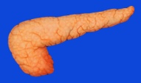
Pharmacologic Targets of Current Drugs Used in the Treatment of T2DM
GLP-1 analogs
Improve pancreatic islet glucose sensing, slow gastric emptying, improve satiety
DPP-4 inhibitors
Prolong GLP-1 action leading to improved pancreatic islet glucose sensing, increase glucose uptake
Biguanides
Increase glucose uptake
and decrease hepatic glucose production
Thiazolidinediones
Decrease lipolysis in adipose tissue, increase glucose uptake in skeletal muscle, decrease glucose production in liver
Sulfonylureas
Increase insulin secretion from pancreatic β-cells
α-glucosidase inhibitors
Delay intestinal carbohydrate absorption
Glinides
Increase insulin secretion from pancreatic β-cells
DDP-4=dipeptidyl peptidase-4; GLP-1=glucagon-like peptide-1; T2DM=type 2 diabetes mellitus
Adapted from Cheng AY, Fantus IG. CMAJ. 2005; 172: 213–226.
Ahrén B, Foley JE. Int J Clin Pract. 2008; 62: 8–14.
Notes:
Pharmacologic Targets of Current Drugs Used in the Treatment of T2DM
The number of antihyperglycemic drugs for use either alone, in combination, or with insulin has grown in recent years, and includes agents with widely differing mechanisms of action.¹
The major mechanism of action of biguanides (eg, metformin) is to decrease hepatic glucose output primarily by decreasing gluconeogenesis and, to a lesser degree, increasing glucose uptake by skeletal muscle.¹
Sulfonylureas (SUs; eg, glimepiride, glyburide) and glinides (eg, nateglinide, repaglinide) stimulate insulin secretion from the β-cell. SUs bind to a specific cell-surface receptor causing metabolic changes that promote exocytosis of insulin-containing vesicles. Glinides also bind to the SU receptor with similar effects, although with a relatively prompt and brief stimulatory effect.¹
α-glucosidase inhibitors (eg, acarbose) do not target any specific pathophysiologic defect in type 2 diabetes mellitus. Rather, they act by inhibiting α-glucosidase and other intestinal brush-border enzymes responsible for the breakdown of oligosaccharides and disaccharides to monosaccharides suitable for absorption.¹
Thiazolidinediones (eg, rosiglitazone, pioglitazone) act as insulin sensitizers, particularly in peripheral tissues. They bind to a specific nuclear receptor active in adipocytes and muscle cells, promoting the expression of various genes involved in carbohydrate and lipid metabolism.¹
Glucagon-like peptide (GLP-1) is an incretin hormone released by gut cells in response to food intake, promoting pancreatic islet activity. Unlike the other agents described here, GLP-1 analogs (including exenatide) are not orally available and must be injected.²
By inhibiting dipeptidyl peptidase-4 (DPP-4), DPP-4 inhibitors such as vildagliptin prolong the action of GLP-1 to stimulate insulin secretion and suppress glucagon release in response to glucose.³
References
Cheng AY, Fantus IG. Oral antihyperglycemic therapy for type 2 diabetes mellitus. CMAJ .2005; 172: 213–226.
Drucker DJ, Nauck MA. The incretin system: glucagon-like peptide-1 receptor agonists and dipeptidyl peptidase-4 inhibitors in type 2 diabetes. Lancet .2006; 368: 1696–1705.
Ahrén B, Foley JE. The islet enhancer vildagliptin: mechanisms of improved glucose metabolism. Int J Clin Pract. 2008; 62 (Suppl 159): 8–14.

Slide 52
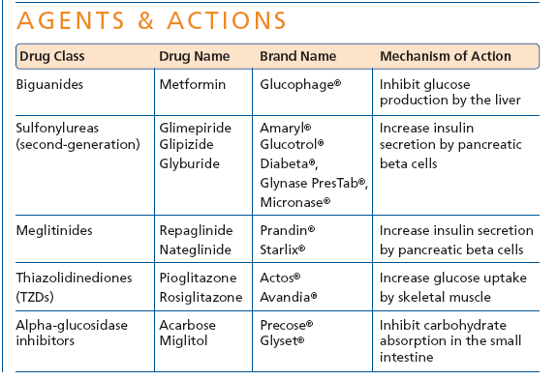
Oral Hypoglycaemic Medications

Slide 53
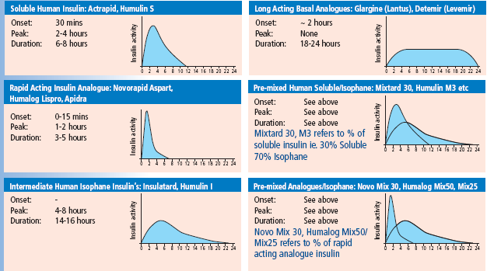
Overview of Insulin and Action

Slide 54
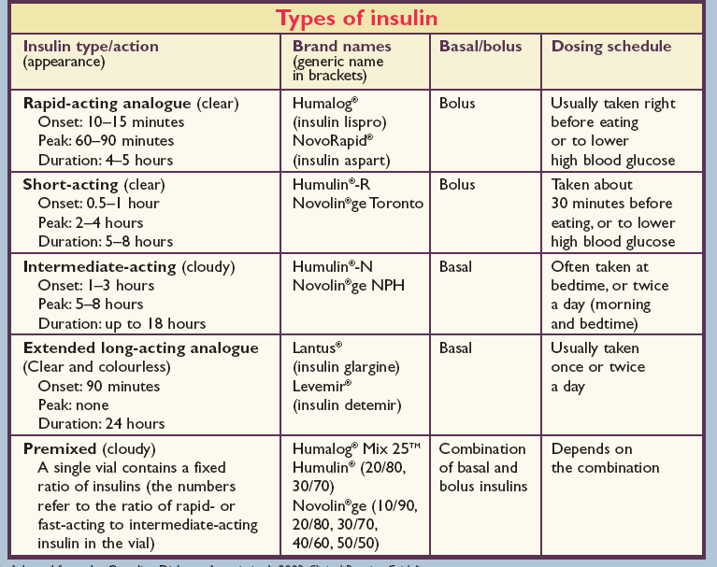

Slide 55
Major Adverse Events of Current Treatments for T2DM Limit Efficacy
Metformin¹
GI effects (nausea, diarrhea), lactic acidosis (rare)
SUs¹
Hypoglycemia, weight gain, hyperinsulinemiaª
Meglitinides¹
Weight gain, edema, CHF, bone fractures (pioglitazone, rosiglitazone)
Myocardial ischemic events (rosiglitazone)
TZDs¹⁻³
α-glucosidase inhibitors¹
GI effects (flatulence, diarrhea)
Incretin mimetics⁴⁻⁸
GI effects (nausea, vomiting, diarrhea), pancreatitis, hypoglycemia (in add-on to SU)
CHF=congestive heart failure; GI=gastrointestinal; SU=sulfonylurea; T2DM=type 2 diabetes mellitus; TZD=thiazolidinedione
ªRole uncertain.
¹Inzucchi SE. JAMA. 2002; 287: 360–372; ²Avandia US Prescribing Information; ³Dormandy JA, et al. Lancet. 2005; 366: 1279–1289;
⁴Buse JB, et al. Diabetes Care. 2004; 27: 2628–2635; ⁵DeFronzo RA, et al. Diabetes Care. 2005; 28: 1092–1100; ⁶Kendall DM, et al. Diabetes Care. 2005; 28: 1083–1091; ⁷Kolterman OG, et al. Am J Health-Syst Pharm. 2005; 62: 173–181; ⁸Byetta US Prescribing Information.
Notes:
Major Adverse Events of Current Treatments for T2DM Limit Efficacy
The most common adverse effects of metformin are gastrointestinal (GI) disturbances such as nausea and diarrhea; in some patients, these are severe enough to cause the drug to be discontinued. Lactic acidosis, a serious but rare side effect, is entirely preventable – metformin should not be used in patients with renal impairment for this reason. Other contraindications are hepatic dysfunction, congestive heart failure (CHF), metabolic acidosis, dehydration, and alcoholism.¹
The risks for hypoglycemia and weight gain are increased with both the sulfonylureas (SUs) and the meglitinides, as these agents increase insulin secretion independently of glucose stimulation. The resulting hyperinsulinemia may have adverse cardiovascular effects, identified in epidemiologic studies but not yet supported by prospective studies such as the UK Prospective Diabetes Study.¹
The thiazolidinediones rosiglitazone and pioglitazone are associated with weight gain and edema.¹ Their use has also been associated with increased rates of CHF and bone fractures, and they are contraindicated in patients with CHF.² Pioglitazone and rosiglitazone are also contraindicated in patients with hepatic impairment.^{1,3} Periodic liver function tests are recommended, but an association with liver injury has not been shown.¹ Rosiglitazone, but not pioglitazone, has been associated with an increased risk for myocardial ischemic events.²
GI disturbances, namely flatulence, abdominal discomfort, and diarrhea, are the primary adverse effects of the
α-glucosidase inhibitors acarbose and miglitol. These effects often lead to discontinuations.¹
The incretin mimetic exenatide is associated with nausea, vomiting, and diarrhea.⁴⁻⁶ Nausea sometimes has led to drug discontinuation. Cases of acute pancreatitis have been reported, resulting in a precaution being added to the US prescribing information.⁷ Although hypoglycemia was reported in a tolerability trial, and hypoglycemia rates were higher when exenatide was combined with an SU or with an SU plus metformin, there was no increased hypoglycemia when exenatide was administered with metformin alone.^{4-6, 8}
References
1. Inzucchi SE. Oral hypoglycemic therapy for type 2 diabetes. Scientific review. JAMA. 2002; 287: 360–372.
2. Avandia US Prescribing Information. Revised November 2007.
3. Dormandy JA, et al. Secondary prevention of macrovascular events in patients with type 2 diabetes in the PROactive Study (PROspective pioglitAzone Clinical Trial In macroVascular Events): a randomised controlled trial. Lancet. 2005; 366: 1279–1289.
4. Buse JB, et al. Effects of exenatide (exendin-4) on glycemic control over 30 weeks in sulfonylurea-treated patients with type 2 diabetes. Diabetes Care. 2004; 27: 2628–2635.
5. DeFronzo RA, et al. Effects of exenatide (exendin-4) on glycemic control and weight over 30 weeks in metformin-treated patients with type 2 diabetes. Diabetes Care. 2005; 28: 1092–1100.
6. Kendall DM, et al. Effects of exenatide (exendin-4) on glycemic control over 30 weeks in patients with type 2 diabetes treated with metformin and a sulfonylurea. Diabetes Care. 2005; 28: 1083–1091.
7. Byetta US Prescribing Information. Revised October 2007.
8. Kolterman OG, et al. Pharmacokinetics, pharmacodynamics, and safety of exenatide in patients with type 2 diabetes mellitus. Am J Health-Syst Pharm. 2005; 62: 173–181.

Slide 56
Contraindications and Precautions for Current T2DM Treatments Limit Use
Contraindicated in renal dysfunction, avoid in liver disease, monitor renal function
Metformin
Use with caution in elderly, and in renal and hepatic impairment, watch for hypoglycemia
SUs
Meglitinides
Use with caution in elderly, and in renal and hepatic impairment
Contraindicated in severe liver disease, congestive heart failure, monitor liver enzymes
TZDs
α-glucosidase inhibitors
Not recommended in severe renal impairment,
check serum liver enzymes
Exenatide injectable
Use with caution in severe renal or severe GI disease
GI=gastrointestinal; SU=sulfonylurea; T2DM=type 2 diabetes mellitus; TZD=thiazolidinedione
From Glucophage [package insert]. Princeton, NJ: Bristol-Myers Squibb Company, 2004; Starlix [package insert]. East Andover, NJ: Novartis Pharmaceuticals Corporation, 2004; Avandia [package insert]. Research Triangle Park, NC: GlaxoSmithKline, 2006; Byetta [package insert].
San Diego, CA: Amylin Pharmaceuticals, Inc, 2006.
Notes:
Contraindications and Precautions for Current T2DM Treatments Limit Use
All of the available therapeutics for type 2 diabetes mellitus have contraindications or other limitations to use, as indicated by package inserts.¹
Metformin should not be used in patients with renal impairment, in case of lactic acidosis. Other contraindications are hepatic dysfunction, congestive heart failure (CHF), metabolic acidosis, dehydration, and alcoholism.²
The thiazolidinediones rosiglitazone and pioglitazone have been associated with increased rates of CHF, and they are contraindicated in patients with this condition as well as in those with hepatic impairment, while in patients with normal liver function periodic liver function tests are recommended.^{2,3}
Periodic liver function tests are also recommended for patients receiving the
α-glucosidase inhibitors acarbose and miglitol, and these agents are not recommended in severe renal impairment.²
References
Glucophage [package insert]. Princeton, NJ: Bristol-Myers Squibb Company; 2004; Starlix [package insert]. East Andover, NJ: Novartis Pharmaceuticals Corporation; 2004; Avandia [package insert]. Research Triangle Park, NC: GlaxoSmithKline; 2006; Byetta [package insert]. San Diego, CA: Amylin Pharmaceuticals, Inc; 2006.
Inzucchi SE. Oral hypoglycemic therapy for type 2 diabetes. Scientific review. JAMA. 2002; 287: 360–372.
Dormandy JA, et al. Secondary prevention of macrovascular events in patients with type 2 diabetes in the PROactive Study (PROspective pioglitAzone Clinical Trial In macroVascular Events): a randomised controlled trial. Lancet. 2005; 366: 1279–1289.

Slide 57
Surgery
Bariatric surgery has been shown to improve diabetes control and, in some situations, normalize glucose tolerance in morbidly obese patients.
It is certainly a reasonable alternative in carefully selected patients if an experienced team (providing appropriate preoperative evaluation as well as technical surgical expertise) is available.

Slide 58
DM in Psychiatry
Antipsychotic drugs are known to cause type 2 diabetes mellitus. Antipsychotic drugs are used in the treatment of schizophrenia or affective disorders.
Studies have shown that patients receiving medication for schizophrenia had higher chances of type 2 diabetes mellitus as compared to other individuals.
A cross-sectional study, conducted with schizophrenia outpatients revealed the presence of type 2 diabetes mellitus prevalence rate of 11.5 percent.
'A cohort study of antipsychotic-naïve patients followed up participants for 3 years after the initiation of antipsychotic therapy. After 3 years of follow-up, the incidence rate of DM was found to be 0.6 percent per patient-year.'

Slide 59
DM in Psychiatric
Stimulation of 5-HT1A is associated with an increase in food intake whereas stimulation of 5-HT2C is related to a decrease in food intake.
Antagonism of the 5-HT2C receptor for histamine can, in turn, lead to an increase in food intake, with most 2nd generation antipsychotics (SGAs) possessing 5-HT2C antagonist activity.
Olanzapine has high affinity for histamine receptors while aripiprazole and ziprasidone have relatively low affinity for receptor affinities.
Recommendations for patient monitoring for the development of dyslipidemia, weight gain, and DM have been published. They consider the potential metabolic risks when initiating a SGA.
patient, family, and caregiver education; baseline screening; and referral to a specialist, if needed, as key components of patient care. As weight gain is considered a precipitating factor for the development of DM and dyslipidemia, monitoring of weight changes with treatment is an important screening measure.

Slide 60
References
International Diabetes Federation. Diabetes atlas. 8th ed. Brussels: International Diabetes Federation; 2017.
. Gezawa ID, Puepet FH, Mubi BM, Uloko AE, Bakki B, Talle MA, et al. Socio-demographic and anthropometric risk factors for type 2 diabetes in Maiduguri, North-Eastern Nigeria. Sahel Med J. 2015;18(5)
https://www.ncbi.nlm.nih.gov/pmc/articles/PMC5984944/
Wild S, et al. Global prevalence of diabetes: estimates for the year 2000 and projections for 2030. Diabetes Care. 2004; 27: 1047–1053.
King H, et al. Global burden of diabetes, 1995–2025: prevalence, numerical estimates, and projections. Diabetes Care. 1998; 21: 1414–1431.
Antipsychotic-Induced Diabetes Mellitus; Theary Chhim et al; US Pharmacist
IDF_Atlas_10th_Edition_2021

